Slide 1
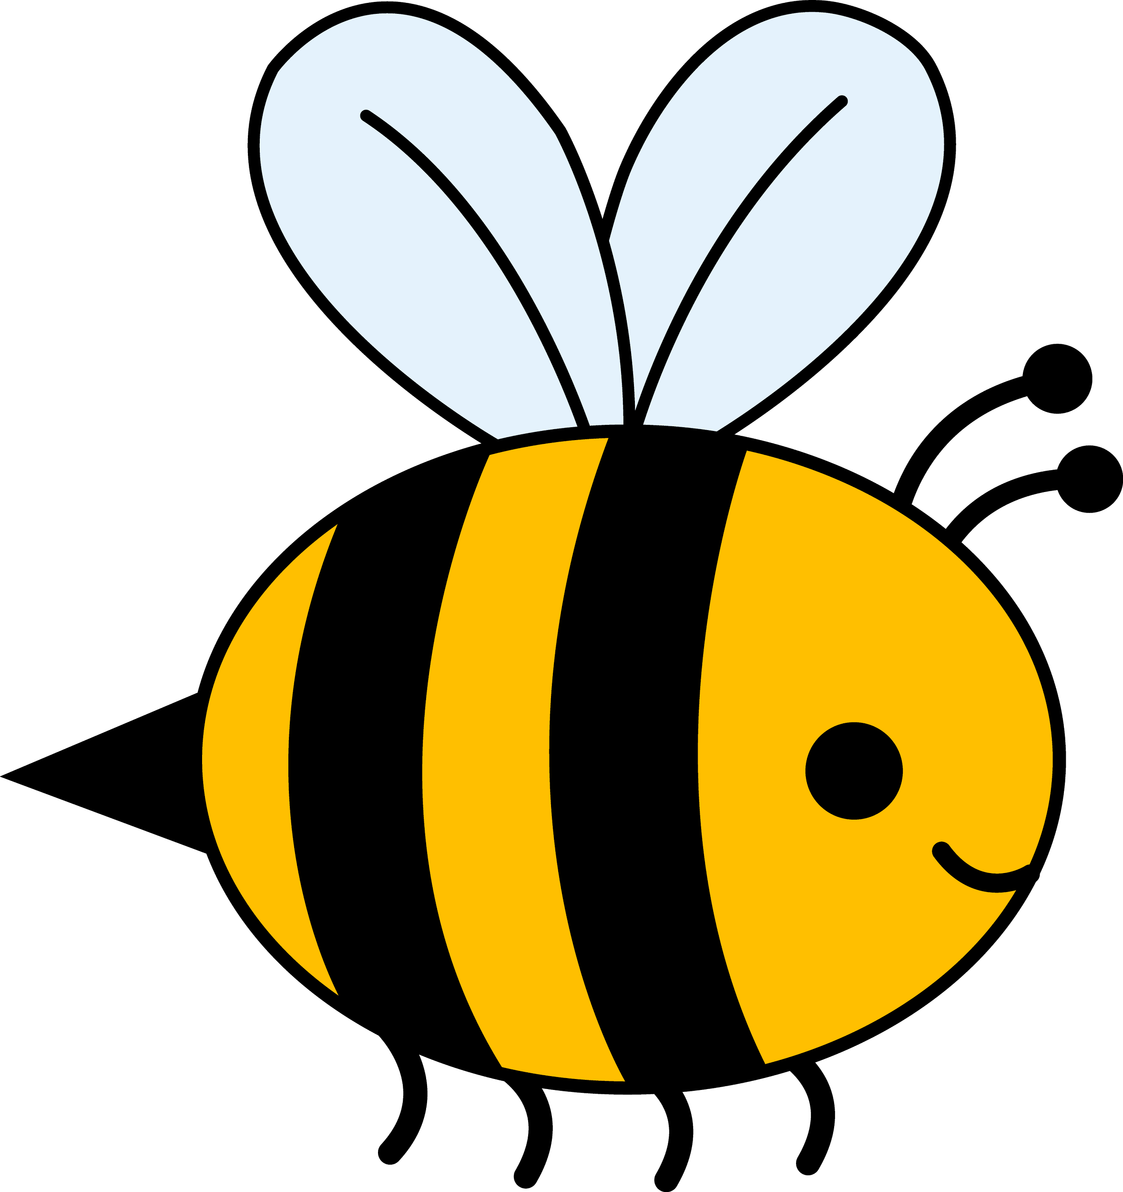
BUMBLEBEES
By Žan D.
School: OŠ Slivnica pri Celju, Slovenia
School year: 2015/2016

Slide 2
Little basic stuff about bumblebees
Bumblebees are best adapted to the cold weather.
They can live in the mountains or in the countryside.
In spring, queens look for a suitable place for nesting.
There are 250 species in the world and 35 species in Slovenia.
Bumblebees produce honey too.

Slide 3
Where do bumblebees live?
Bumblebees live in the holes in the ground or in trees.

Slide 4
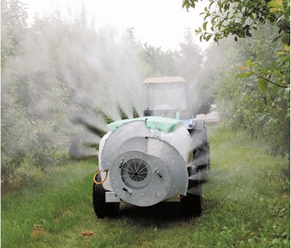
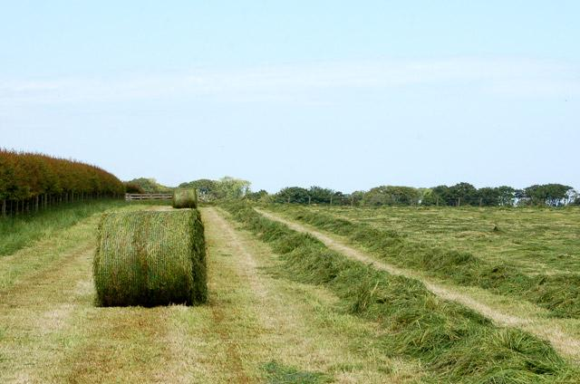
Threat for bumblebees
Bumblebees are threatened by many pesticides and non-ecological farming.

Slide 5
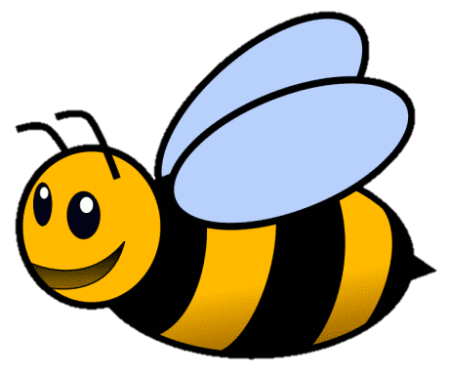
How can we save bumblebees?
WE SHOULD:
plant suitable flowers
make bumblebee hives
mow the meadows a bit later than usually

Slide 6
THANKS FOR YOUR ATTENTION!

