Slide 1
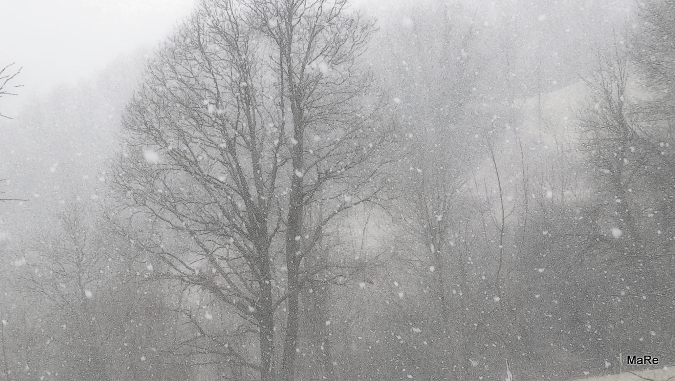
What do bees and bumblebees do in winter?
By Andraž I. K.
School: OŠ Slivnica pri Celju, Slovenia
School year: 2015/2016

Slide 2
This is winter in Slovenia

Slide 3
Some people believe that bees sleep during the winter.
But they don’t! They only rest.

Slide 4
~ HONEY BEES ~

Slide 5
In winter the honey bees form a cluster. They warm themselves by fluttering their wings and shivering, and they wait for the outside temperatures to rise above 10 degrees Celsius when they can leave their hives again. In order to keep shivering, the bees must have enough honey which gives them energy. The beekeepers are supposed to make sure the honey supply stays full in winter too.
https://www.youtube.com/watch?v=1DIZjBRNfFs

Slide 6
~ BUMBLEBEES ~

Slide 7
Bumblebee colonies last only one season - in the autumn all the workers, the males and the original queen die. The only ones who survive the winter are the new queens, which - after mating - find a place in the ground to spend the winter. In the spring we can only see new queens examining the holes in the ground or the moss to use as a nest. Bumblebees form a new colony every year.

Slide 8
~ WILD BEES ~
https://www.youtube.com/watch?v=1DIZjBRNfFs

Slide 9
In May or June solitary bees lay eggs in the holes or tubes they can find (e.g. in the bamboo canes, insect hotels etc.). Into the holes they also place some pollen and nectar, so each larva has enough food to eat until it develops into an adult bee. The holes are closed off with mud. Original solitary bees die, but the new solitary bees which emerge in the next spring spend the winter at distinct stages - either as an egg, a larva or a pupa. The stage depends on the wild bee species.

Slide 10
See you in spring!
I’m just having a little rest! ;-)

