Slide 1
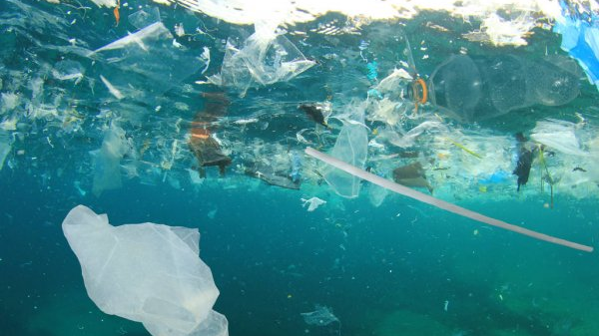
Problems in sea

Slide 2
Sea rising level
In the natural world, rising sea levels create problems in coastal ecosystems that provide protection against storms and for fish and wildlife habitats, including commercially valuable fisheries. As seas rise, saltwater is also contaminating freshwater aquifers, many of which support municipal and agricultural water supplies and natural ecosystems.

Slide 3
Climate change
Climate change includes global warming caused by greenhouse gas emissions and large-scale changes in weather patterns. Although there have been earlier periods of climate change before, humans have had an unprecedented impact on the Earth's climate system and caused changes on a global scale.

Slide 4
and as a result of the increase in temperature, there was a high thaw, destruction of habitats and species of animals that no longer exist. And if this problem continues, we will also have the stigma of the human race.

Slide 5
Solutions for climate change
the greatest solution of all for the present environmental disasters would be the disappearance of the human race ... but for people who are aware of what is going on the solutions are obvious, ecological alternatives to non-polluting fuels alternatives to waste degradation, and not to throw into the sea.

Slide 6
End
Trabalho realizado por: pedro pinguinha 8ºc

