Slide 1
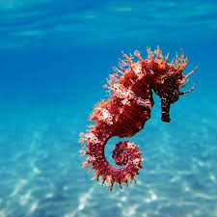
Seahorses

Slide 2
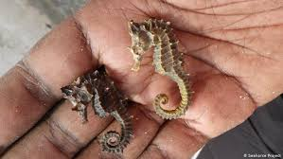
Seahorses might not look much like fish, but they are fish. Like all fish, seahorses have gills so that they can obtain oxygen from the water. Unlike other fish, seahorses swim up right. They also have bony plates covering their bodies rather than scales.
What is a seahorse?

Slide 3
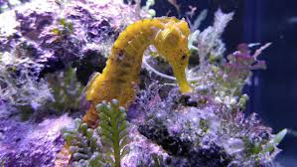
Worldwide • Seahorses are mainly in warm , shallow, coastal seas. They live among seagrass , mangroves coral and kelp. In these places they are protected against strong currents and storms
Where seahorses live?

Slide 4
Some seahorses live in estuaries, the sheltered places were rivers meet the sea. • Australian About 25 species of seahorses re found in Australian waters. Some species are widespread and others are found only in certain areas. For example, the pygmy seahorse is found along the coasts of Queensland and Japan. And the southern potbelly seahorse lives along the Victorian and Tasmanian coasts.
Where seahorses live?

Slide 5
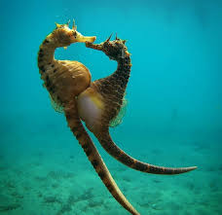
Did you know that the male has the baby. It is the only animal were the male is pregnant. I no it is a bit weird but it is true. • At the beginning of the breeding season the male seahorse grows a pouch on his belly. • The male and female entwine there tails before the female lays her eggs in the mails pouch. • The male fertilizes the eggs and they attach to the wall of his pouch. Inside the embryos develop.
Pregnancy

Slide 6
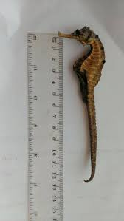
Maximum length from snout to tail: Big-bellied seahorse-32cm Denise’s pygmy seahorse- 1.6cm Long-snouted seahorse-16cm Pacific seahorse-35cm Western Australian seahorse- 20cm
Size

Slide 7
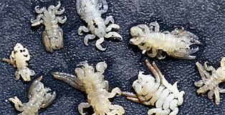
Seahorses eat little types of food. Example: Sea lice; sea snail; sand fly
Food

Slide 8
Trabalho Realizado por:
Pedro Picoito nº18
Rafael Gomes nº19
Raul Jesus nº20
Tiago Pedro nº21

