Slide 1
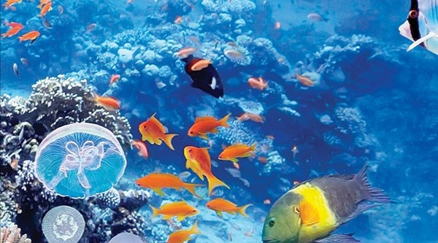
Marine habitats

Slide 2
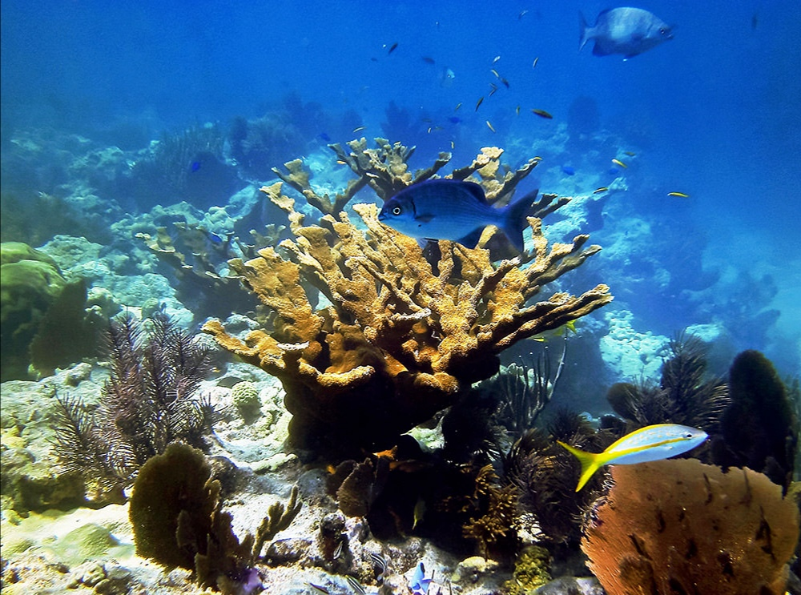
Marine habitats are habitats that support marine life. Marine life depends in some way on the saltwater that is in the sea. A habitat is an ecological or environmental area inhabited by one or more living species. The marine environment supports many kinds of these habitats.

Slide 3
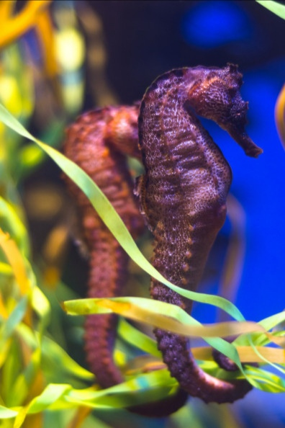
Portugal is home to many wonderful marine creatures, in particular the long-snouted seahorse and the short-snouted seahorse. These seahorses were found in record-breaking numbers in the Ria Formosa Natural Park in early 2000s. However, since then their numbers have been declining sharply.

Slide 4
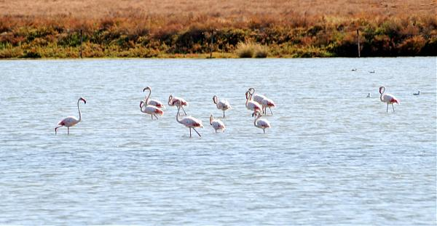
Sapal de Castro Marim
And if we look to the east, we almost glimpse the Marshland of Castro Marim and Vila Real de Santo António, the first Nature Reserve created in our country. This area of ​​salt pans, pastures and marshes, has the limits of both locations and extends along the Guadiana River.

Slide 5
Work done by: Francisco conçeição n*7 and Gustavo Branco n*10 8°C

