Slide 1
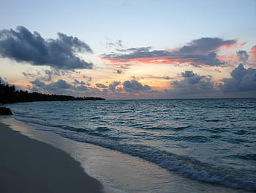
Habitats and Biodiversity
Ria Formosa

Slide 2
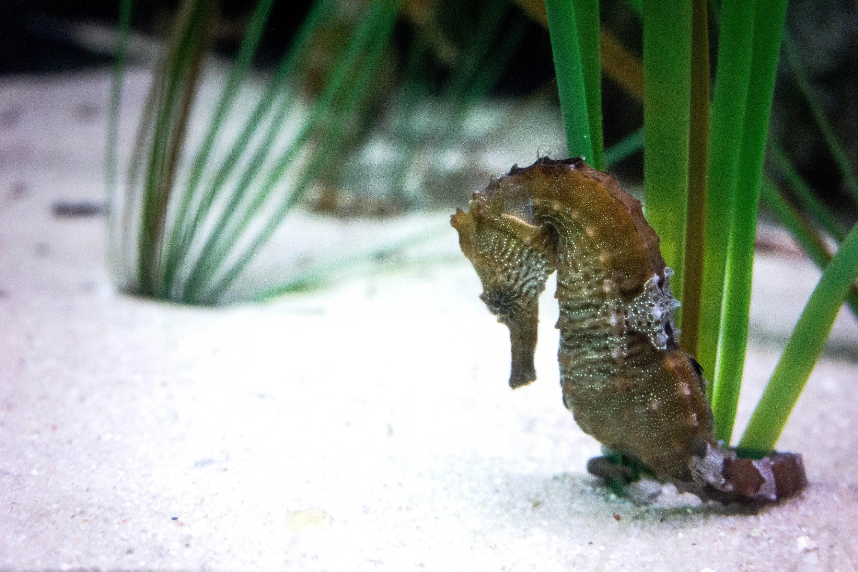
seahorse is an animal in stretching
In general,seahorse are just over 15 cm long.
The seahorse has small fins,which does not allow swimming against the current.
Thus,he prefers quiet and shallow water environments

Slide 3
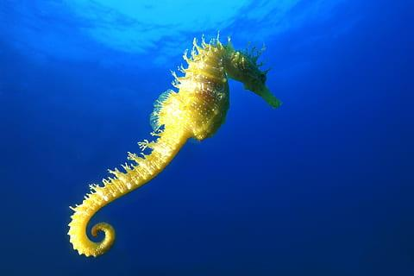
All species of seahorses are in danger of extinction.
One of the causes is predatory fishing and habitat destruction.
Another couse is the frequent capture of them to be used as a decoration
piece or simply be created in an aquarium

Slide 4
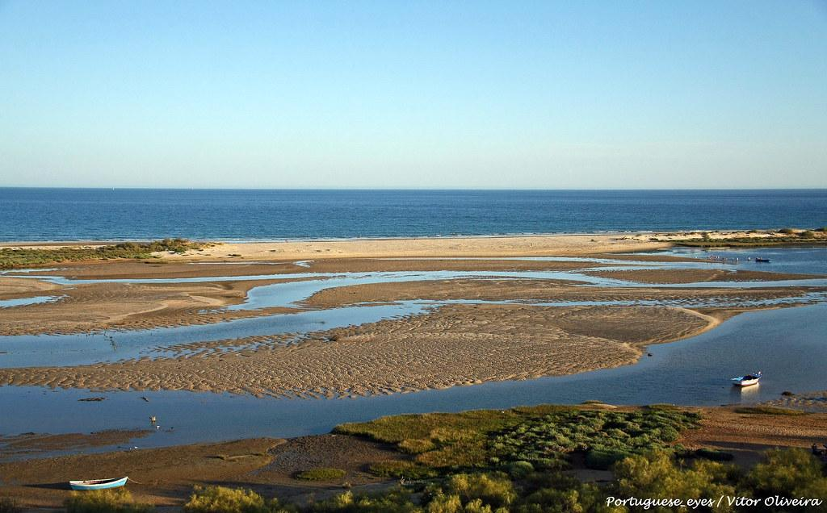
work done by
Lara Messias Francisco nº14 8ºC

