Slide 1
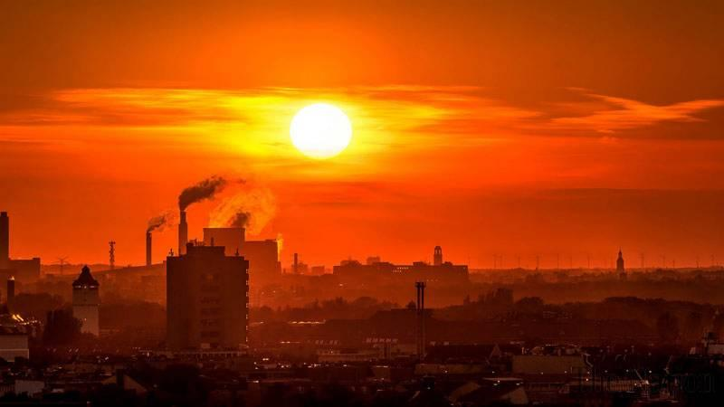
Climate Changes
and
Sea Rising Levels

Slide 2
What are climate changes?
Climate change, as the name implies, refers to “ climate change on a global scale, or regional climates of the Earth over time, affecting the balance of systems and ecosystems that have been established for a long time." Currently the average temperature of the planet is 0.85 ° C higher than that of the 19th century.
each of the last three decades has been warmer than any other since 1850, the year that records began to be recorded.

Slide 3
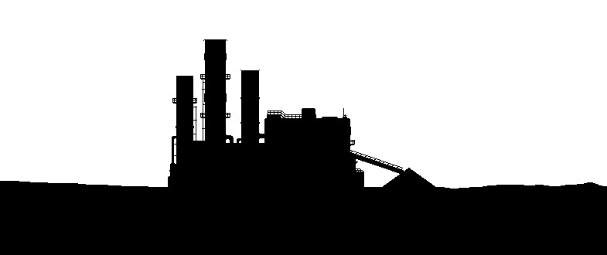
Causes of Climate Change
The cause of the increase in temperature is the excess of gases in the atmosphere, which are caused, for example:
by burning coal,
Oil and gas,
Industry
Cutting down forests,
livestock activity increase
use of nitrogen-containing fertilizers.

Slide 4
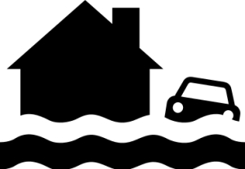
Consequences of Climate Change
Ice melting and sea rising levels, resulting in flooding and erosion, and eventually making coastal regions and islands that disappear due to rising sea levels
Death of living beings, which is caused due to the rapidity of climate change, which complicates the ability of many plants and animals to adapt.
Increased mortality. There has been an increase in deaths related to heat and there are already changes in the distribution of some diseases transmitted by water.
Torrential rain
Prolonged droughts
Heat waves
Tornados
and other extreme weather events are already more frequent

Slide 5
How can we help solving this problem?
We can help by:
walking, cycling or using the bus instead of driving the car, because it’s estimated that in Portugal 25%
of carbon transfers are caused by car traffic, and being the 2nd leading source of gas emissions in the U.S
Buying products manufactured and originated in out home country
decreasing the use of electricity
Reducing the consumption of beef and dairy products, because the digestive process of both cows and sheep , produces too much methane, which is one of the gases responsible for climate change.

