Slide 1
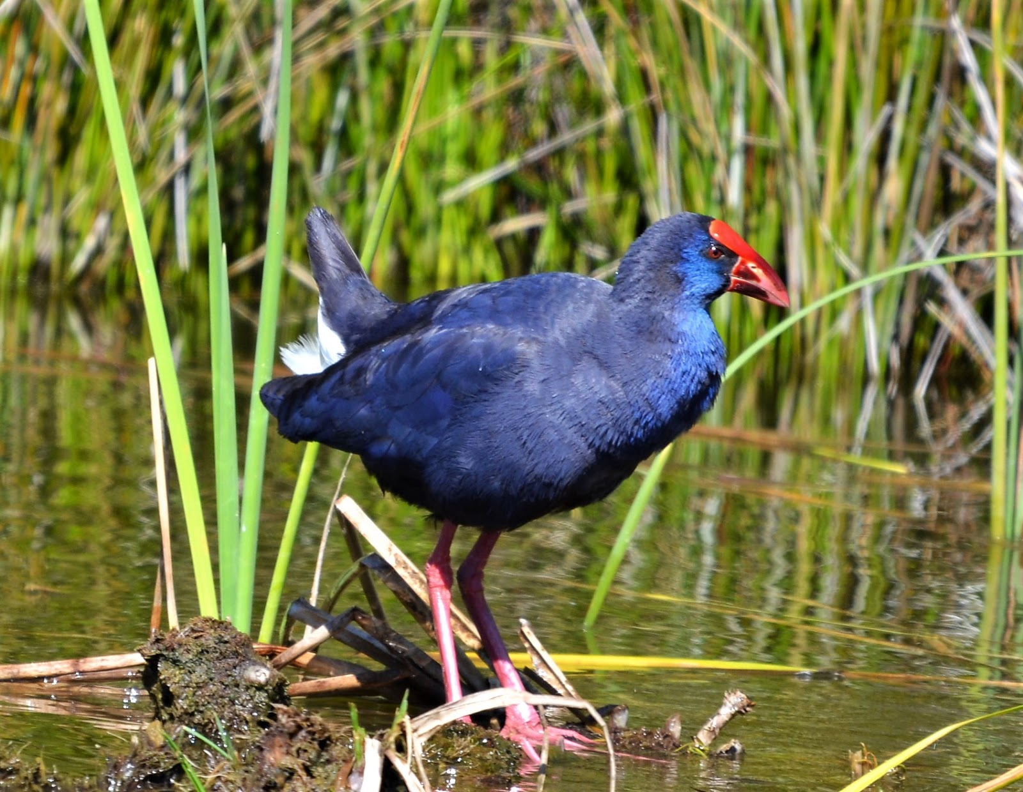
The fauna of the Ria Formosa

Slide 2
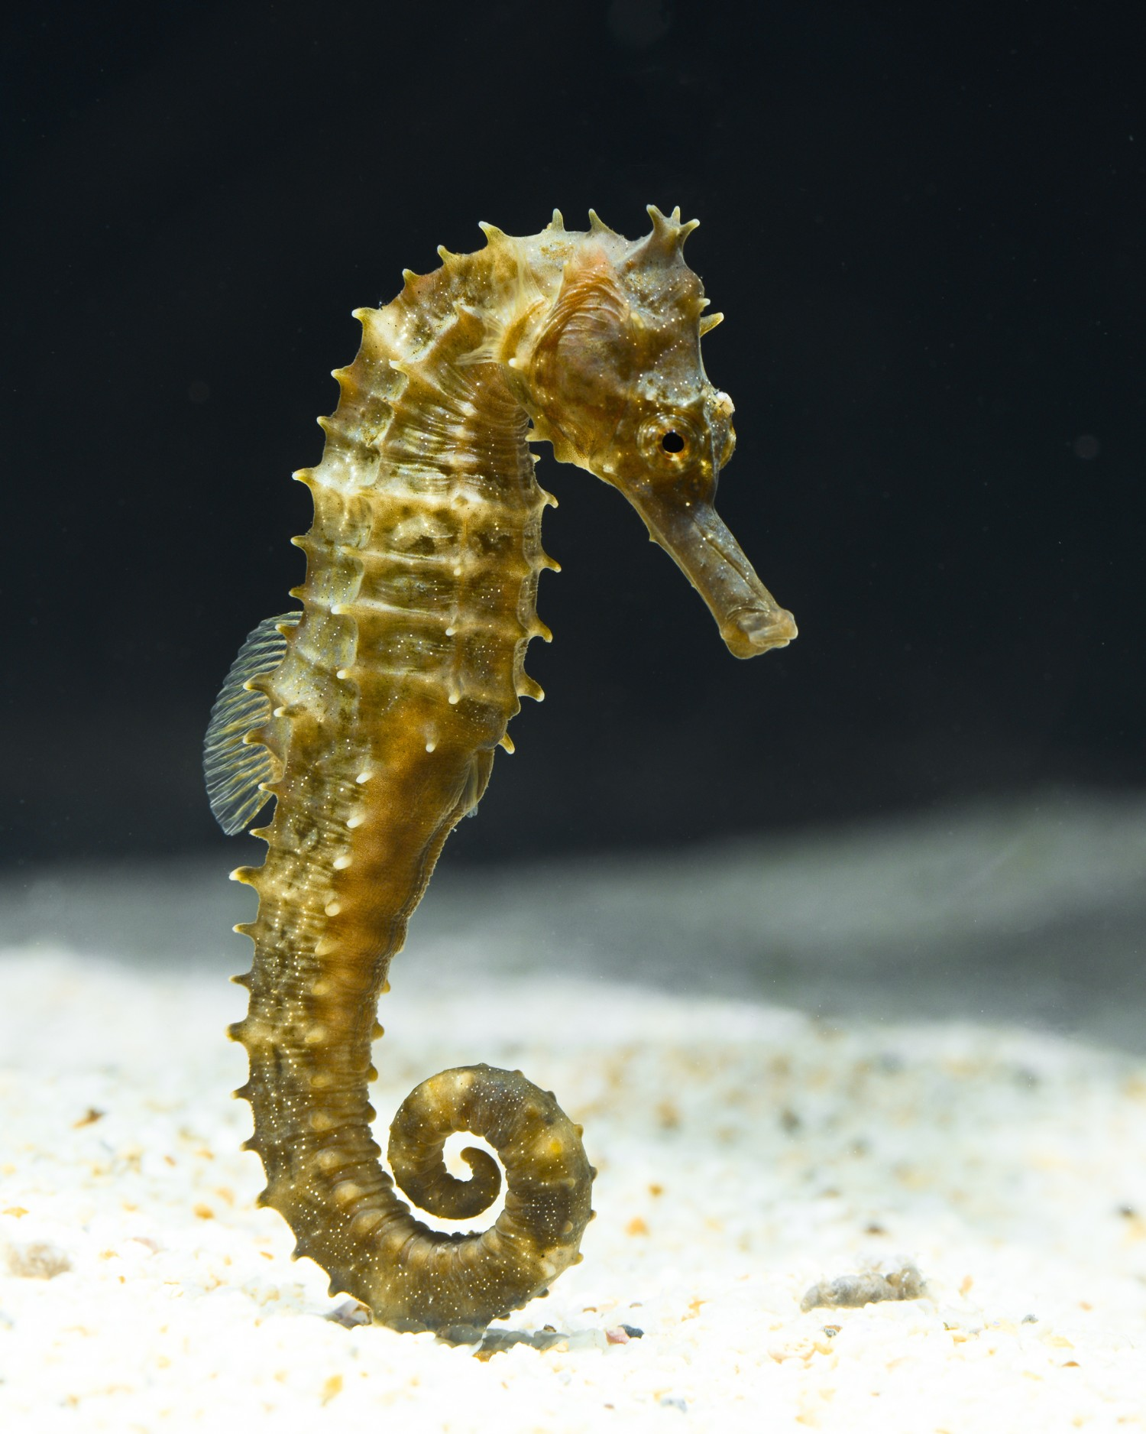
Endangered Species
Seahorse
Seahorses are the most endangered species in the Ria Formosa, having been the place in the world where they concentrated the most, and over the years they have dropped about 90% of their population due to various factors, illegal fishing, accidental fishing, illegal trafficking among others.

Slide 3
Endangered Species
Sea cucumbers
In two years, 75% of the sea cucumber population disappeared in several places in the Ria Formosa. The species Holothuria arguinensis is the most affected: next to the island of Armona there were 120 individuals per hectare, in 2014. Today, there are about 30. Despite being in the protected area of the Ria Formosa Natural Park, it is close to the islands of Armona and of the Breech that the biggest losses are detected. All this due to fishing and illegal selling, usually sold in the Asian market.

Slide 4
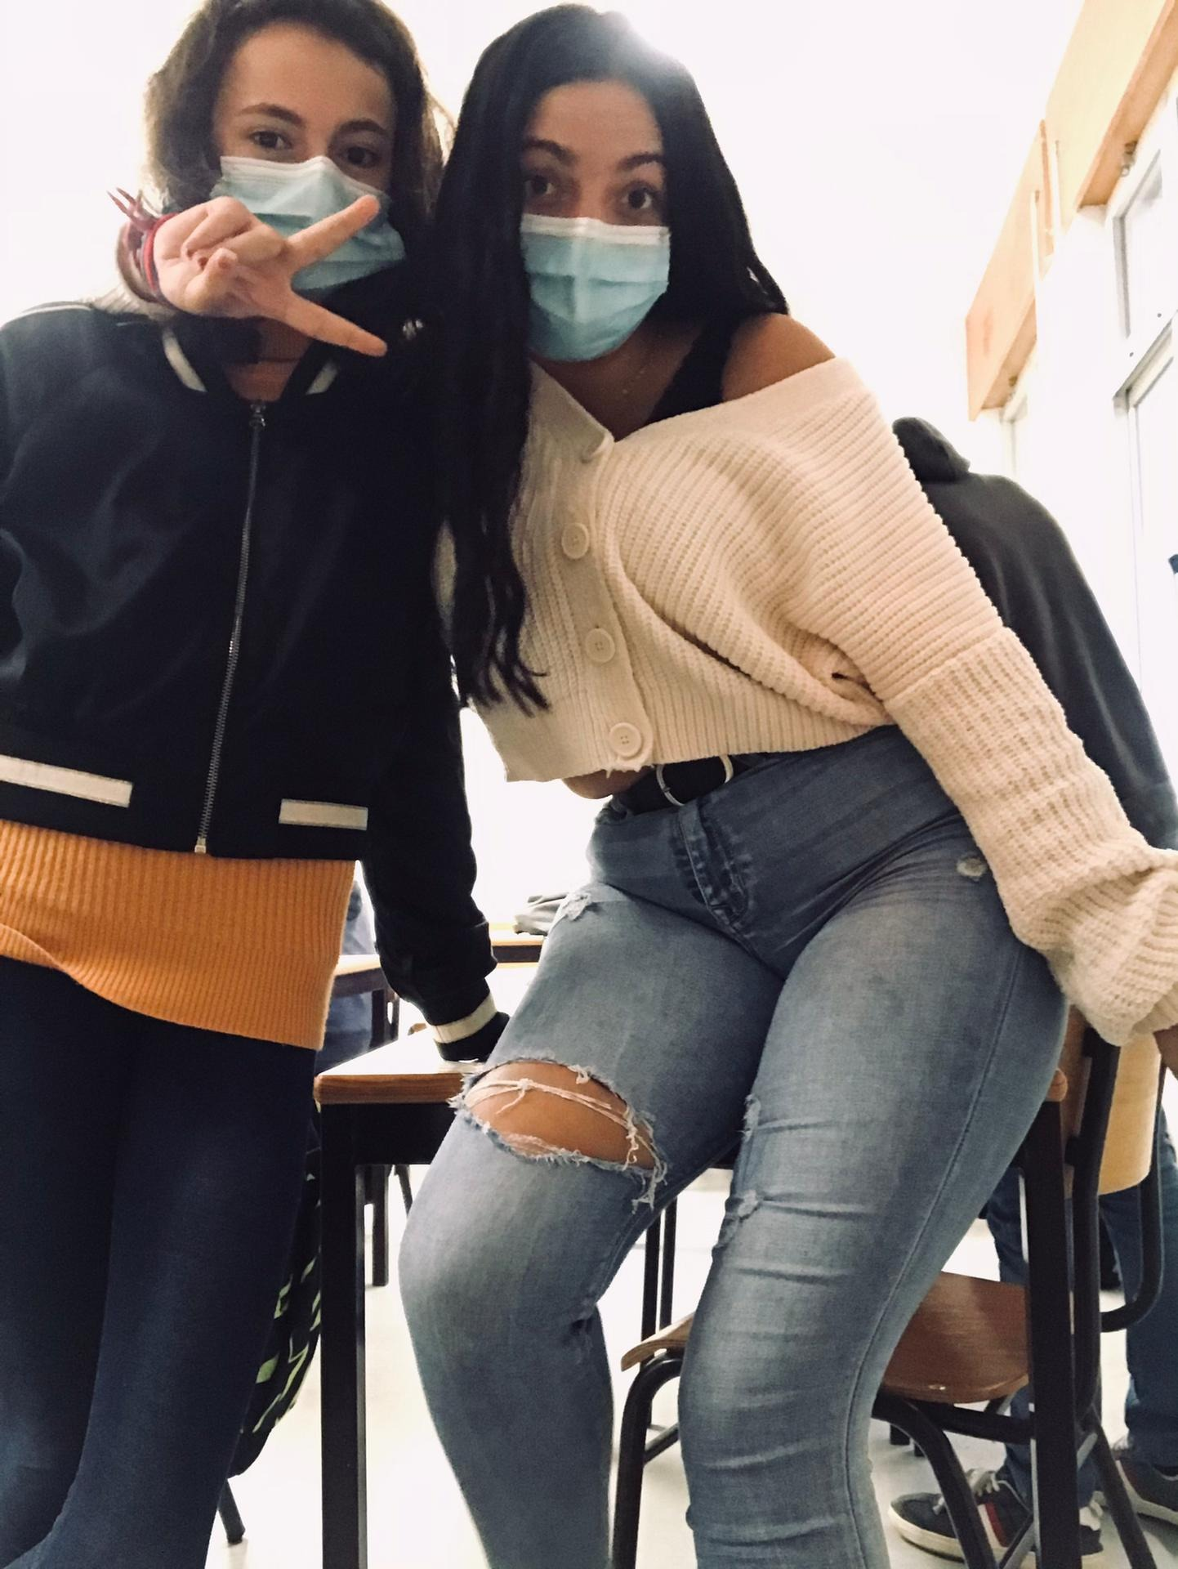
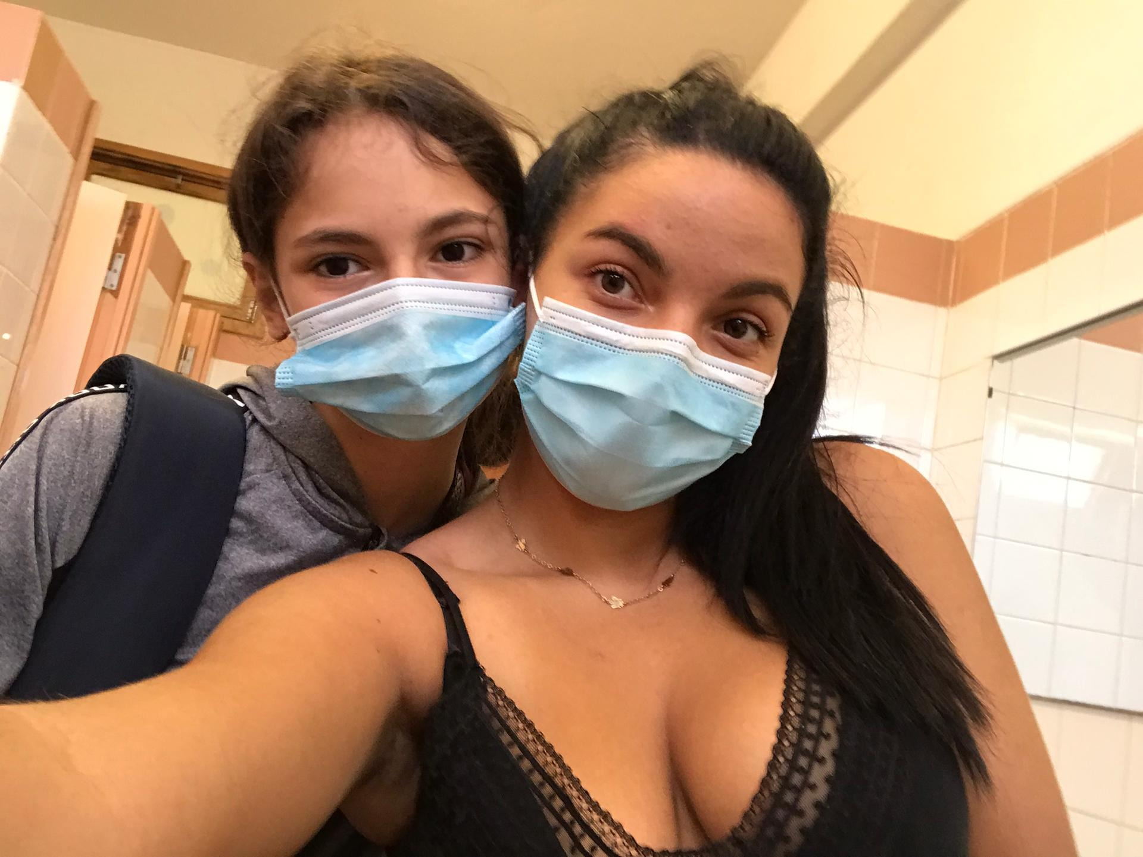
Work done by:
Beatriz Carmo 8ºC nº2
Inês David 8ºC nº12

