Slide 1
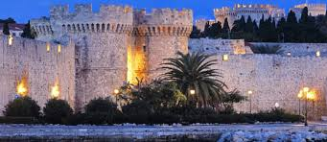
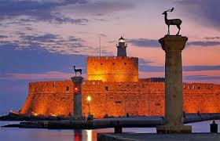
My rhodes
Rhodes is a very beautiful island of the Dodekanisos.
It is the third biggest island in Greece.
Particularly important for the Greek economy. Visitors arriving on the island by cruise ship are counted in the tens of thousands per year.
It is an internationally recognized tourists destination.

Slide 2
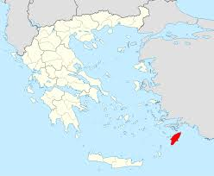
Rhodes at the dodekanisa, in Greece

Slide 3
sights

Slide 4
palaces
They were created over many centuries. (ancient times, Byzantium)
Τhe reinforcement, the completion or the construction from the beginning for most of the castles of Rhodes, is due to the Ioannites knights. (1309-1522)
One of them is the medieval city of Rhodes.
Ιn it is the Palace of the Grand Master.
Today it functions as a museum.
You will find it at the end of Knights Street.

Slide 5
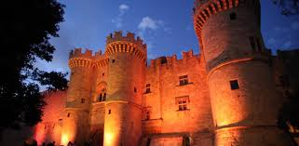
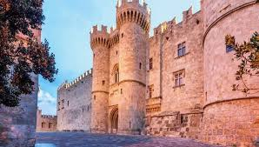
The palace of the grand master in the Medieval city of rhodes

Slide 6
Archaeological Museum οf rhodes
It is near the port of the city of Rhodes, in the medieval city of Rhodes.
It is housed in a 1489 two-story medieval building which was used as a Knights' Hospital.
In the inner courtyard, impresses the sculpture of a lion devouring its prey.
On the first floor you will find tombstones, coats of arms of the Knights, pots and statues from antiquity.
On the first floor stand the statues of Aphrodite (of Rhodes) and the marble head of the Sun.

Slide 8
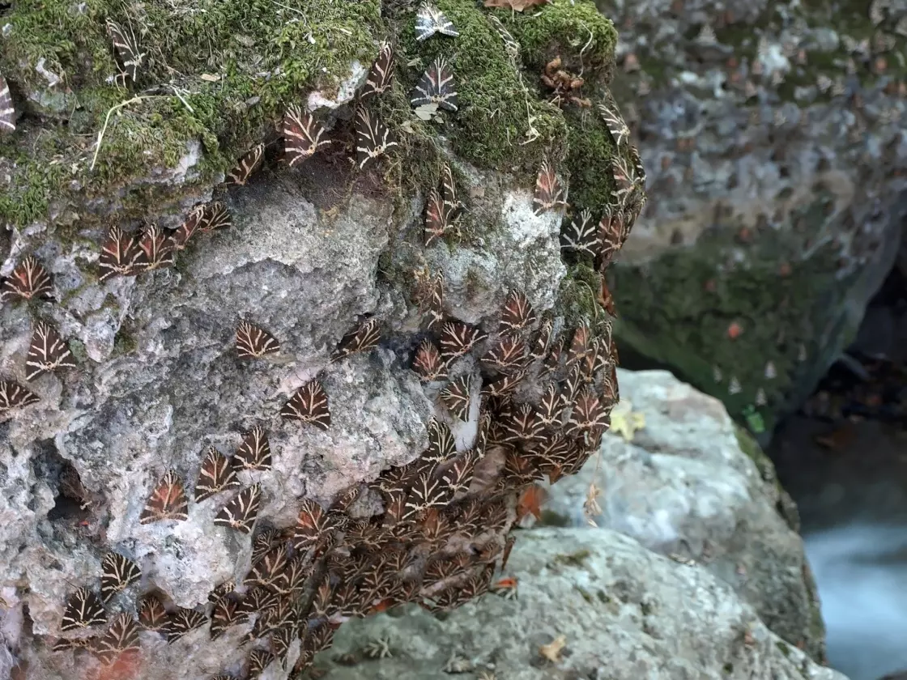
Valley of the butterflies
It is the most popular natural attraction of Rhodes.
It is a beautiful environment with lush vegetation, waterfalls and springs, while the area is landscaped with wooden bridges, benches and lakes.
Every year, from June to September, butterflies gather here to mate, creating a colorful and spectacular spectacle.

Slide 9
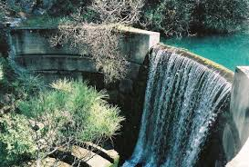
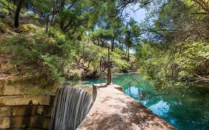
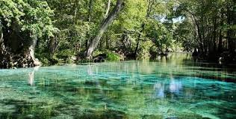
seven sources
Τhis enchanting location is not yet widely known.
Τhe landscape is beautiful with many springs, trees, waterfalls and a lake with ducks, while there is a restaurant where you can eat delicious Greek food.

Slide 10
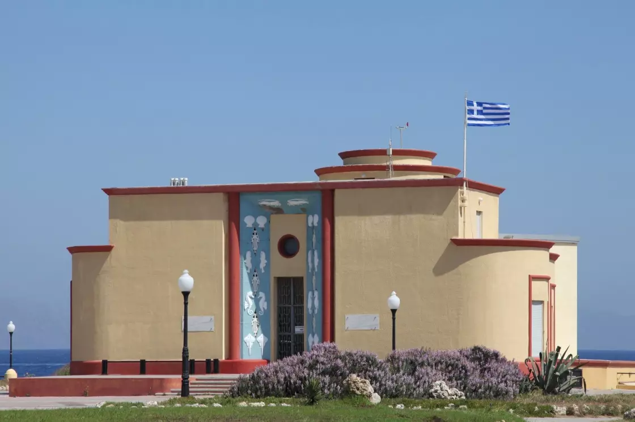
Aquarium
The aquarium is located at the northern end of Rhodes.
It is one of the best of its kind in Greece.
It gives the opportunity to young and old to get to know the sea world by admiring fish, shellfish, turtles, seals, crabs, sea urchins, mollusks and many more, some of which are endangered.

Slide 11
the baths and springs of kallithea
It is one of the most famous sights of Rhodes, attracting tens of thousands of visitors every year.
It is an architectural ensemble of the Italian era.
You can see the room of the Rotunda in which the thermal waters once gushed, but also many others, such as the beautiful mosaics.
The springs are located by the sea, 9 km. south of the city of Rhodes, just before Faliraki.

Slide 12
Kalithea: the baths

Slide 13
An important moment from the history of Rhodes
Rhodes was integrated into Greece in 1947, after a long period of Italian rule (1912-1947).
Official anniversary of integration March 7, 1948.

Slide 14
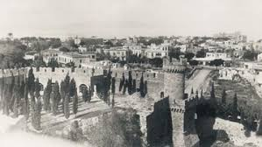
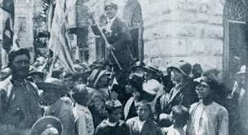
1947: the Dodecanese kneel in front of the Greek flag

Slide 15
Thanks for watching

Slide 16
Προγραμμα Erasmus+ : “ymweltfreundliches Europa – die zukunft beginnt jetzt!/ environmentally friendly Europe – the future begins now”
Dosis Eyea Argero Class B, November 2020

