Slide 1
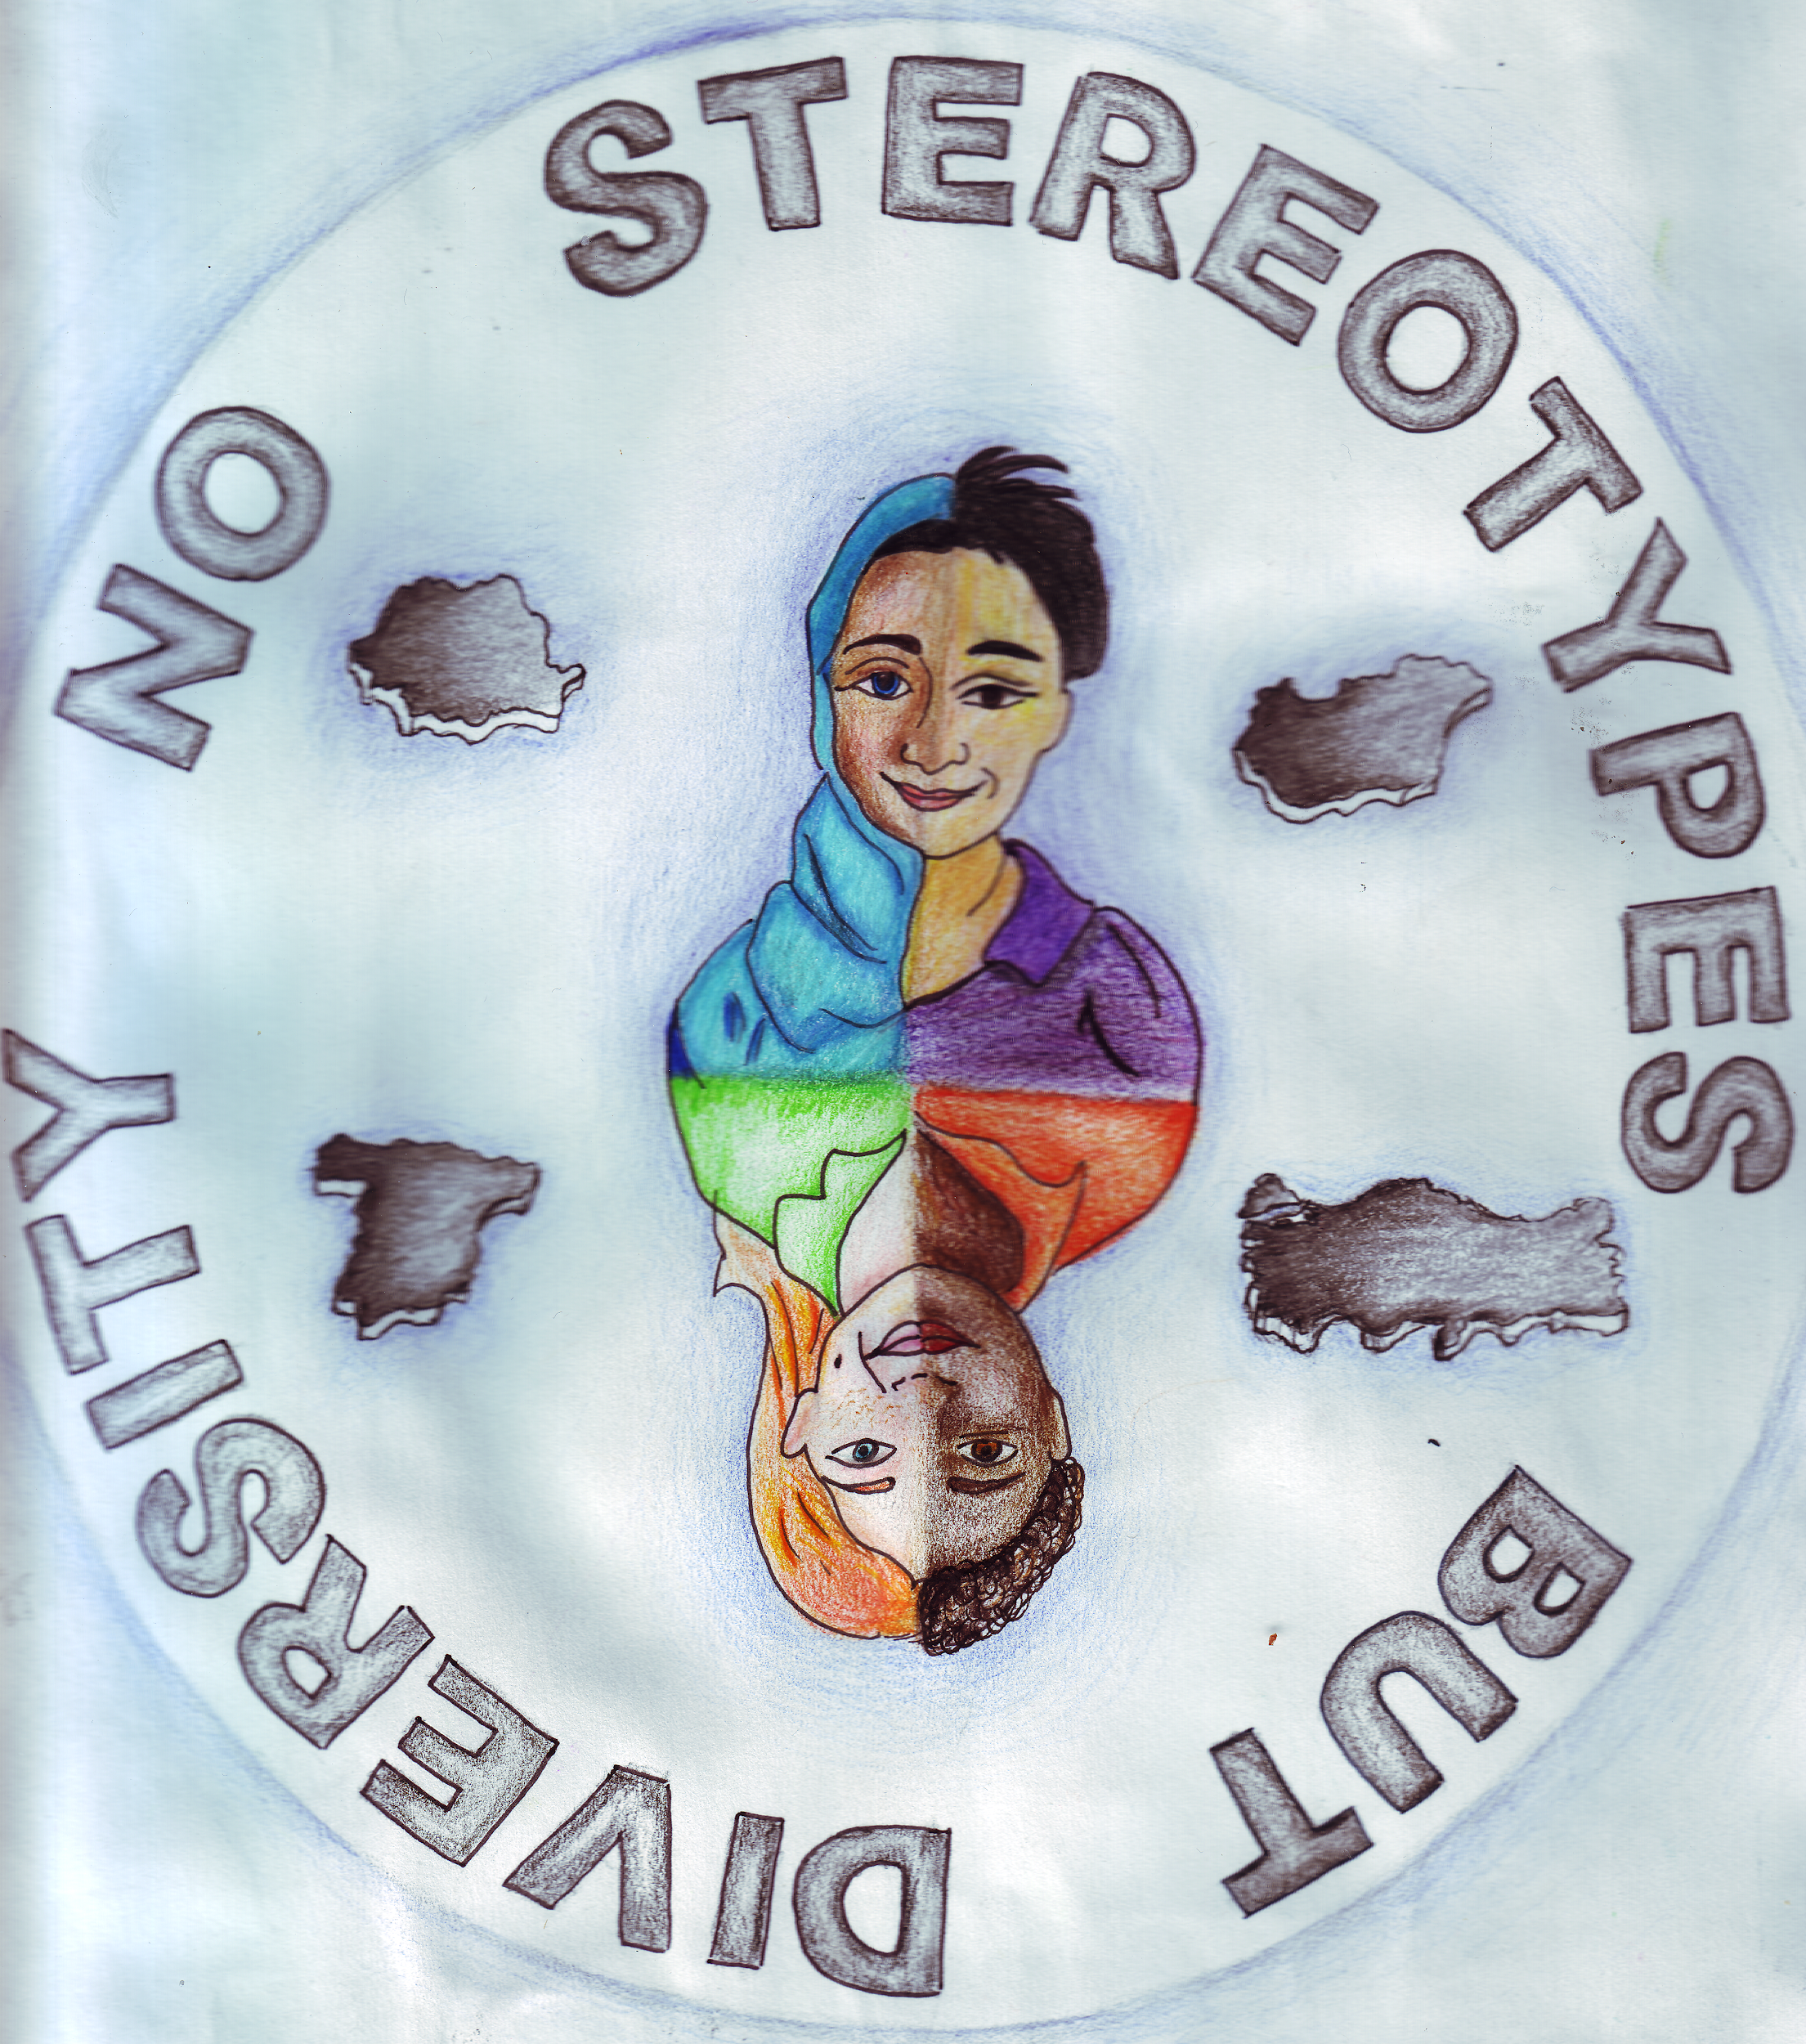
No Stereotypes But Diversity 2017-1-HU01-KA219-035974
HUNGARY, Budapest 19th March 2019.

Slide 2
Exercice
a) Students discussion in small mixed group b) Teacher - test
“Bullliying tree” - roots-basic-consequences (4 students + 2 teachers)
“phisical-verbal-indirect” byllying situation
Dilemma questions

Slide 3
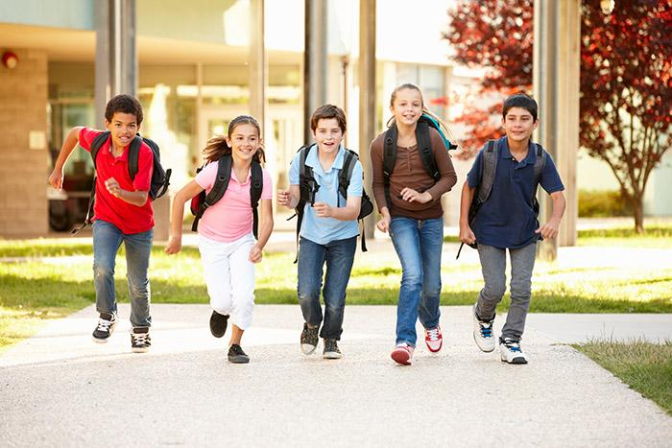

Slide 4
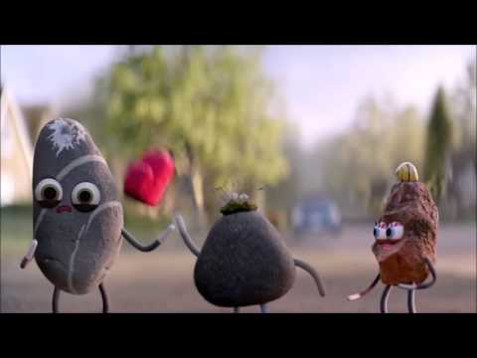
Be Together. Not The Same!!! https://www.youtube.com/watch?v=B0KyZNoVhD8

Slide 5
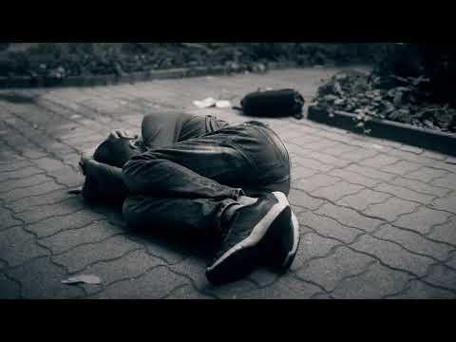
Vigyázunk rájuk?/Care we him? 0.40 https://www.youtube.com/watch?v=DOMexs9gnpw

Slide 6
What is the situation in your school? discussion /students/
Are there abusive cases at your school? During addressing for example? Are there offensive nicknames?
Are there prejudices against students because of belonging to a religion, ethnic minority or group of refugees?
Is something happening when students complain about an injury? What is the result of it?

Slide 7
Bullying at Greecland Middle School
Mennyit tudsz az iskolai zaklatásról? (teachers)
Szerinted az alábbi állítások igazak vagy hamisak?
Az egyszeri vagy ismétlődő bántalmazást vagy megfélemlítést iskolai zaklatásnak nevezzük.
A zaklatás szinte mindenhol része az iskolai életnek.
Az iskolai zaklatás a tanulók körülbelül 25%-át érinti.
A zaklatás módszerei és típusai között a fizikai bántalmazás a leggyakoribb.
A zaklatók az átlagnál rosszabb tanulók.
Lényegesen kevesebb a lány zaklató, mint a fiú.
Egyes tanulók mássága teszi őket áldozattá.
A védekezésre biztatás hasznos.
A legjobb módszer a zaklatóval szemben az, ha nem veszünk róla tudomást.
Az iskolai környezet majd magától megoldja a problémákat.
A jó családi háttérrel rendelkező gyerekek között kevés a zaklató és a zaklatott.
A szülők többsége tud róla, ha a gyermekét zaklatják.
A tanárok többsége észreveszi, ha egy tanulót zaklatnak az osztályában.
A gyerekek erősek és túlteszik magukat a zaklatás okozta sérelmeken.
Az USÁ-ban az iskolai vérengzések 80%-át hosszantartó zaklatás áldozatai követték el.
Notes:
Megoldás: csak a 2. és a 15. állítás igaz.

Slide 8
Teachers working in pair
One-off or recurrent abuse or intimidation is called school bullying.
Harassment is part of school life almost everywhere.
School bullying affects about 25% of students.
Among the methods and types of harassment, physical abuse is the most common.
Harassers are poorer than average
There are significantly fewer harassers than the boy.
The discrepancy of some students makes them a victim.
Encouraging protection is helpful.
The best way to get to the harasser is to ignore it.
The school environment will solve the problems by itself.
Children with good family backgrounds have little harassment and harassment.
Most parents know if their child is being harassed.
The majority of teachers notice that a student is being harassed in his class.
Children are strong and overwhelmed by harassment.
In the US, 80% of school bloodshed victims have been victims of long-lasting harassment.
Notes:
Megoldás: csak a 2. és a 15. állítás igaz.

Slide 9
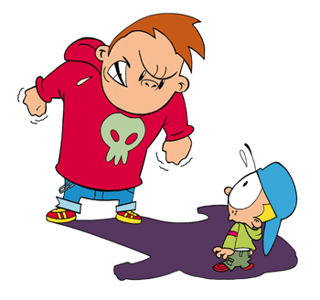
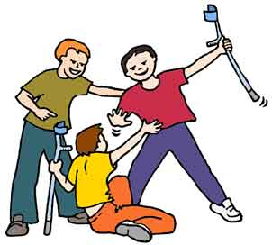
Az iskolai zaklatás
< három feltételnek kell teljesülnie >
• agresszív viselkedés vagy sérelem okozása szándékosan
• ismétlődően, hosszú időn át
• hatalmi egyensúly hiánya

Slide 10
The bullying three conditions must be met
• intentionally aggressive behavior or harm
• repetative for a long time
• lack of power balance

Slide 11
CLIQUES

Slide 12
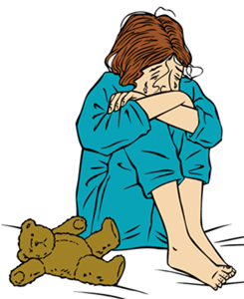
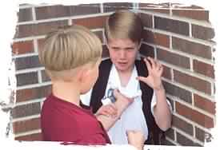
By which kind of difference
students making bullying?
Making someone looking ridiculous, mocking his/her different qualities.
height
weight
clothing
speaking style (dialect)
game style
movement
etc.

Slide 13
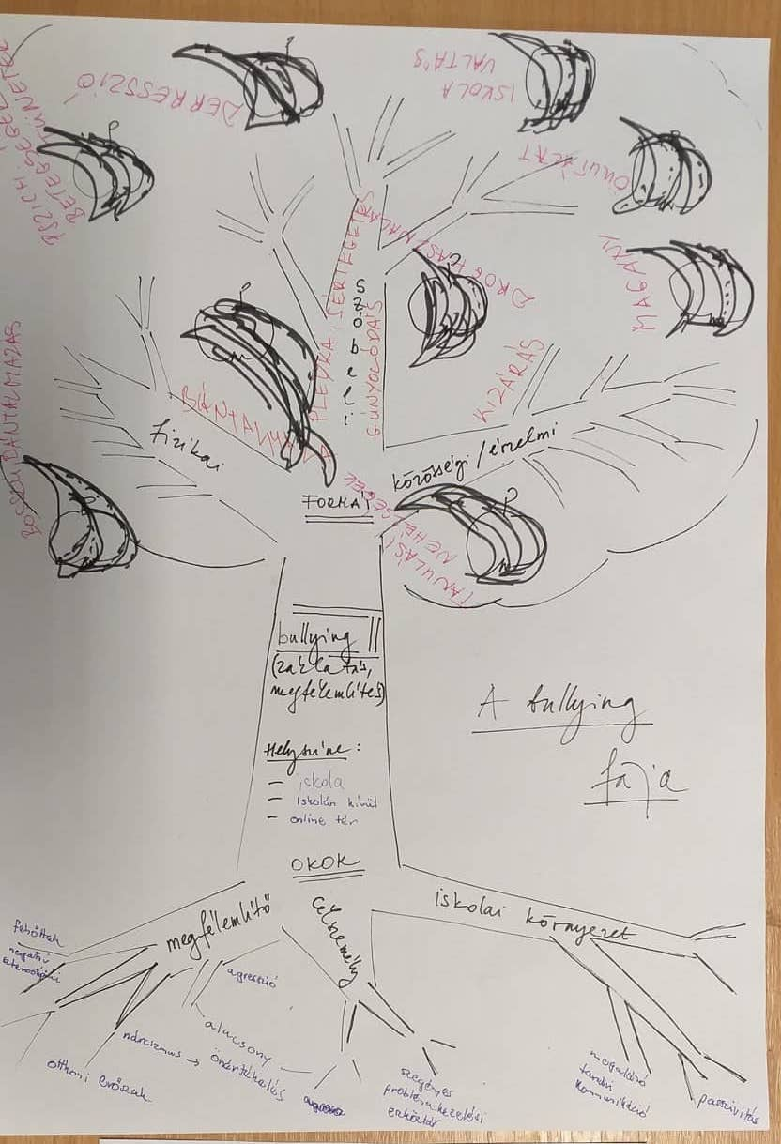
“Bullying tree” 4 students + 2 teachers
consequences, effect
forms
space/area
roots/causes

Slide 16
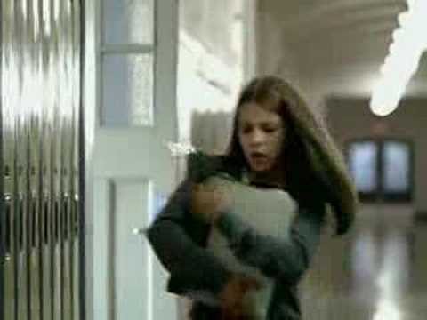
Words Hurt 0.31 https://www.youtube.com/watch?v=sbKBvrEr2wE

Slide 17
What is bullying?
It is an intentional, repetitive behavior that aims to cause
physical or psychological pain/cause damage to a non-provocative student who cannot defend her/himself.
Verbal bullying, the victim's humiliation is also a serious problem.
It is difficult to recognise the hidden/indirect abuse, many times even the victim doesn’t know about it. For example who is behind the malicious, expiring rumors or uploaded to the internet.

Slide 18
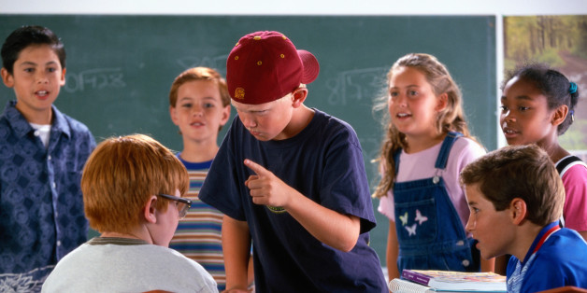
Physical - Verbal - Indirect/Social

Slide 19
Physical - Verbal - Indirect
A boy from your class during break pushes mud to one of your quiet boy classmate’s face.
physical

Slide 20
Physical - Verbal - Indirect
Girls from your class in the changing room are gossiping maliciously about a girl from a different class.
indirect

Slide 21
Physical - Verbal - Indirect
Older boys on their way home are pushing a boy into a trench.
physical

Slide 22
Physical - Verbal - Indirect
Three girls during lunch don’t let a forth girl sit next to them, saying ,,We lose our appetite from you”
verbal

Slide 23
Physical - Verbal - Indirect
Around half the class at the beginning of a lesson are imitating and mocking one of the high-tempered girl classmates of yours.
verbal

Slide 24
Physical - Verbal - Indirect
Some boys are looking into the toilet, while a boy from 1st grade is in, than they don’t let him out.
physical

Slide 25
Physical - Verbal - Indirect
A student from a higher class after school is sending threatening messages to your classmate, who just arrived recently to your school.
indirect

Slide 26
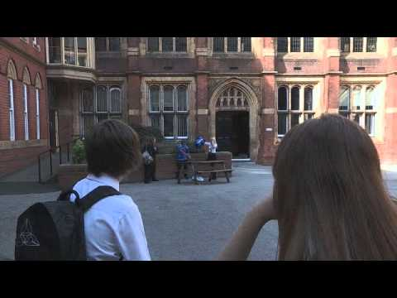
Spot it and Stop it - Interactive Anti-Bullying Video 2. https://www.youtube.com/watch?v=9SAN2l1cP9w

Slide 27
Do you think children and adults can stop the abuse?
Does it belong to you when someone else hurts?
This can be an exemption when you hurt someone because you had a bad day or are you angry with someone?
Does anyone deserve to be called or hurt by nicknames?
If the abuser encourages you to do something, can you say no?
Can you stand up against the abuser?
If they hurt you, can you interacting back?
Can you ask for help if they hurt you or if someone else hurts?

Slide 28
Quis about the buliying for the teacher
https://docs.google.com/document/d/1MbV8iAqna38ZGYHesJVE2lIszd4Ie9oPNSDKV_Isgqc/edit
How much do you know about school bullying? (yes or no)
One time or recurrent abuse or intimidation is called school bullying.
Harassment is part of school life almost everywhere.
School bullying affects about 25% of students.
Among the methods and types of harassment, physical abuse is the most common.
Harassers are poorer than average.
There are significantly fewer harassers than the boy.
The discrepancy of some students makes them a victim.
Encouraging protection is helpful.
The best way to get to the harasser is to ignore it.
The school environment will solve the problems by itself.
Children with good family backgrounds have little harassment and harassment.
Most parents know if their child is being harassed.
The majority of teachers notice that a student is being harassed in his class.
Children are strong and overwhelmed by harassment.
In the US, 80% of school bloodshed victims have been victims of long-lasting harassment.

Slide 29
II. Workshop - SKYPE
20 March 2019

Slide 30
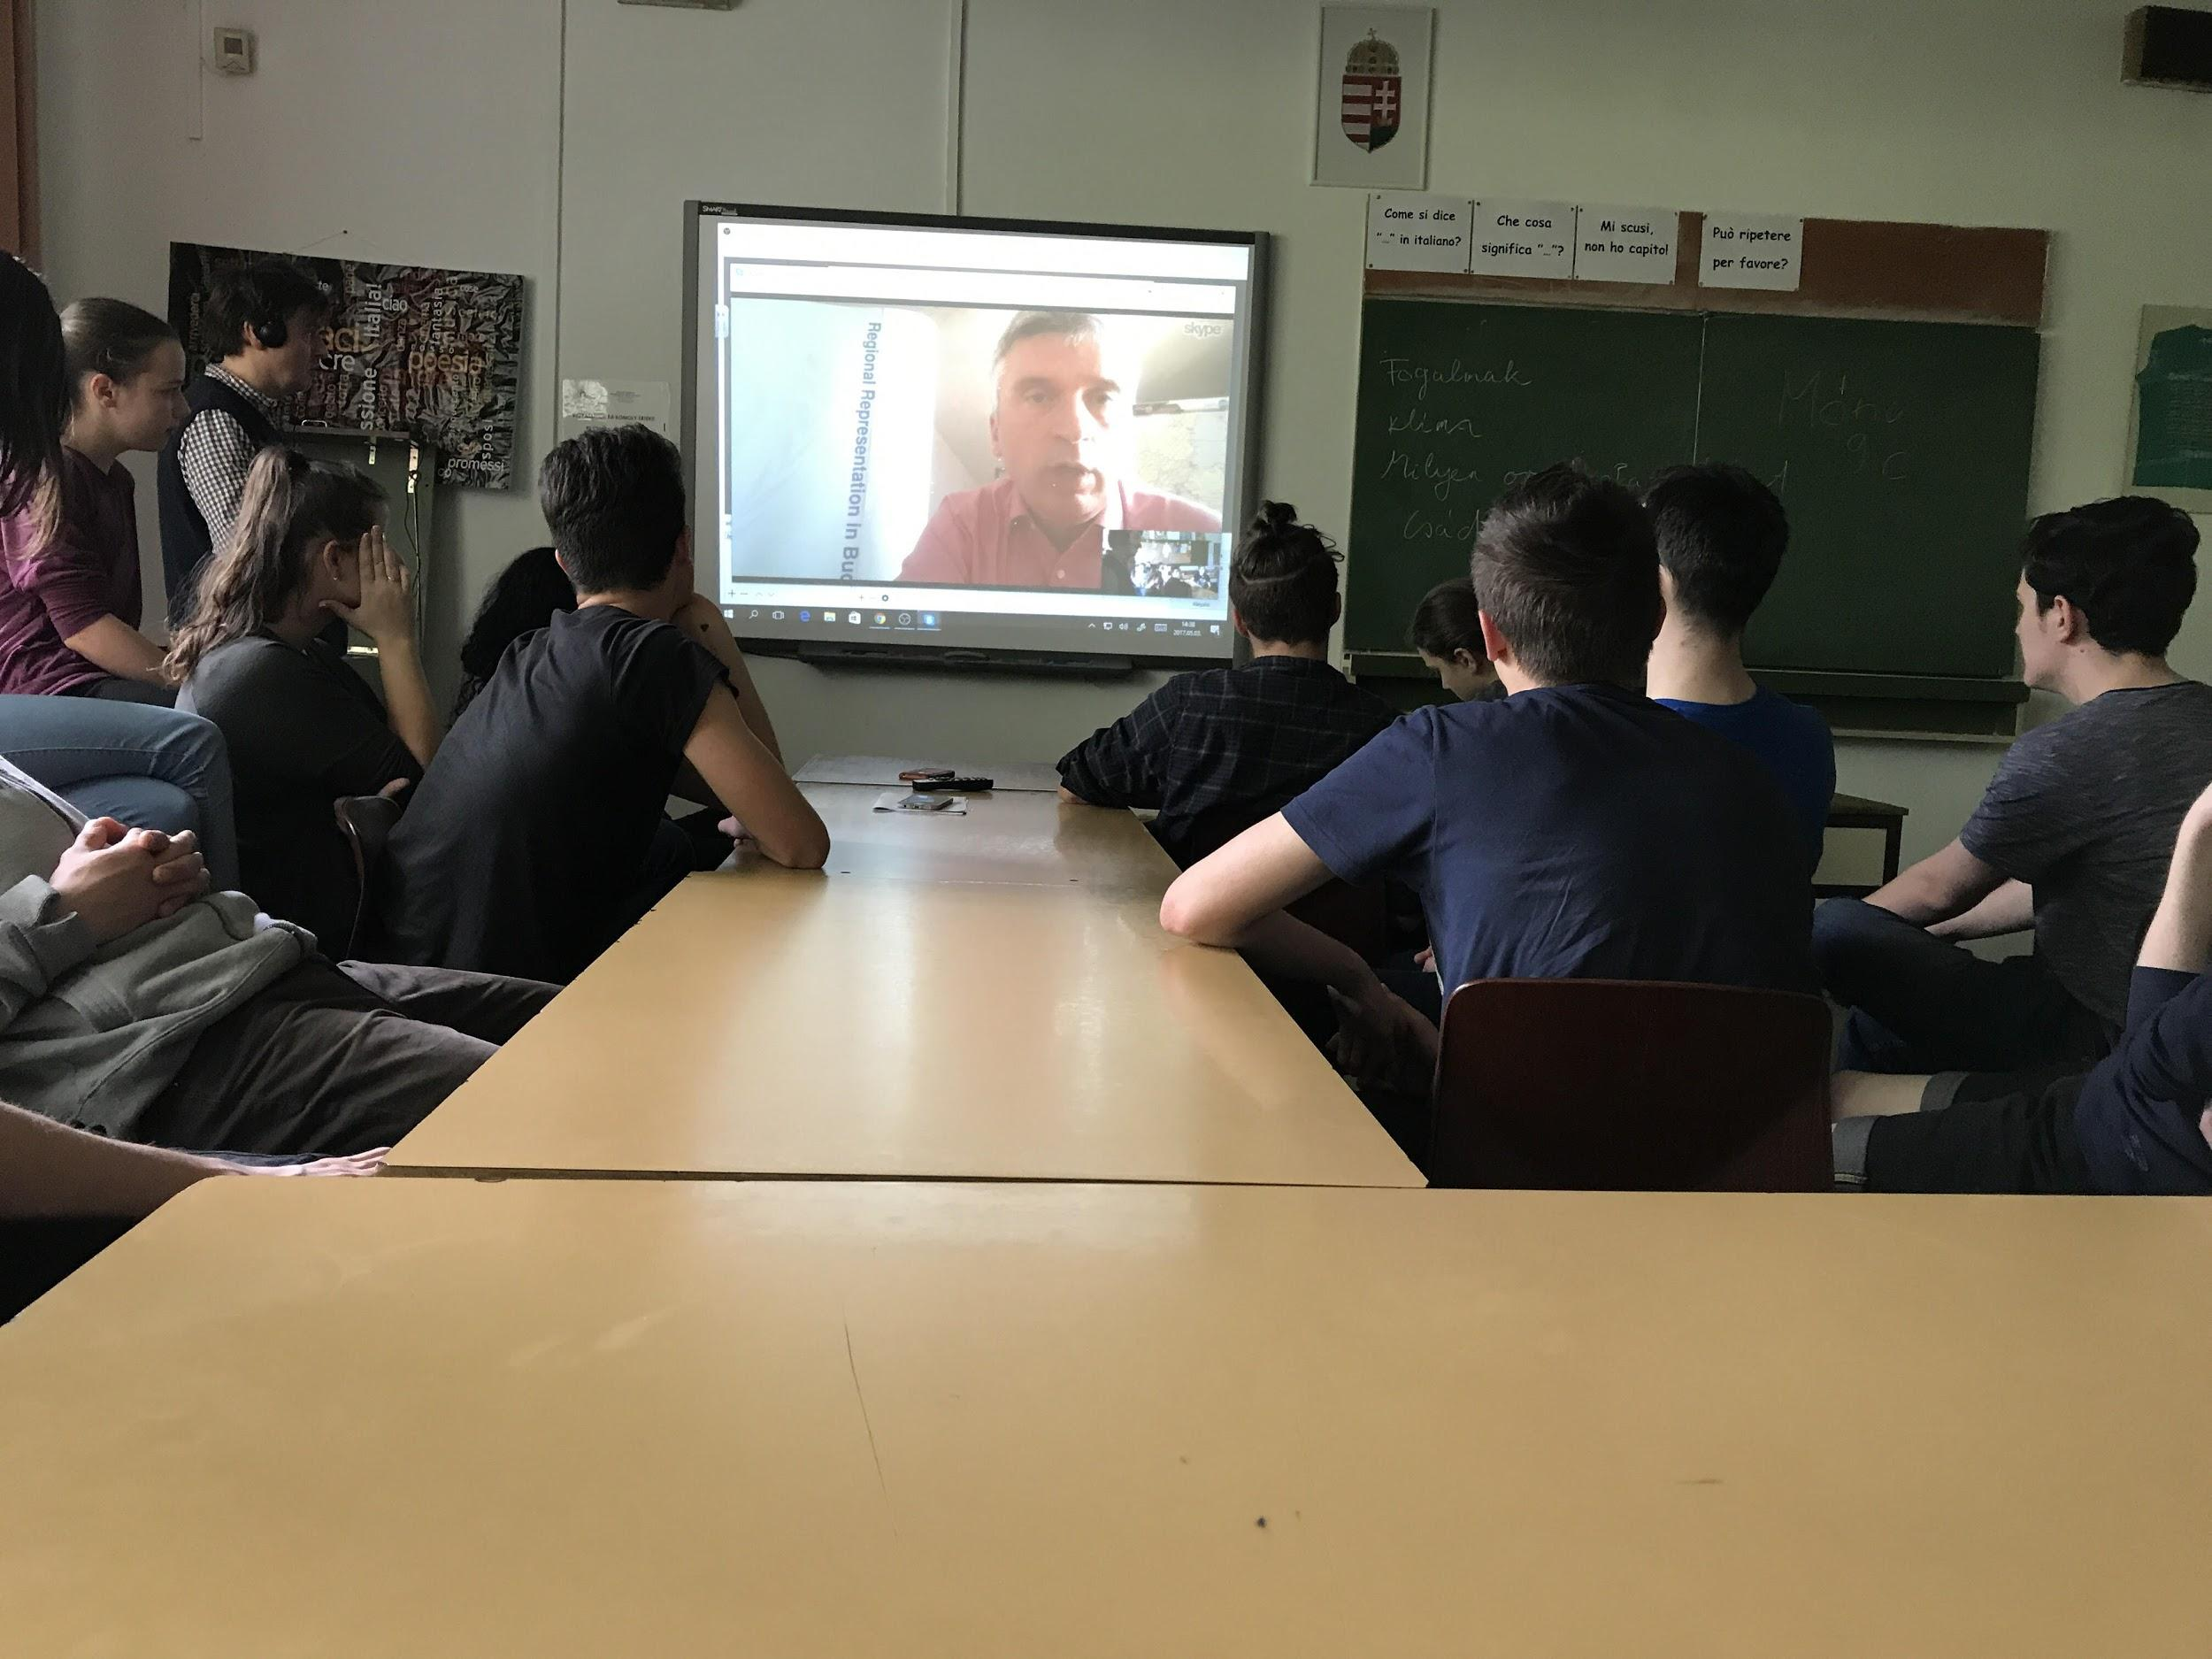
Nagy Ernő
United Nations High Commissioner for Refugees(UNHCR)
Senior Communication /Public Information Associate of UNHCR Regional Representation for Central Europe Purtătorul de cuvânt al Națiunilor Unite pentru azil
Portavoz de asilo de las Naciones Unidas
Birleşmiş Milletler Sığınma Sözcüsü

Slide 31
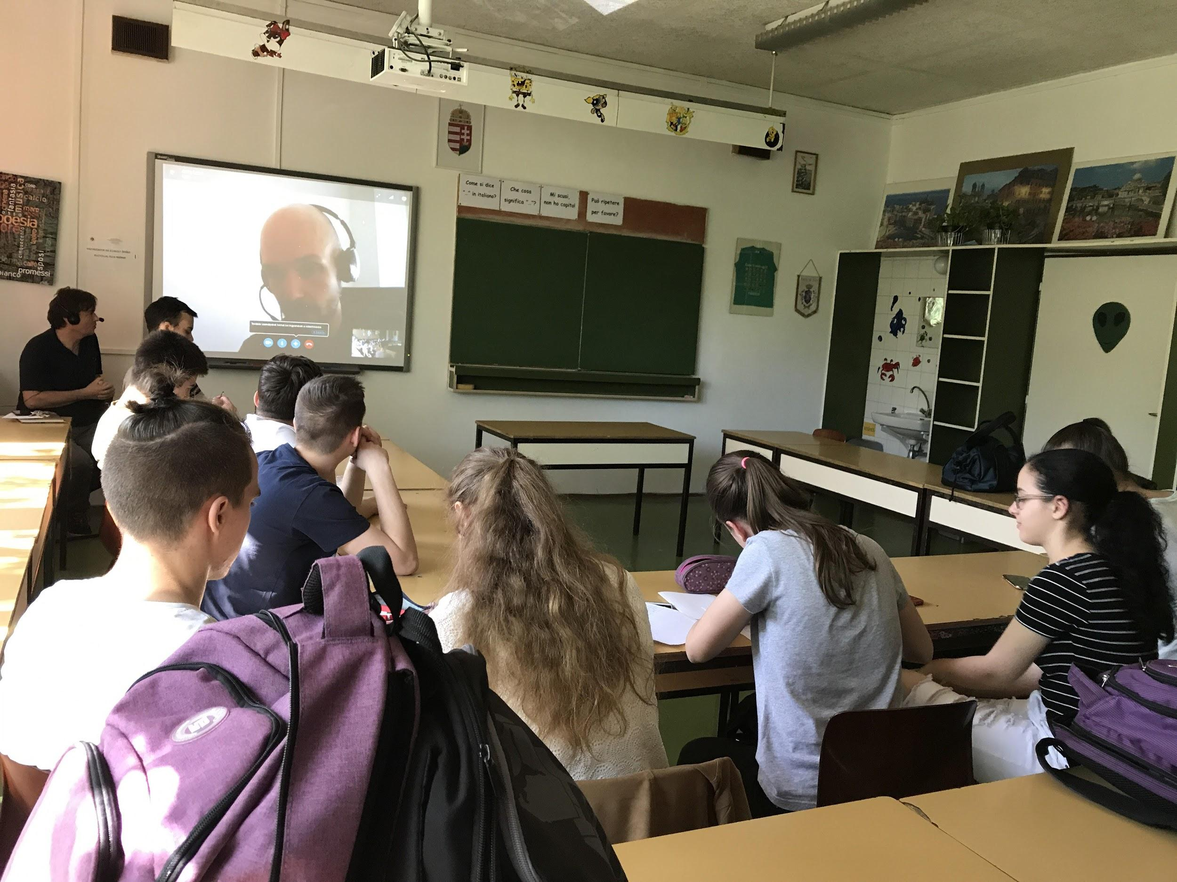
MENEDÉK- Association for Refugees

