Slide 1
ITALIAN LANDSCAPES
In the next slide you will see some of the most famous landscapes in Italy
from north to south

Slide 2
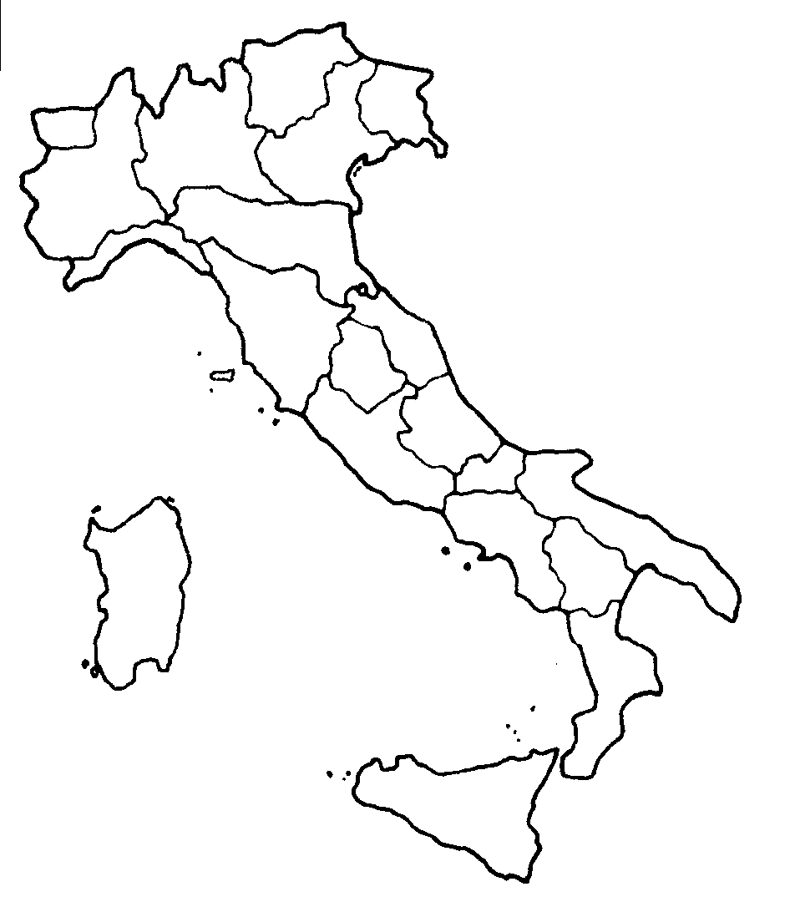
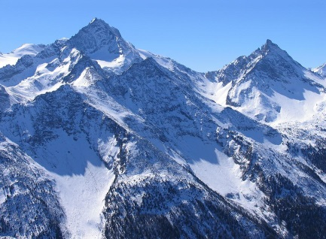
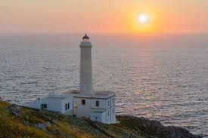
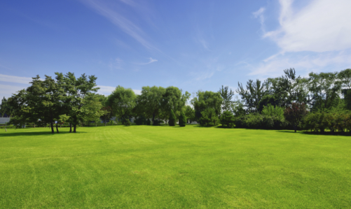
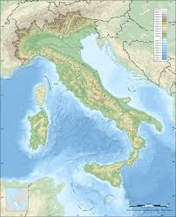
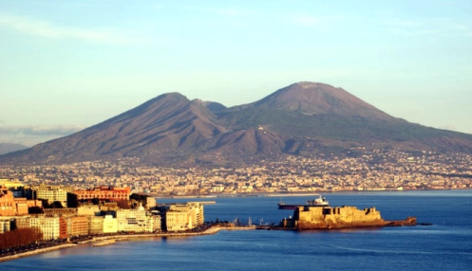
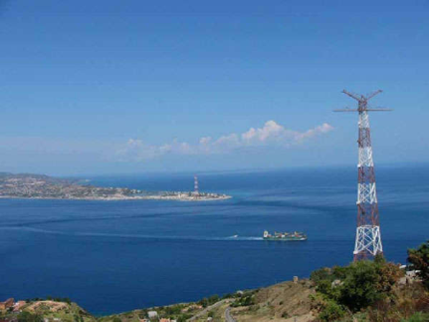
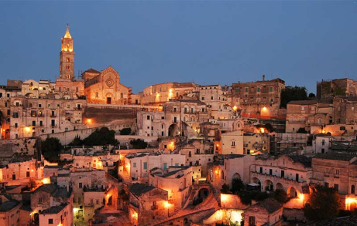
Alpi mountains
Padana’s plane
The eastest part of Italy
Vesuvio
volcano
Matera’s rock
Messina’s strait

Slide 3
And now??
Are you ready to test your knowlidge about italian landscapes?
COMPLETE THIS TEST TO CHECK WHAT YOU HAVE LEARNT
Letizia,Lauren,Mattia,Gianmatteo

