Slide 1
Volunteer firefighters in Hungary

Slide 2
HNFA
= Hungarian National Firefighters Association
1870 – 1945
Main goal
= the advancement of the firefighter movement in Hungary
train firefighters
ratification of firefighting
after WW II. association was suspended by Hungarian Government

Slide 3
HFA
= Hungarian Firefighters Association
Tasks:
promote and improve firefighting in Hungary
build communities
coordinate professional and academic work
build good relationships across borders
Goals:
increase the number of cooperation agreements between carrer fire services and volunteer firefighters
increase the number of independently deployable volunteer fire bridages
upgrade the vehlices
Educate young generations about volunteering and firefighting

Slide 4
Training:
acquire new skills
theoretical and practical training
test their skills
Competitons:
organizing various national and international competitions every year
helps firefighters prepare accordingly

Slide 5
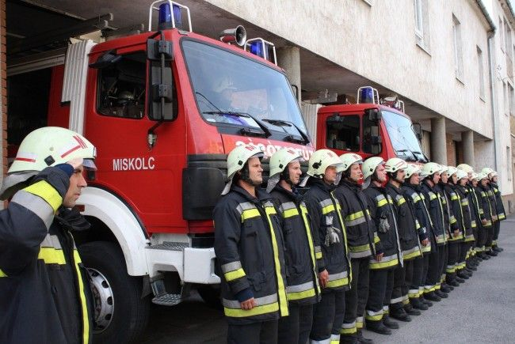
their goal is to protect 3.767 milion people
25 383 total volunteer firefighters

Slide 6
THANK YOU FOR YOUR ATTENTION
ORANGE TEAM

