Slide 1
Legends and myths
Romania

Slide 2
The night of THE SAINT ANDREY
Source: http://www.desprecopii.com
It is the Romanian equivalent of the Halloween night and it is accompanied by many traditions and superstitions. Spirits go out into the world, wolves speak in humans language, and people defend themselves with garlic from spells.
The night of THE SAINT ANDREY is a kind of magical night, when in order to remove the evil there are made various gestures for protection. One of them is that garlic is put on doors, windows, everywhere where evil can enter. The garlic was also seated in the stables for animal protection.

Slide 3
It is also said that on the eve of St. Andrew the strigoes appear.
Girls who want to marry hide under the pillow a basil cord to dream of her future husband.
Source: https://www.europafm.ro

Slide 4
The Olt and the Mures
The Olt was the boy of a king of the Eastern Carpathians. He had a brother, Mureş, and although they looked like two drops of water, the two were extremely different. Thus, while Mures was silent, reserved and closed in itself, the Olt was ambitious, proud and always put on paper. For this reason, the two quarreled and fought at every occasion.

Slide 5
The Olt and the Mures
Over the years, the childish struggles and beatings of the two brothers have become more and more violent. Often the brothers fought between them until they could not rise from the ground or until they were full of blood.
Having missed his brother, the Mures landed up to the Danube, hoping that if he flows into it he will reach his brother and they will be reconciled.

Slide 6
Source: https://adevarul.ro/locale/slatina/de-pornit-fabuloasa-legenda-fratilor-olt-mures-explicatiile-raul-oltul-navalnic-nabadaios-muresul-e-linistit-1_55229927448e03c0fd46c198/index.html

Slide 7
Siutghiol Lake
Instead of Mamaia Lake(Siutghiol), it was a village of very bad people who did not want to receive anyone in their village.
On a holiday day, when all people were at home, a stranger came into their village, asking them to stay for a night. Seeing the traveler that in such a large village there is no welcoming man, he headed to the edge of the village, climbing up a hill where there was a small stone house, a dear woman, received on the traveler. But the woman, being very poor, began to cry that she had nothing to give her to the guest.

Slide 8
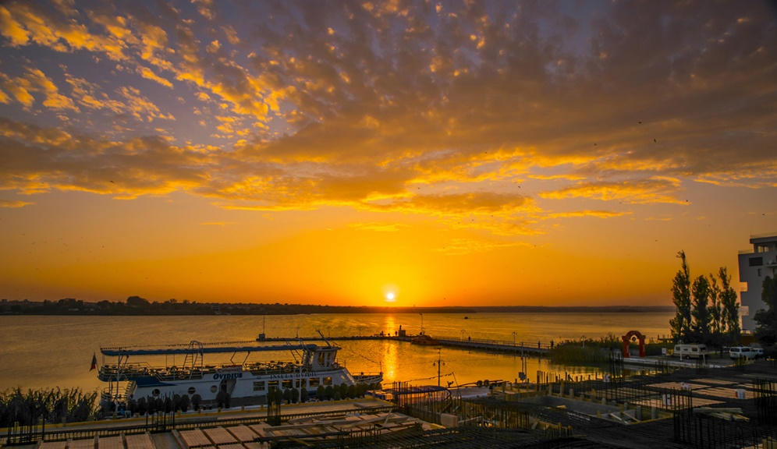
Then the traveler told the widow to put a piece of cold pudding in the stove kiln in the ashes. The woman was amazed that then she could look for ashes to take her mother's milk to serve her guest, and instead she found a large, fluffy bread that made the traveler tired.
Finally, the day after the wonderful guest's departure, the village with the wicked people sinks under water, turning into a deep and deep lake, leaving only a small island with the house of the good woman.
(narrated by old Seit Agi Ali, from Taşaul)
Source: https://imagesoundexpert.blogspot.com

Slide 9
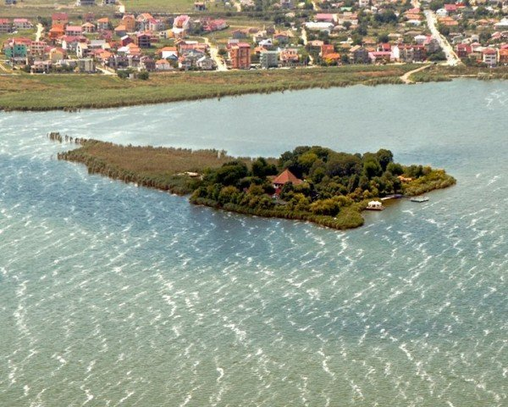
Source: http://blog.icar.ro/wp-content/uploads/2016/07/Insula-Ovidiu-1.jpg

Slide 10
The Tâmpa Mountain
It is said that before time, Bârsa Country was a great sea. And the giants came from the east, and with their great footsteps they traveled from the mountain to the mountain. They had arrived at the Great Stone, but there was no further tram going, for, no matter how big their footsteps were, they did not reach the Fagaras Mountains. So they grabbed hammers and shovels, dug stones and earth, from where the Timis is now, and thrown them to the sea at the place where Tampa is now, when the height of the water rose above it. Tâmpa Mountain was sharp then. The giants took only one step from the Great Stone up here. The first, when he stepped on the sharp tip of Tampa's weight, he bevelled (tâmpit, teșit, netezit) and since then his name was Tâmpa.

Slide 12
The Sphinx
The Sphinx in the Bucegi Mountains is an anthropomorphic megalith located at 2216 m altitude. The origin of the Sphinx name is due to its resemblance to a human head, more precisely to the Egyptian Sphinx, its formation being due to wind erosion (wind). Formed from a large block of stone that has taken shape today in a very long time, the Bucegi Sphinx, located on Bucegi Plateau, measures 8 meters in height and 12 meters in width.
From a historical and even mystical point of view, the Sphinx is "the representation of a supreme divinity from Pelasgian times".

Slide 13
His human aspect is associated with an expression of sovereignty and power, this being evidenced by the proportional face, severe lips and the chin. Pelasgians were before the Greeks, their tribes were spread especially in the Aegean Sea. Its resemblance to a Sphinx (if viewed from certain angles marked around it), as well as the legends and the history of the place, have made this geological formation an important tourist attraction.
During the period 1966-1968, the Peruvian architect Daniel Ruzo had noticed that the Sphinx resembles the main figure of a carved ensemble on a rock on the Marcahuasi Plateau in Peru, called "The Monument of Humankind": "The Sphinx is not just a single face, being surrounded by others, but of different breeds, as well as the head of a dog, who acts as guardian of a treasure in a "cave of the treasure" near Man. "

Slide 14
It is said that this place was an energy center used in the time of aliens, many legends circulating through parts of the place in this sense. In the immediate vicinity of the Sphinx there is a particular cave that would gather special energy mysteries. These mysteries are the attraction of many people passionate about this subject. Other rumors say that there would still be a mine of uranium, abandoned, which is no longer in operation during the Second World War.
In the mountains of Romania there are also other megaliths bearing the names of the Sphinx: the Sphinx from Stănişoara, the Sphinx from Piatra Arsă, the Sphinx of the Lainic, the Sphinx of the Bratocei, the Bănăţean Sphinx, also known as the "Toplet Sphinx", the Sphinx from the Stones of Solomon , The Sphinx of the Gutâiului Mountains.

Slide 15
Source: http://www.turistderomania.ro/tdruplfiles/sfinxul-din-bucegi.jpg

