Slide 1


“An outline of history of local and regional architecture”
IIS DELLA CORTE-VANVITELLI
Cava de’ Tirreni
“GREEN ALLIANCE”
School year : 2018-2020

Slide 2
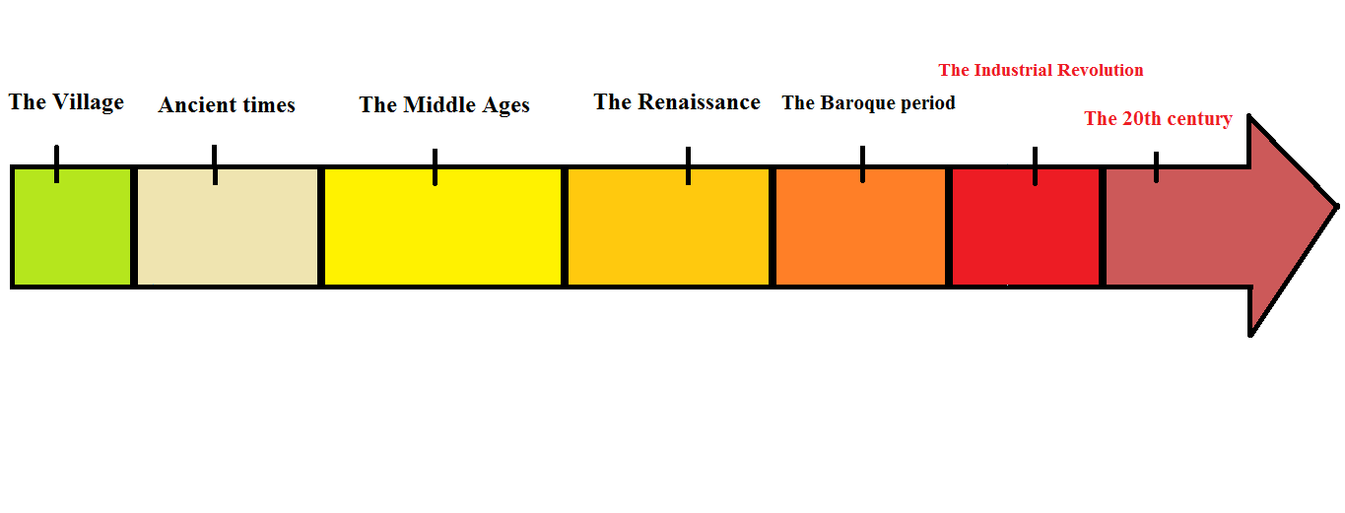
From the early settlements to the present day…

Slide 3
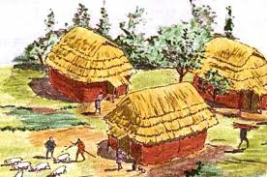
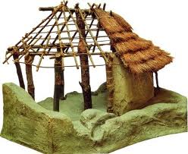
The village.
Between 8,000-10,000 years ago, the systematic cultivation of plants and domestication of animals made settlements as stable as possible, so were born the villages.
The original inhabitants of Campania were three defined groups of the Ancient peoples of Italy, who all spoke the Oscan language which is part of the Italic family; their names were the Osci, the Aurunci and the Ausones

Slide 4
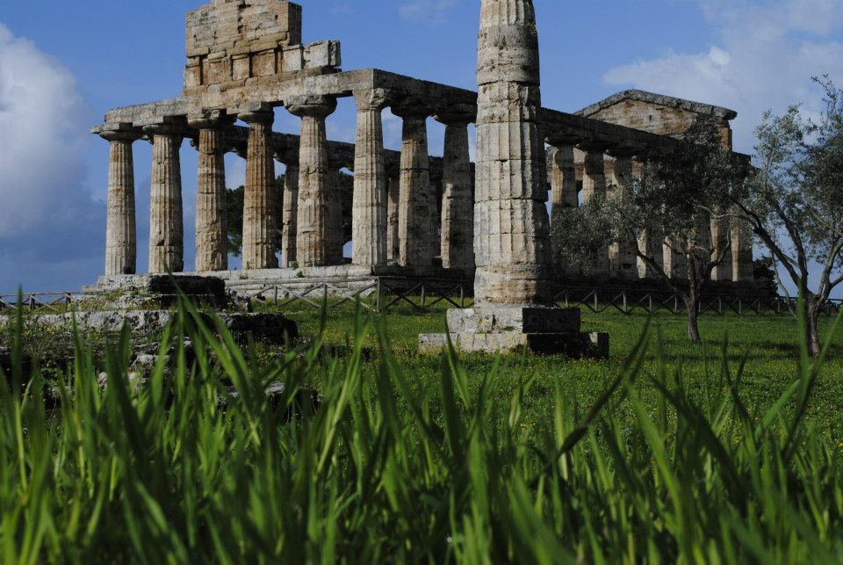
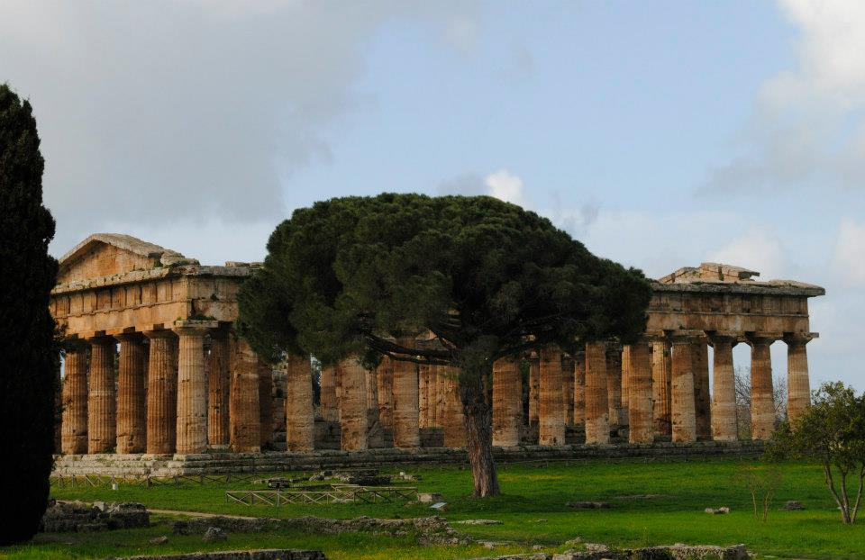
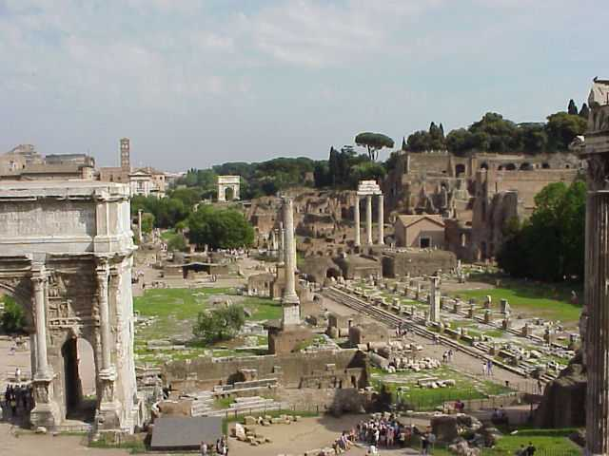
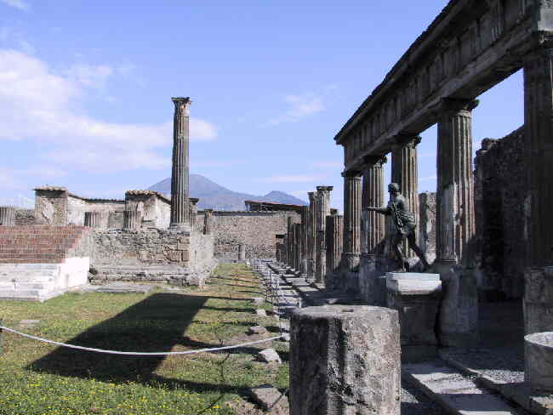
Ancient Times.
Paestum
In the past, city dwellers reserved certain areas for meeting, recreation, trade and worship. Athens and Rome were the great examples of this kind of urban organization.
THE AGORA
and
THE FORUM
Pompei and Ercolano

Slide 5
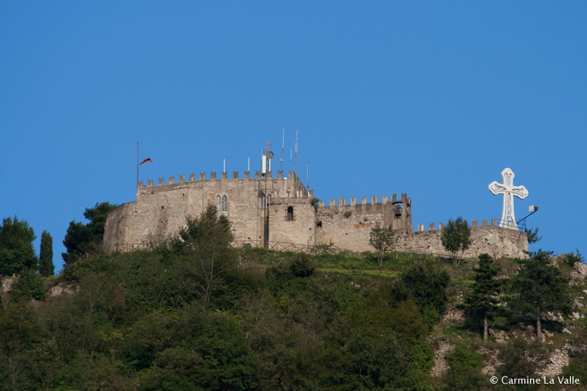
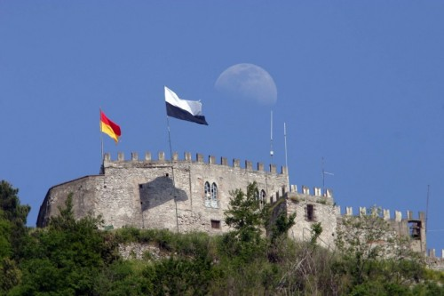
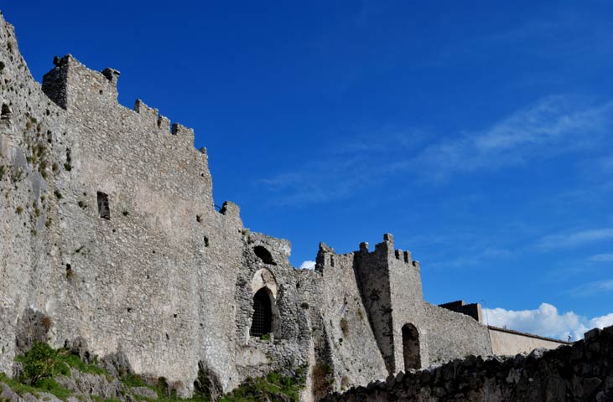
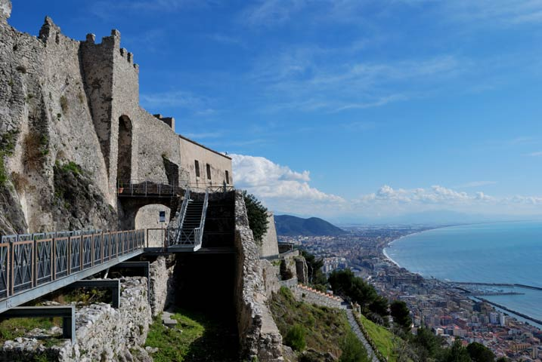
The Middle Ages.
In the Middle Ages, thick walls were built around the city. They provided protection to the city inhabitants and to rural people but with the population growth the walls were knocked down
Cava de’ Tirreni
Salerno

Slide 6
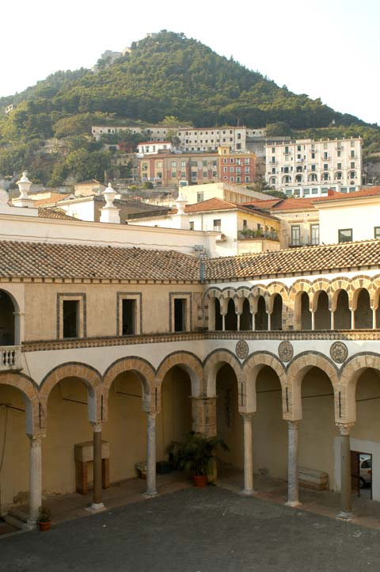
Salerno Cathedral
Salerno Cathedral (Duomo di Salerno) is a historic eleventh century cathedral which was built upon the ruins of a ninth century Christian church and, beneath that, a former Roman temple.

Slide 7
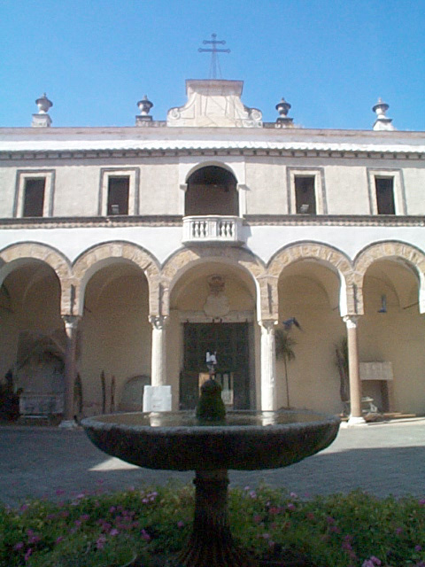
It was constructed in 1080 and its founder, Robert Guiscard, dedicated it to San Matteo, known as Saint Matthew the Evangelist. Guiscard, who was a Norman duke of Apulia and Calabria who had recently taken over southern Italy, probably knew that this dedication would be a popular move, as San Matteo’s relics had recently been transferred to Salerno. In fact, the remains of this evangelist saint are still contained in the cathedral’s crypt.

Slide 8
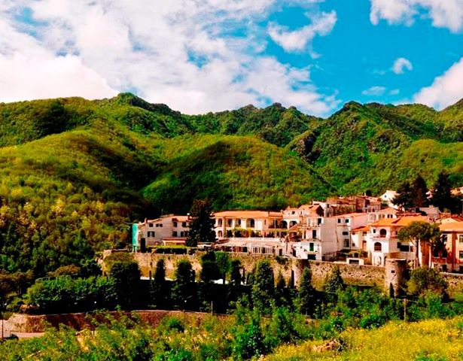
The Benedectine Abbey
Cava de’ Tirreni
In 1011 the Benedectine Abbey of Holy Trinity was founded.
The Abbé Peter I (1079-1123) founded and built in the 11th cent. just beside the Benedectine Coenobium ,the hamlet of Corpo di Cava guarded by high walls and bastions; as a matter of fact, this is the first modern settling of the town of Cava .

Slide 9
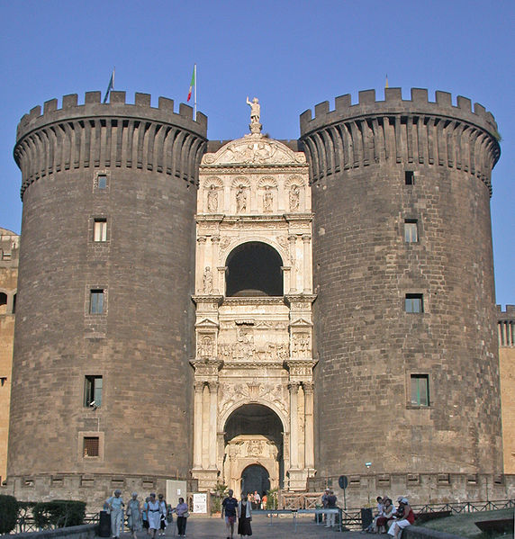
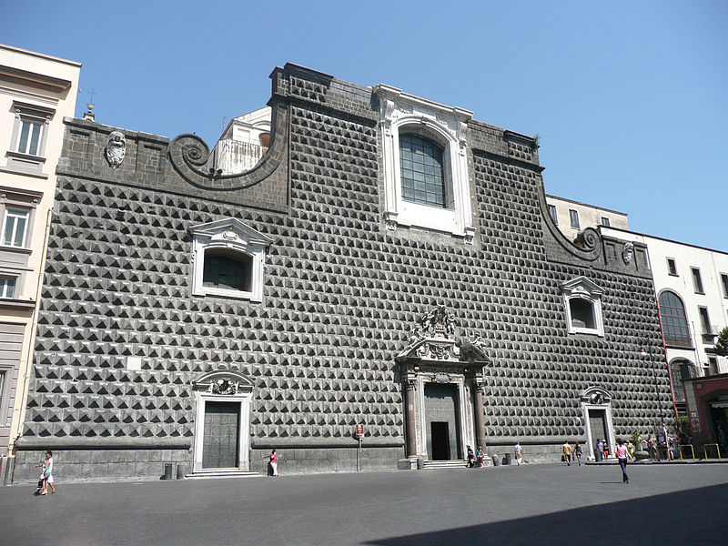
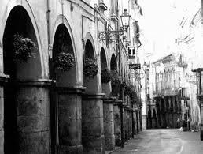
The Renaissance.
During the Renaissance, city planners designed parts of cities on a grand scale. Many artists were involved in works to beautify cities.
Napoli
Cava de’ Tirreni

Slide 10
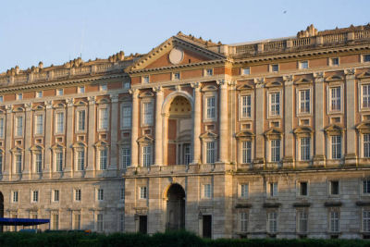
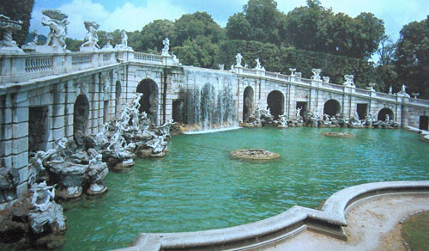
The Baroque Period.
The Baroque city is closely linked to the appearance of great nation-states, when ambitious monarchs constructed new palaces and courts, but also long avenues, radial street networks, monumental squares, geometric parks and gardens.
Caserta

Slide 11
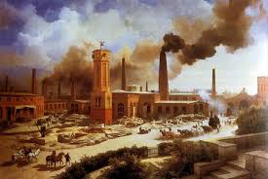
Industrial revolution…
The first Industrial Revolution concerns the English textile industry and metallurgy and is preceded by the agricultural revolution. The second Industrial Revolution in England will take place around 1850.
The term “Industrial Revolution" refers to the sudden development process of technology applied to industrial production that began in
England since the
mid-eighteenth century.
In particular, the main aspects are:
Technological innovations
The transport network
The transformation of the city

Slide 12
… The major changes …
The first significant change is the 'INCREASE OF POPULATION due to the decrease of the coefficient of mortality.

Slide 13
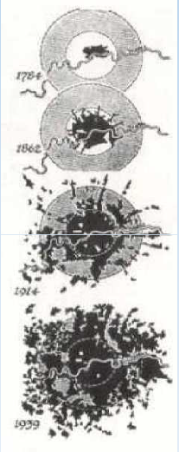
… EXPANSION OF THE CITY …
The intense process of urbanization was a direct result of industrial development that required large concentrations of labor and consumer markets for their goods. Huge masses of peasants were transformed into urban proletariat, increasing the size of the city.

Slide 14
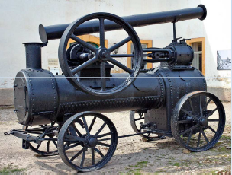
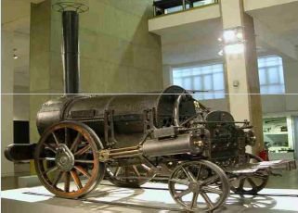
… The transport network …
the exigencies of trade, especially the need for transport of goods, caused the development of the transport network.
In Italy the first railway is the Naples - Portici (40 km), which was opened on October 3, 1839 and was carried out by Ferdinand II of Bourbon from a French joint stock company.
The first two locomotives arrived from England. It was the sister of Bayard and Vesuvio who designed the prototype of Stephenson

Slide 15
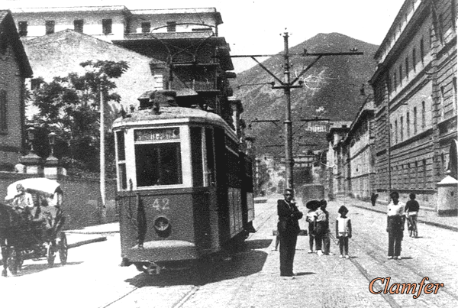
The Train Station and the Tramway
Cava de’ Tirreni
A train station and also an electric tramway that connected it to Salerno were built in Cava in this period.
The railway station was ordered by King Ferdinand II in 1848 to reach Naples in a easily way. As a matter of fact the King inaugurated the railway station on Aprile 1st 1857.
The works were given to Bayard de la Vingtrie company.

Slide 16
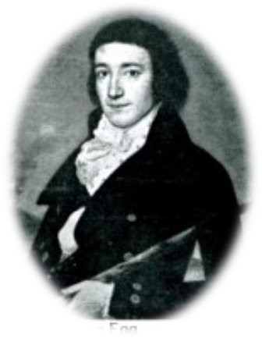
… Industrialization arrives in Italy…
In Italy, the industrial revolution began in the late 1800s and early 1900s, two centuries later compared to what happened in England.
The entrepreneur Giovan Giacomo Egg
Inside of textile mill
In the last decades of the eighteenth century, the first Swiss mercenaries landed in southern Italy and Sicily. Among them, the entrepreneur Giovan Giacomo Egg, who once arrived in Italy, decided to found the first Italian cotton mill near Caserta.
Thanks to the opening of the cotton mill more than two hundred jobs were assigned, including workers and officials.
Another enterpreneur that landed in Italy was Federico Alberto Wenner who founded the Agro Nocerino Sarnese cotonificio
"the Southern Manufacturing Cotoniere."

Slide 17
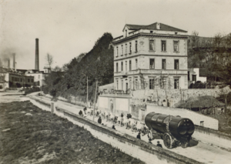
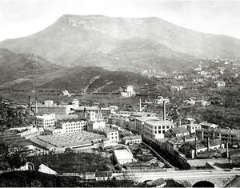
… Southern Manufacturing Cotoniere …
During the reign of Joachim Murat (1808-1815) some Swiss families started the textile industry in the Agro Nocerino Sarnese
In 1835 the area of the river Irno had therefore already a certain concentration of textile industry.
Federico Alberto Wenner, a Swiss industrialist, who arrived in Salerno in 1829, founded with his fellow countrymen the textile industries of Fratte of Salerno.
In 1918, the plants are nationalized, with the name of Southern Manufactures Cotoniere spa, which in the meantime had passed to his son Roberto Wenner.
Establishments Manufactures of Southern Cotoniere (MCM) of Fratte of Salerno.

Slide 18
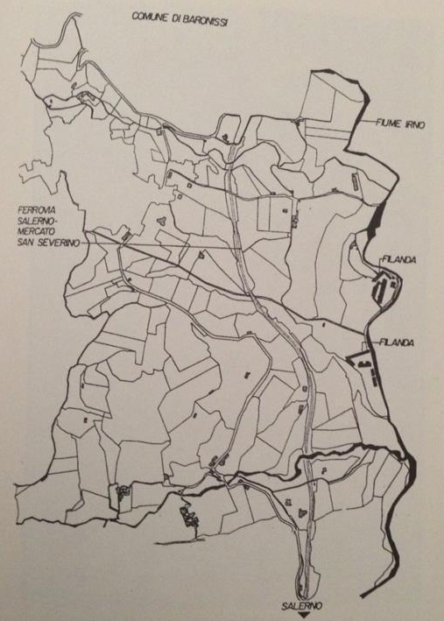
INDUSTRIAL SETTLMENTS IN SALERNO

Slide 19
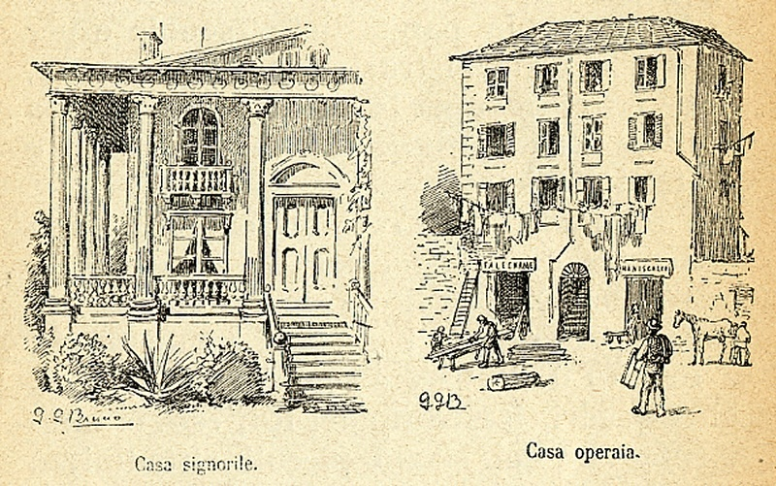
…..Evolution of the dwelling….
With the industrial revolution dwellings changed. The various social classes,
rich, bourgeois and workers , could afford new forms of accommodation:
- The rich people lived in more secluded villas or cottages
(elegant detached houses)
- The poor people lived in less secluded dwellings
(terraced houses or multi-storey buildings)
The quality of poor housing deteriorated to the tolerable limit for the lowest-paid workers:
Comparison between a rich and a poor house

Slide 20
… the workers' housing: plants …
The plan refers to some workers’ homes of the late nineteenth century in Portapia district in Rome. The picture shows the plant design of the apartments which have a medium-small dimension equipped with all the necessary sanitary facilities.

Slide 21
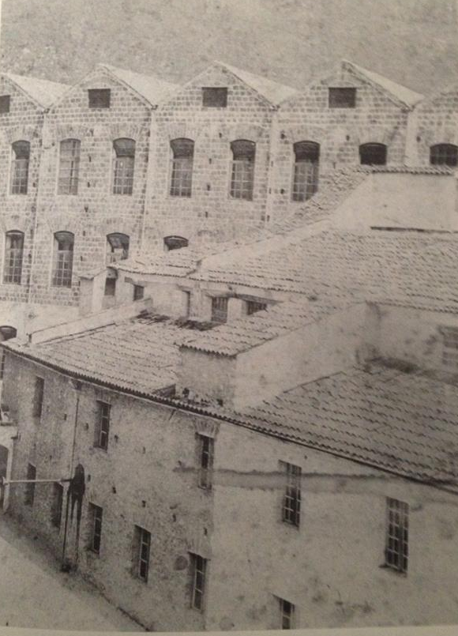
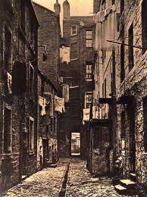
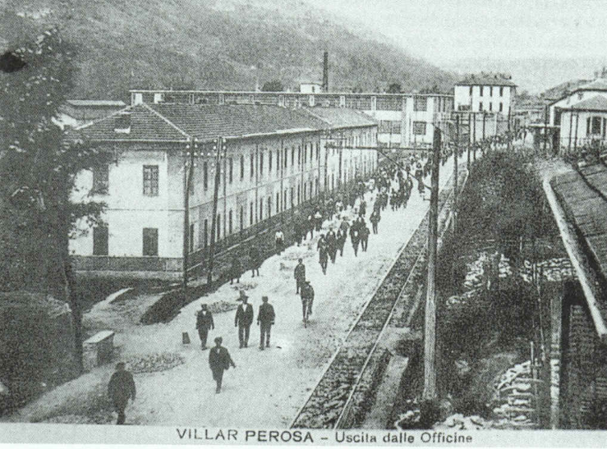
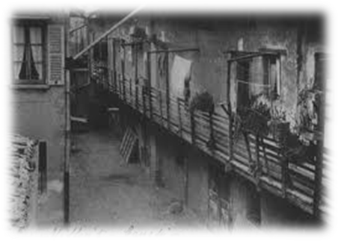
… home working ….
Workers' houses in unsanitary conditions

Slide 22
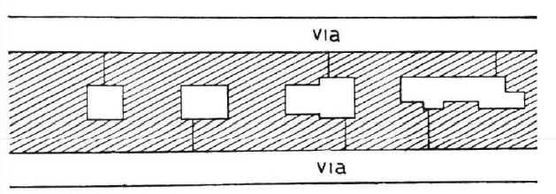
… TYPES OF COURTS …
all houses are gathered in the courtyards
the courtyards of the new houses are fairly regular and
there is not sufficient air.

Slide 23
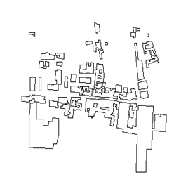
… Cartography of NocerA Superiore …
TYPE OF BUILDINGS
Example of open courtyard
Example of enclosed courtyard
Example of alleys

Slide 24
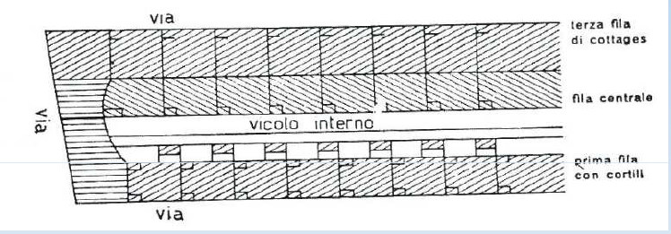

… example of alleys…
Houses at the 1st row have a back door and a small backyard
At the 2 nd row houses have a wall in common with the 3rd row,
So they are characterized by a poor ventilation

Slide 25
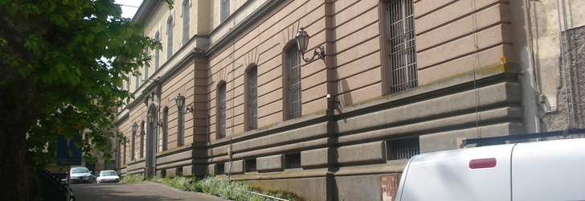
THE CAVA DE' TIRRENI FACTORY
OF SIGARO TOSCANO
Tobacco production in Cava de’ Tirreni runs back a long way into history. According to tradition, the earliest tobacco cultivations, in Campania, were planned by Gioacchino Murat in the days of the Kingdom of Naples. From 1912, Cava de’ Tirreni has been one of the principal locations manufacturing the famous Italian cigar.

Slide 26
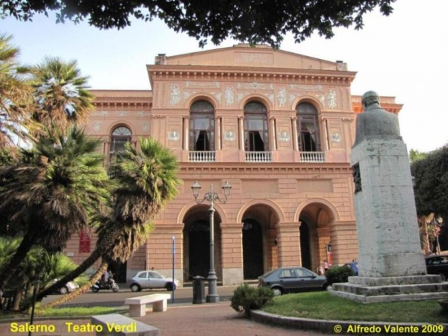
IMPORTANT PUBLIC BUILDINGS
The Theatre in Salerno
The Giuseppe Verdi Municipal Theatre has got a wooden structure.

Slide 27
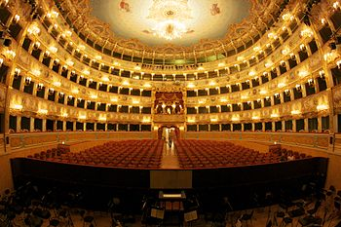
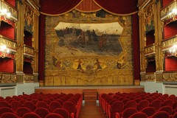
The building was decided by the Town Council of Salerno on December 14, 1863, on proposal of the then mayor Matteo Luciani
The plan and work management were entrusted to the architects Antonio
D' Amora and Giuseppe Manichini who based themselves on the measurement and proportions of the San Carlo Theatre of Naples..
The Theatre was inaugurated on April 15, 1872 with the performance of Rigoletto; on March 27, 1901 the Theatre was dedicated to Giuseppe Verdi

Slide 28
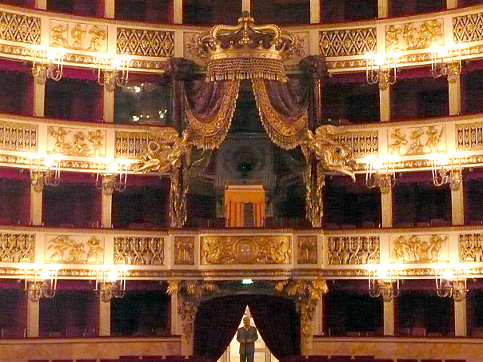
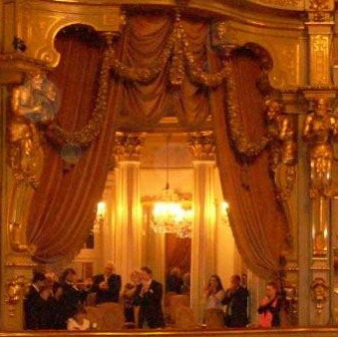
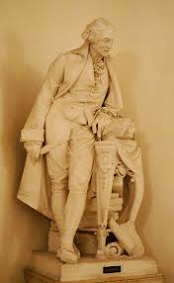
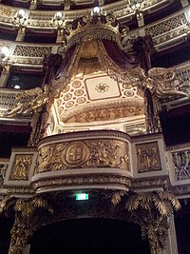
The decoration work was, directed by Gaetano D' Agostino, gifted painter who was supported by the most prestigious names of the Neapolitan artistic world..

Slide 29
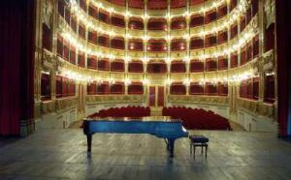
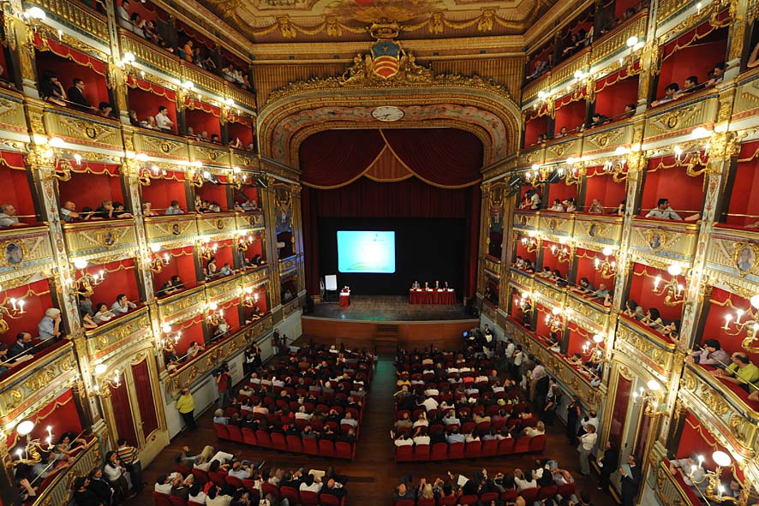
At the entry there is a statue "Pergolesi morente" by the sculptor Giovanni Battista Amendola

Slide 30
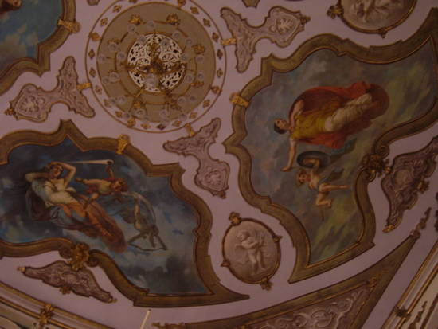
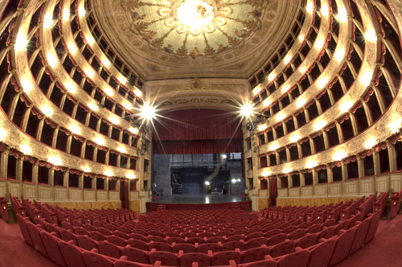
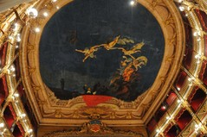
The ceiling is particularly interesting with paintings by Pasquale Criscito

Slide 31
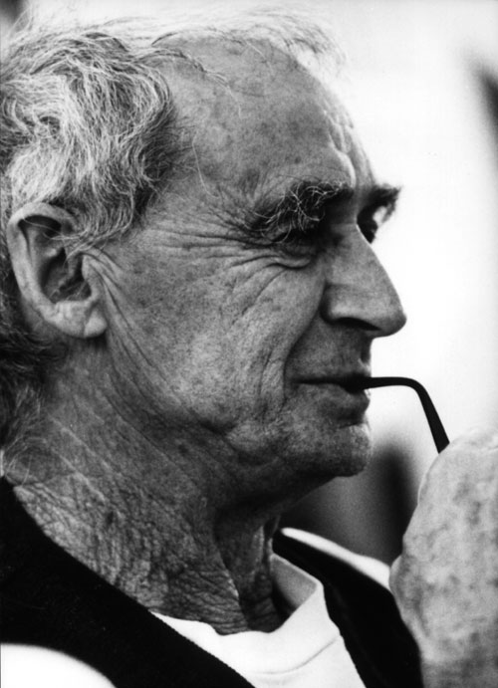
Artistic ceramic factory in Vietri sul Mare
In 1953 Soleri designed his first major building, the Ceramica Artistica Solimene ceramics factory and studio at Vietri sul Mare on the Amalfi coast of southern Italy.

Slide 32


It had five storeys of workshops wrapped in a continuous spiral ramp around a great skylight hall filled with angular concrete supports. Perched on a cliff overlooking the
Mediterranean and faced with glazed pots, the building relied on locally available materials, handcraft and a dramatic structure.

Slide 33

The pasta factory “Ferro”
The first signs of the industrial revolution also occur in
Cava, which from a purely agricultural village turns into a small industrial area. Among the best industrial activity of the pasta stands the mill, feed mill and pasta factory "Marcantonio Iron & Sons.
" The majestic factory, which is spread over three floors in Corso Mazzini, occupied many workers. It was capable of producing more than 114 types of pasta and it was known even in the United States for the production and supply of pasta, flour, semolina and feed of fine quality . In the early life of the 900, and precisely on December 31, 1969 the historic company closed its doors . On the ground floor there was a mill, consisting of the mill room, dining room purifiers and sifters, the latter referring to the selection of the ground. The pasta was made from the engine room, galleries drainage and drying bins.
This virtual reconstruction was made possible thanks to Antonio Auriemma , one of the 170 employees of the historic
"Marcantonio Ferro & Sons."

Slide 34

Liceo Classico Giambattista Vico
NOCERA INFERIORE
During the fascist period a new school was built in Nocera Superiore . The imposing building was constructed in a “M” shape to please the Dictator Mussolini.

Slide 35


THE 20 th CENTURY ARCHITECTURE.
OUR PROVINCE
SALERNO
The post-war period was difficult for all Italian cities, but Salerno managed to improve little by little becoming a modern European city. In recent years the town administration has taken great strides giving impulse to the revaluation of the whole urban territory.

Slide 36

In the last two decades, Salerno has become one of the most important cities in the world for its contemporary architecture designed by archistars such as Zaha Hadid (maritime terminal), Ricardo Bofill (Liberty Square and Crescent), Santiago Calatrava (Marina d'Arechi Port Village), David Chipperfield (judiciary citadel).
(Marina d'Arechi Port Village),

Slide 37

The New Salerno Ferry Terminal
The New Salerno Ferry Terminal will forge an innovative, intimate relationship between the City and the Waterfront. Like an oyster, the building has a hard shell that encloses soft, fluid elements within. A ‘nerved’ roof acts as an extended protection against the intense Mediterranean sun. When passengers arrive at the Terminal, their drifting begins in dynamic spaces organized around focal points such as the restaurant and the waiting room. The project for the new ferry terminal is the result of an international competition which was won by the English architect Zaha Hadid in 1999. It is under construction.

Slide 38

The architect Ricardo Bofill presented the plastic model of the new Piazza della Libertà on 18 th March 2009.
The project includes an underground parking area , a semi circular large open area, a sea front walk , a covered area for events and venues with shops , bars and restaurants,.
Piazza della Libertà is intended to become one of the new symbols of Salerno.
THE NEW PIAZZA DELLA LIBERTA’
SALERNO

Slide 39
IIS DELLA CORTE-VANVITELLI
eTwinning Group
Coordinator: Mrs Gianna Barrella
HEADMISTRESS:Franca Masi
THANKS FOR YOUR ATTENTION

