Slide 1
Diseño del título
Subtítulo

Slide 3
Education In Andalusia.
Education is a vital element in the development of citizens’ awareness and the promotion of a democratic culture which fundamental values are based on coexistence and social participation.
It is therefore essential to achieve the integration of everyone into the Educational System, wherever they were born, in Andalusia or in any other part of the world.

Slide 4
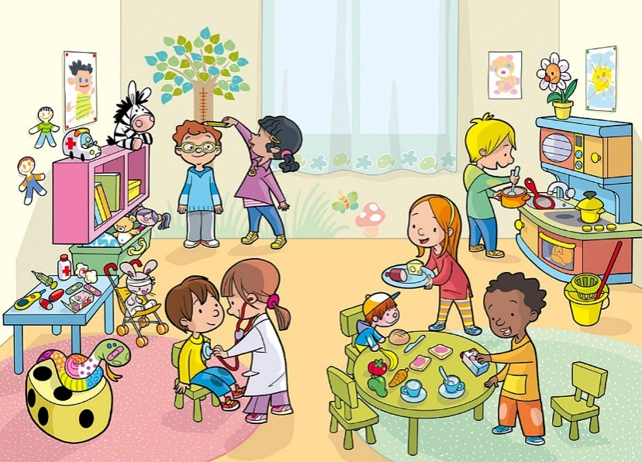
Types Of Education I
In Spain we have 3 stages of compulsory education:
Infant, Primary and Secondary Education.
Education is free in public schools in Andalusia.
THE 3 STAGES
1.Nursery. Kids attend to lessons when they are three to six years of age. It is voluntary, although it is recommendable for their development.

Slide 5
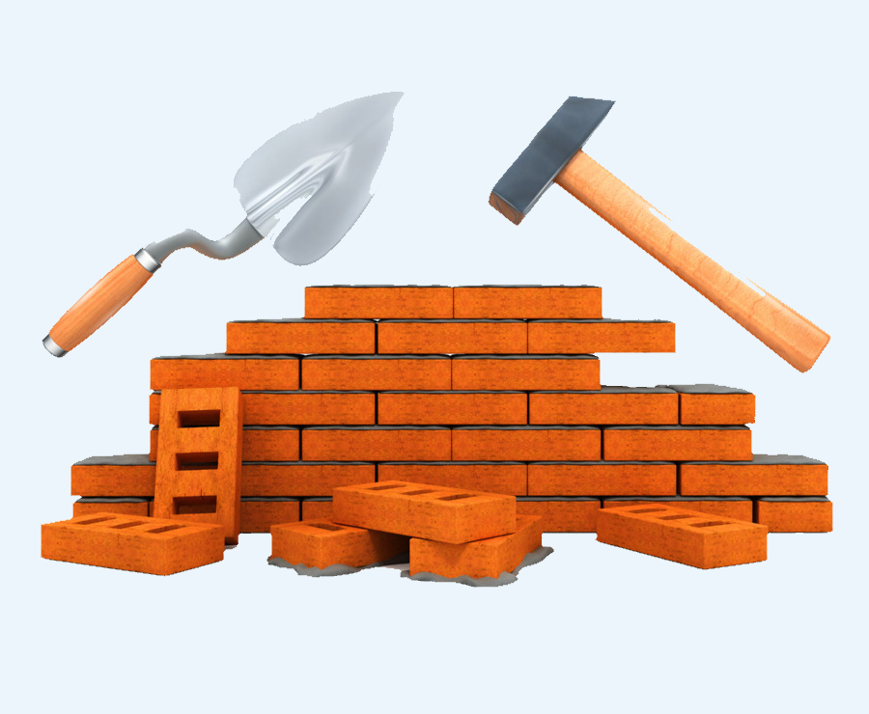
Types Of Education: Obligatory Education
2. Primary Education: Students begin when they are 6 and finish are 12 years old.
To guarantee students a comprehensive education and prepare for Secondary Education our system concentrates on learning strategies:
Reading and writing
Calculating.
Culture.
Good habits
Creativity

Slide 6
Infant
Primary
Secondary

Slide 7
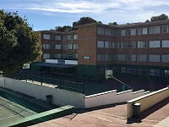
SECONDARY EDUCATION
Secondary: Consists of four academic years, usually between the ages of 12 and 16 years. Pupils who successfully complete this stage are awarded the Certificate in Obligatory Secondary Education. This qualification allows them to enter the Baccalaureate, Middle Grade Professional Training or to leave school and begin work.

Slide 8
SECONDARY EDUCATION
Middle Grade Professional Training, from 16 to 18 years. The aim is to prepare pupils to enter a specific profession. Pupils who successfully complete their Middle Grade Professional Training receive the qualification of Technician .
Our educational system also offers professional skills courses to students over 16 who have not obtained the Certificate in Compulsory Secondary Education. These programmes train young people for going to work.

Slide 9
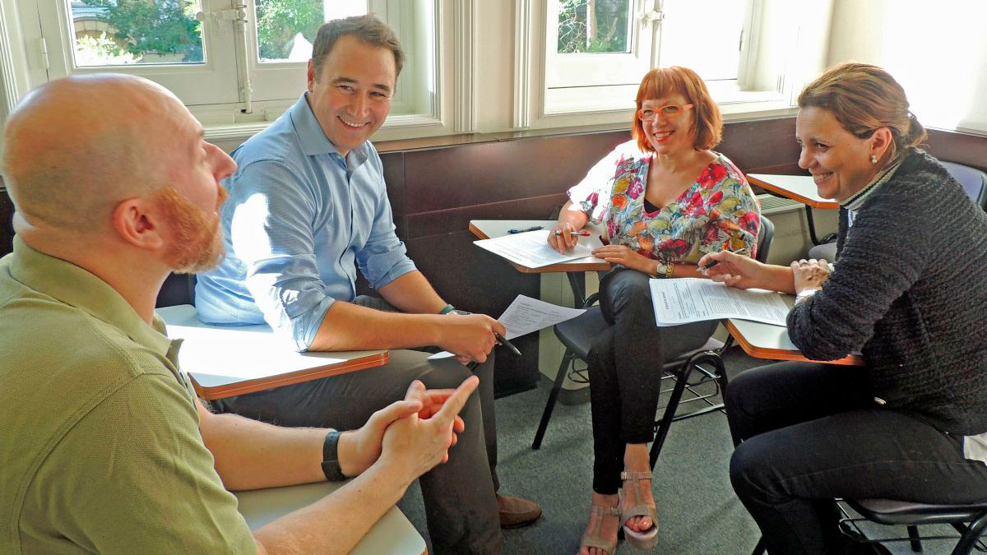
Adult Education
There are Permanent Education Centres in many towns in Andalusia, providing Basic Training for adults, Secondary Education and Baccalaureate. Classes are in the evenings.

Slide 10
Life In School
We have daily classes from Monday to Friday.
We have 5 or 6 hours of classes. In general, most centres have a morning timetable.
Attendance is obligatory. Parents must justify any absence of their children.
All schools have Organisation and Regulations which organize pupils’ behaviour and possible corrective measures.

Slide 11
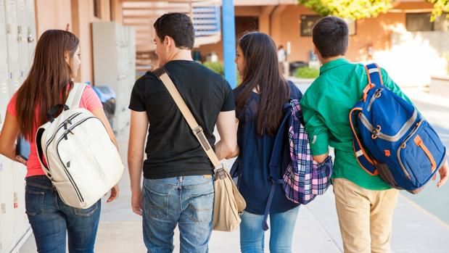
School calendar
. For a new student, who comes out of usual schooltime, families must contact the school and, if there are vacancies, enroll.
School year begins in September and ends in June. We have 168 days of classes per year.
There are three holiday periods:
Christmas: from late December to early January.
Easter: in Spring (March or April).
Summer: from late June until mid-September.

Slide 12
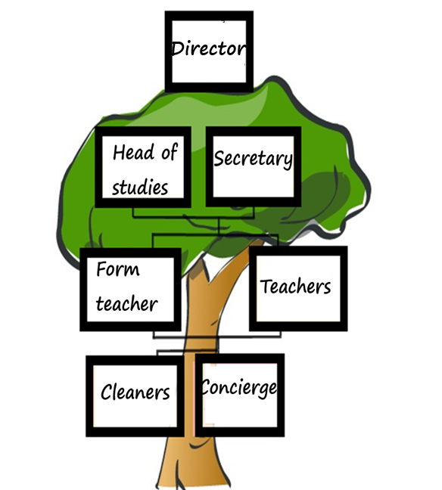
Schools ´ Organisation
Schools are organised and run by the School Management Team which is formed by the Director, the Head of Studies and the Secretary.
Classes have a special Tutor who is responsible for students, contact with families and student´s progress. They hold meetings regularly and every term, prepare a report with the results.

Slide 13
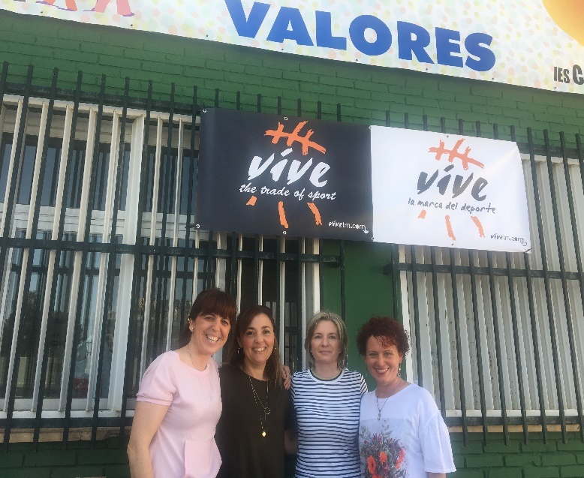
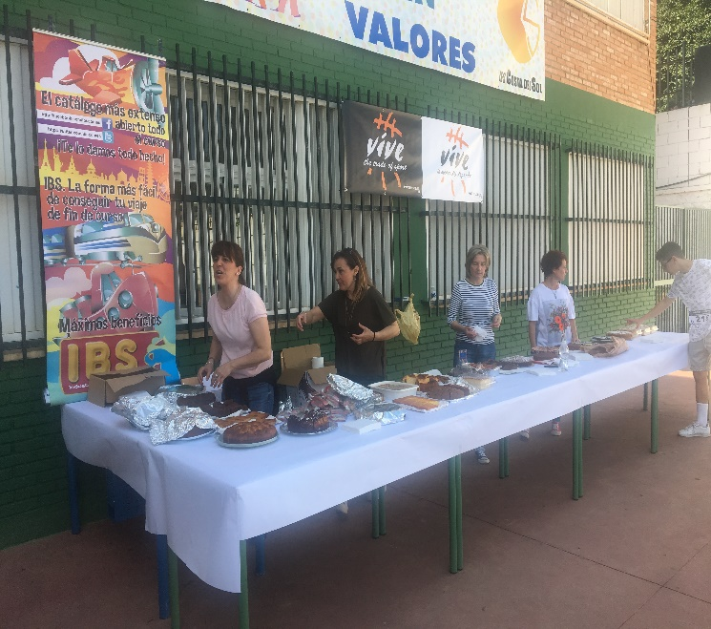
Participation Of Families in School Life
Parents’ Association: Parents participate in school life through their associations. They attend classroom meetings, collaborate in the elaboration of the school´s educational project. They encourage and take part in extra-curricular activities, excursions, talks, etc.

Slide 14
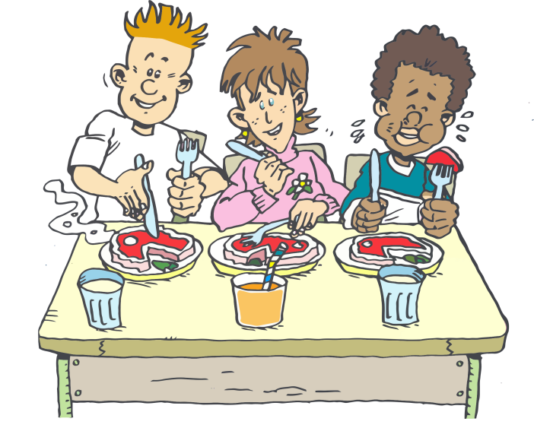
Complementary Services
Spanish schools have:
Transport service for pupils in Obligatory Education
Early morning classroom. It starts at 7.30 a.m. until lessons begin.
School canteens offer pupils healthy meals without leaving school.
extra-curricular activities, outside class hours:
back-up lessons, sport, music, art, etc.
Every single activity in the Open School Plan is free of charge or subsidised.

Slide 15
School Grants and books
In Primary Education and Obligatory Secondary Education textbooks are free
Our Ministry of Education has established Study Grants and Aid to guarantee access for all students in obligatory education

Slide 16
Specific Attention For Inmigrant Pupils
The Andalusian Educational System has Spanish language and culture teachers and a welcome programme for immigrant pupils. There is also a programme for the conservation of their native language and culture.
Town Councils have a Social Service department which offers specific programmes for the foreign population.

Slide 17
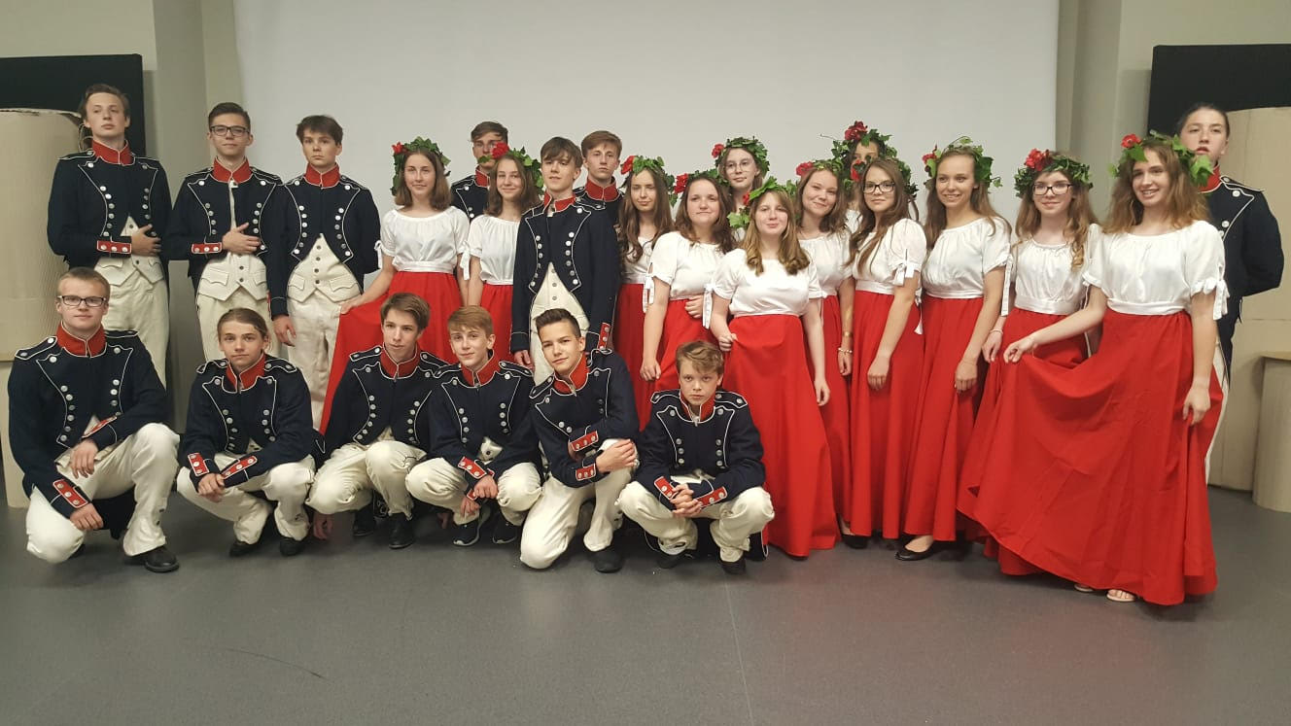
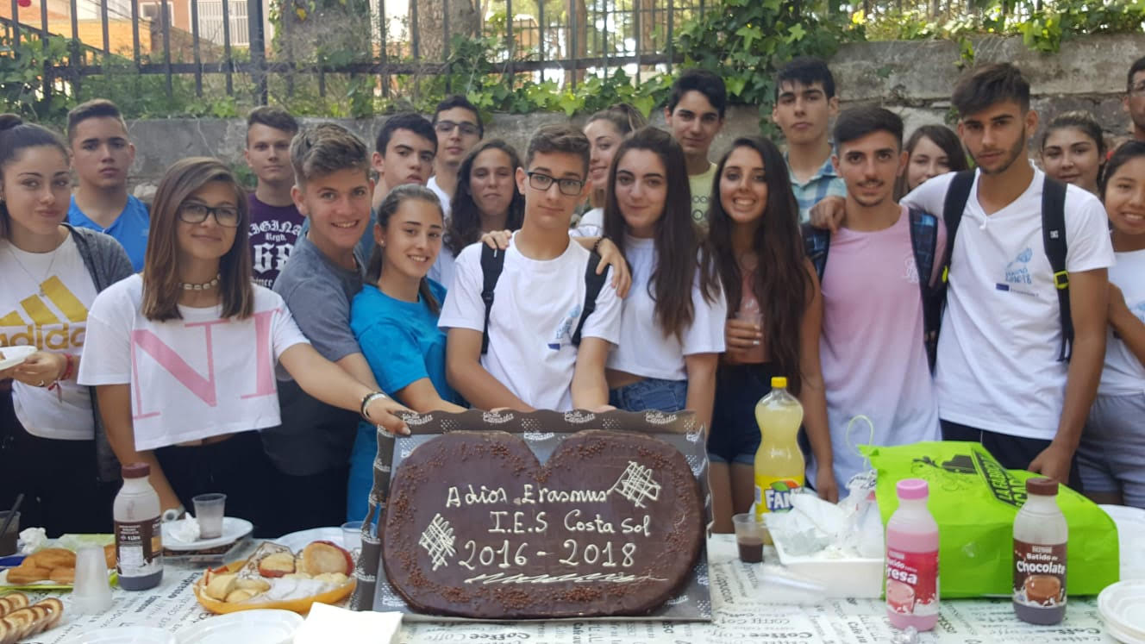
Erasmus+ programmes
Our school has many educational programmes: Schools of Peace, Profundiza and Erasmus+

Slide 18
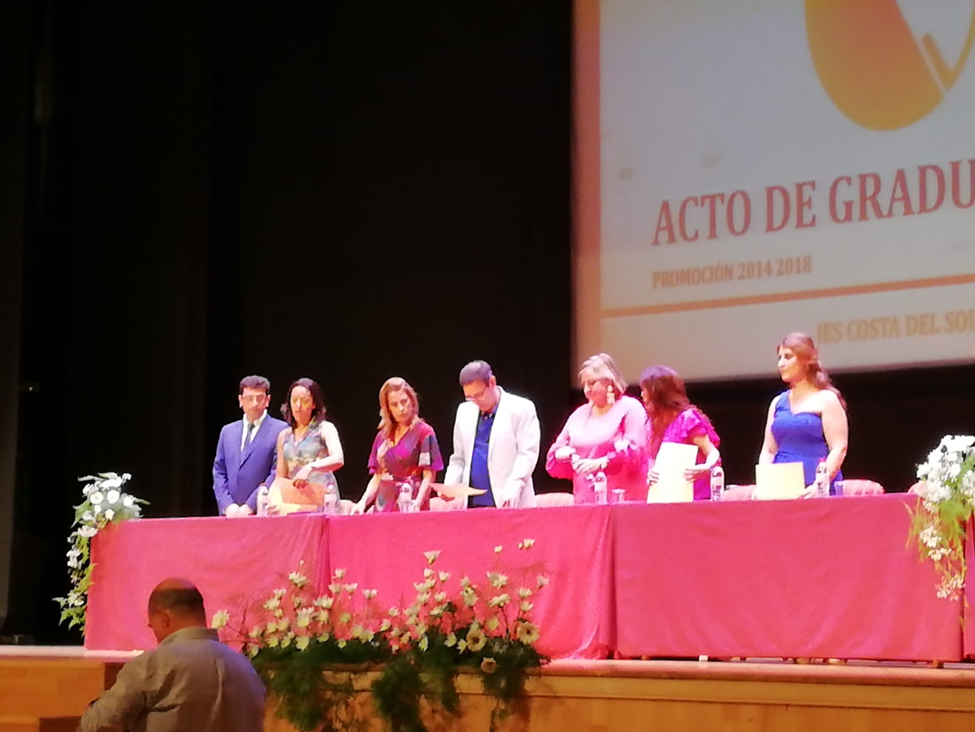
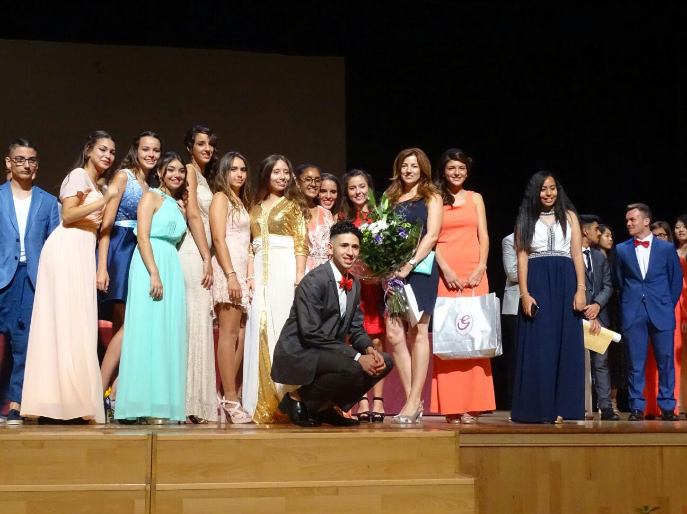
Our Moment!! We are graduates!!

