Slide 1
Floods

Slide 2
Floods

Slide 3
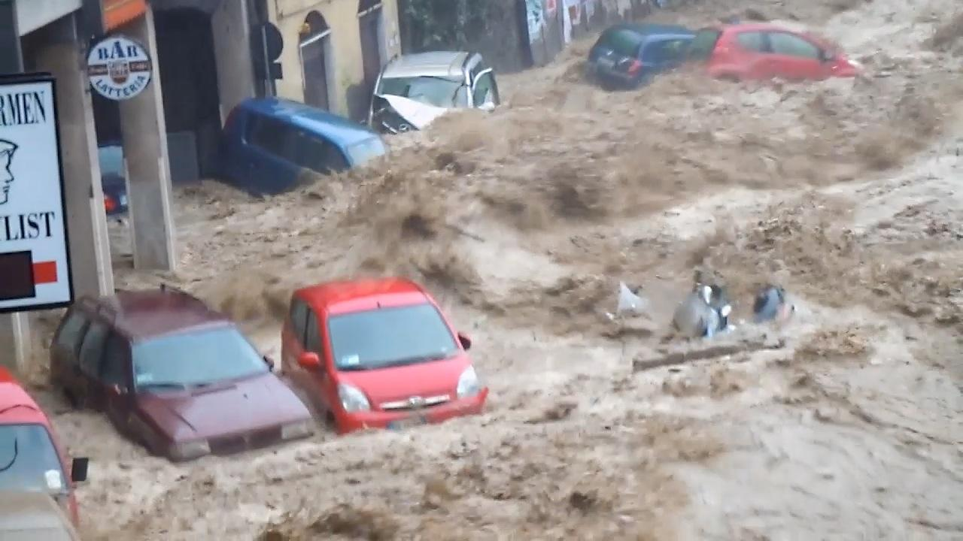
FLOOD IN GENOA 2014

Slide 4
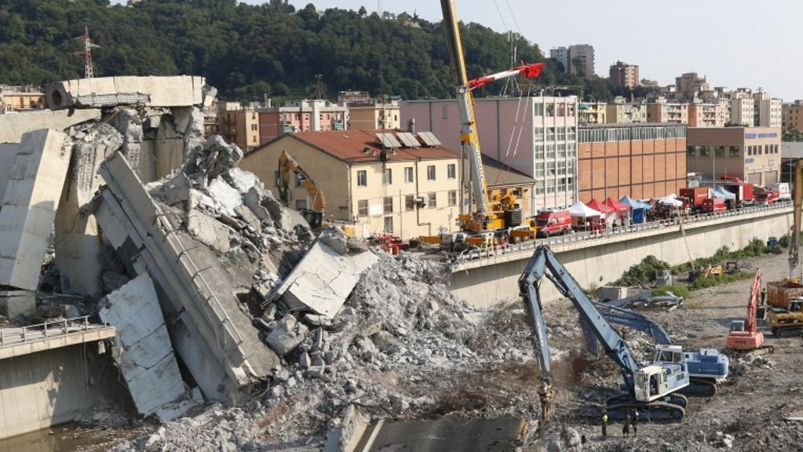
COLLAPSE OF THE MORANDI BRIDGE GENOA 2018
Caused by poor prevention,lack of environmental policies and bad mantainance

Slide 5
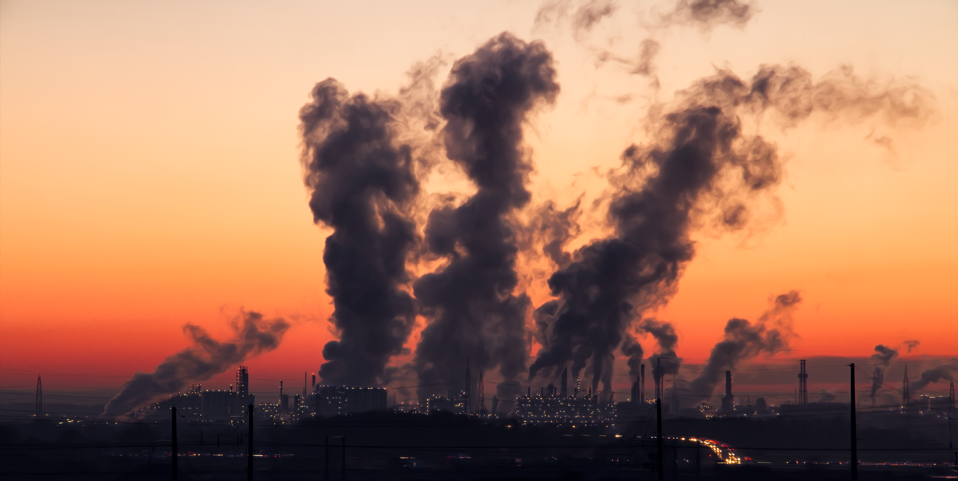
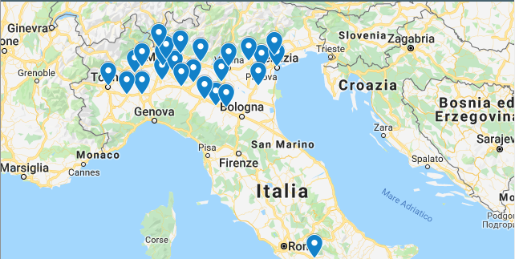
AIR POLLUTION
Air pollution occurs when harmful or excessive quantities of substances including gases, particles, and biological molecules are introduced into Earth's atmosphere.

Slide 6
WHAT ARE FINE PARTICLES?
Fine particles are nothing else but fine dusts, which means solid particles in the air smaller than 15 µm (mikroˈmɛːtro/)

Slide 7
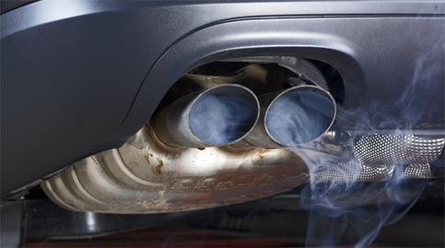
HOW DO FINE PARTICLES ARISE?
Fine particles arise from natural and anthropogenic (human) manners.
Human fine particles producers are: industry, private households and little small consumers, traffic, rail transport, electric and district heating plant, transportation, bulk handling and industrial brands.

Slide 8
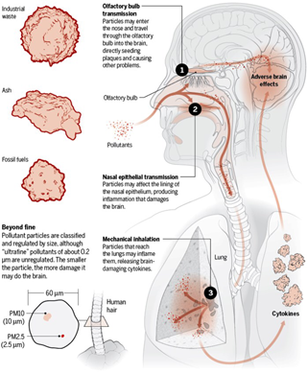
WHY ARE FINE PARTICLES SO DANGEROUS?
For people from all over the European Union, life expectancy can be reduced by an average of one year due to the entire pollution of fine particles.
The risks due to fine particles include increased allergic symptoms, asthma, airway disorders and lung cancer, as well as a great risk of inflammation of the mid-range for children.

Slide 9
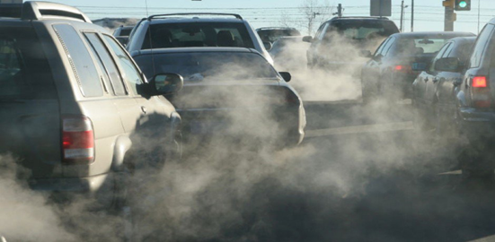
FINE PARTICLES AND POLLUTANTS. ORIGIN AND IMPACT
Several studies have been conducted and published in Germany identifying fine particles as a source of asthma and respiratory diseases.
This is due to the very small size of the particles which go into the pulmonary alveoli and can thus also be responsible for cardiovascular diseases.

Slide 10
AIR QUALITY INDEX IN OUR AREA
The Air Quality Index, is a parameter that on a daily scale synthetically represents the level of atmospheric pollution and allows an immediate communication on the level of risk for the population.
Each air quality index value is assigned a color and a judgment on the state of air quality.
Key | Excellent | Good | Discrete | Mediocre | Poor | Very Poor | Awful

Slide 11
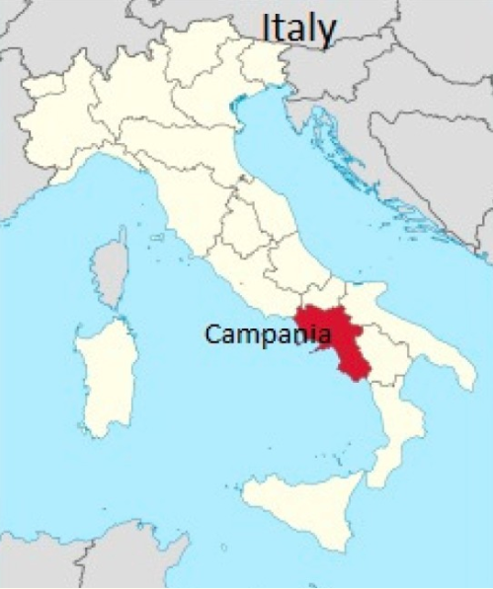
POLLUTION PROBLEMS IN CAMPANIA REGION

Slide 12
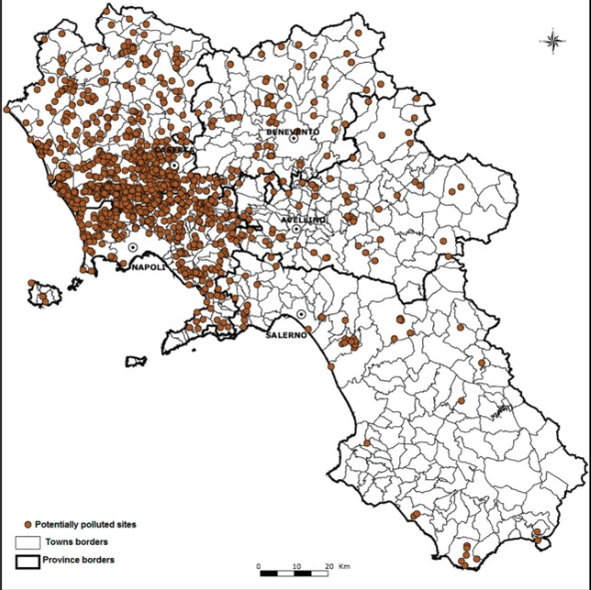
SOIL POLLUTION IN OUR REGION
The area of Naples and Campania region, in Italy, are experiencing the dramatic consequences of diffuse and illegal waste dumping. This area has been referred to as the “Land of Fires” because of the common practice of waste burning.

Slide 13
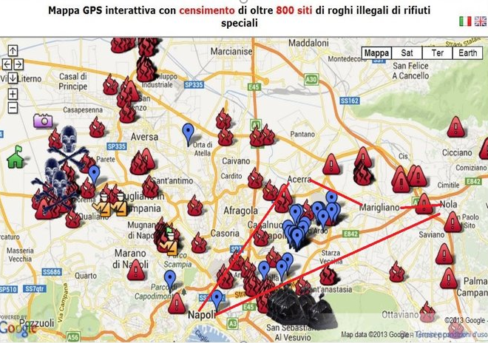
ILLEGAL WASTE BURNING IN CAMPANIA REGION
NEGATIVE CONSEQUENCES.
A study highlighted an increase in mortality rate, due to malignancies in a specific area with 250,000 inhabitants in the province of Naples, the capital city of the Campania region, including the towns of Nola, Marigliano and Acerra, which was identified by the authors, as a “triangle of death”.

Slide 14
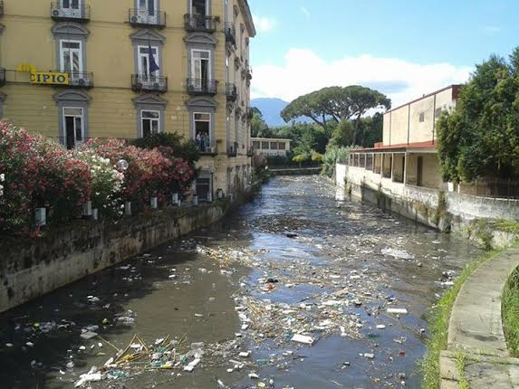
Water pollution in campania region
The Sarno, known as Sarnus to the Romans, is a stream that passes through Pompeii. It is considered the most polluted river in Europe, as a result of industrial, agricultural and water waste from the tanning factories around the town of Solofra.

Slide 15
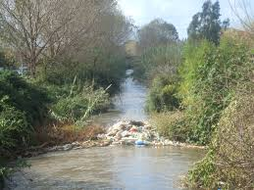
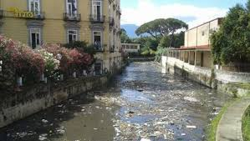
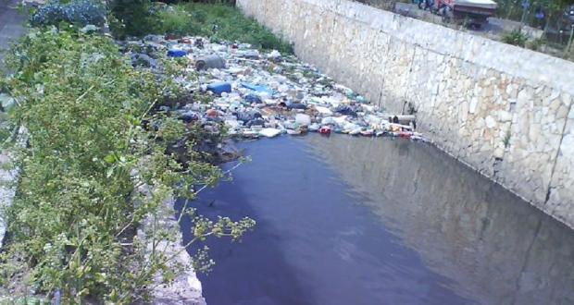
Pollution of the Sarno river
Pollution levels "evolve" along the length of the Sarno. Near Mt. Sarno itself, the river is still in a rather natural state. Flowers grow on the banks and fish swim in the waters. As it is channeled through the town of Sarno, itself, at the foot of the Picenti range, it is still a pleasant little stream.
A few kilometers farther along, however, at the confluence with the Cavajola river (flowing from its source near Cava de’ Tirreni) and the Solofana river, the pollution picks up and is visible. In Scafati, there is chemical foam in the water.

Slide 16
Volcanic Eruption
Illegal Buildings

Slide 17
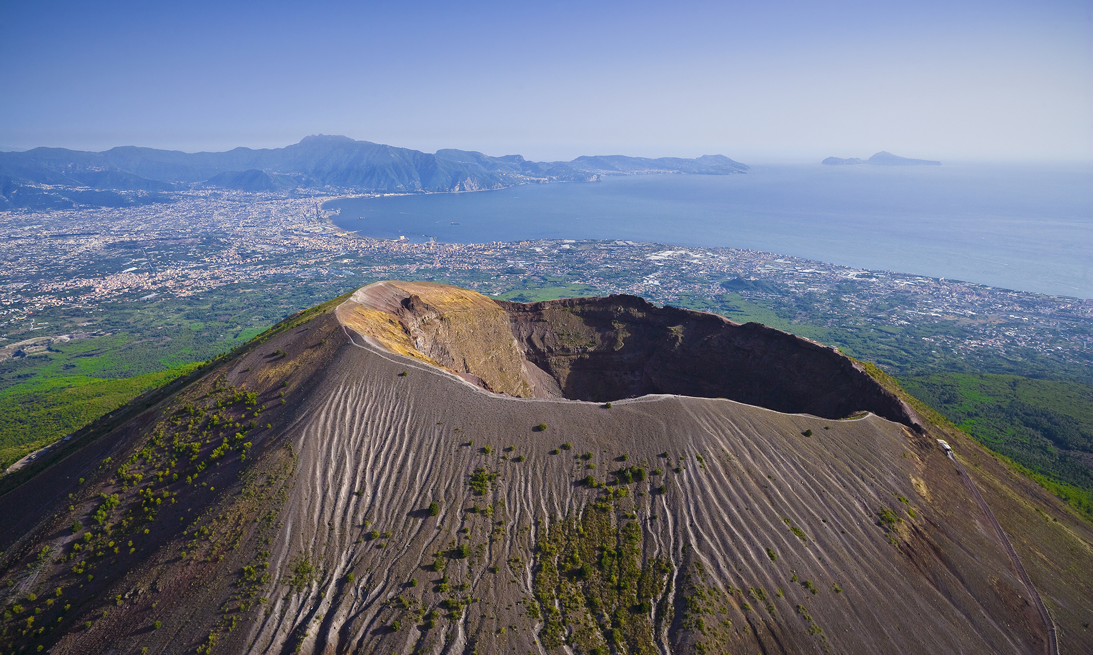
Mount Vesuvius eruption risk
The volcano is one of the few active super volcanoes in the world. This means it could potentially erupt at the highest level measured by the Volcanic Explosively Index. Camp Flegrei is an almost 13 kilometre wide volcanic crater, home to more than 1.5 million people.

Slide 18
Bibliograpghy:
http://davidrichardboyd.com/appointed-as-un-special-rapporteur-on-human-rights-and-the-environment/
http://www.greenreport.it/news/clima/oms-la-morte-inquinamento-atmosferico-ci-vede-benissimo-colpiti-piu-poveri-anche-europa/
https://www.scribblemaps.com/maps/view/Morphology_of_Italy/FxJrJiSmId
https://www.express.co.uk/news/world/1060302/naples-volcano-eruption-campi-flegrei-naples-on-alert-could-volcano-destroy-naples

Slide 19
THANKS FOR YOUR ATTENTION

