Slide 1
Legends and myths
Romania

Slide 2
Siutghiol Lake
On the place where today we can find Mamaia Lake (Siutghiol-near Constanța), it was a village with very bad people who did not want to receive anyone in their houses.
On a holiday day, when all people were at home, a stranger came into their village, asking them to stay for a night.

Slide 3
Siutghiol Lake
After noticing that in such a large village there is no welcoming man, the traveler headed to the edge of the village. He climbed up a hill where there was a small stone house. A nice widow received him. But the woman, being very poor, began to cry that she had nothing to give her to the guest.

Slide 4
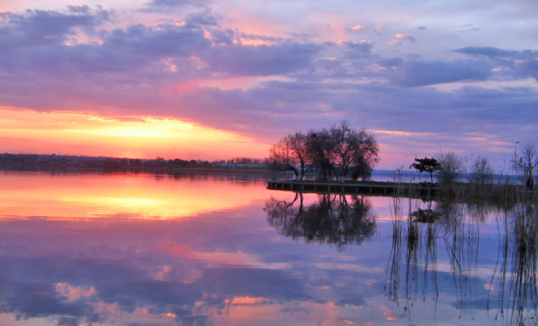
Siutghiol Lake
The traveler told the widow to put a piece of cold pudding in the stove kiln in the ashes. The woman was amazed that after a while she found there milk and a fluffy bread. She and her guest ate and went to sleep.
Source: https://locuridinromania.ro/wp-content/uploads/2016/10/Lacul-Siutghiol-din-orasul-Constanta.jpg

Slide 5
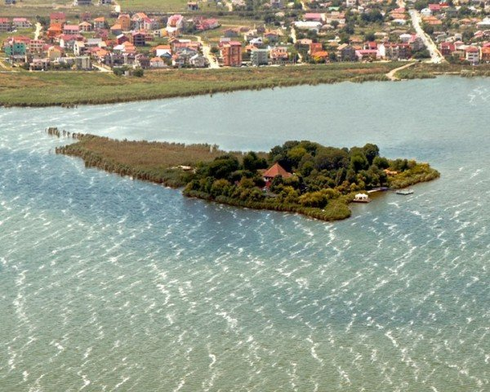
Siutghiol Lake
Finally, the day after the wonderful guest's departure, the village with the wicked people sinks under water, turning into a deep and deep lake, leaving only a small island with the house of the nice woman.
(narrated by old Seit Agi Ali, from Taşaul)
Source: ttps://www.litoralulromanesc.ro/application/views/images/obiective%20turistice/7__insula_ovidiu.jpg

Slide 6
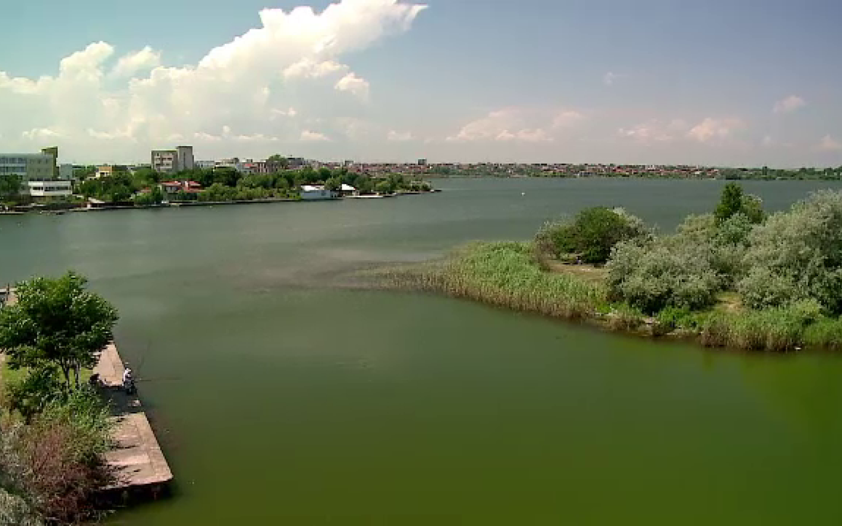
Source: http://blog.icar.ro/wp-content/uploads/2016/07/Insula-Ovidiu-1.jpg

Slide 7
Thank you for your attention!

