Slide 1
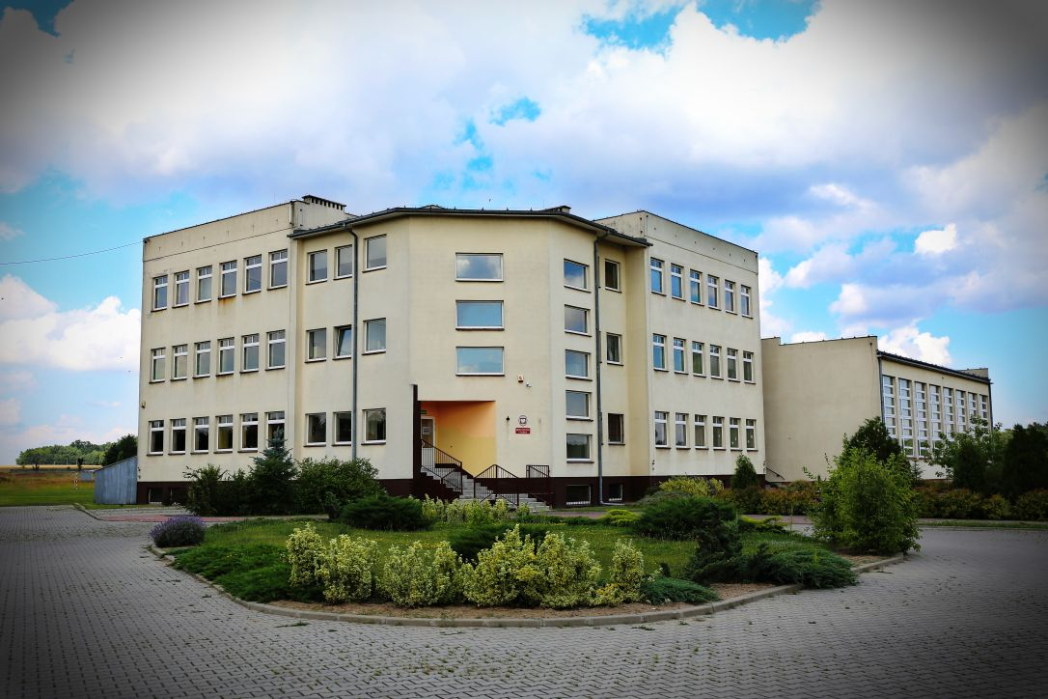
Educational system in Poland

Slide 2
Some Basics
Education is obligatory
Kids 6 to 18 have to go to school
State school are free nobody has to pay
School system is carried out by the government and administered by local government

Slide 3
STRUCTURAL REFORM IN 2017
Educational reform in Poland
has been implemented since the beginning of 2017.

Slide 4
The reform has been implemented between 1 September 2017 and the school year 2022/23. On the 1 September 2017 pupils graduating from year 6 of the primary school became pupils of grade 7. The new structure includes:
8-year primary school,
4-year general secondary school,
5-year technical secondary school,
3-year sectoral VET school (stage I),
2-year sectoral VET school (stage II),
post-secondary school.

Slide 5
COMPULSORY EDUCATION
Full-time compulsory education lasts for 10 years and comprises:
the last year of pre-school education,
6 years of primary school education,
3 years of lower secondary school education.
Starting 2017 a new structure of school education is being implemented in which full-time compulsory education will last for 9 years.
the last year of pre-school education
8 years of primary school education.

Slide 6
Institutions for children aged 3-6
pre-school,
pre-school class in a primary school,
Every 4- and 5-year-old has an entitlement to a place in a pre-primary setting, and as of September 2017 – every 3-year-old. As of the school year 2016/17 compulsory education in grade 1 of primary school starts at the age of 7. Parents of 6-year-olds have a choice – they can enroll their children in the 1 grade of primary school or keep them in a pre-school institution.

Slide 7
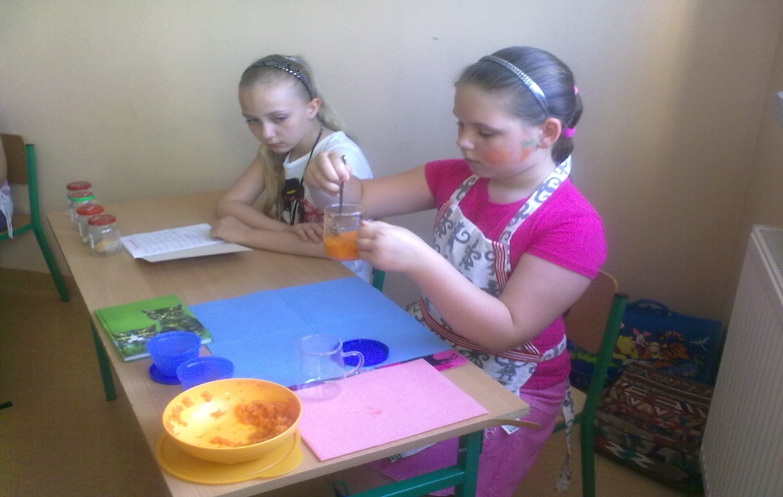
Primary education
Old structure 6-year primary school was compulsory for all pupils who are usually aged 6/7-13. 4 It included two stages:
grades 1-3 (early school education),
grades 4-6 where teaching is done by subject.
At the end of primary education pupils took a compulsory external exam, the results of which were used only for information and not for selection purposes.

Slide 8
New structure
8-year primary school is compulsory for all pupils who are usually aged 6/7-15. It includes two stages:
grades 1-3 (early school education),
grades 4-8 where teaching is done by subject.

Slide 9
Lower secondary education
Old structure
3-year lower secondary school for students aged 13-16 is another stage of compulsory education.
At the end of it pupils take a compulsory external exam and its results influence admission to upper secondary schools.

Slide 10
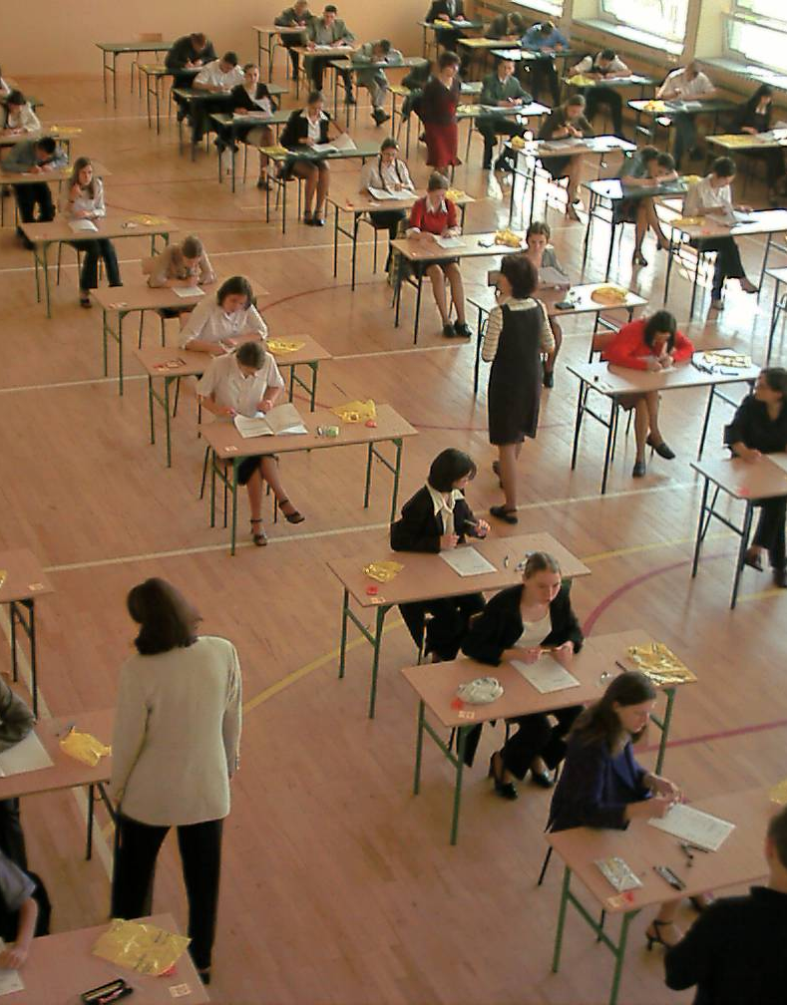
Lower secondary education
New structure
Starting in 2017 the 3-year (lower secondary school) will be phased out.
The compulsory external exam will take place in grade 8 of primary school and its results will influence admission to secondary schools.

Slide 11
Upper secondary education
Although this stage of education is not compulsory vast majority of students continues education in upper secondary schools. There are three types of upper secondary schools :
3-year general upper secondary school ,
4-year technical upper secondary school,
3-year basic vocational school
Pupils attend upper secondary schools at the age of 16-19 (16-20 years in case of the technical upper secondary school).

Slide 12
New structure starting in 2019/20
The new reformed structure of upper secondary education includes the following types of schools:
4-year general secondary school,
5-year technical secondary school,
3-year sectoral VET school (stage I),
2-year sectoral VET school (stage II).

Slide 13
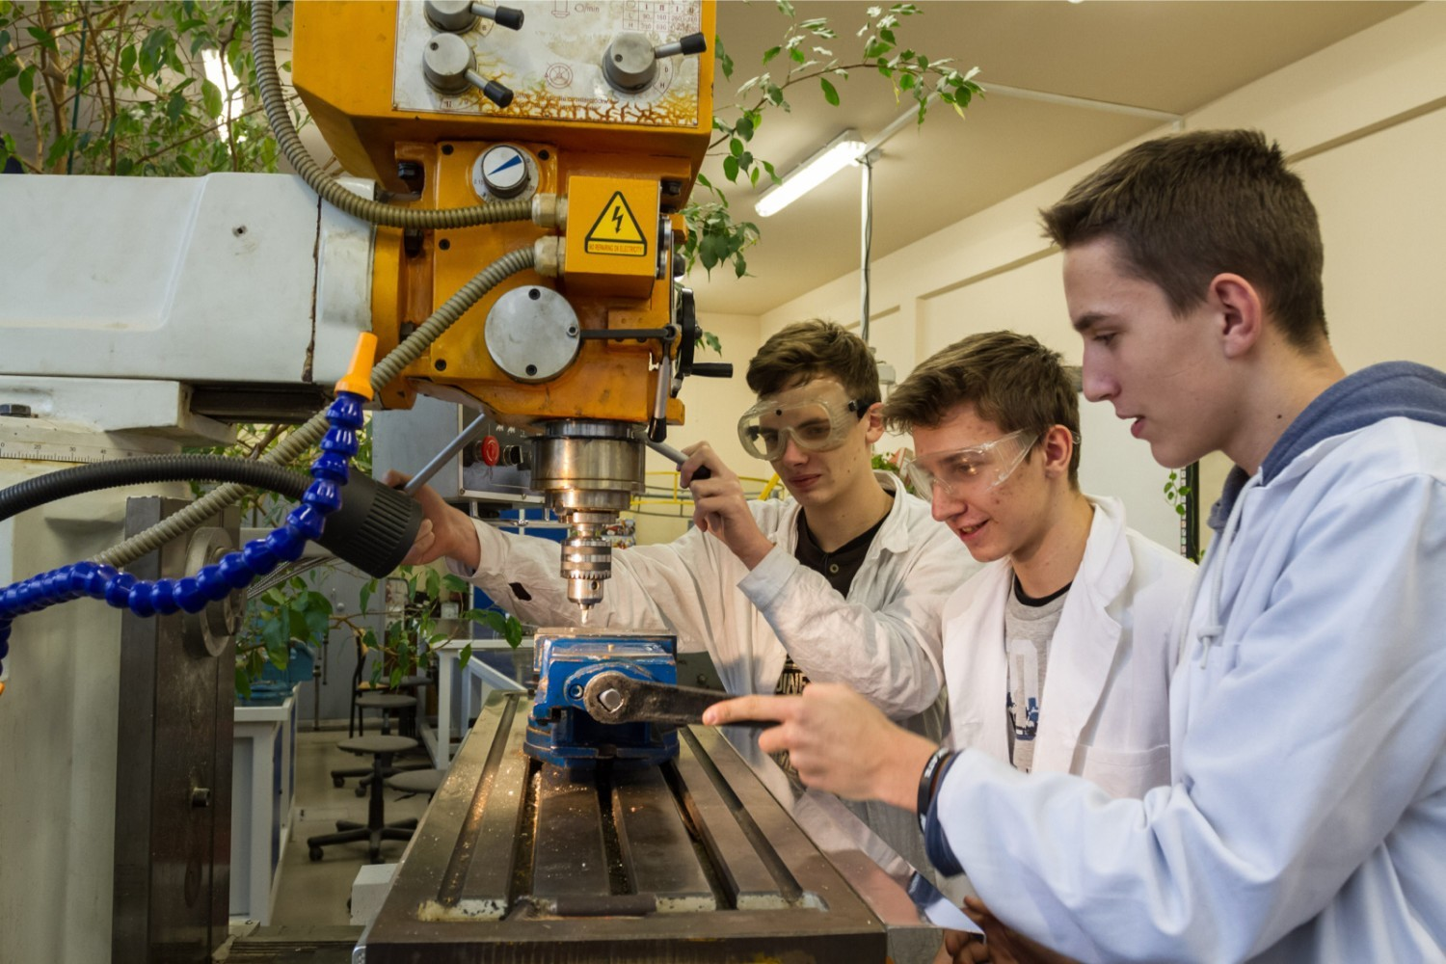
Vocational education
Students of vocational schools – basic vocational schools and technical upper secondary schools – may take exams confirming vocational qualifications in a given occupation during the course of study or upon completion of school to receive a diploma confirming their vocational qualifications.

Slide 14
Grades at Polish school
6 - (Excellent)
5 - (Very good)
4 - (Good)
3 - (Satisfactory)
2 -(Insufficient)
1- (Fail)

Slide 15
School Subjects
Polish, History and Social Studies,
Modern Languages: English, German, Russian, Italian, Spanish, French,
Maths, Chemistry, Biology, Physics, Geography,
ICT, PE, RE, Citizenship,
Music, Art, Technology.

Slide 16
Religious education
At each level of education there are 2 hours of religious education per week.
RE is not obligatory.

Slide 17
Timetable
Lessons start at 8 o’clock
Each lesson lasts 45 minutes
After each lesson there is a break of 10 minutes
There is one break – 20 minutes, usually from 10:35 – 10:55

Slide 18
 | Monday | Tuesday | Wednesday | Thursday | Friday
8:00-8:45 | Polish | Chemistry | Polish | Chemistry | Polish
8:55-9:40 | Art | Maths | Maths | Design and Technology | History
9:50:10:35 | Maths | Physics | German | Polish | Geography
10:55-11:40 | Geography | Polish | History | Lesson with a Form teacher | English
11:50-12:35 | IT | English | English | Biology | RE
12:45-13:30 | PE | German | Citizenship | RE | Maths
13:40-14:25 | Family Education | PE | PE | Physics (extra leson) | Maths (extra lesson)
14:30-15:15 |  | English (extra lesson) | Safety education | Polish (extra lesson) | PE

Slide 19
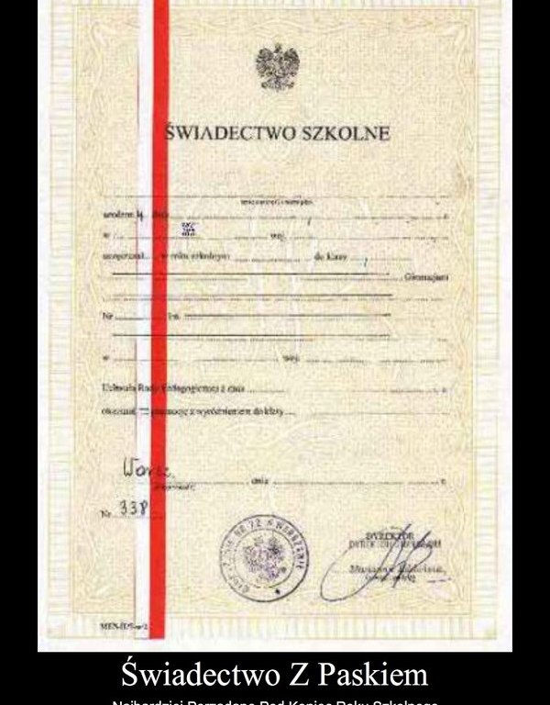
Certificates
At the end of every school year each student gets a certificate.
Those students who complete
with an average grade of at least
4,75 get a certificate with honors.

Slide 20
School year
School year starts on 1st of September and finishes around 20th of June.
The school year is divided into two terms.
There is a winter break (2 weeks) and spring break (1 week) at Easter.

Slide 21
ADULT EDUCATION
Adult education is open to adults who wish to complete school education on primary and secondary level or acquire new vocational qualifications and skills for professional or personal reasons.

Slide 22
The End
Presentation made by our Polish team
Thank you for you attention ☺

