Slide 1
ERASMUS+ KA2 GREEN ALLIANCE ENVIRONMENTAL ISSUES

Slide 2
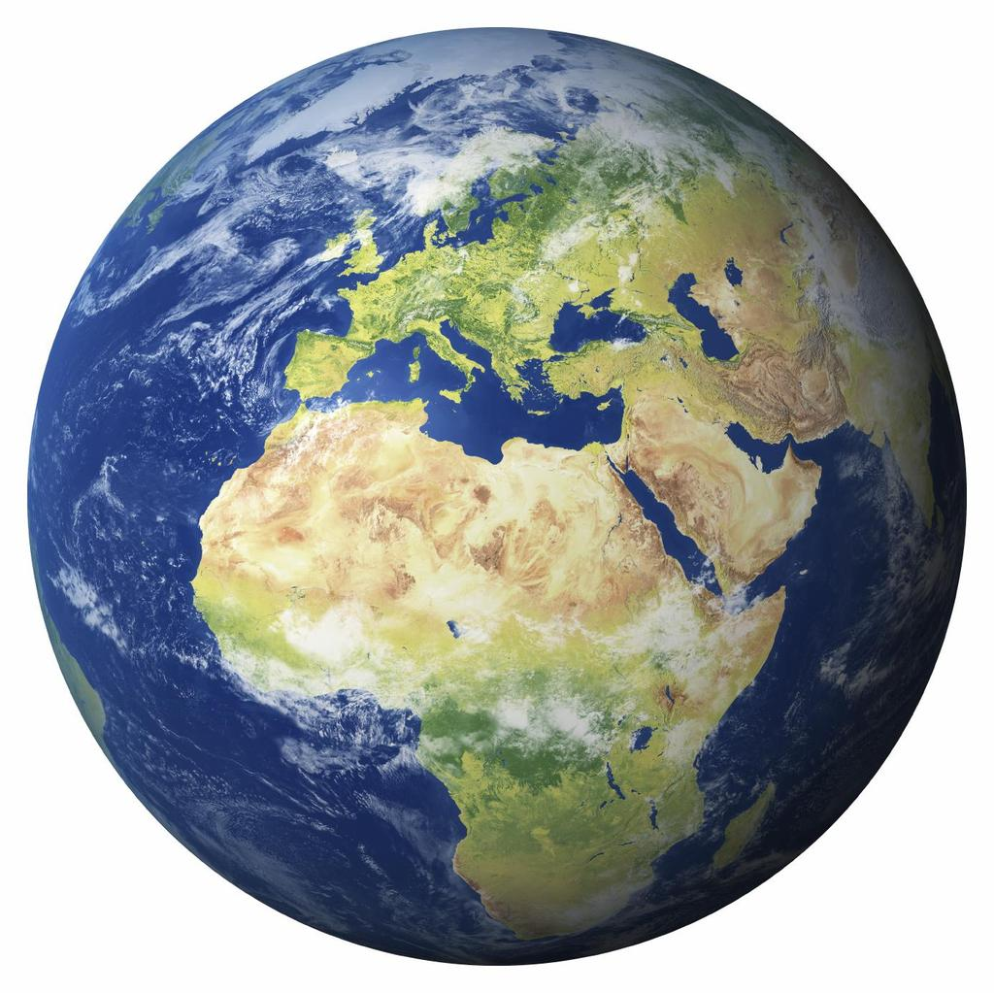
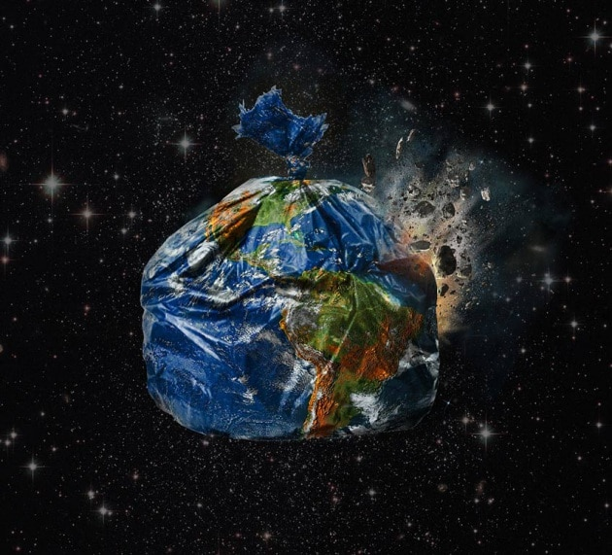
OUR PLANET EARTH
YESTERDAY
Our Earth is going to explode because of many environmental issues, mainly created by human actions.
TODAY

Slide 3
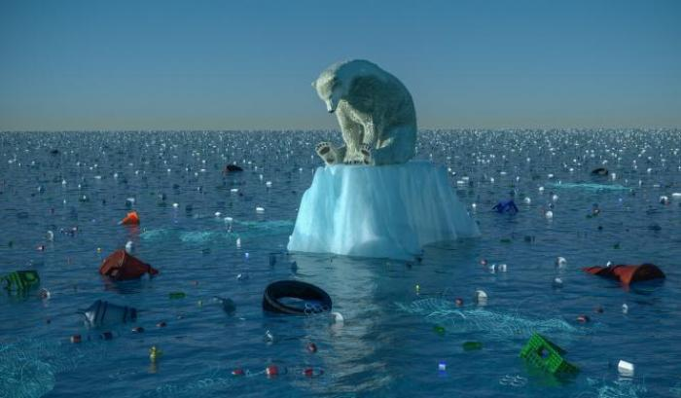
CLIMATE
CHANGES
Climate change is one of the greatest threats facing the planet. It is the most serious issue and the main cause of environmental disasters all over the world.

Slide 4
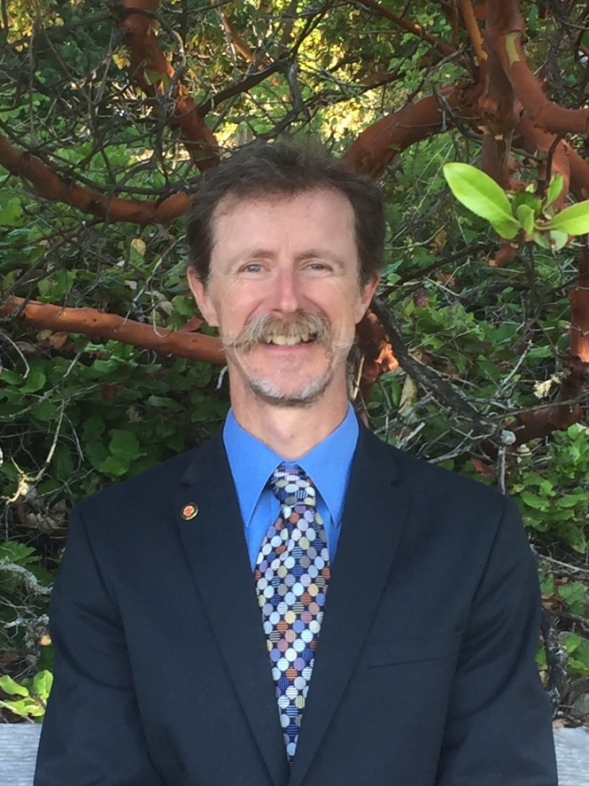
Dr. David Richard Boyd, a Special Rapporteur on human rights and the environment by UN
says
that every 5 seconds there is a victim due to air pollution,
every hour ,700 people die in the world
air pollution is about to cause the sixth mass extinction of the
planet.
what we live in, is the only planet in which life is possible ".
Dr David Richard Boyd Professor of Law, Policy, and Sustainability cross-appointed at the Institute for Resources, Environment, and Sustainability and the School of Public Policy and Global Affairs at the University of British Columbia.

Slide 5
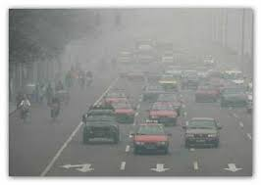
Global warming means that the planet has been slowly and steadily getting warmer and the temperature is going to rise over the next hundred years.
Some regions have experienced extremely cold winters, while in others there have been heavy rain and severe heat waves.
The Polar ice cap has been melting and sea level have been rising.
Glaciers all over the world are receding.
DISEASES CAUSED BY AIR POLLUTION
Boyd has also highlighted how it is known that pollution causes respiratory diseases, asthma, lung cancer, birth problems and neurological disorders

Slide 6
SOLUTIONS SUGGESTED BY DAVID BOYD
The seven key measures that States should apply to comply with the obligation to ensure a healthy environment are:
1. Monitor the quality of the air.
2. Identify the causes of pollution.
3. Inform the inhabitants and involve them in the
decision-making processes on the subject.
4. Issue regulations that set clear limits against air
pollution, reducing the emissions of gases by at
least 80% by the middle of the century
5. Draw up action plans against this serious danger.
6. Provide adequate funds for the application of
these anti-pollution plans.
7. Assess progress in this field.

Slide 7
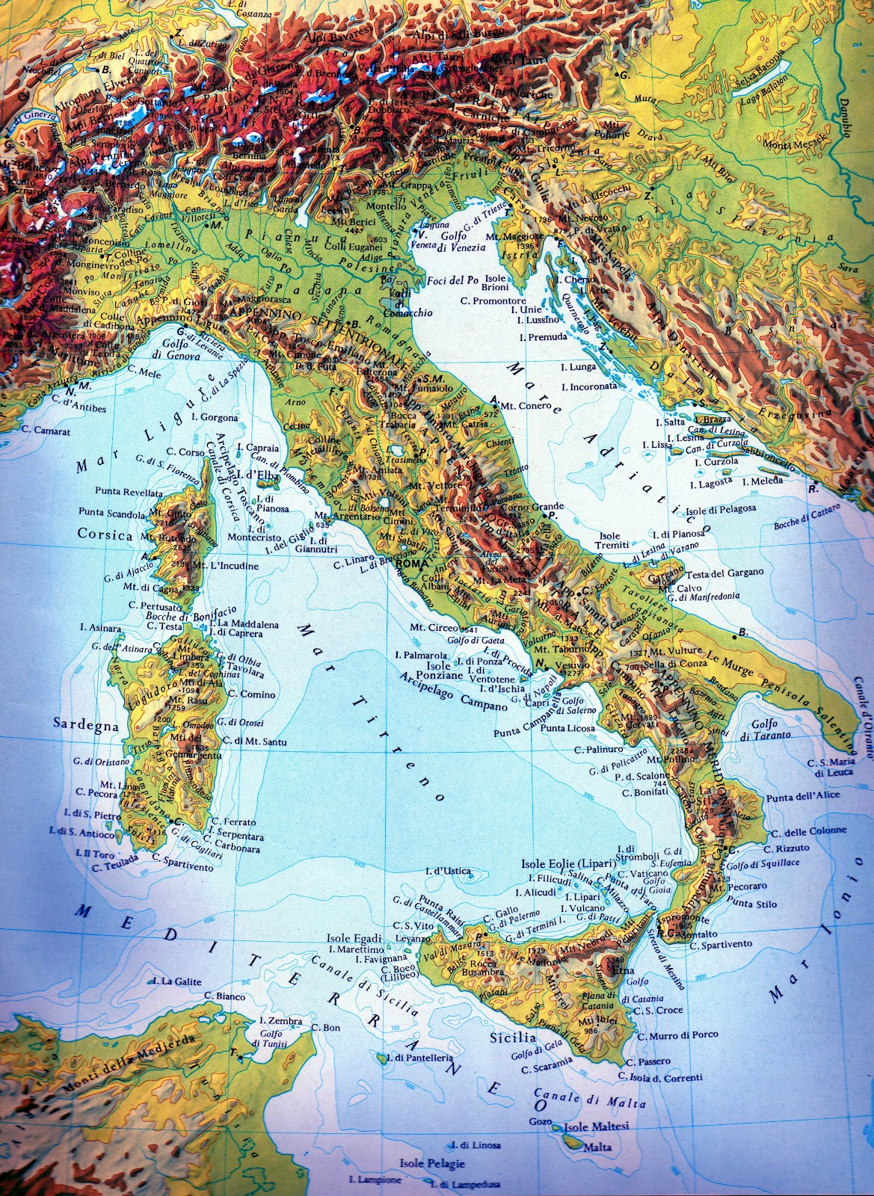
MAIN ENVIRONMENTAL ISSUES IN ITALY «Hydrogeological instability»
MORPHOLOGY OF ITALY
Italy has a rich morphology, the high peaks of Alps, the chain of the Appennines through the whole peninsula, kilometres of sandy or rocky beaches, as well as some plains with long and narrow shape.
Italy has a high hydrogeological instability : this means that the balance between the water system (rivers, lakes ….)and the rock system (mountains, hills…) is precarious.

Slide 8
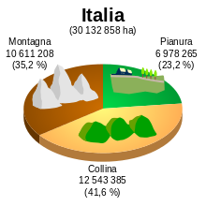
THE TERRITORY OF ITALY
MOUNTAINS
PLAIN
The high peaks of the Alps and the chain of Apennines
The biggest plain in Italy is the Po valley
THE BALANCE BETWEEN THE WATER SYSTEM AND THE ROCK SYSTEM IS PRECARIOUS.
HILLS

Slide 9
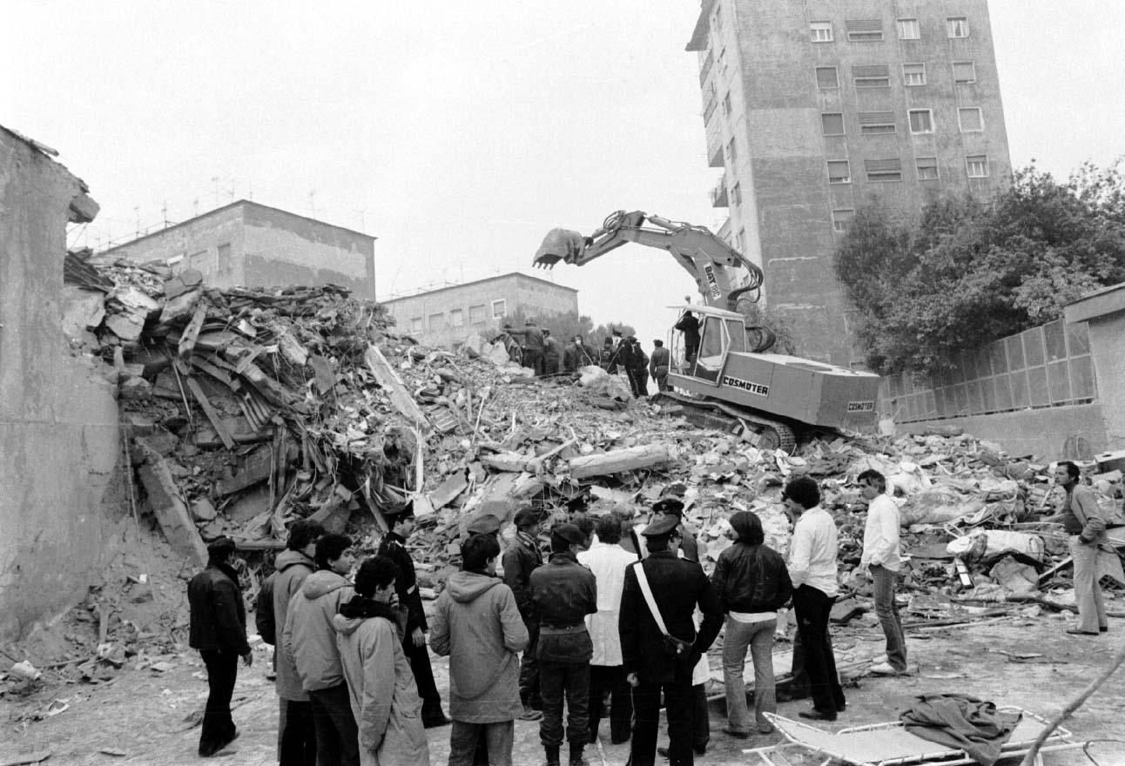
For these reasons the Italian territory is frequently subjected to earthquakes, floods, landslides and even volcanic
eruptions. These dangers are increased by poor
prevention, lack of environmental policies and illegal building. As a conseguence disasters are very costly due to damange to land, loss of human lives,
possessions and the disruption of economic activities.
EARTHQUAKE IRPINIA ITALY 198O

Slide 10
Earthquakes

Slide 11
EARTHQUAKE AQUILA ITALY 2009

Slide 12
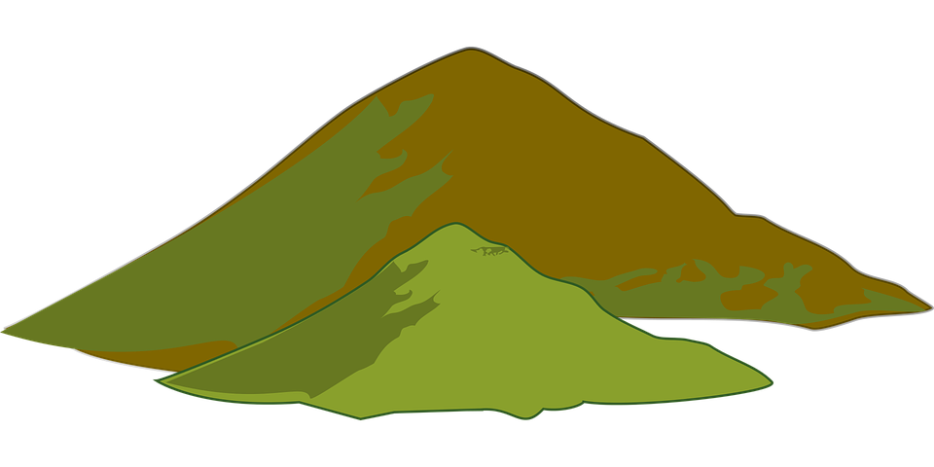
Landslides

Slide 13
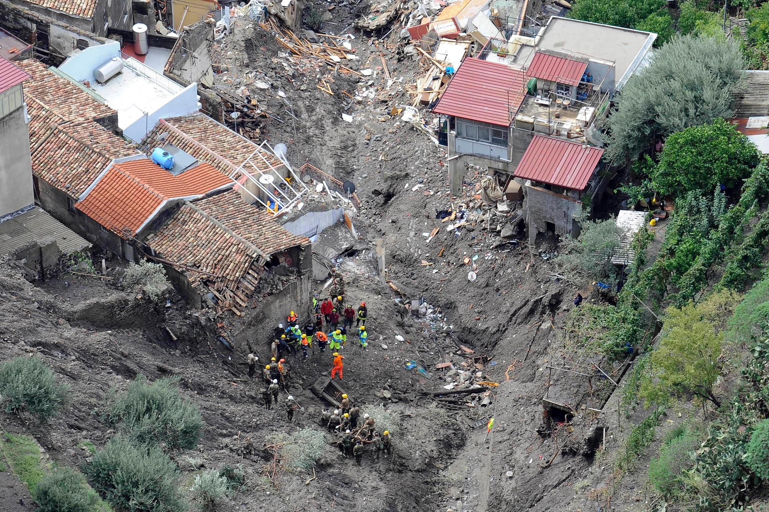
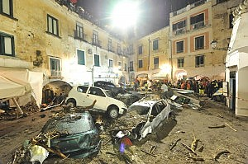
LANDSLIDE IN ATRANI AMALFI COAST 2010
LANDSLIDE IN SARNO 1998

Slide 14
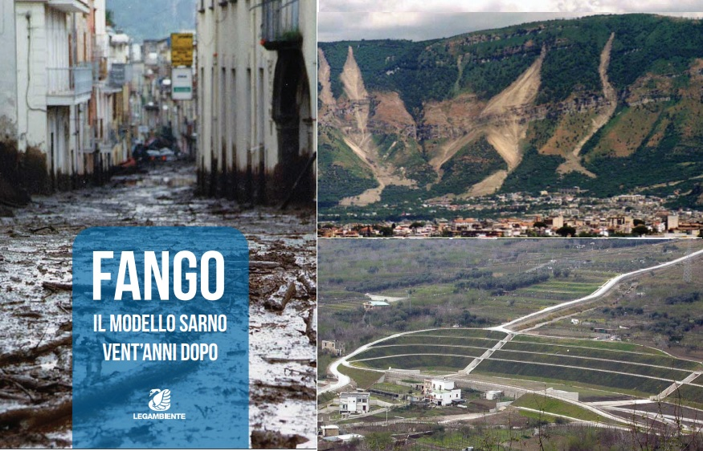
After this tragic events, the Italian civil protection has decided to introduce various weather warnings (weather bulletins) which according to the colors of these, the mayor of each city can decide to impose a more or less serious meteorological alert.

