Slide 1
My breakfast
Matúš Hitka
Základná škola M. Tareka
VII. trieda

Slide 2
1.What do you ussually eat for your breakfast?
2. What does it look like?
3. How to make it?

Slide 3
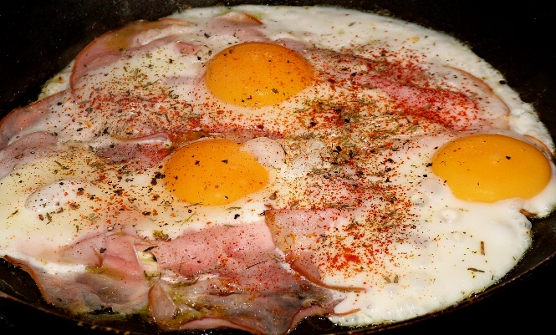
Beat eggs, milk, seasoned salt, salt, and black pepper together in a bowl.
Advertisement
Step 2
Heat olive oil in a large non-stick skillet over medium-high heat; saute jalapeno in hot oil until slightly softened, 2 to 3 minutes. Add ham to jalapeno and cook until heated through, about 1 minute.
Step 3
Pour egg mixture into ham mixture. Cook and stir until eggs are set but not dry, 3 to 5 minutes. Sprinkle 1/2 of the Cheddar cheese over eggs; cook and stir until cheese is melted. Transfer eggs to a plate and sprinkle remaining cheese over the top.
1.MY favourite breakfast is ham and eggs with vegetables. During the common days when I go to school I have very fast breakfast. Usually I eat yoghurt or corn flake with milk. At the weekend when I am not in hurry I have for breakfast my most favourite meal ham and eggs.
2. pictures:
3.recipe:
Step 1.
Beat eggs, salt and black pepper together in a bowl.
Step 2.
Heat olive oil in a large pan, add ham and let it fry until is crunchy.
Step 3.
Pour egg mixture into ham mixture. Cook and stir until eggs are set, but not dry, 3 to 5 minutes. At the end sprinkle pinch of red pepper and marjoram. Transfer meal to a plate. Cut the vegetables into small pieces and put in a bowl. I like to eat together with tomato, cucumber, green pepper and letuce.

Slide 4
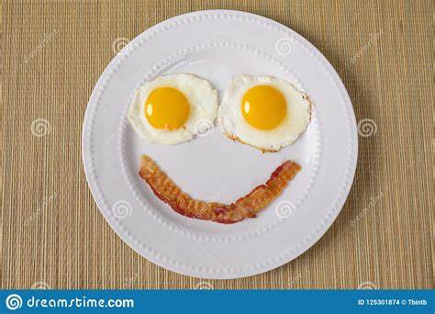
HAVE A NICE TEA !!!

