Slide 1
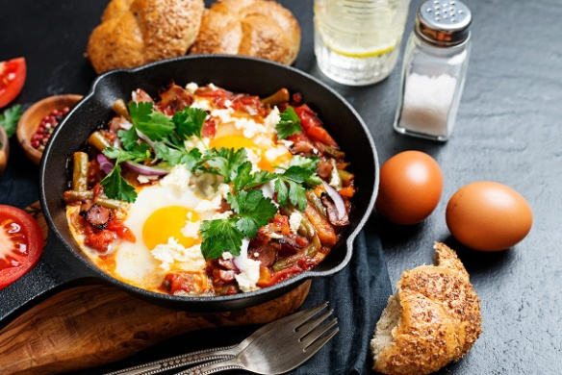
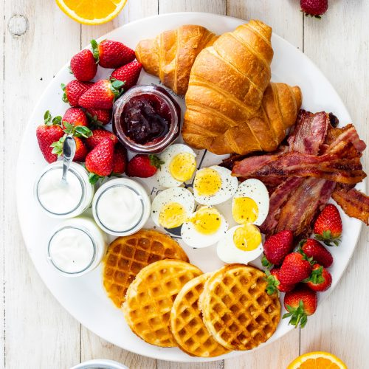
Our breakfast
Tamara Kočíková

Slide 2
Content
Recipe our favourite breakfast
How to make it?
Our breakfast description
What do usually eat for breakfast?
Photo of our favourite breakfast
What does it look like?

Slide 3
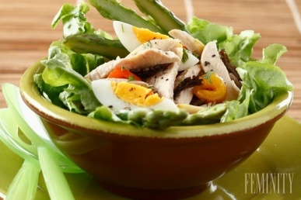
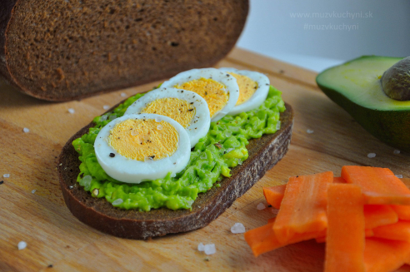
What do I usually eat for breakfast?
1.I usually at typical weekend days or holidays days eat for breakfast boiled eggs with bread and with some vegetables and with hot chocolate . But when I go to school during typical school days I eat for breakfast bread with ham and with some vegetables and with fruit juice which I make with my mixer.
2.
My favourite breakfast is boiled eggs with avokado‘s bread
3. recipe of my favourite avokado‘s bread with boiled eggs.
1.cut one piece of bread and take one piece
2.Take one piece of avokado and put out its inside
3.boil the egg then cut it and later put it on the avocado sauce on the bread and when you need you can give a bit of salt.
You need: one piece of bread, one piece of egg and one piece of avocado and a bit of salt.

Slide 4
Tamara from Slovakia základná škola M. Tareka Abrahám

