Slide 1
A TRADITIONAL CROATIAN BREAKFAST

Slide 2
This morning I had some bread with a spicy add on called ‘ajvar’ and some onions and to top it all of I had ‘čvarci’ with some salt.
čvarci= cracklings- roasted pork rind
Marko Pranjković, 7.c

Slide 3
This is my breakfast. For breakfast I usually have cornflakes and milk, but this time it's different. I had honey, eggs, butter, cheese, yoghurt and a lot more for brekfast this morning. My favourite dish here is 'hrenovke'- suasages or Frankfurter. A lot of Croatian people like to eat that for breakfast. I find them very tasty and perfect. My not so favourite part of this breakfast is actually honey. I don't like honey at all, but a lot of people do like it. I really don't know why I don't like honey, but it just isn't tasty for me.
Laura Klajn, 7.b

Slide 4
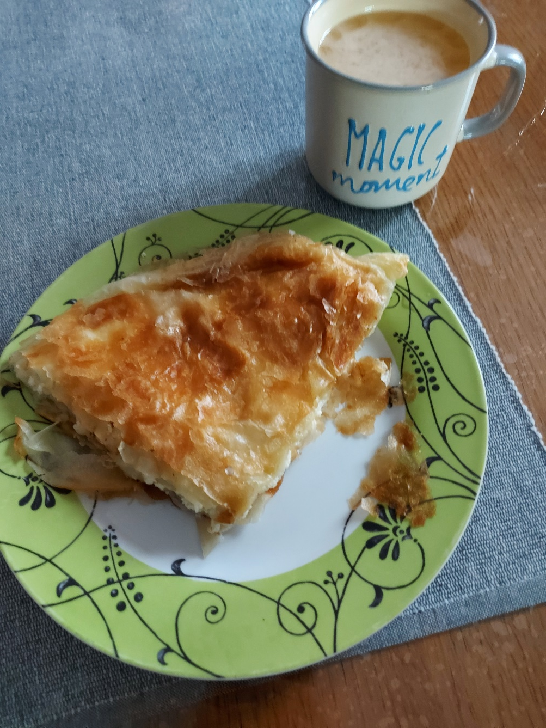
This is my breakfast. This morning I ate ‘burek sa sirom’ (I really don't know how to say that in English- it is a traditional cheese pie eaten in the Balkans), and drank ‘Cedevita’- it is a brand name for the powder you mix with water to get juice.
Mia Čotić, 7.b

Slide 5
This is my breakfast today. It’s a slice of my mom’s homemade bread topped with butter and grandma’s homemade apricot jam. I also have a Harry Potter cup of cocoa.
My usual breakfasts are: ‘Čokolino’ (powder or granules that mixed with milk form a chocolate porridge), pancakes, oatmeal, cornflakes in milk, something delicious from the bakery and of course - this from the picture.
Elena Krstevski, 7.c

Slide 6
Yesterday I had cereal with milk for breakfast.
Melani Skender, 7.b

Slide 7
I eat pancakes for breakfast.
Petra Kočiš, 7.b

Slide 8
I eat mashed bananas with oat cereals for breakfast.
Lucija Petričević, 7.a

