Slide 1
Our week in Poland
This project has been funded with support from the European Commission.
This publication [communication] reflects the views only of the author, and the Commission cannot be held responsible for any use which may be made of the information contained therein.

Slide 2
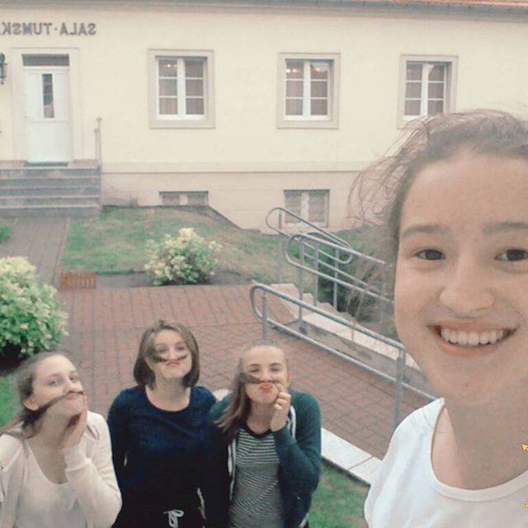
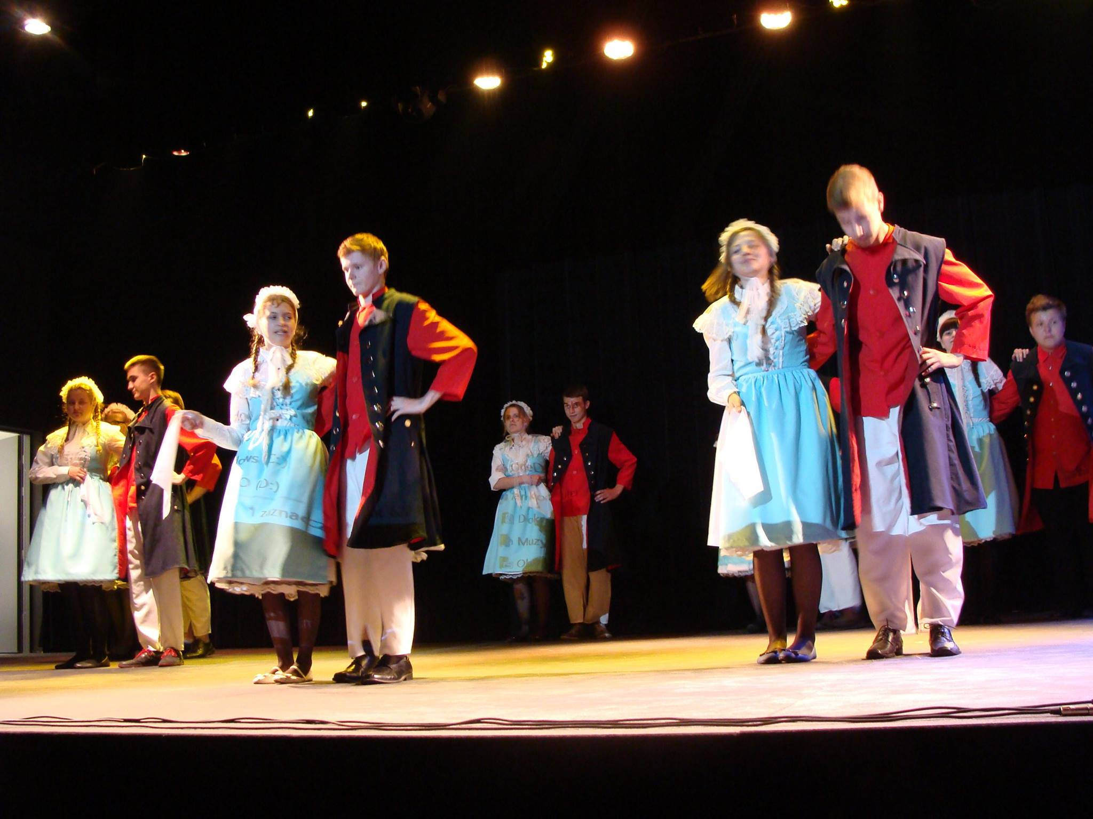
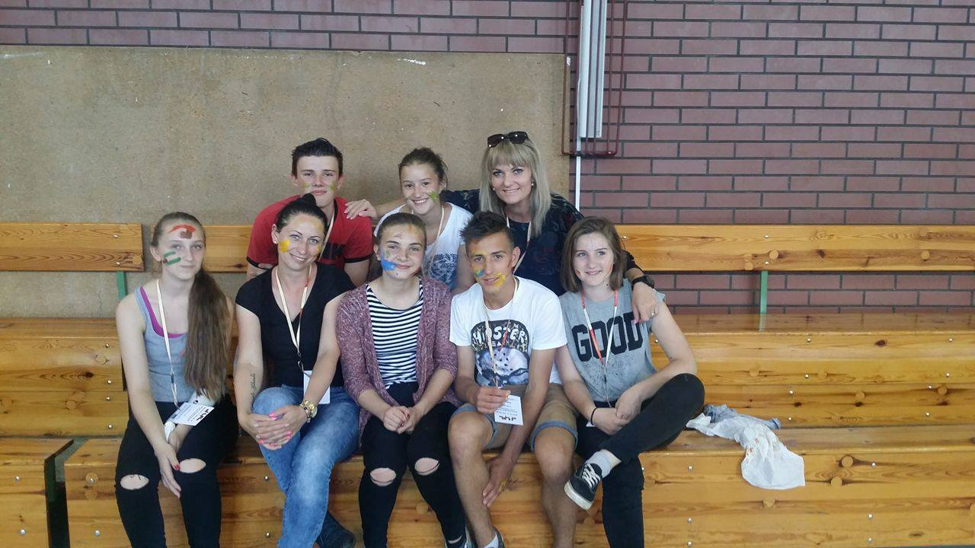
Monday
We had official welcome at Krzystof Szkudlarek‘s Centre of Culture in Witkovo
We had feet painting Workshop.
Everything was on our faces.
This was hotel
Adalbertus

Slide 3
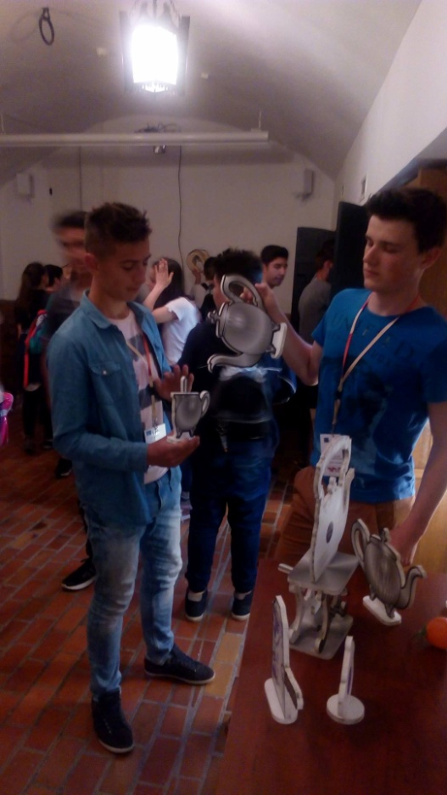
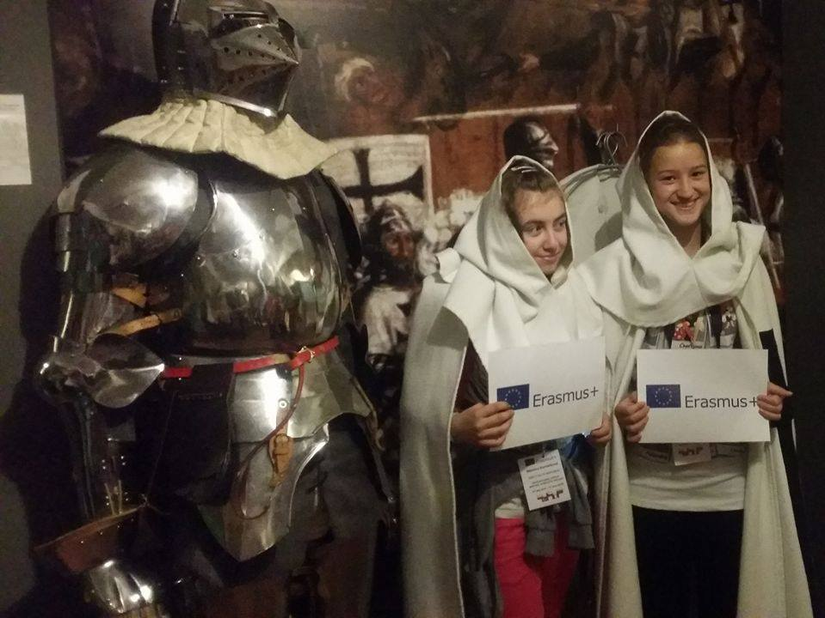
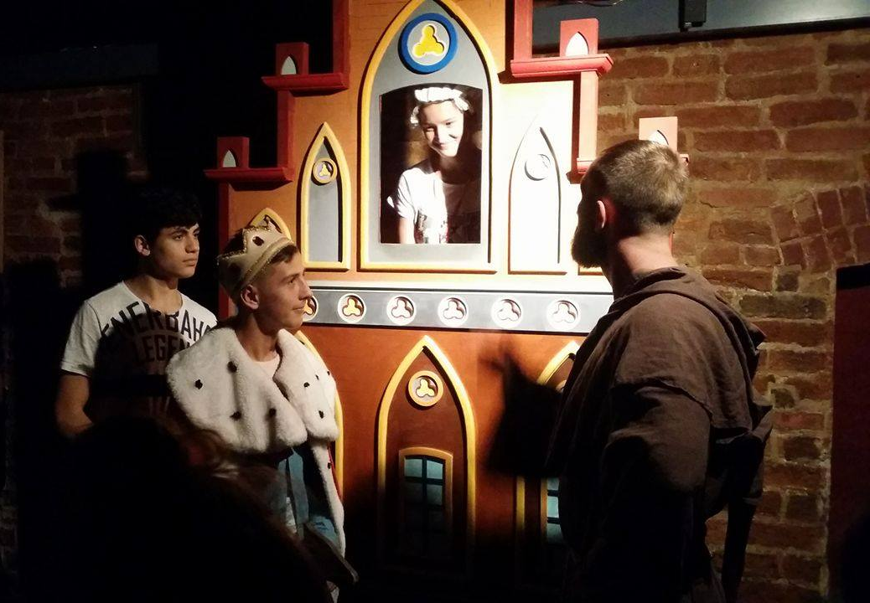
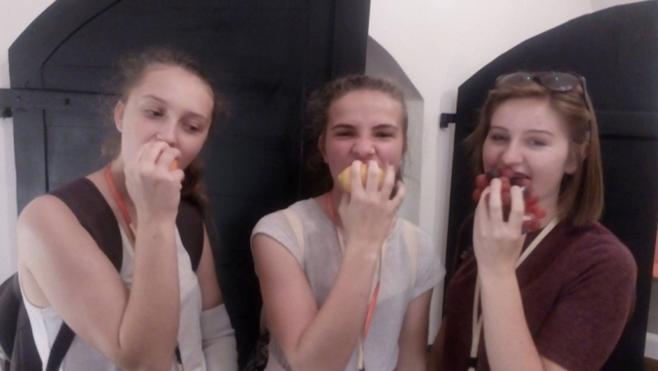
Tuesday
We visited Toruń.
Toruń museum was musem full of history.
The house of legends.
We were listening lot of legends of the city.

Slide 4
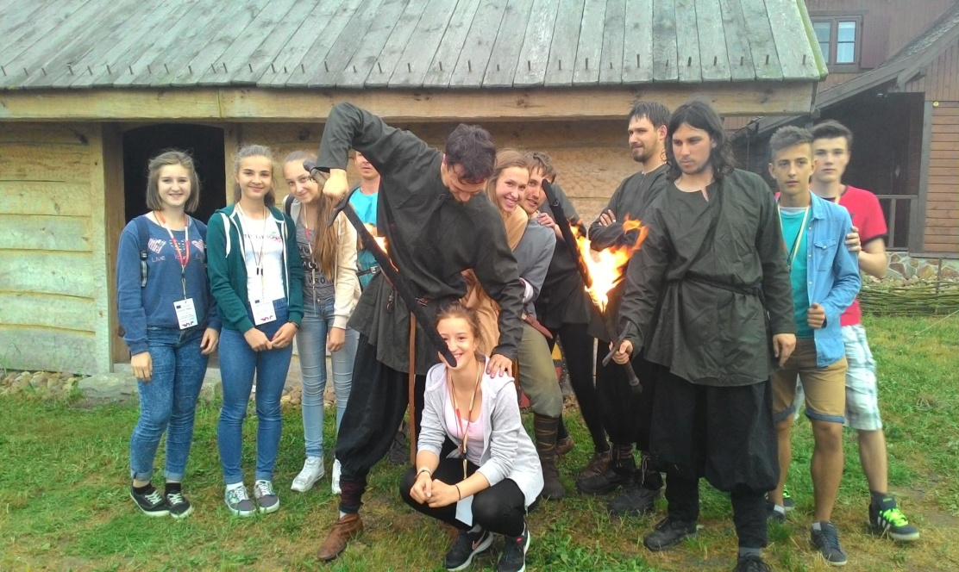
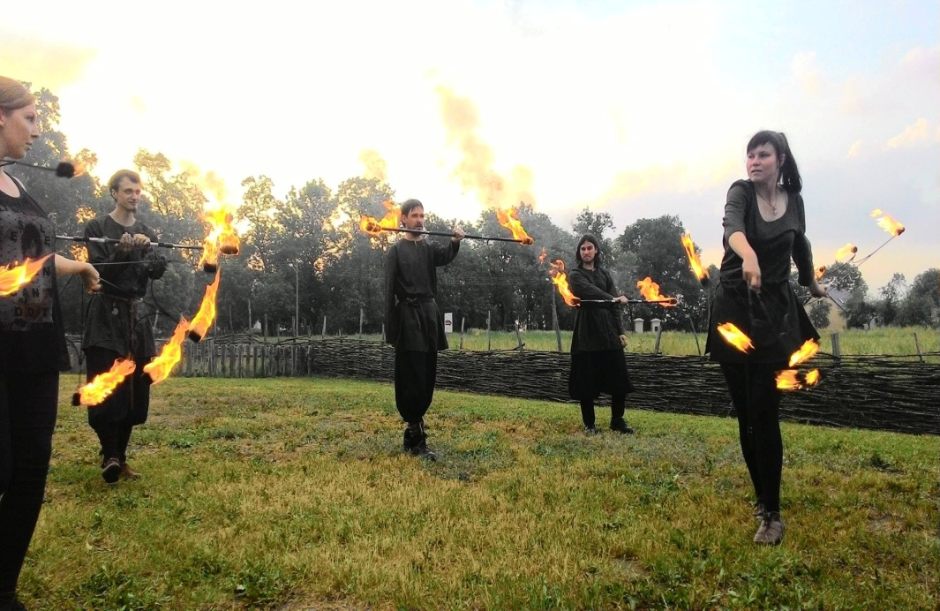
Wednesday
We had medieval day.
We were anchering, making ceramics, throwing with spears and so one...
On the over, We had fireshow.

Slide 5
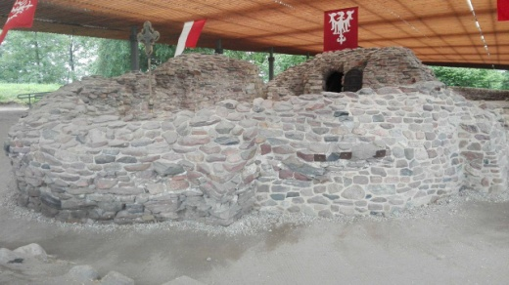
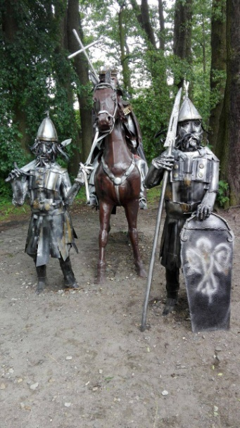
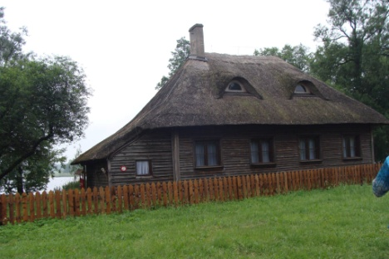
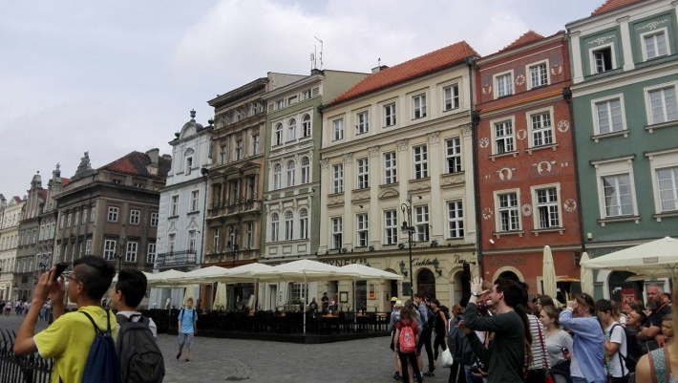
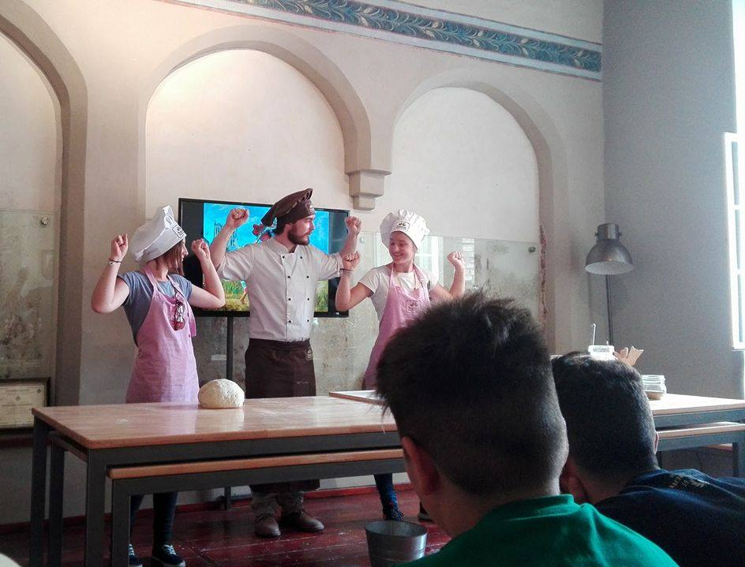
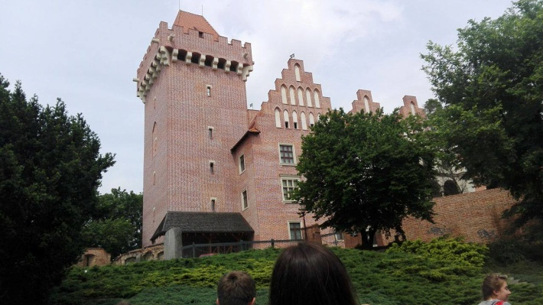
Thursday
We visited Ostrów Lednicki.
We had an educational lesson
In English.
We were building bridge.
We were in Poznań-one
Of the city‘s main tourist
Attractions.
And then We went to
Poznań Croissant Museum
And Experience.

Slide 6
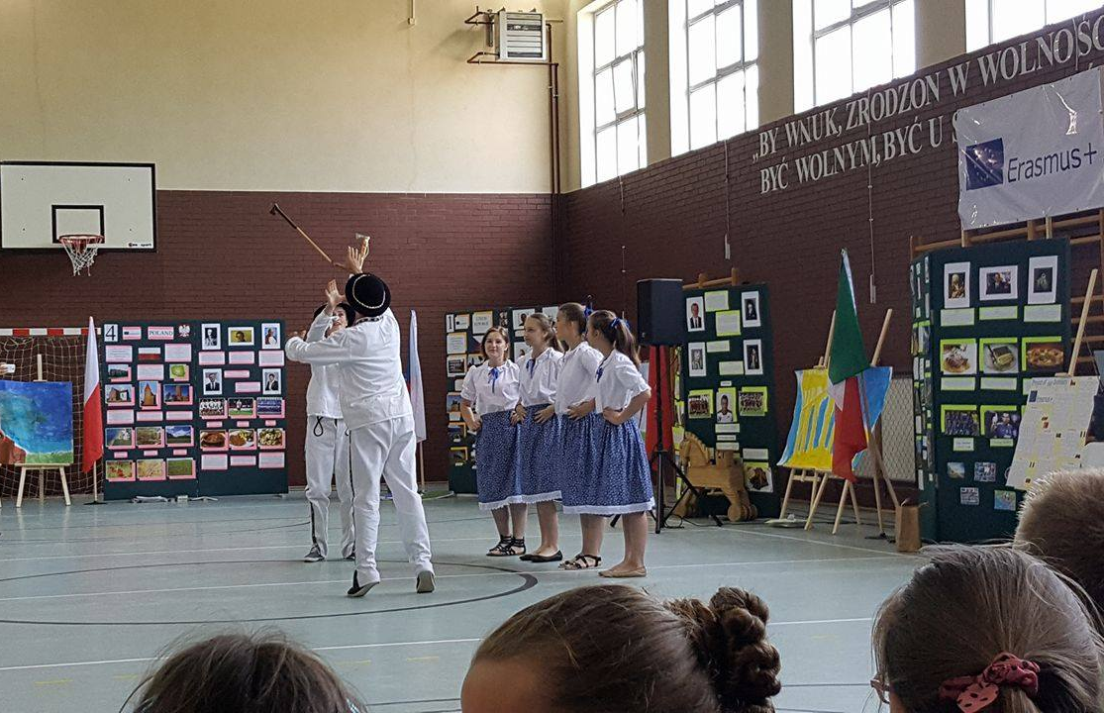
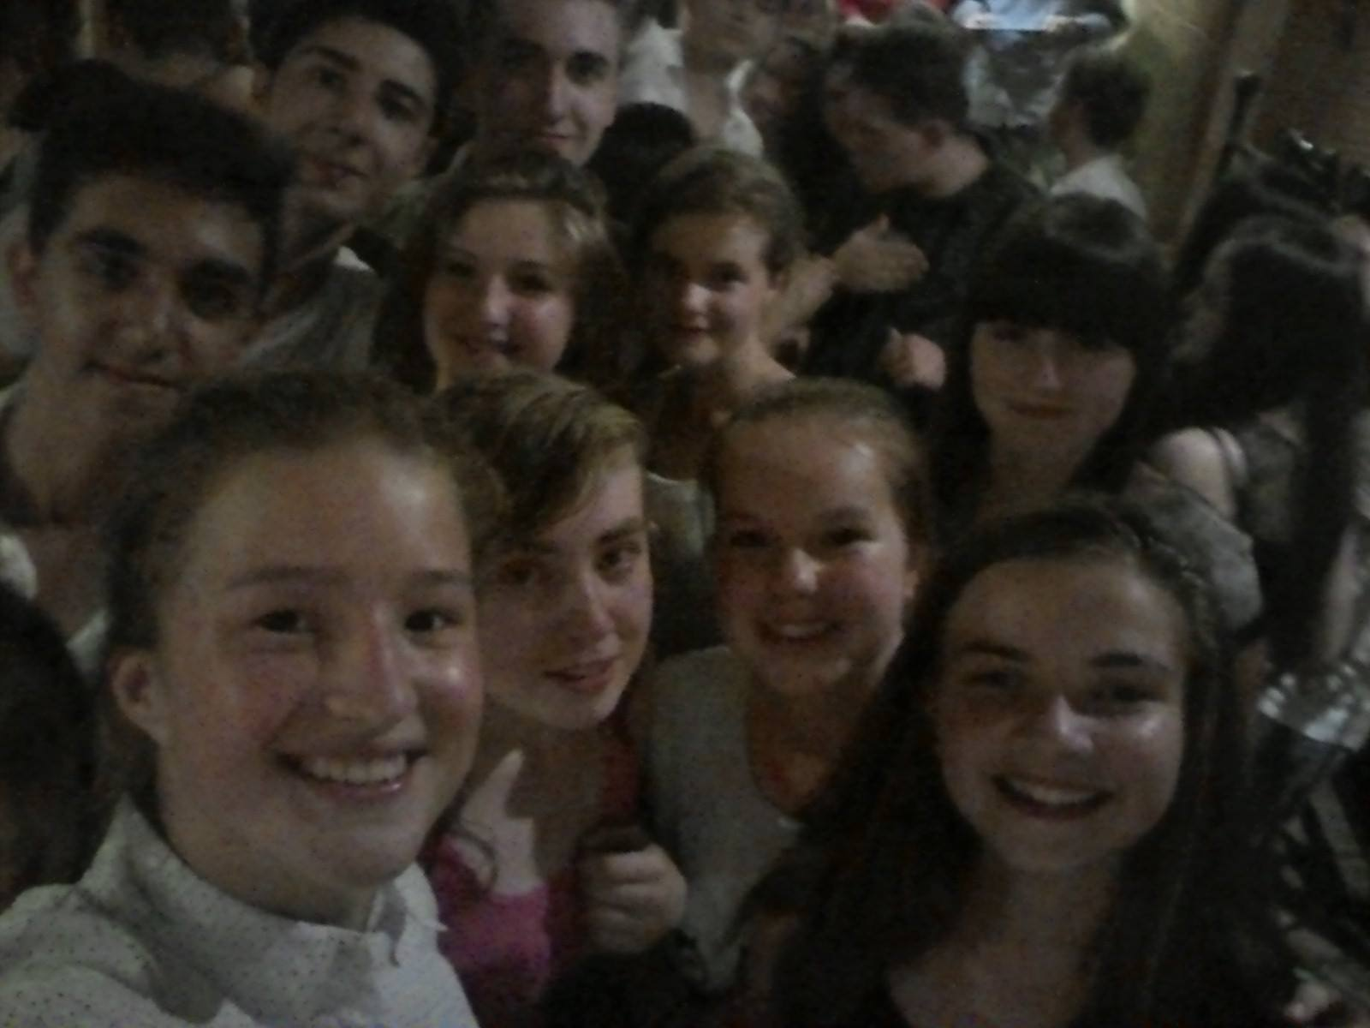
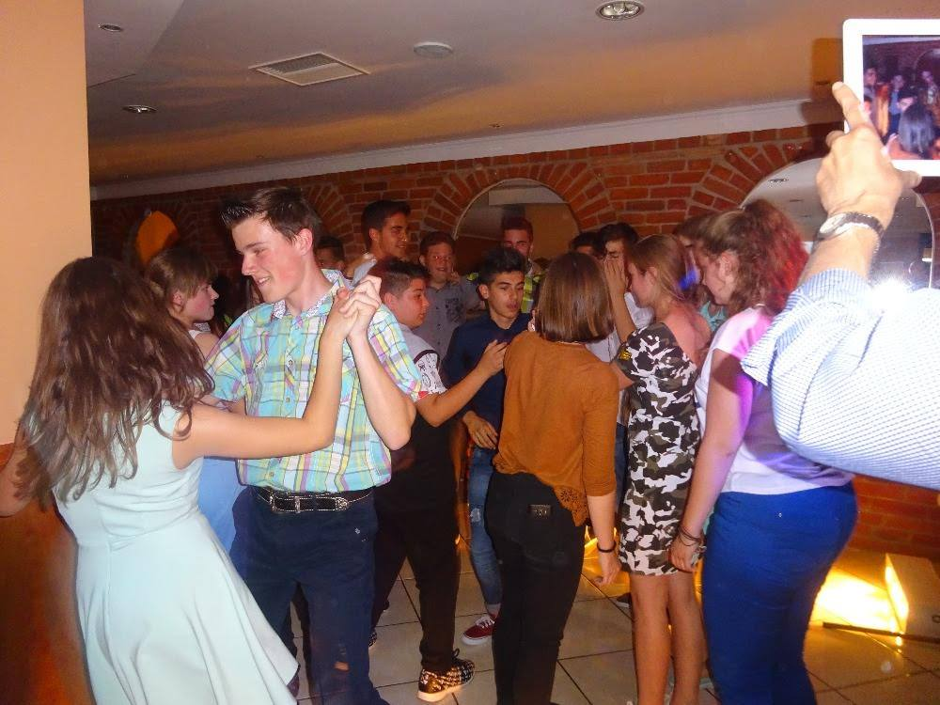
Friday
We were dancing and singing songs at school.
Then, Was the official closing of the meeting.
We had disco for our group.
It was fantastic end of the meeting.

