Slide 1
Our week in Poland
This project has been funded with support from the European Commission.
This publication [communication] reflects the views only of the author, and the Commission cannot be held responsible for any use which may be made of the information contained therein.
Henrieta Čierniková

Slide 2
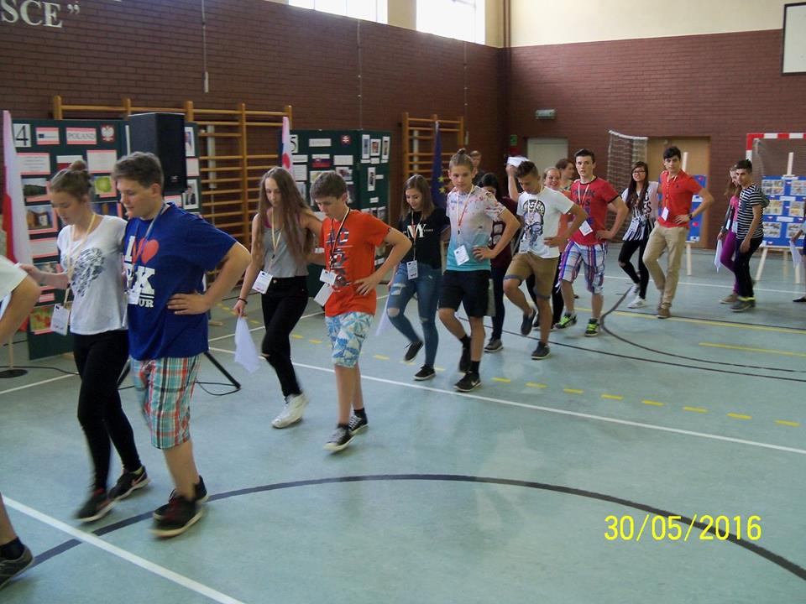
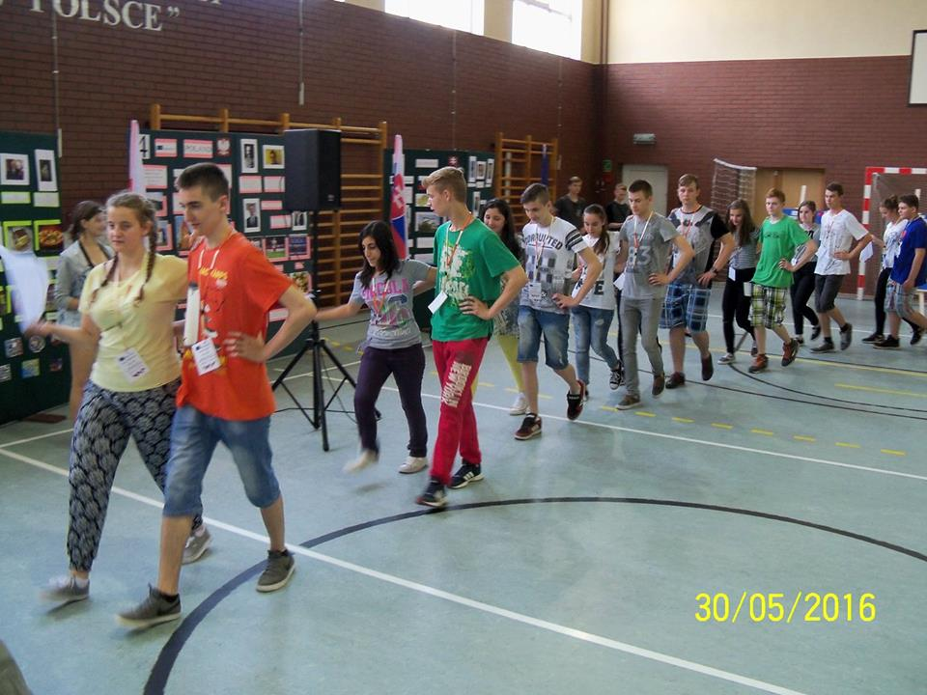
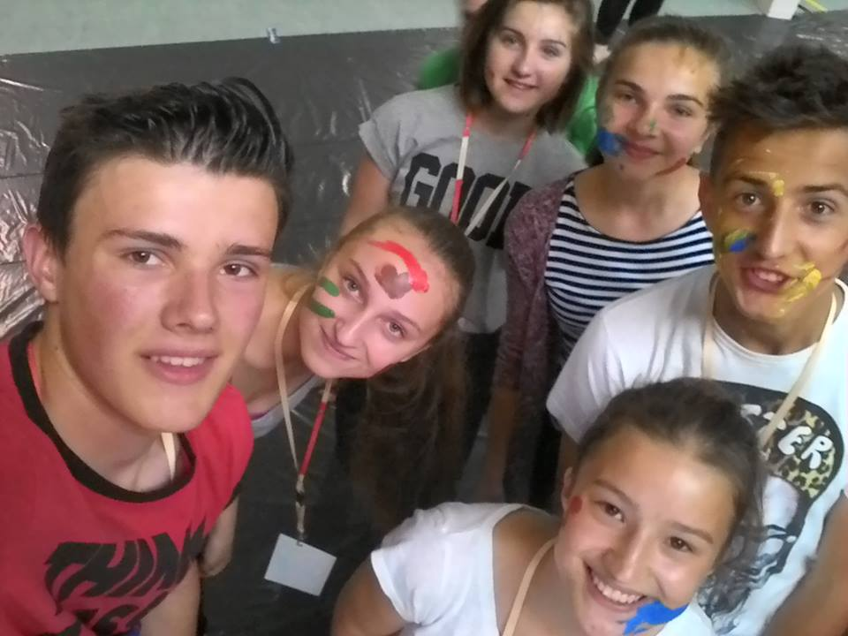
Monday
On Monday, we learned how to dance Polish dances.
But it was still the best painting hand, foot.

Slide 3
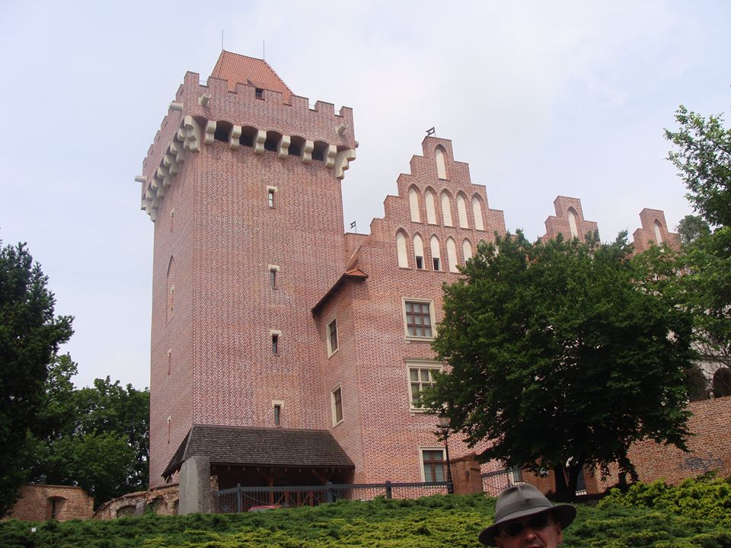
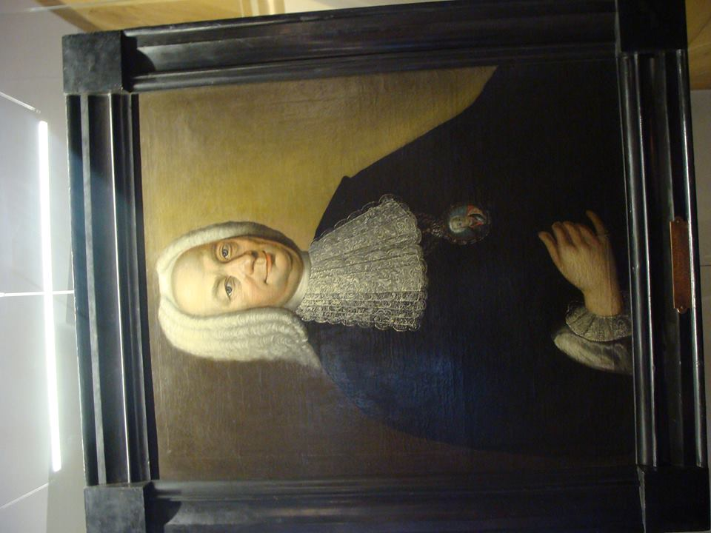
Tuesday
On Tuesday we were in Torun. There were beautiful buildings

Slide 4
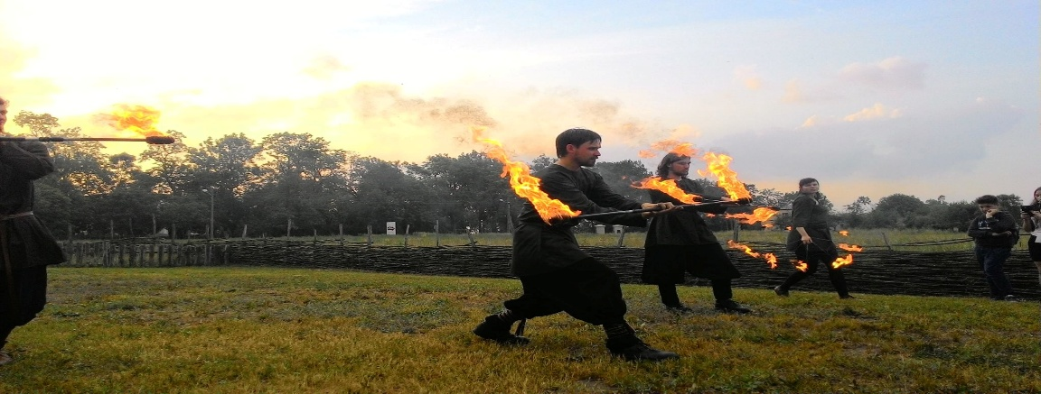
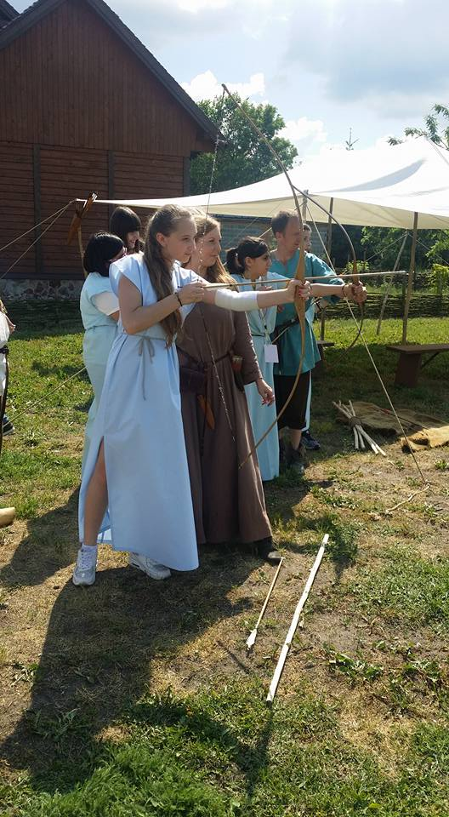
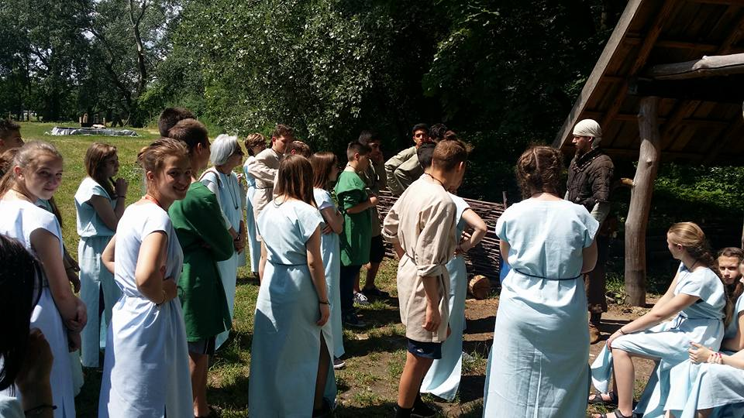
Wednesday
In Wednesday we had a historic day which was very entertaining.
They were ready for us various fun activities
Finally, we saw the fire show

Slide 5
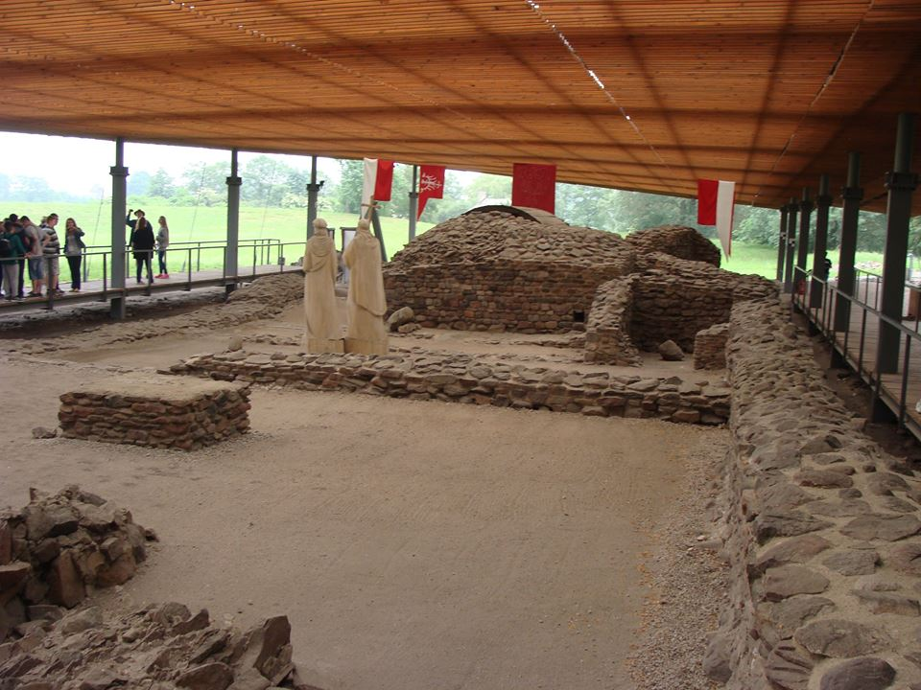
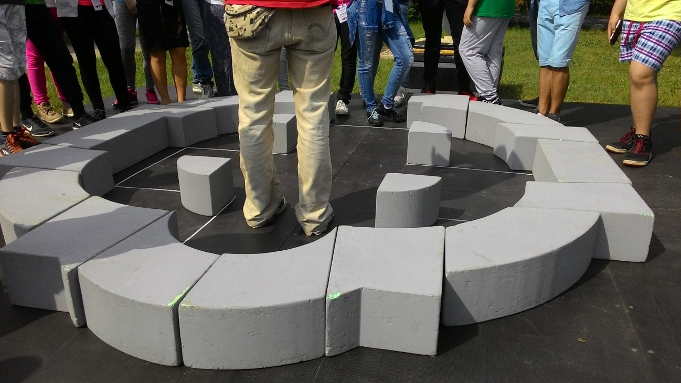
Thursday
On Thursday, we were on the island and in Poznan

Slide 6
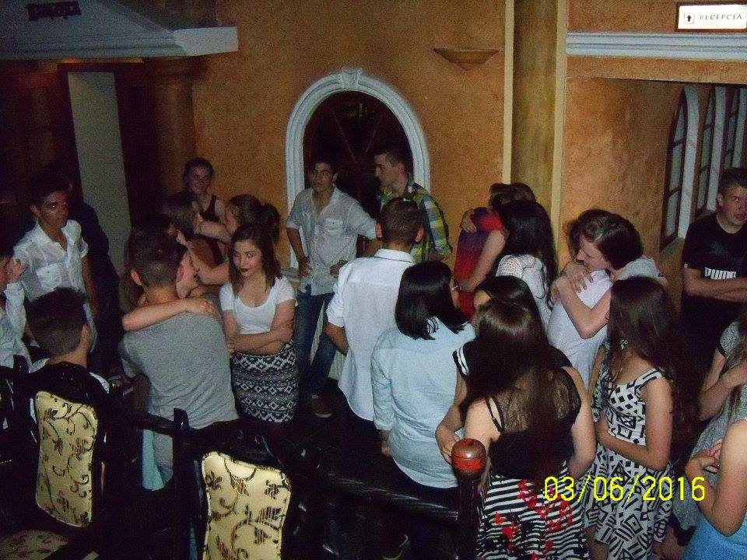
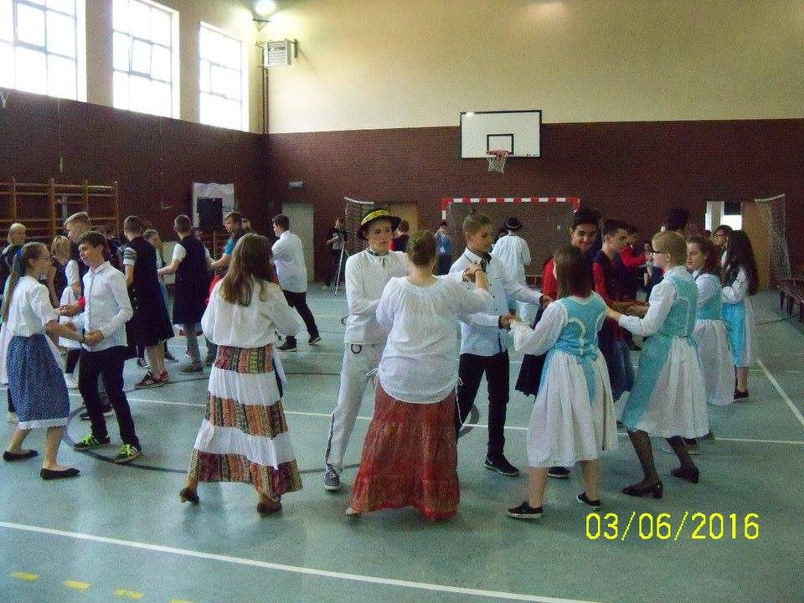
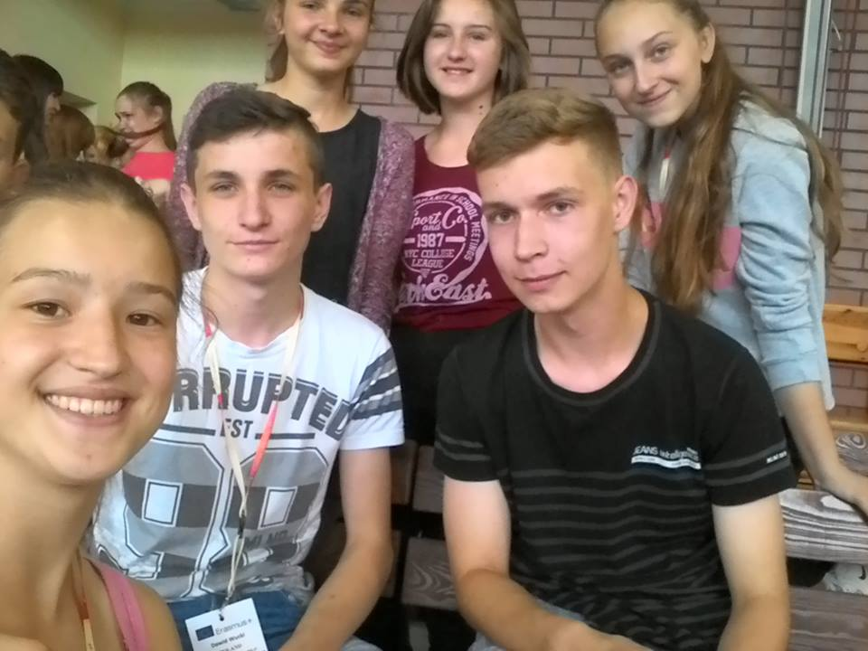
Friday
On Friday we performed in front of the school, inventing stories should Disco. And worst of what could come was parting

Slide 7
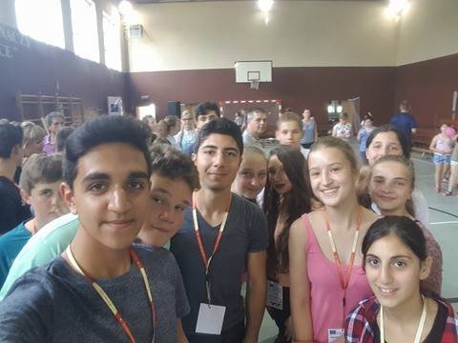
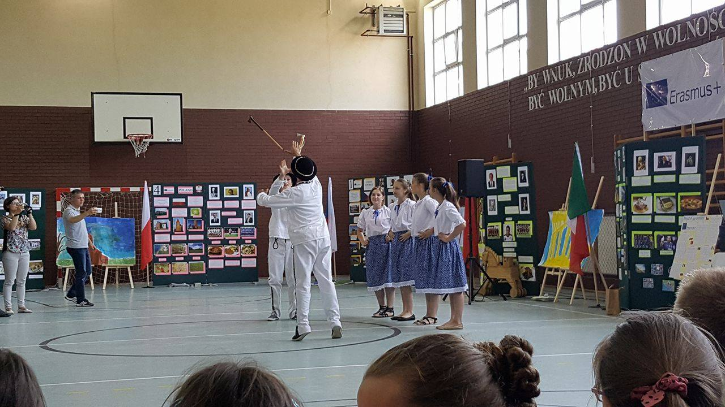
Thank you for this unforgettable week

