Slide 1
Jumanji
- Welcome to the jungle

Slide 2
TECHNICAL DETAILS
Director: Jake Kasdan
Genre: adventure, fantasy, comedy, action
Main Actors :
-Dwayne Johnson
-Jack Black
-Kevin Hart
-Karen Gillan
Release: 2017
Duration: 119 min

Slide 3
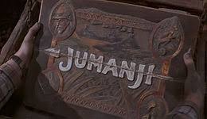
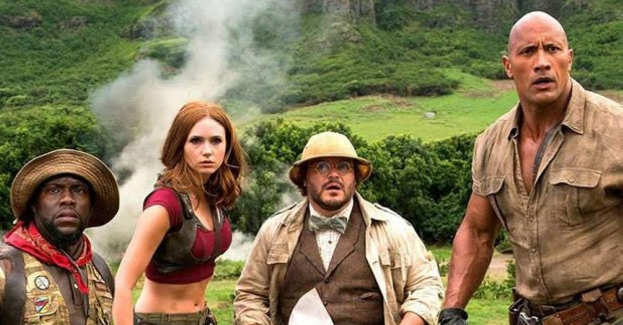
Jumanji Plot
In 1996, a teenager named Alex Vreeke receives the original Jumanji board game after his father finds it while jogging on a beach, but puts it aside, dismissively noting that nobody plays board games anymore, instead playing a video game involving motorcycles. Overnight, the game changes so that the box's contents are now a video game cartridge, but when Alex puts it in his console and turns it on, he vanishes.
Twenty years later, high school student Spencer Gilpin is sent to detention for helping his former best friend, Anthony "Fridge" Johnson, with his homework by writing Fridge's essays for him. They are joined by Bethany Walker, a beautiful girl who was caught talking on her phone during a quiz, and Martha Kaply, a socially awkward girl who objected to being made to participate in gym class. For detention, they are charged by Principal Bentley with removing the staples from discarded magazines in an old storage area, but Spencer discovers the console containing the Jumanji game and convinces the others to play it with him. They are unable to access one of the five-player options, a pilot, but once all four others have been selected, the game draws them all inside it.

Slide 4
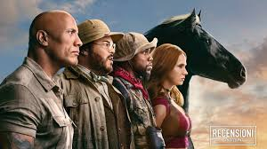
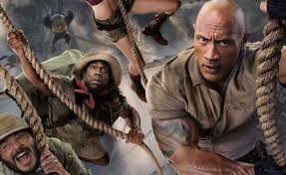
Finding themselves in a jungle, all four are shaken to realize that they have become the avatars they chose for the game. Spencer finds himself turned into Dr. Smolder Bravestone, played by Dwayne Johnson, a muscular archaeologist. Fridge arrives into the game as Franklin "Moose" Finbar, played by Kevin Kart, an expert zoologist, but Fridge is upset that his avatar is a foot shorter than he normally is. Martha becomes Ruby Roundhouse, played by Karen Gillan, the "killer of men". Bethany is now Dr. Shelly Oberon, played by Jack Black, a cartographer that Bethany mistook for a woman because the description read "curvy genius" (and she becomes horrified upon seeing her reflection). The four freak out as they realize they are in the game. Almost immediately, Bethany is suddenly eaten by a hippopotamus that emerges from the river, but she swiftly reappears after falling out of the sky. Fleeing from a stampede of hippos, the group encounter Nigel, whose repetitive responses help Spencer identify him as an non-player character, who tells them that they have come to Jumanji in response to a letter Nigel wrote to Spencer's avatar. The letter explains that Nigel was part of an expedition by explorer John Hardin Van Pelt to claim the legendary gem, the "Jaguar's Eye", removal of the gem from the large jaguar statue granting Van Pelt control over the animals of Jumanji.

Slide 5
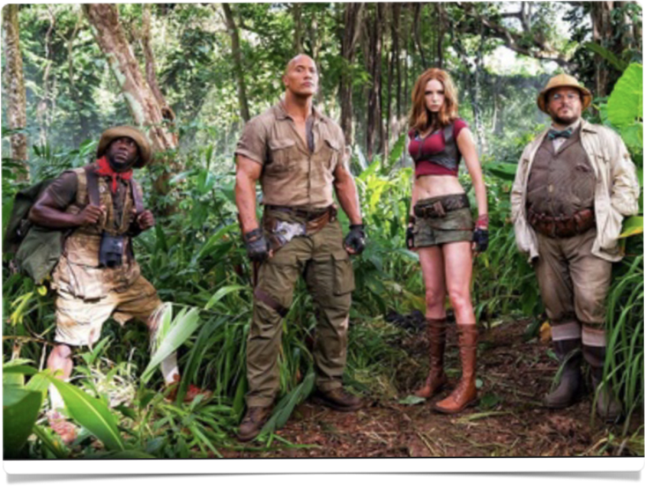
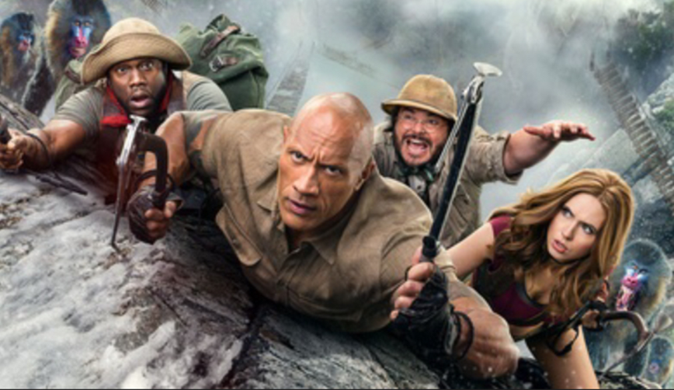
In order to complete the game, the players must return the gem to the jaguar statue and call out “Jumanji”. are dropped off outside a forest, it. With those instructions given, the group where is that Bethany alone can read the map gave map stage of their quest. revealed after her forearms, now only of lives they that she has of Nigel returns to the group them, the directing them to the next They are subsequently attacked by Van Pelt's menon manage to escape by fleeing through the trees and jumping off a .After emerging from the, Martha realizes been immediately avatar explodes. Examining series of line tattoos which originally consisted three where Martha and Bethany have two, Spencer realizes these indicate the number have in the game, guessing world three river their both in the game, and in the real a on bars motorbikes, but cliff into a river. shot, but that bars that they will die for good, as well, once they lose all lives.
While traveling to the bazaar where receive argument between Spencer and Fridge over Fridge's perception enter's problem results in Fridge pushing Spencer off a cliff, costing In the bazaar, as one of his Fridge loses one of his lives when cake - previously identified character's weaknesses - and explodes, drawing the attacked, they attention of Van Pelt's minions.
Fortunately, before discover their next clue able to by hidden in a their basket containing which the team are acquire pooling skills and coming together, allowing Spencer to catch the snake while Fridge defangs it. off, but they are When Pelt's forces attack, Spencer attempts to fight them soon confronted by Van himself, onlyjust escaping when another player uses smoke grenade distraction and lead role in this one of his lives. they are a snake, Van a Pelt as a they will their next clue, an of Sp him he eats them to a secret passage.

Slide 6
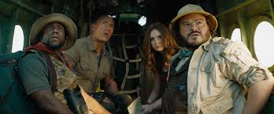
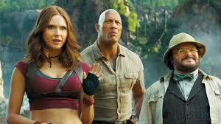
There is a brief panic when damage to the helicopter traps it in a canyon in front of a rampaging herd of white rhinoceros, but Spencer is able to repair the damage and help them ascend. Unfortunately, they lose the gem when it falls out of Fridge's backpack, but Spencer is able to reclaim the gem after using Fridge as a 'sacrifice' to draw the rhino herd's attention, subsequently ordering Alex to spin the helicopter in time to catch Fridge as he 'respawns'. Once they land, Alex is stung by a mosquito and begins to die due to his avatar's weakness, but Bethany saves him by giving him CPR, which passes one of her remaining lives to him. As they prepare for their next step, Spencer and Martha admit that they have feelings for each other in the real world, while Bethany begins to bond with Alex.
Making their way to the jaguar statue, they find themselves confronted by actual jaguar guards, which cost Spencer one of his lives when he attempts to take the gem along the path to the statue alone. With Fridge's support, Spencer implements a plan where Martha takes out Van Pelt's approaching minions while the other three provide a distraction for the jaguars, leaving Spencer to take one of the minion's motorbikes and continue to the statue. Van Pelt attempts to gain the advantage by taking Bethany hostage, but Fridge is able to drive the jaguar guards away by befriending an elephant, only for the players to lose the gem when it is thrown away. While the others distract Van Pelt's minions, Spencer takes the bike to the top of the statue while Martha retrieves the gem from a pit full of snakes, using her character's weakness to venom to sacrifice her second life and 'respawn' in a position where she can pass the gem to Spencer as she falls. With this action, Spencer places the gem in the statue and calls out "Jumanji!", ending the game and restoring the jungle to peace. With this victory, Nigel appears to congratulate the group, shaking their hands and returning them to the real world.

Slide 7
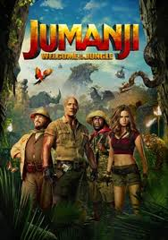
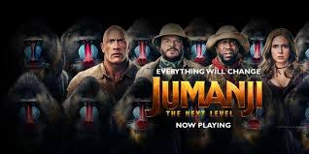
Back in the storage room, all four detention students have returned to their true forms, but are saddened to find that Alex is not among them. As they walk home, they witness the Vreeke household - which had fallen into disrepair as Alex's parents had no answer as to his fate - has been fully restored. As a car parks outside the house to release a family, the father sees the former players and confirms that he is Alex, who emerged from the game in 1996 and changed his history, also revealing that he named his eldest daughter after Bethany.
The following week at school, Spencer and Fridge are friends once again, and Bethany is making plans to go backpacking, while Spencer and Martha start dating. When they hear the drumbeats of Jumanji, they take the console out to the back of the school and Fridge drops a bowling ball onto it, each intending that this will end the game once and for all.
However, at the end of the end credits, Jumanji's menacing jungle drums play once again, suggesting the game still exists in some form to play another of its dangerous games.

Slide 8
Jumanji and Time-Traveling
One of the main themes of the film is time traveling. What is time traveling?
Time traveling is the concept of movement between certain points in time, analogous to movement between different points in the space by a person or an objects using a device known as time machine. In the film there’s a time jump of 20 years, from 1996 to 2017, and the radical shift in the time and space greatly disorients the characters, also due the change of bodies.

