Slide 1
MATHS AND FUNDRAISING
BALIKESİR KARESI SECONDARY SCHOOL

Slide 2
MATHS AND FUNDRAISING
For the first part of this activity our 8th class students donated 2 liras for cat houses and with that money they bought the needs for cat houses. As a result 110 cat houses were made by our students in Technology and Design lessons and they were left to the streets for the cats in snowy days.

Slide 3
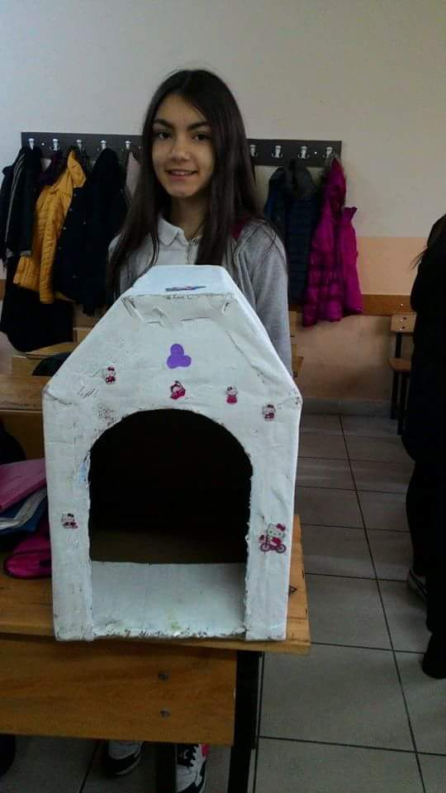
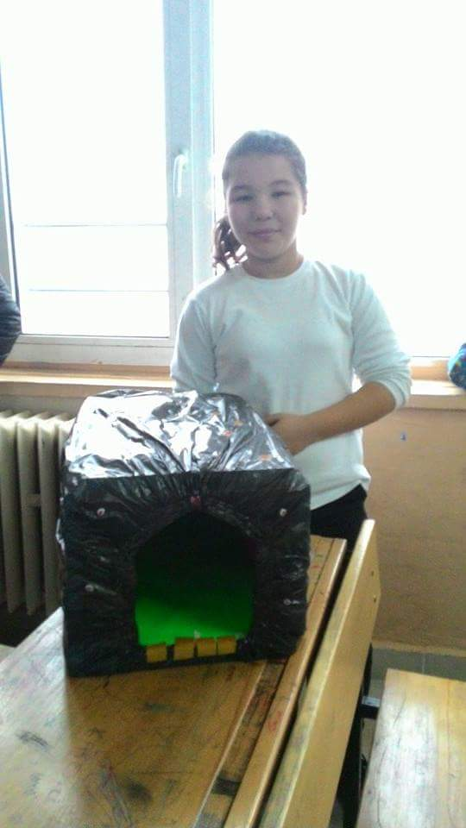
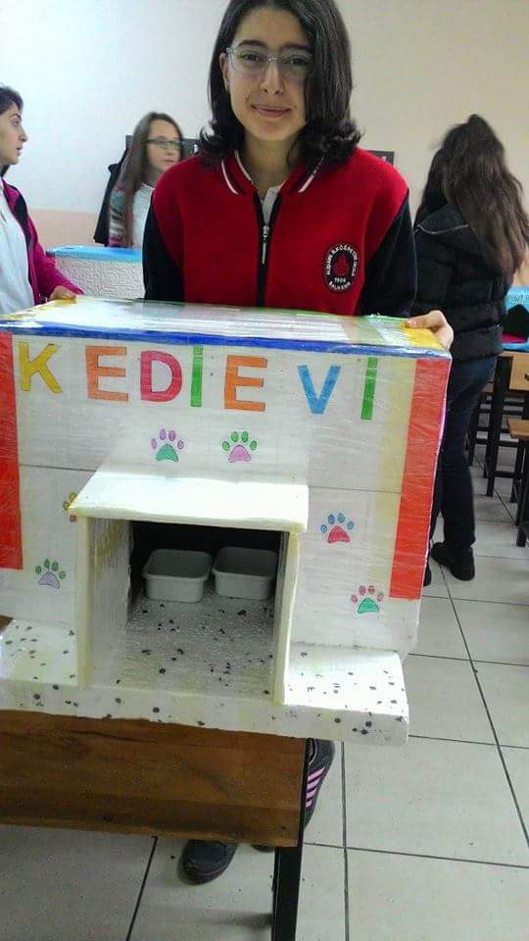
Cat Houses ☺

Slide 4
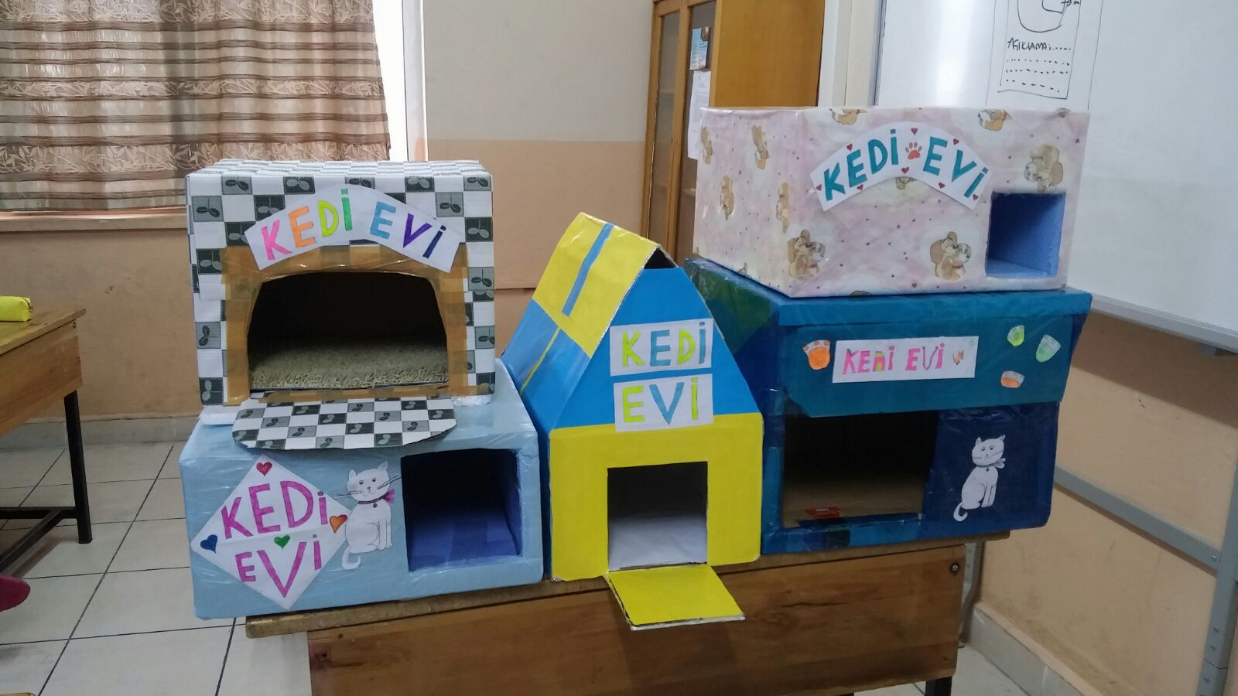
Cat Houses

Slide 5
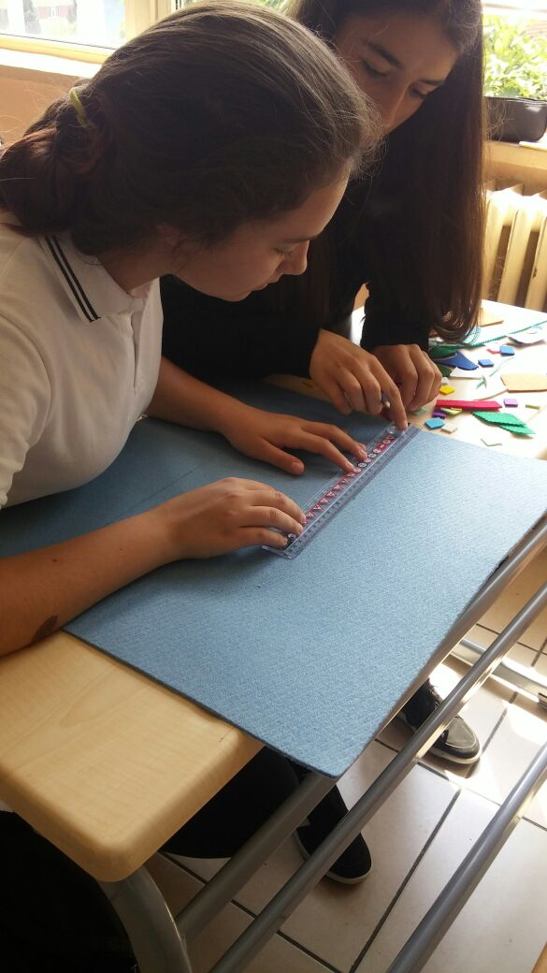
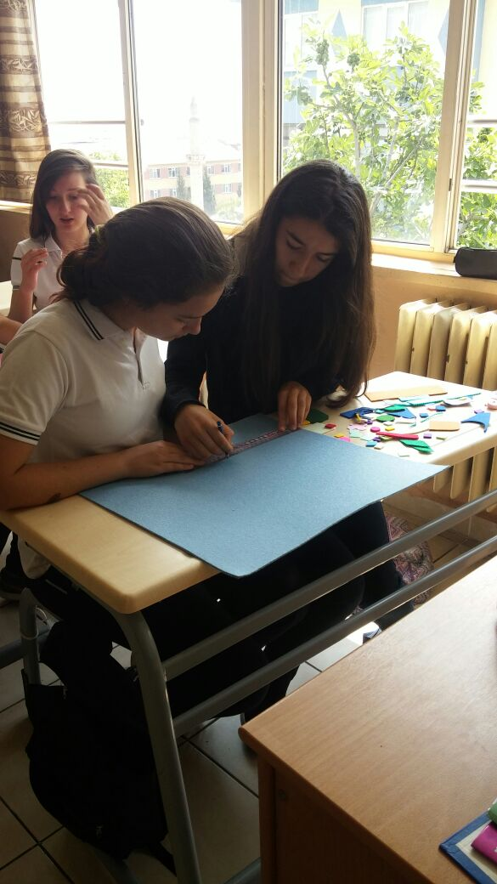
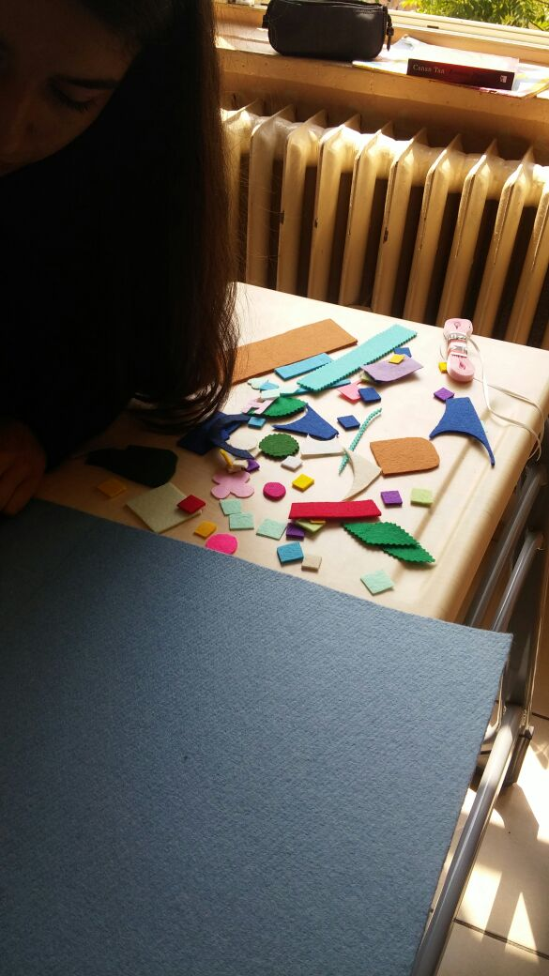
Our students also designed some book spreads and wall decorations

Slide 6
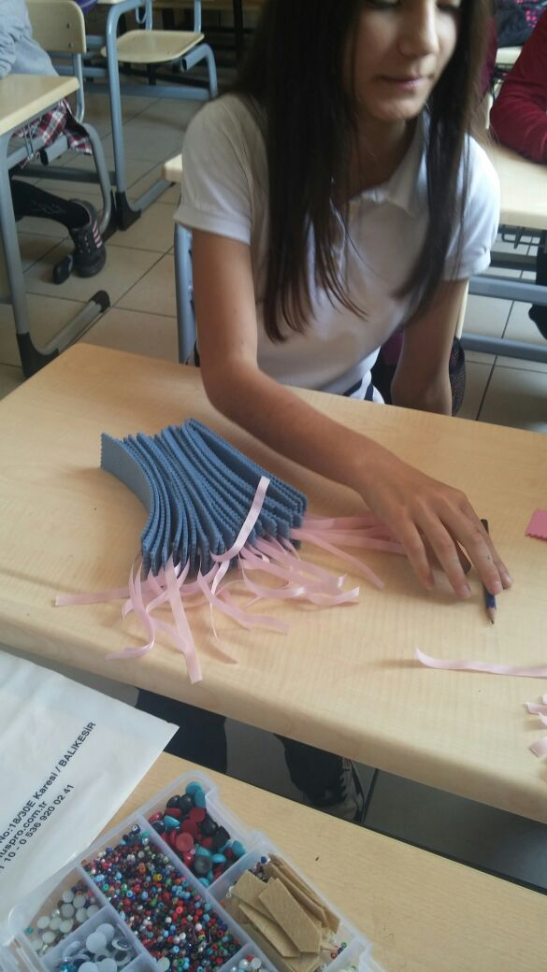
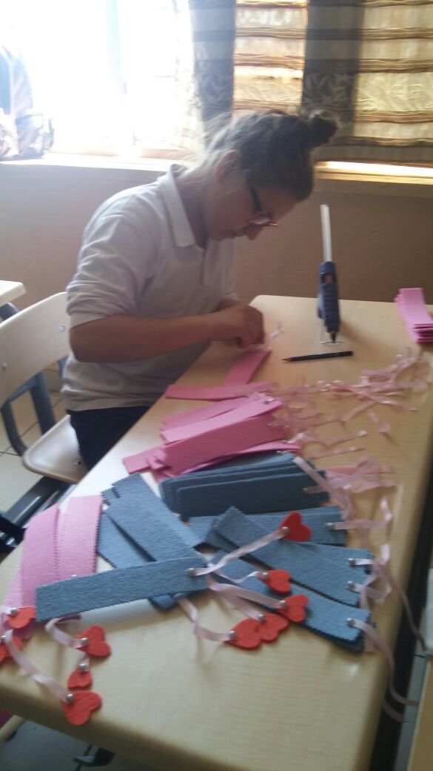
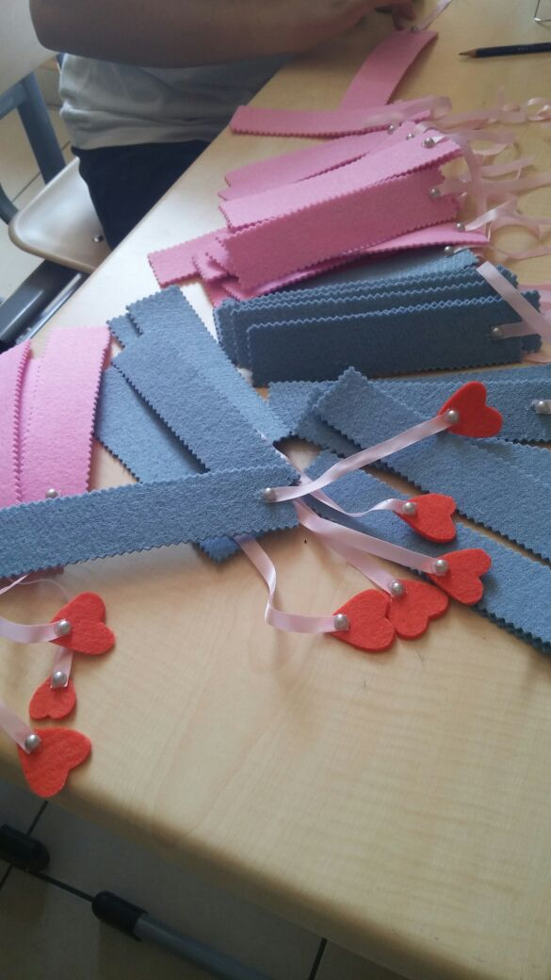
They will be sold in our school kermis

Slide 7
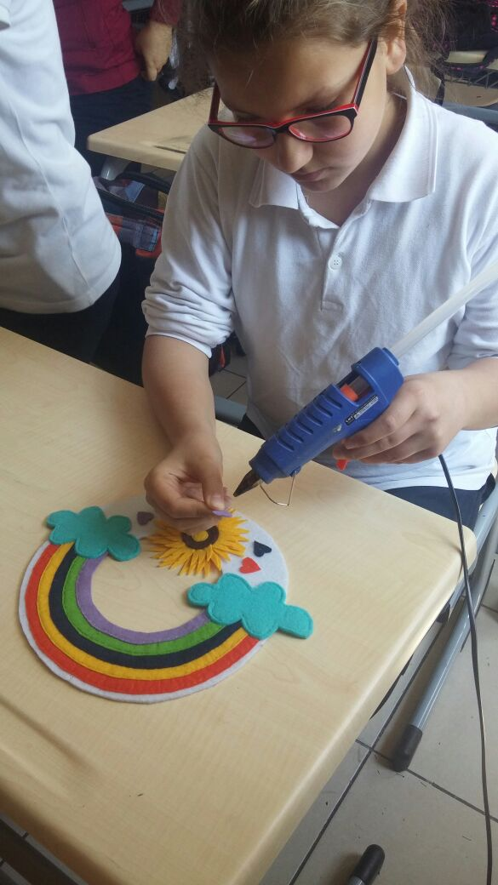
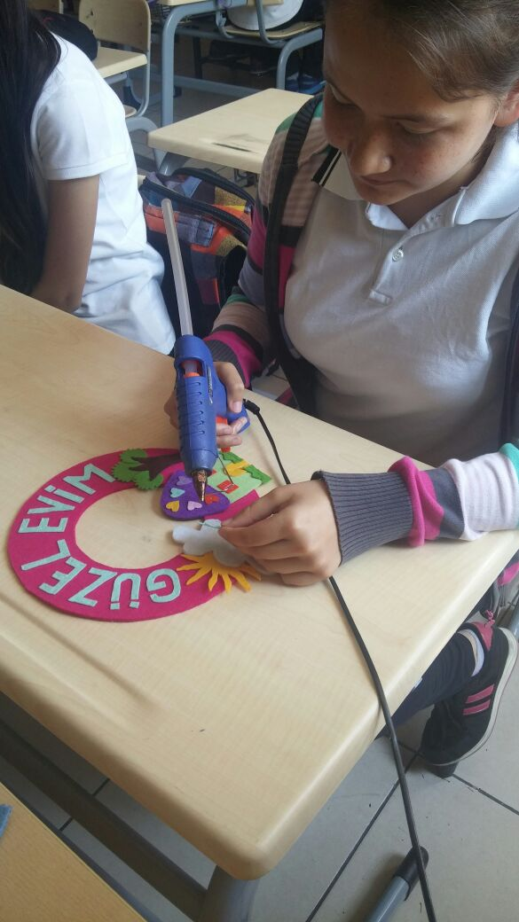
We hope to get almost 200 liras after selling them to use in our science laboratuary

Slide 8
Donation for the Orphans
All of our classes collected money in their class moneyboxes for the children whose mother and father died. We have been collecting money for 4 months
Every month moneyboxes are opened and the money is sent to the children.
We have collected about 900 liras since we started and the activity is still going on…

Slide 9
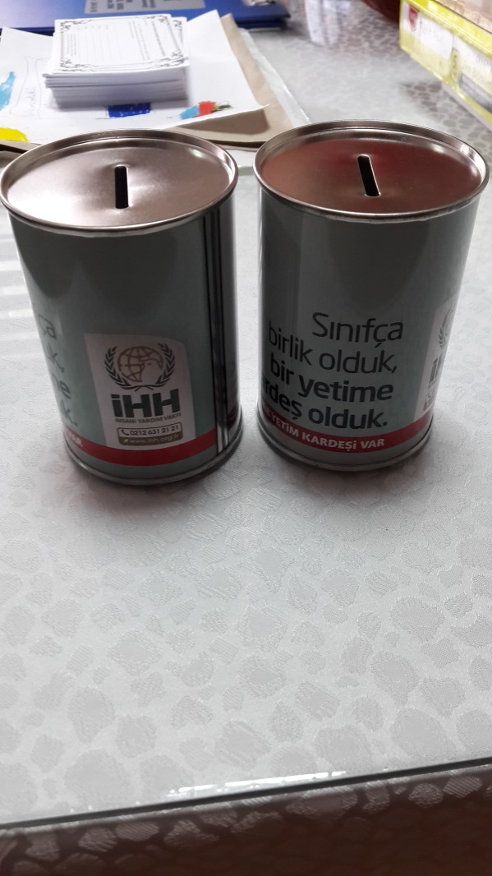
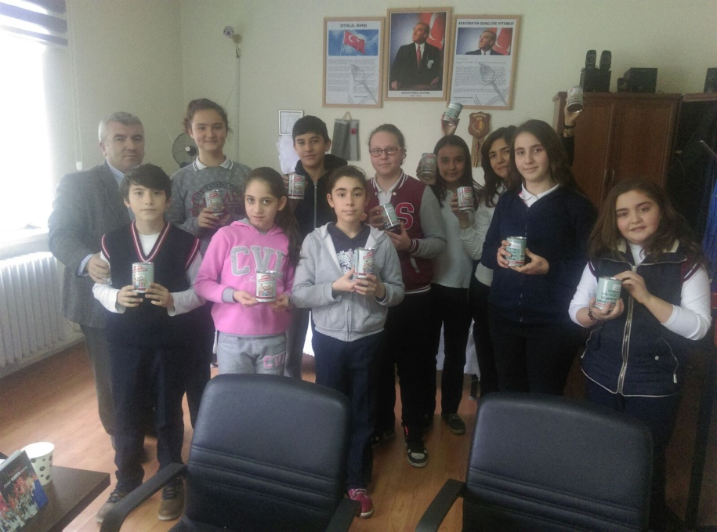
These are the moneyboxes and responsible students for the moneyboxes

Slide 10
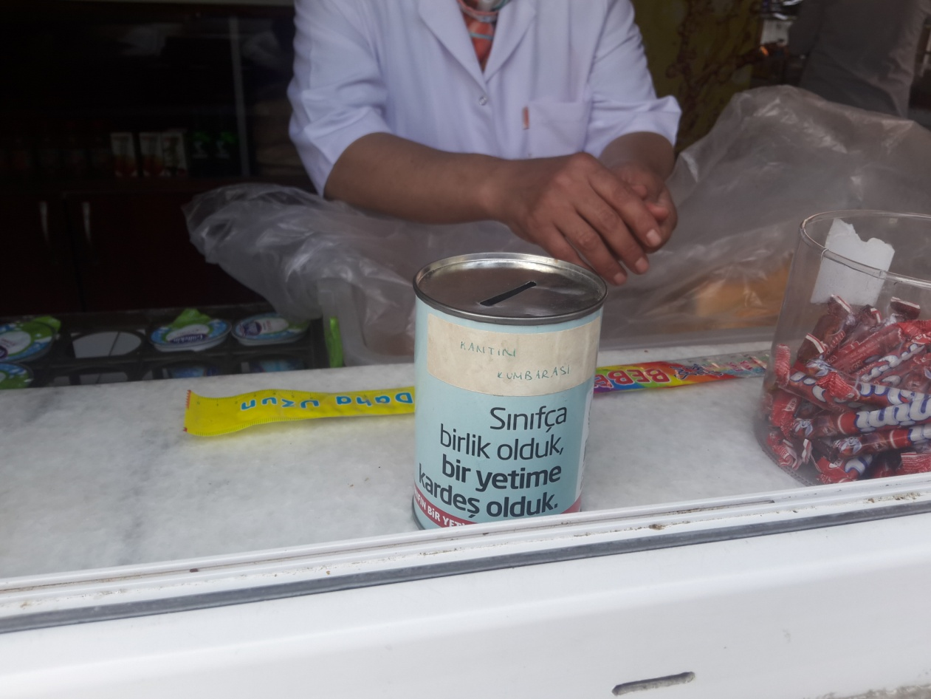
We have even have a moneybox in our school canteen

Slide 11
Dreams comes true ☺
It is obligatory to wear uniforms in our school.
For this part of Maths and Fundraising activity students came to school with daily clothes after donating 2 liras ☺
Here are their photos having fun
We will use this money in our students graduation party!

Slide 12
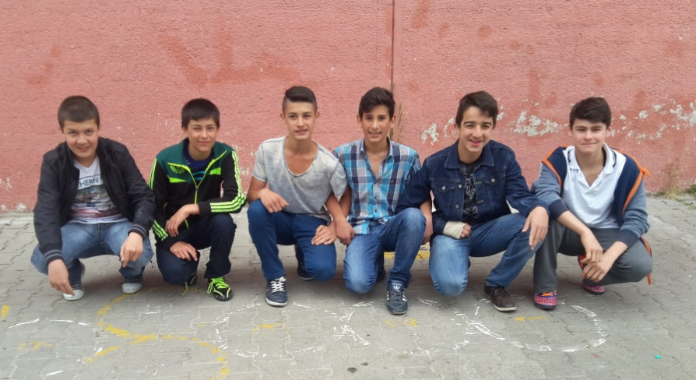
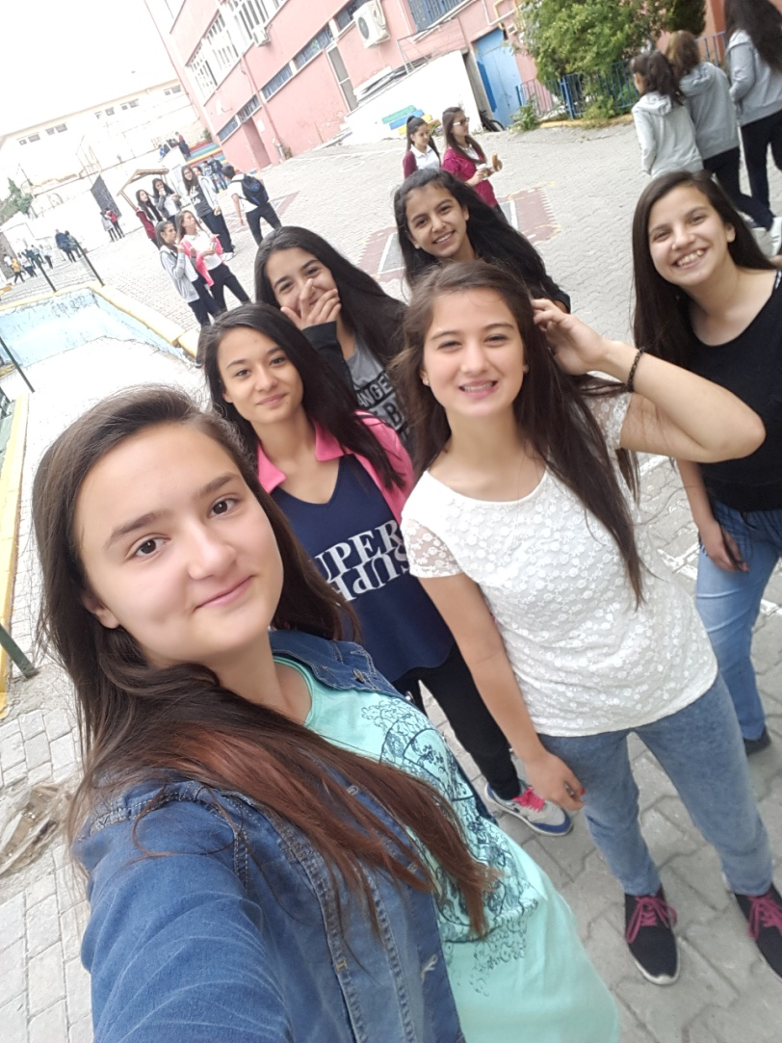
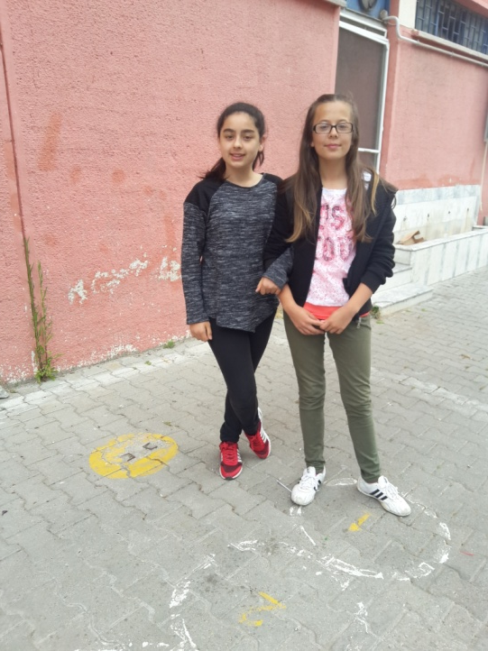
Photos of the day ☺

Slide 13
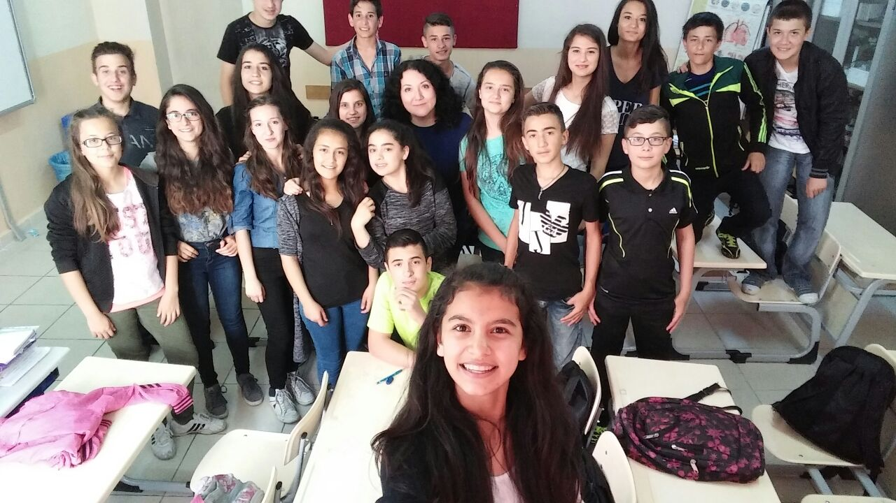
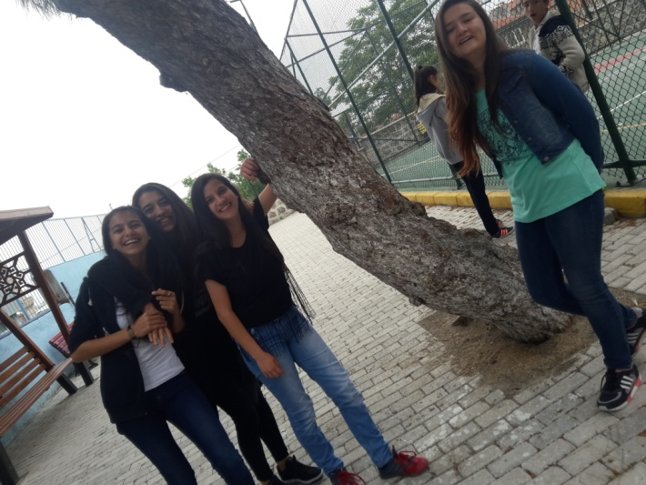
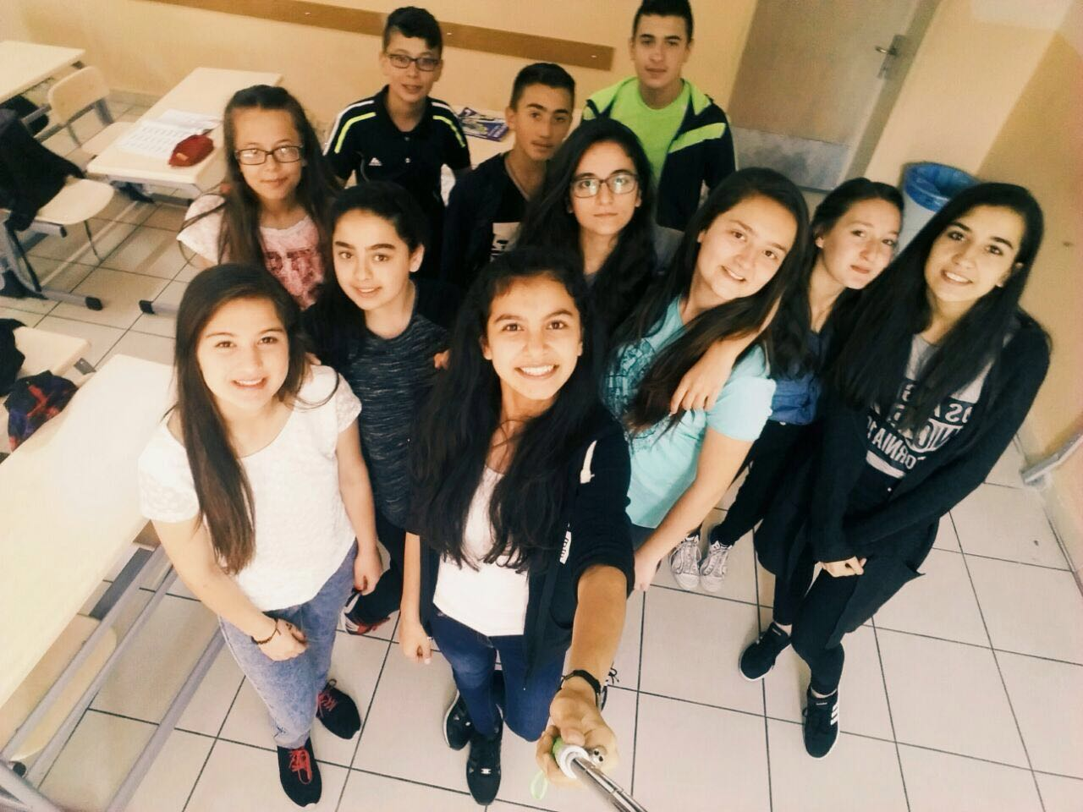
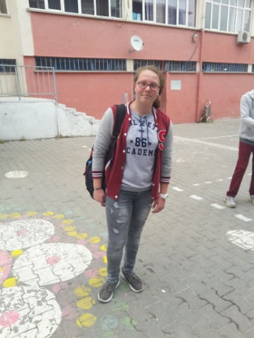
More ☺

Slide 14
Thanks for watching and listening

