Slide 1
BALIKESİR KARESİ ORTAOKULU
MATHS IS EVERYWHERE
MATHS AND ART
ACTIVITY 4

Slide 2
MATHS AND ART

Slide 3
Maths and Art
For the Science Fair organised in our school, our students made researches about Maths and Art.
We found that there were many relations between the maths formulas and relations between famous buildings.
We saw that many of the architects of the famous buildings used golden ratio.
Here are some examples

Slide 4
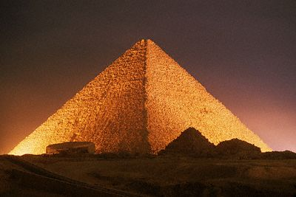
GREAT PYRAMIDE IN EGYPT

Slide 5
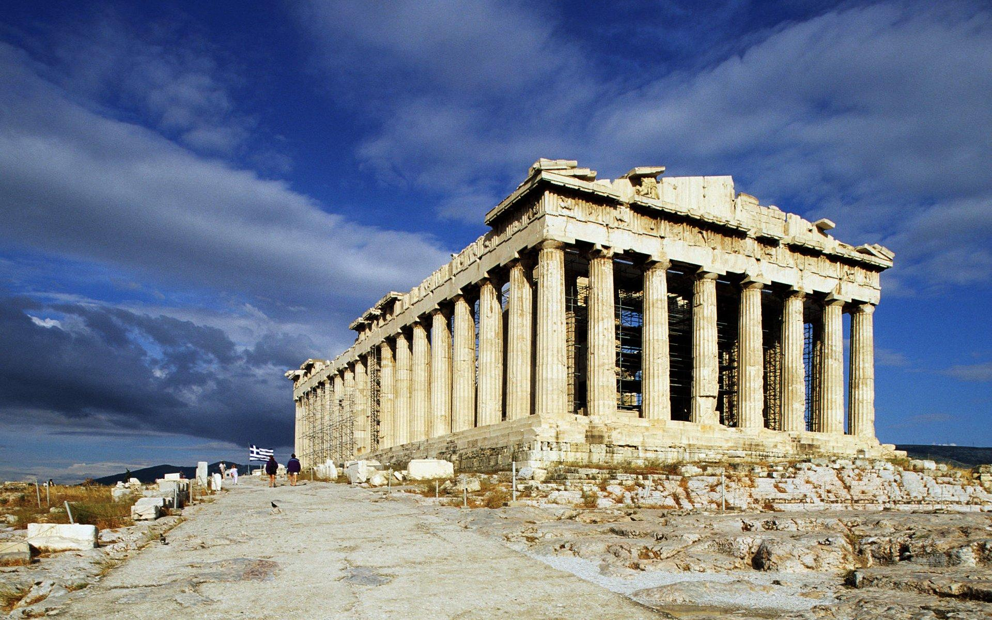
PANTHENON IN ATHENS

Slide 6
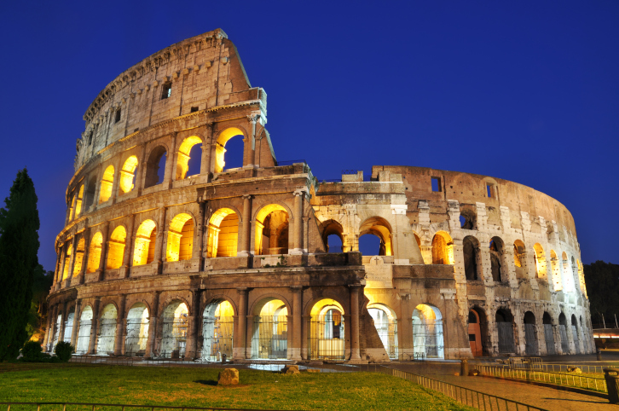
COLLOSEUM IN ITALY

Slide 7
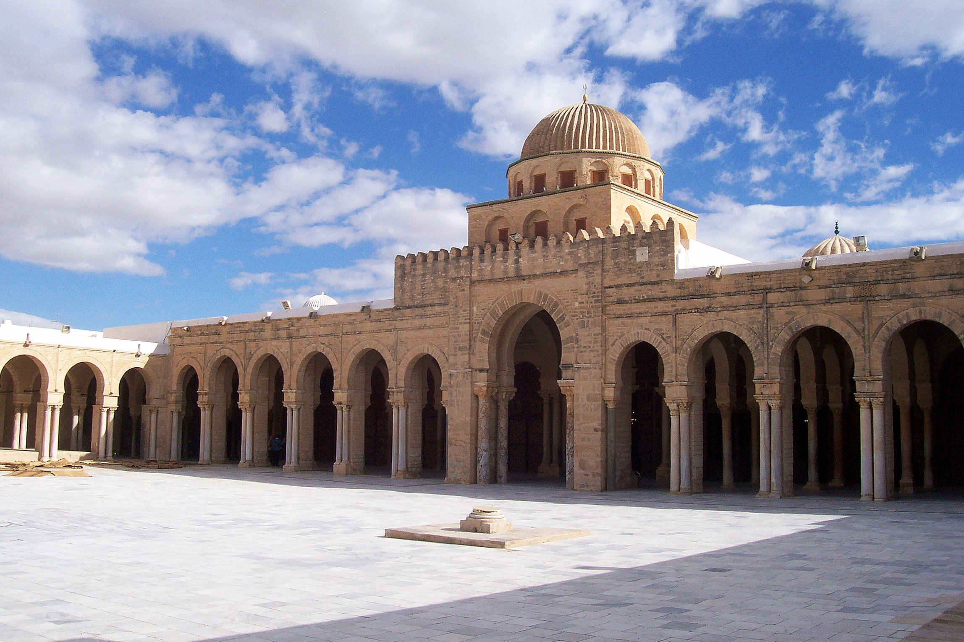
GREAT MOSQUE IN TUNUSIA

Slide 8
Mimar Sinan
A great Turkish architect Mimar Sinan who lived during the most powerful times of Ottoman Empire was a great mathematician. It is said that he solved an 13 unknown equation when building Selimiye mosque.
And also he used golden ration too.
Here are some examples of his work.

Slide 9
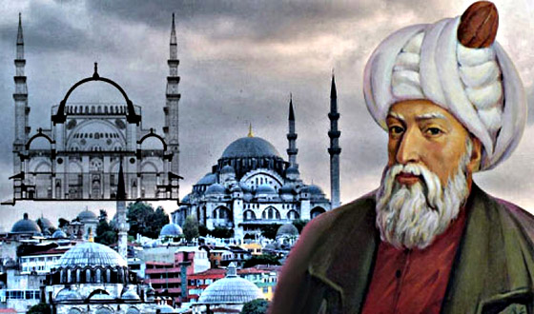
Mimar Sinan

Slide 10
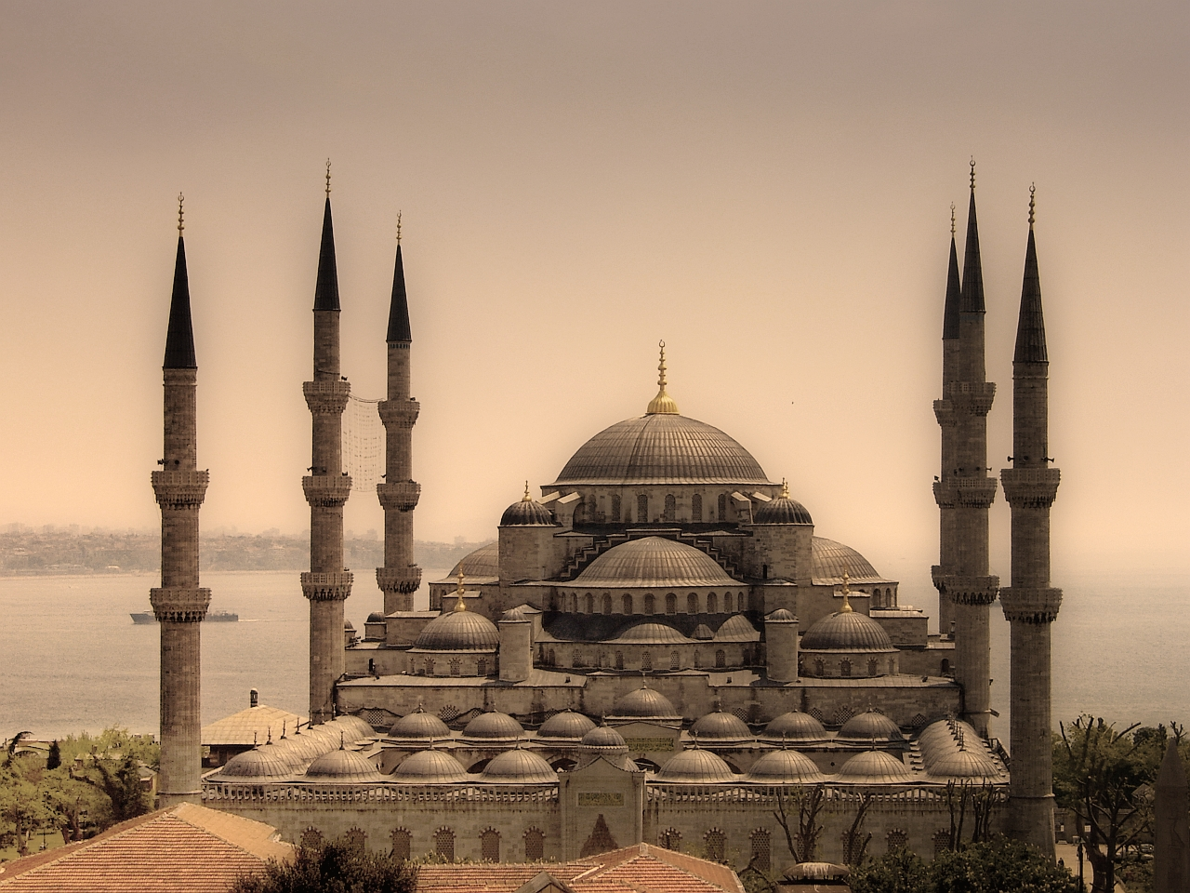
SULTANAHMET MOSQUE IN ISTANBUL

Slide 11
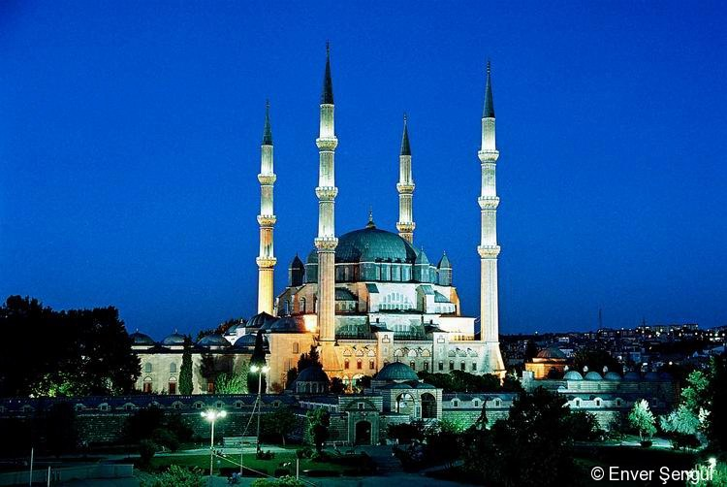
SELİMİYE MOSQUE IN EDİRNE

Slide 12
TURKISH ART AND MATHEMATICS

Slide 13
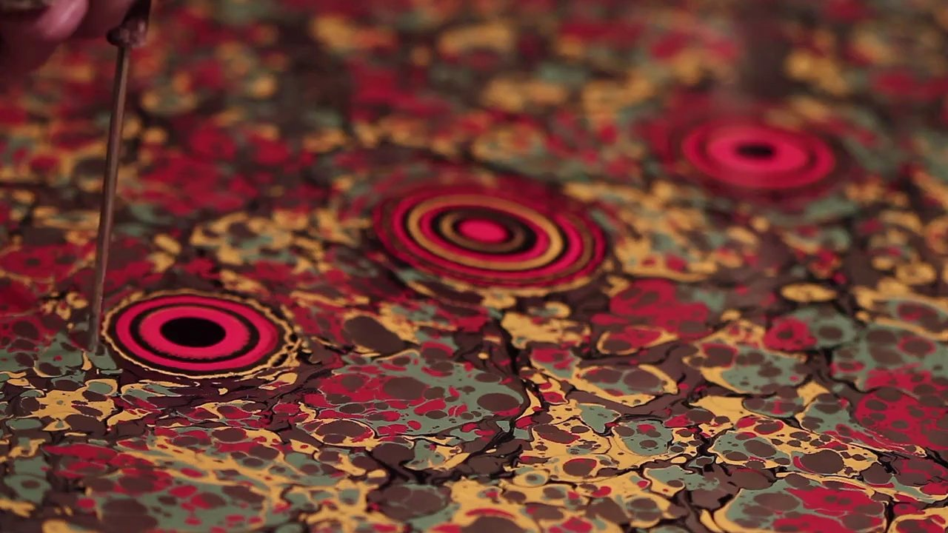
PAPER MARBLING (EBRU)

Slide 14
Paper marbling is a method of aqueous surface design, which can produce patterns similar to smooth marble or other stone. The patterns are the result of color floated on either plain water or a viscous solution known as size, and then carefully transferred to an absorbent surface, such as paper or fabric. We can see many mathematical shapes and patterns in this art.

Slide 15
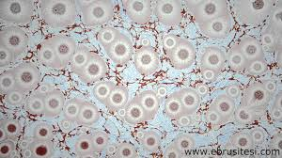
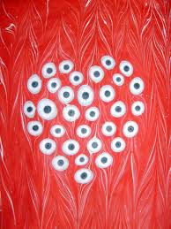
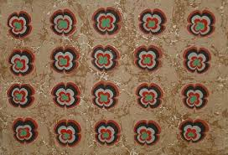

Slide 16
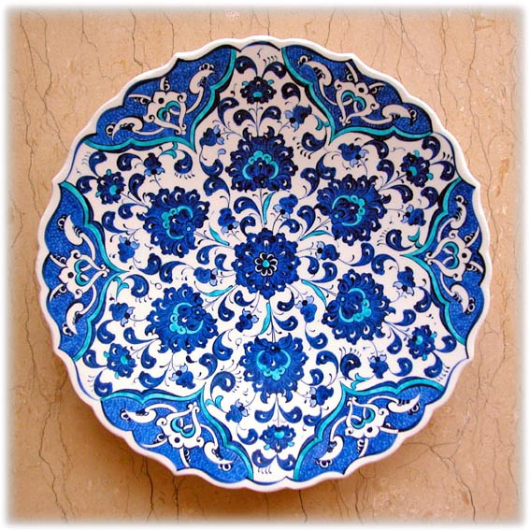
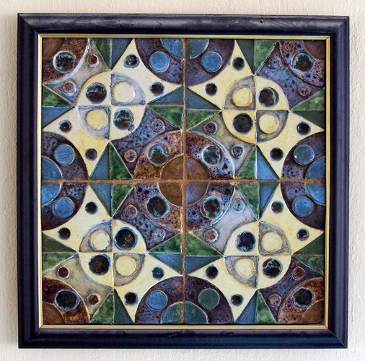
CERAMIC ART

Slide 17
This art is called “Çini” in Turkish and we can see many patterns and geometrical shapes in the products of this art.

Slide 18
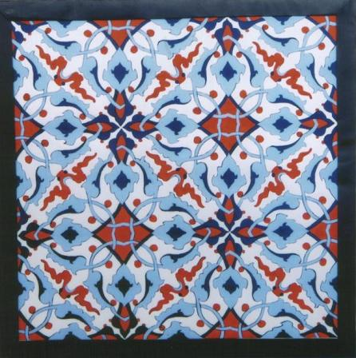
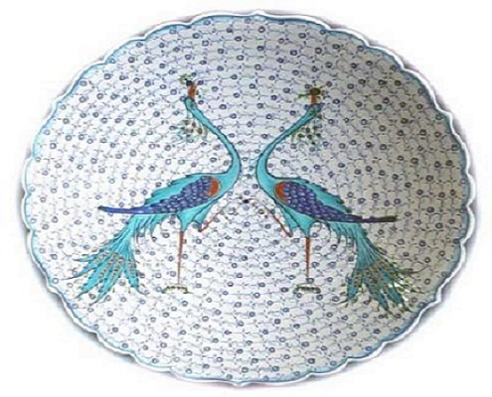

Slide 19
EL YAPIMI HALILAR
YAĞCIBEDİR HALILARI
SINDIRGI - BALIKESİR
HANDMADE YAĞCIBEDİR CARPETS
SINDIRGI BALIKESİR

Slide 20
Also in our city there are carpets which are made in a small town called Sındırgı.
We also found many patterns and geometrical shapes in those carpets

Slide 21
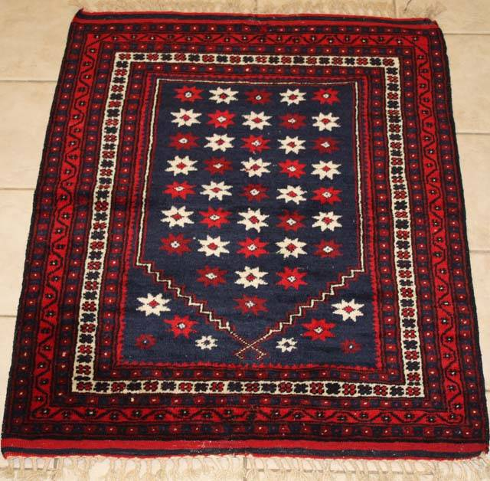
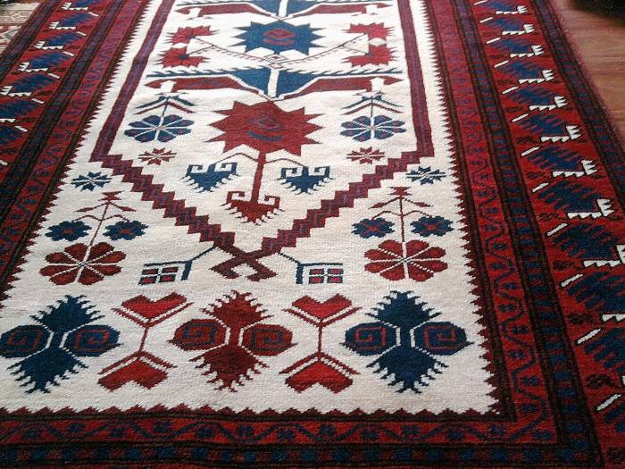
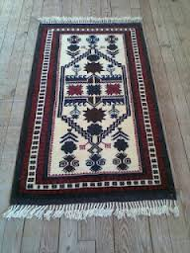
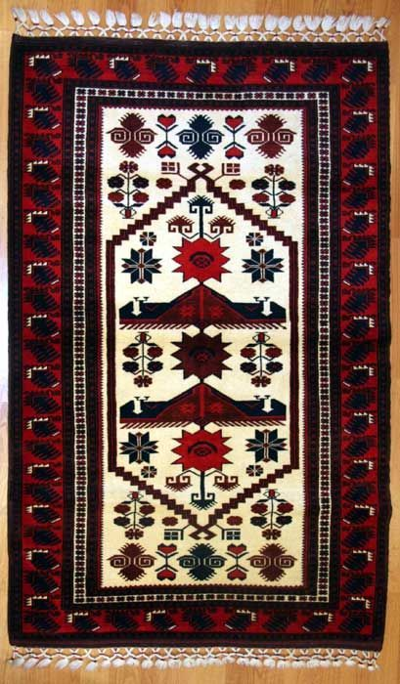

Slide 22
TÜRK MOZAİK SANATI
TURKISH MOSAIC ART

Slide 23
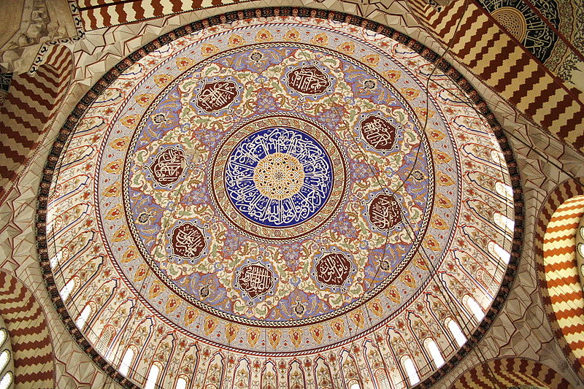
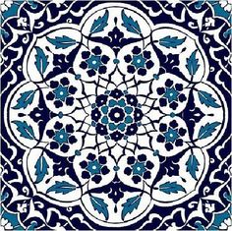
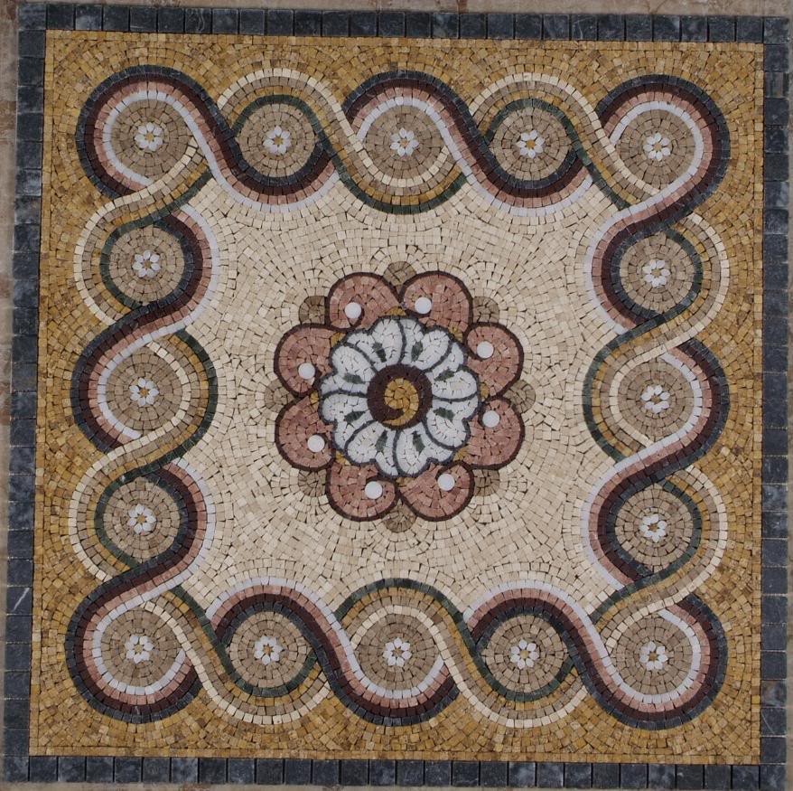
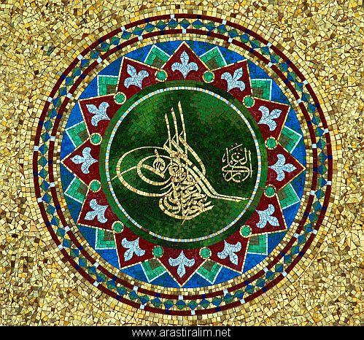

Slide 24
TÜRK MİNYATÜR SANATI
TURKISH MINIATURE ART

Slide 25
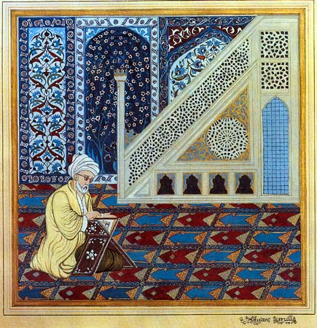
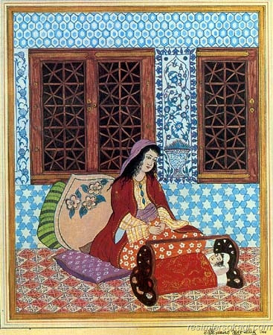

Slide 26
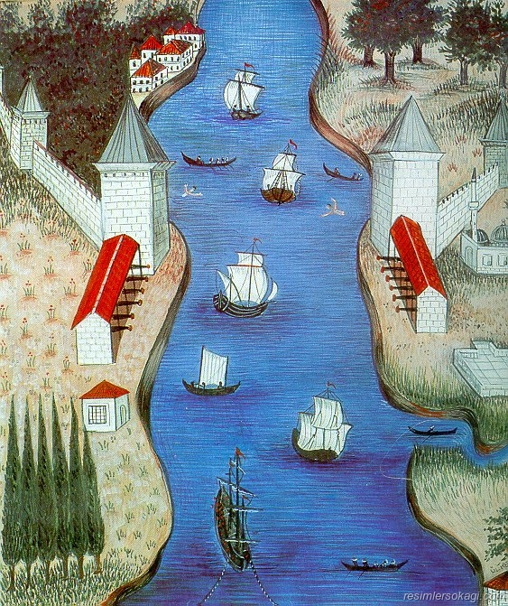
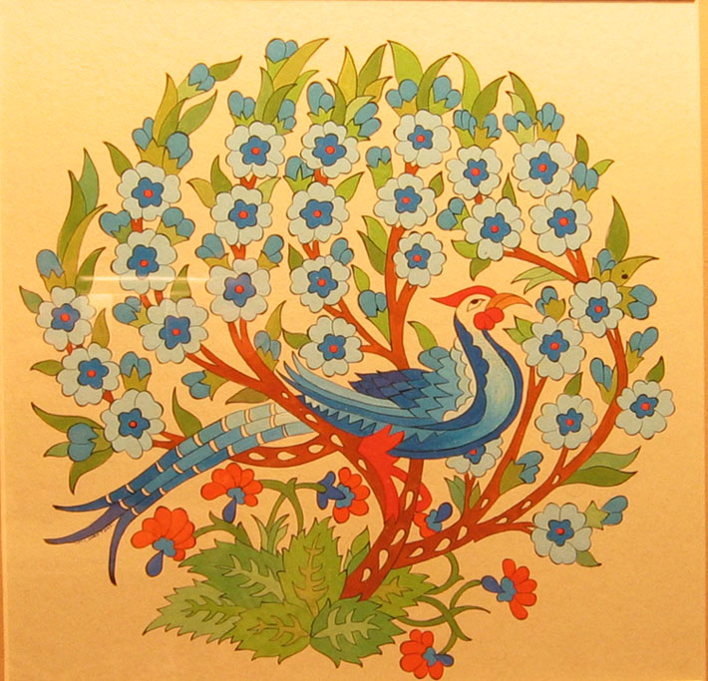

Slide 27
OUR WORK ABOUT MATHS AND ART

Slide 28
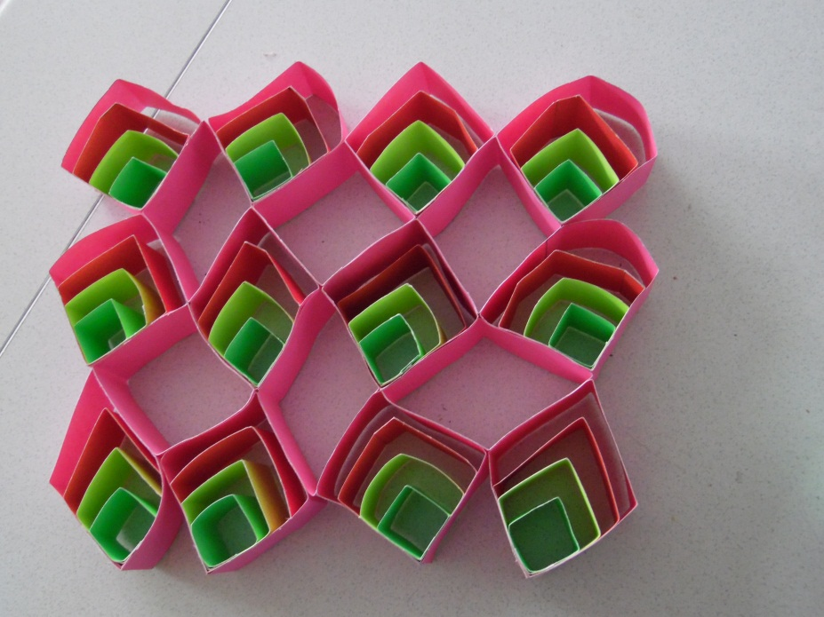
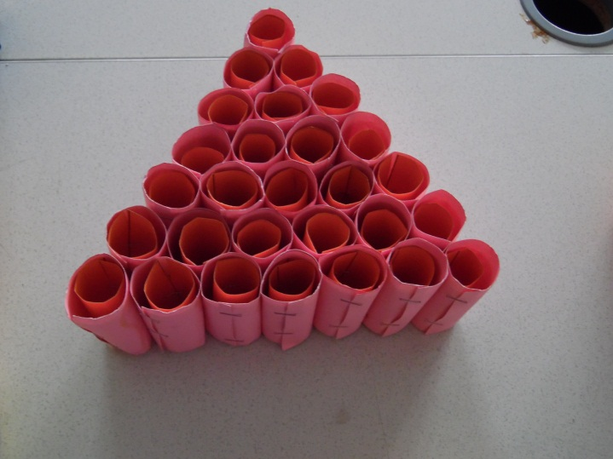
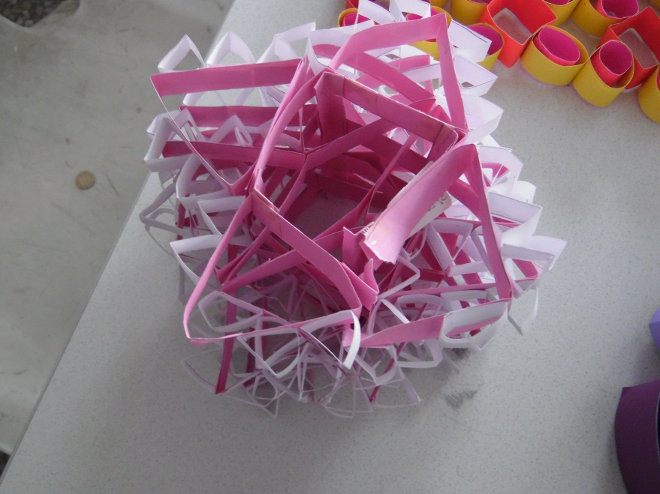
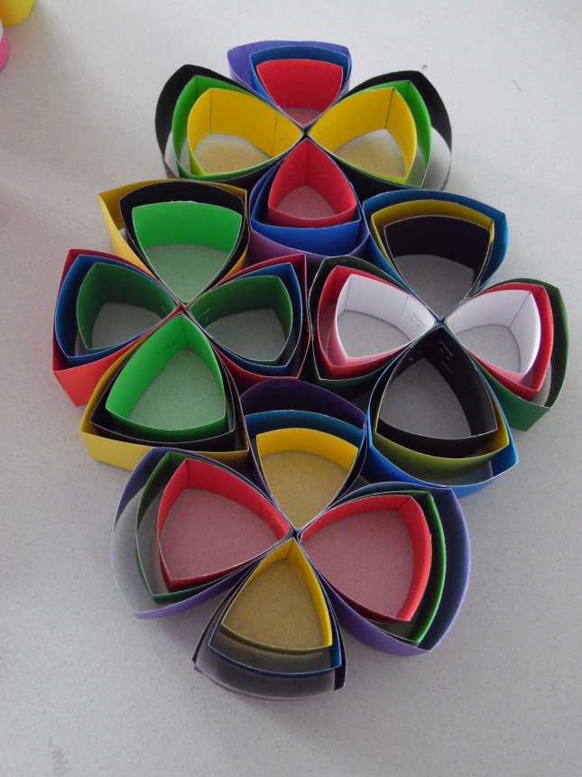
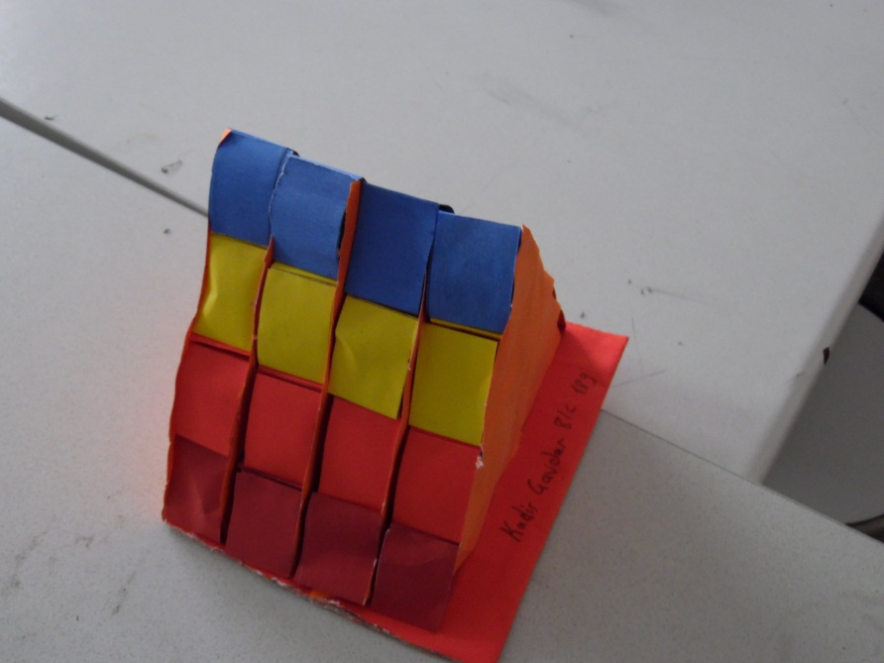

Slide 29
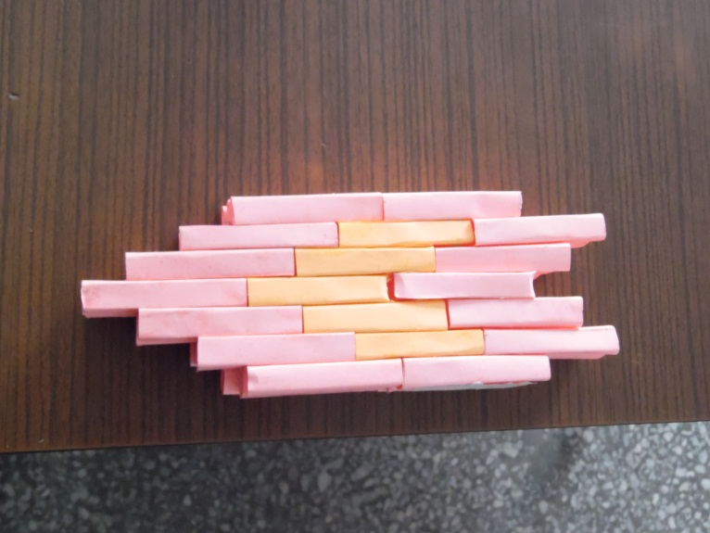
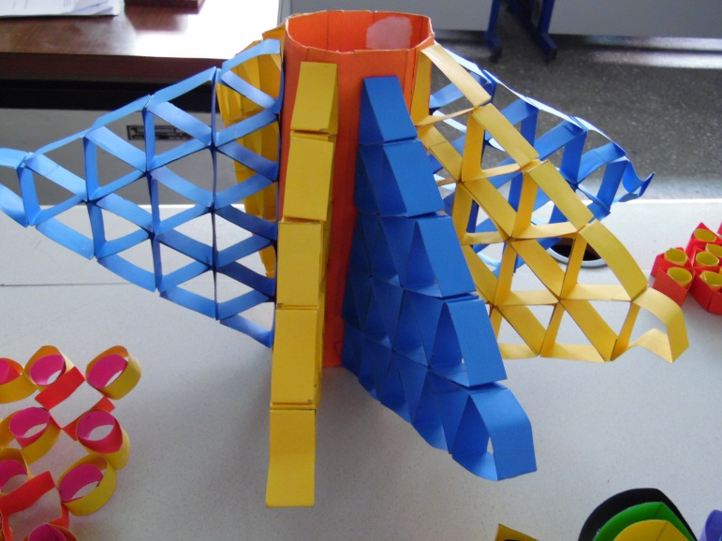
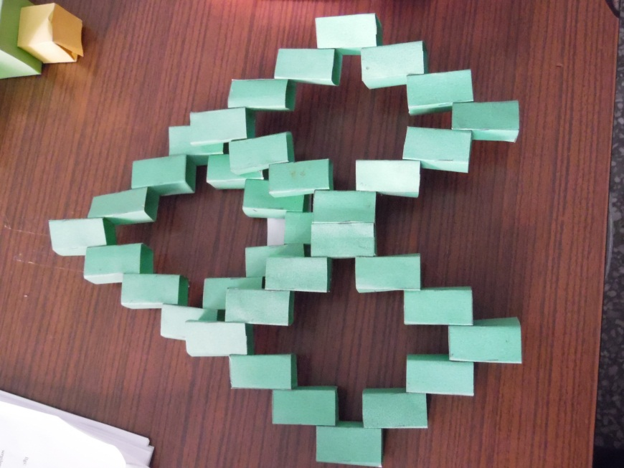
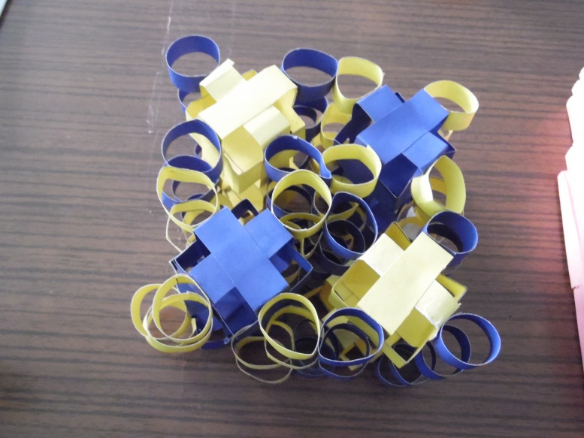
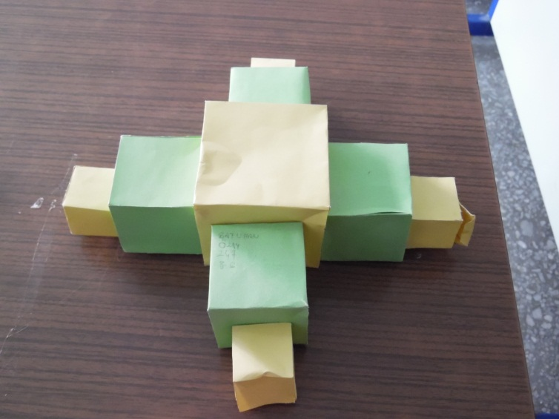

Slide 30
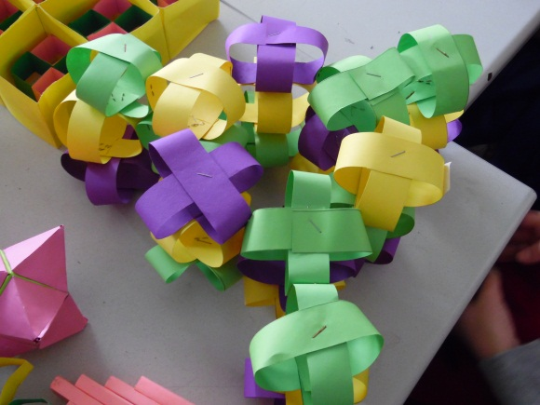
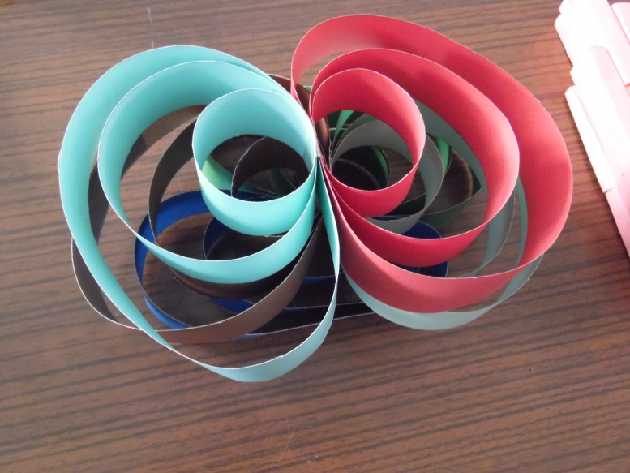
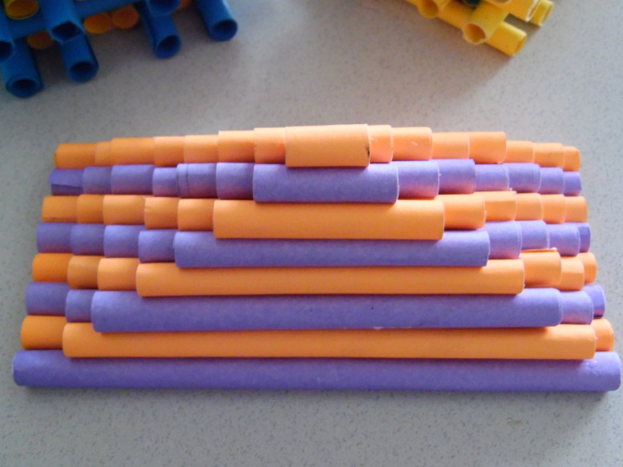
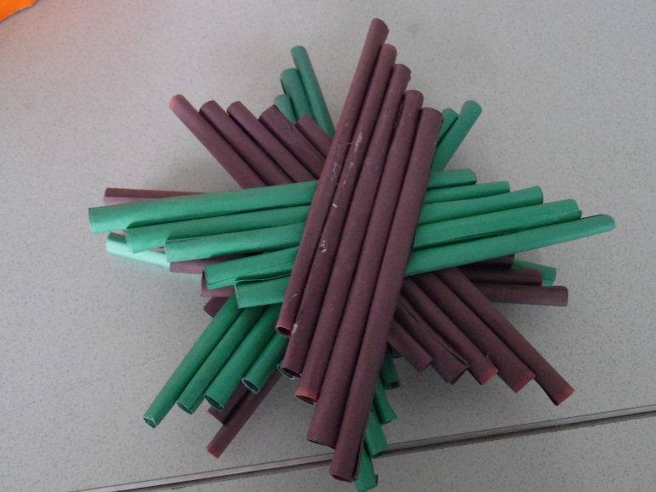
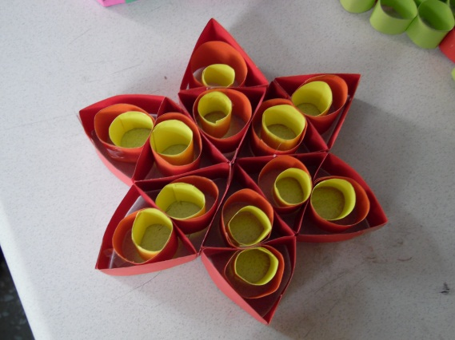

Slide 31
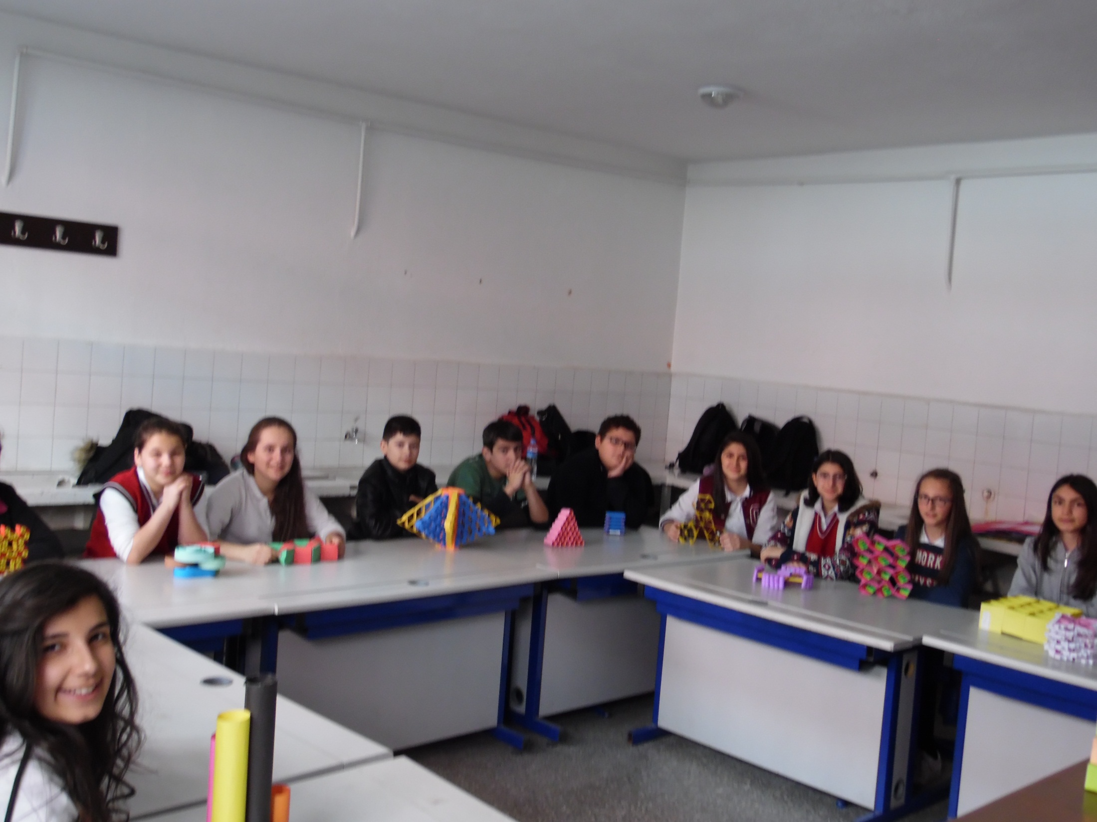

Slide 32
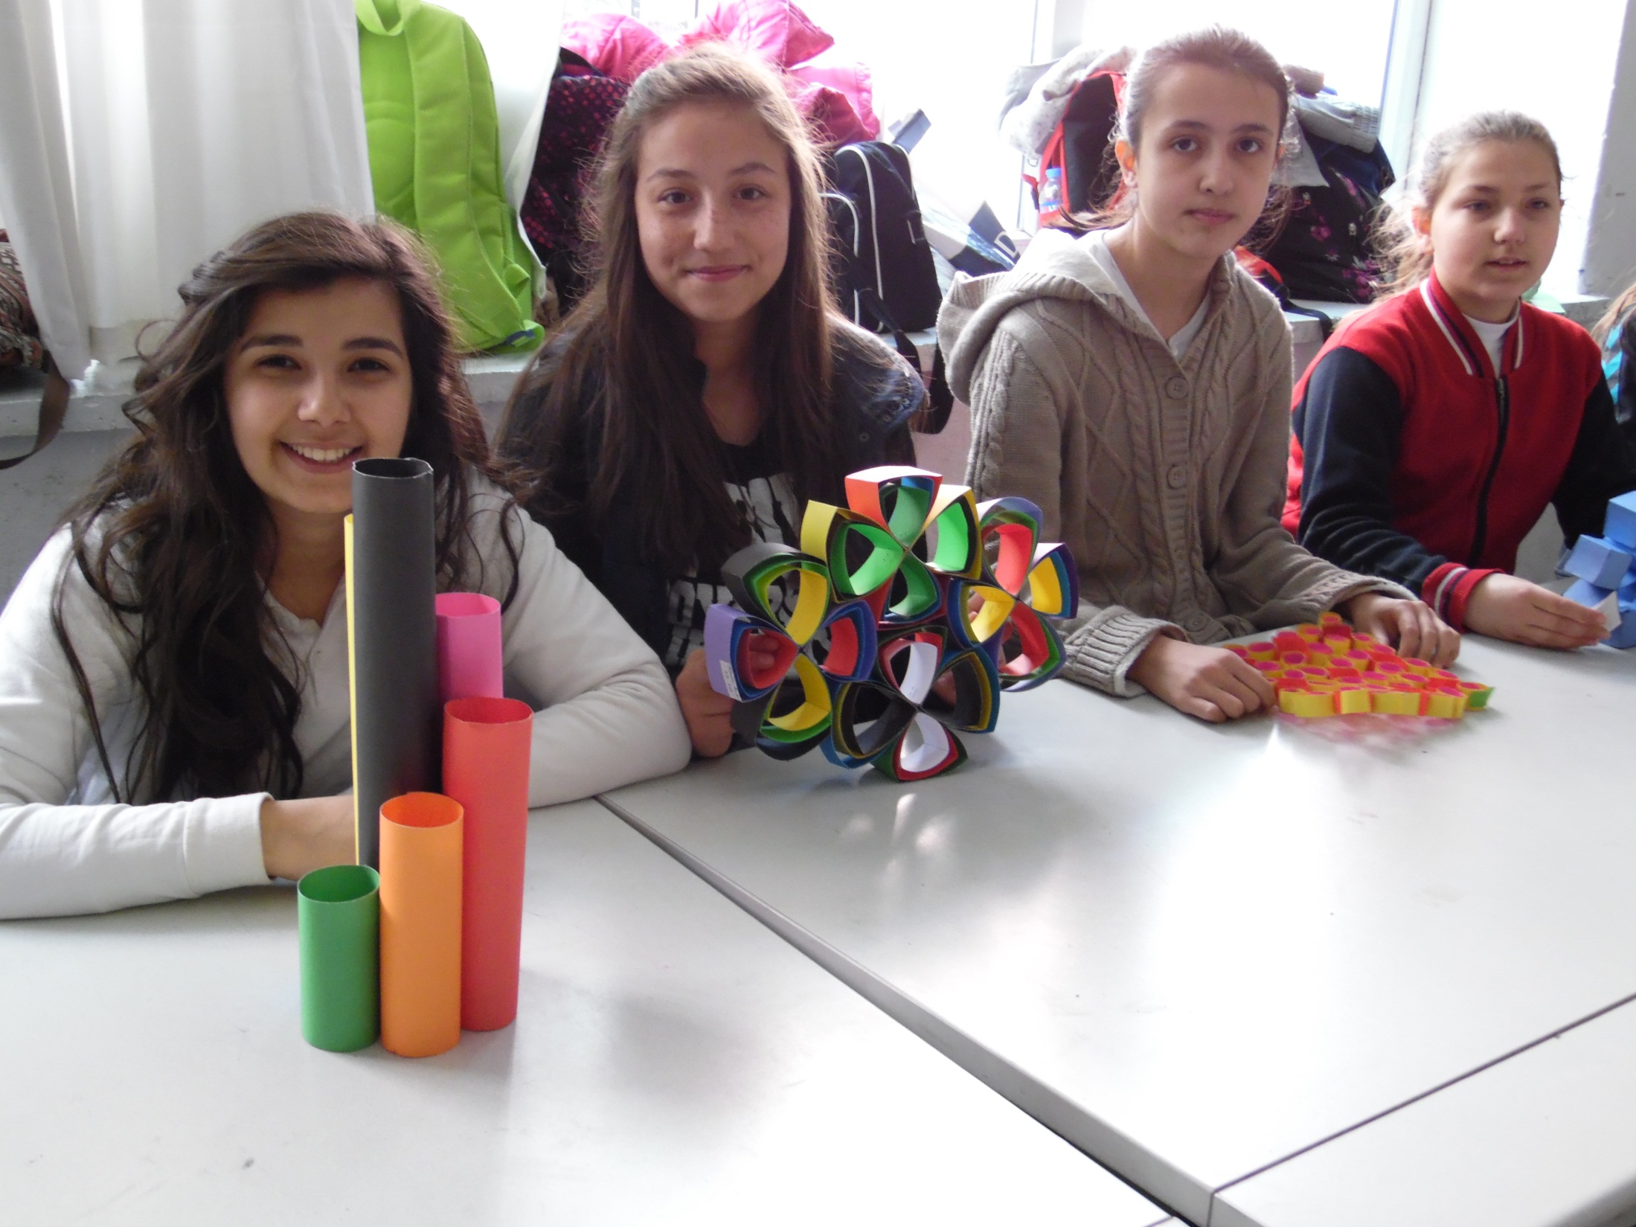

Slide 33
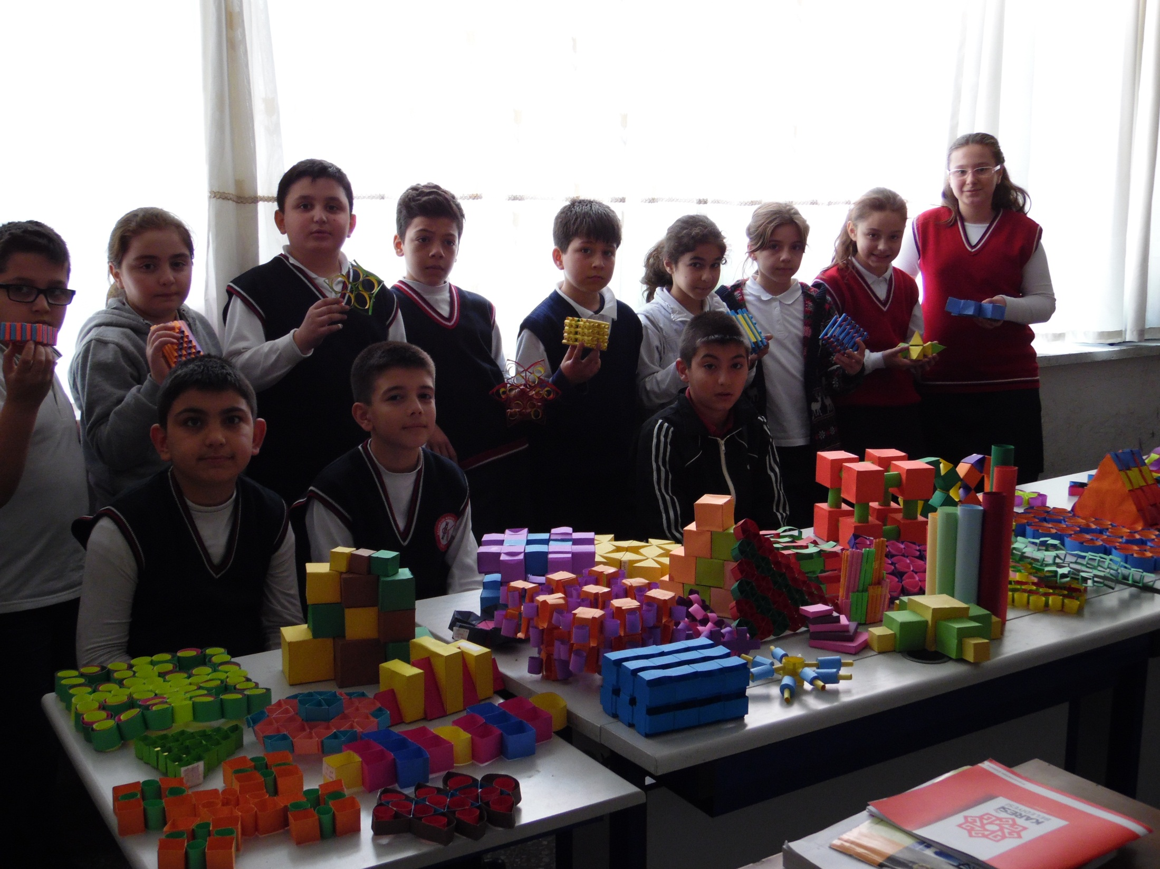

Slide 34
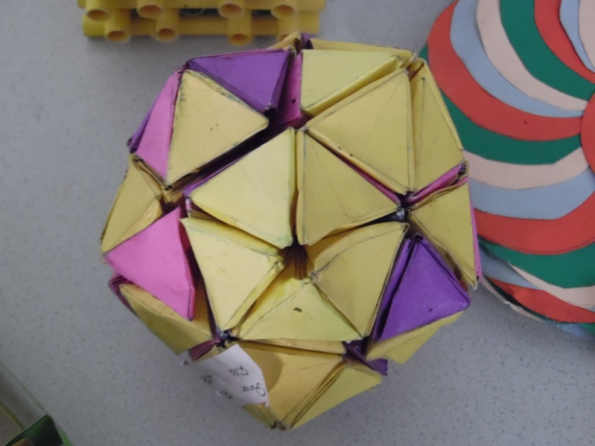
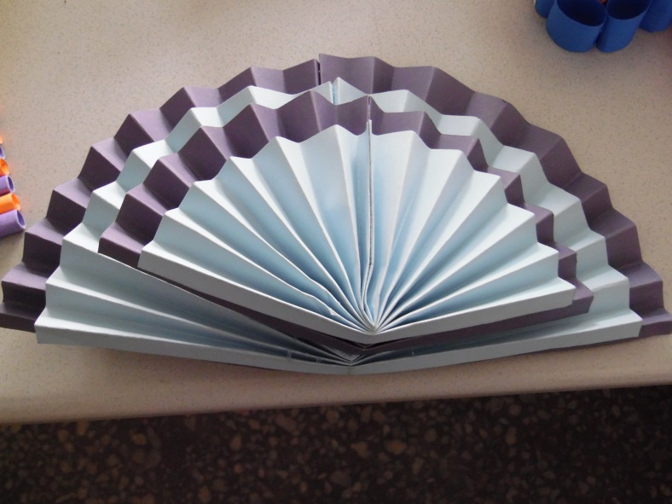
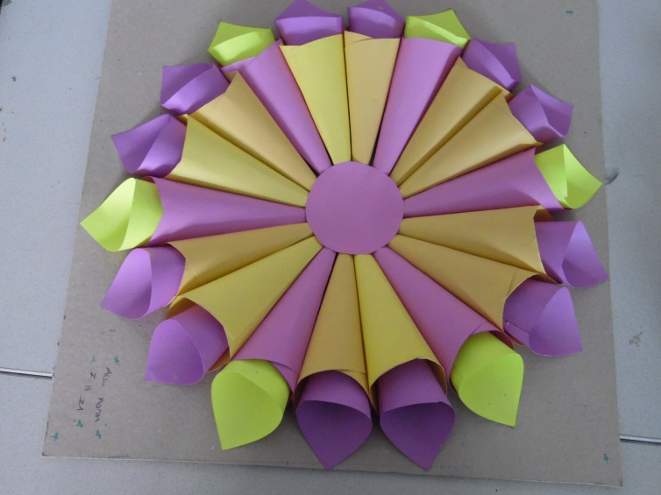
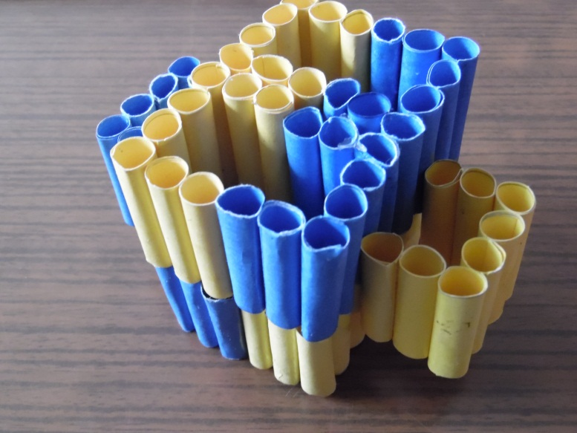
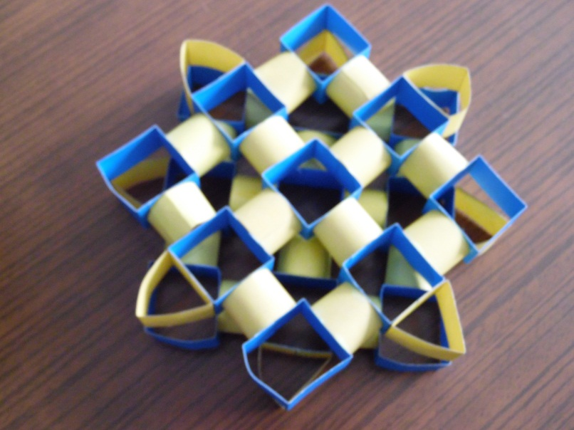

Slide 43
KÜÇÜK SURPRİZLER
LITTLE SURPRISES

