Slide 1
2014-2016 MATHS IS EVERYWHERE
1
Task III: Maths and Travelling
(POLAND)

Slide 2
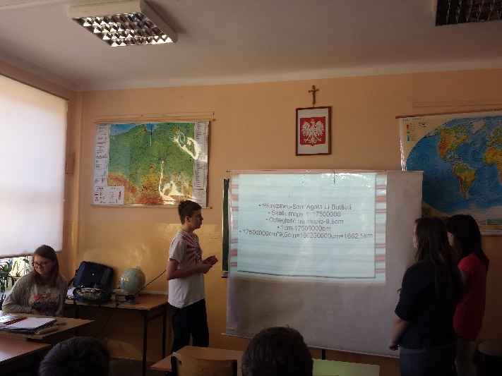
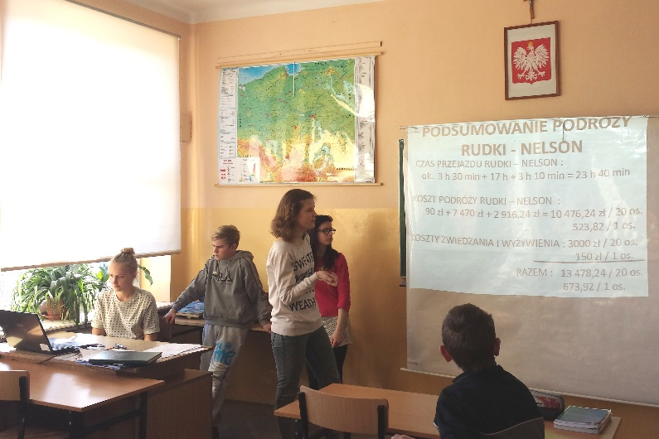
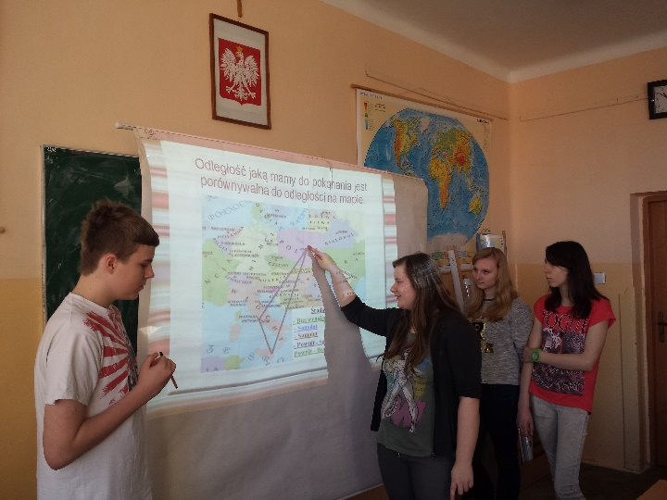
2
In the third task students had to calculate
and present the best ways of travelling to the partner schools –
the fastest, the cheapest and the most economical means of transport.

Slide 3
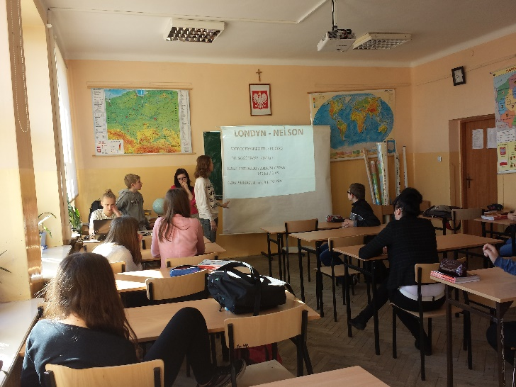
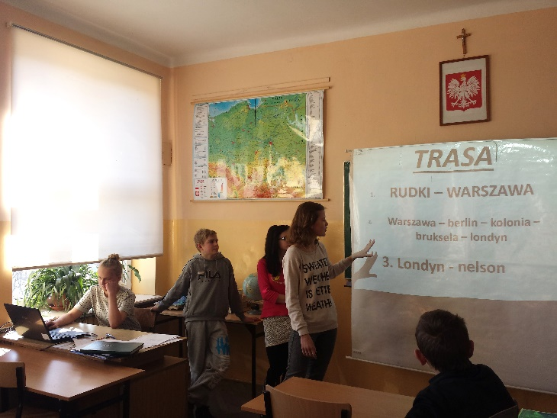
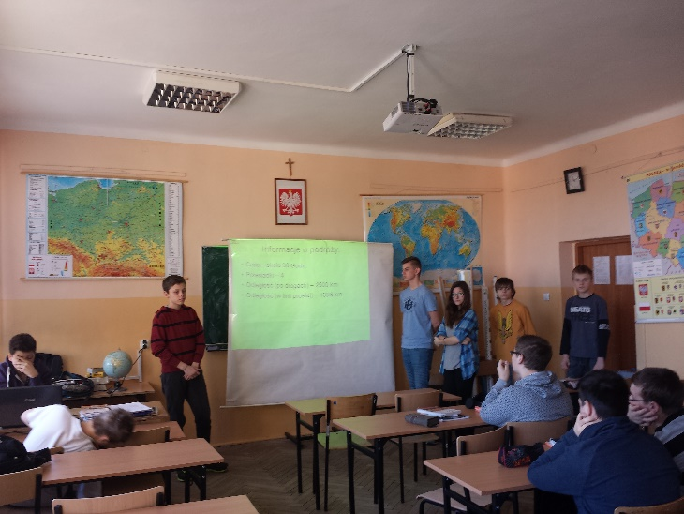
3
Our students worked in groups.
76 students from Junior High School
and 24 students from the Primary School participated in the task.
They drew the means of transport - a car, a train or a plane –
and made calculations for them.

Slide 4
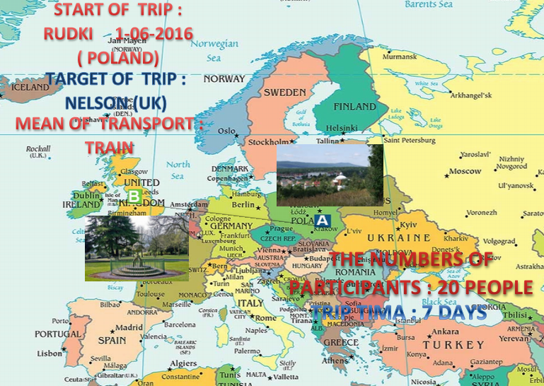
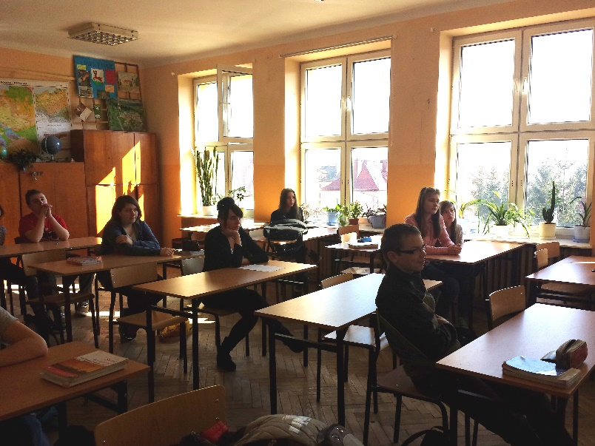
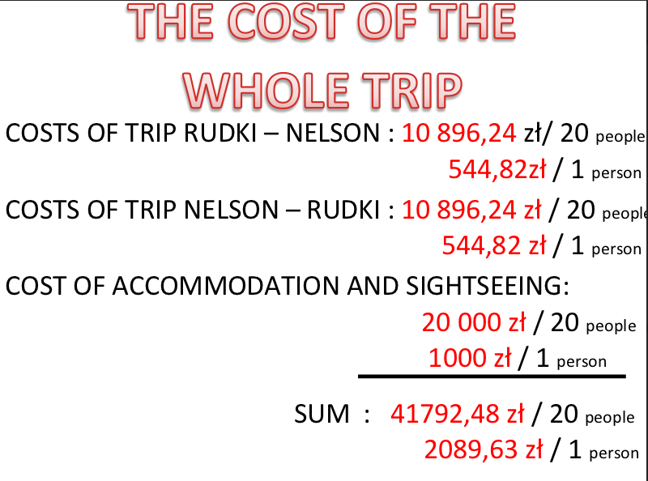
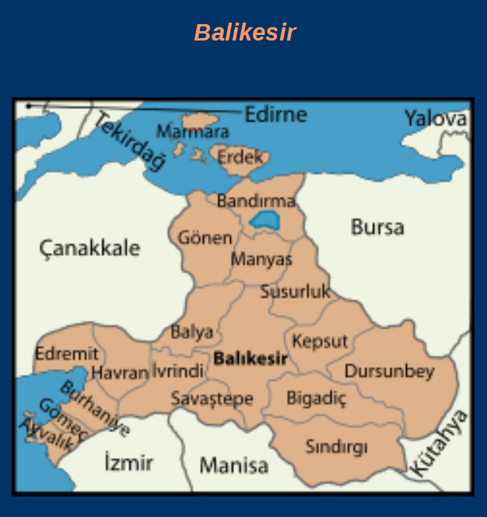
4
They prepared multimedia presentations
and showed them in geography lessons.

Slide 5
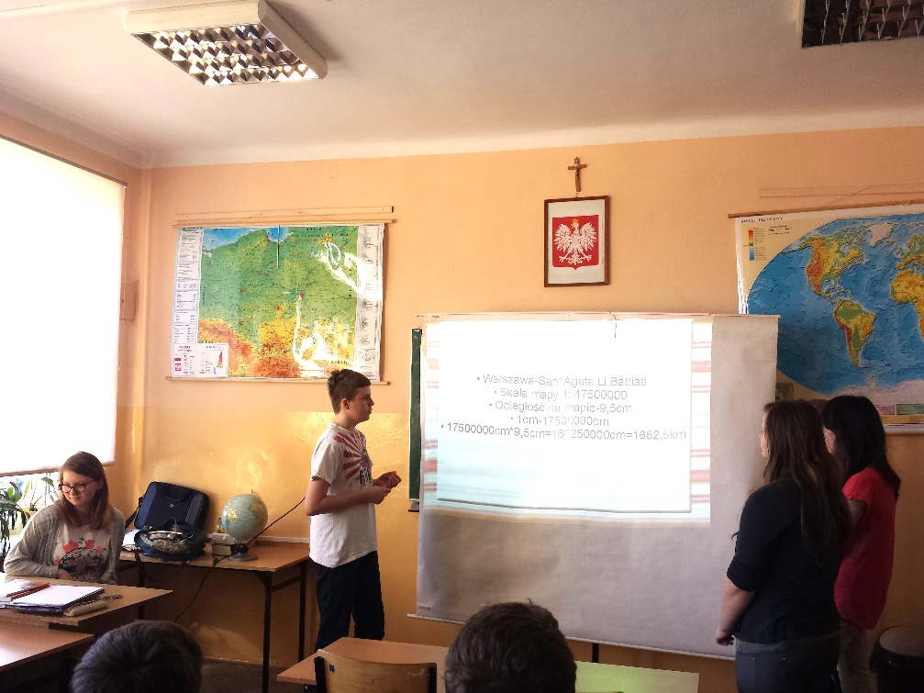
5
One of the best presentations was made by
Karolina, Maciej, Klaudia, Weronika and Angelika.
HERE IT IS:

Slide 6
6
TASK 3 MATHS AND TRAVELLING
OUR GROUP MEMBERS:
Karolina
Klaudia
Weronika
Angelika
Maciej

Slide 7
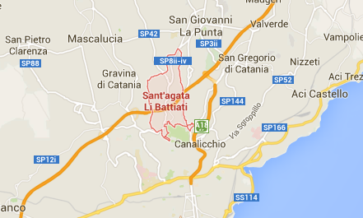
7
In our group there are 20 members.
We will travel by plane to the partner school
in Sant’Agata Li Battiati in Italy.

Slide 8
8
Warsaw - Sant'Agata Li Battiati
Map scale 1:17500000
Map distance - 9,5cm
1cm - 17500000cm
17500000cm*9,5cm = 166250000cm = 1662,5km

Slide 9
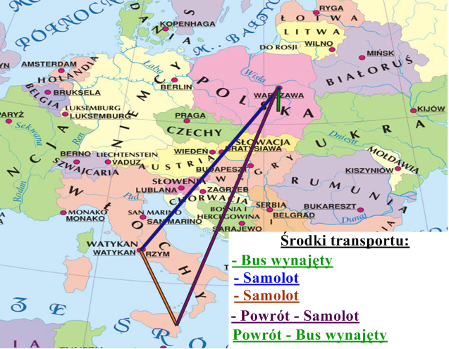
9
The distance that we have to travel
is comparable to the distance on the map.

Slide 10
The plan of our journey:
10
Rudki - Warsaw
Warsaw - Rome
Rome - Catania
Catania - Sant'Agata Li Battiati

Slide 11
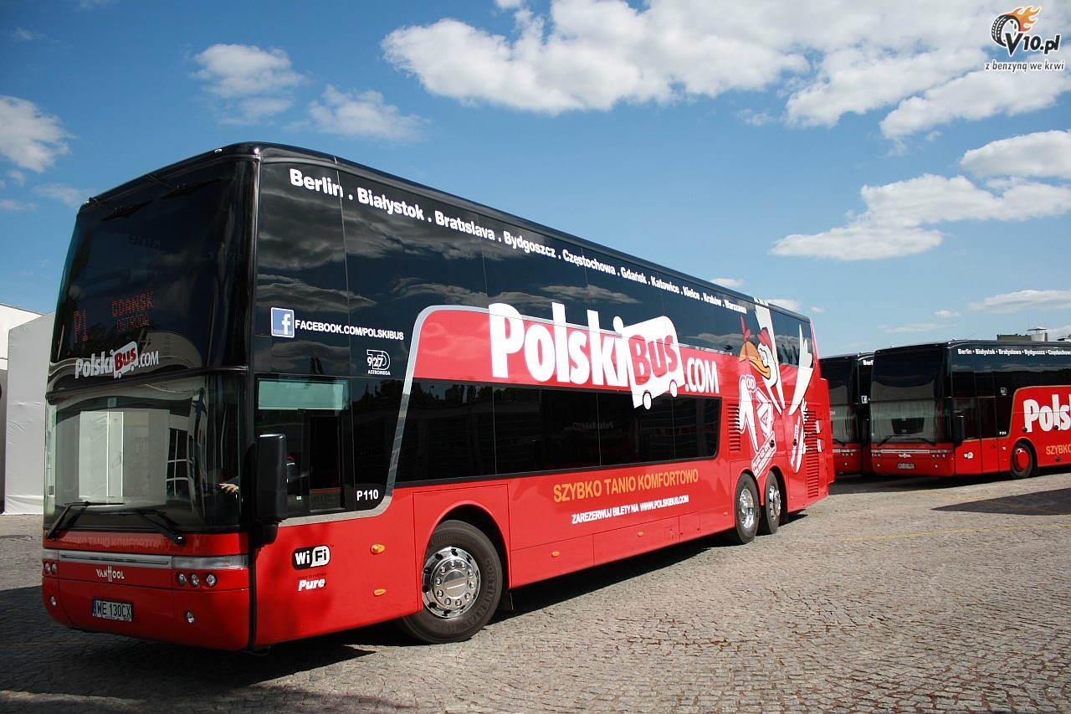
11
Rudki - Warsaw – by minibus (rented)
2.8zł/km * 166km = 464.8zł
The distance from Rudki do Warsaw
will be covered in 2 hours.
There are more than 10 people in our group,
so we will have to arrive at the airport 2 hours before the flight.
We leave Rudki at 8.00.

Slide 12
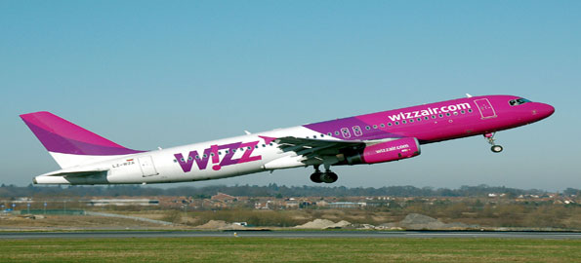
Warsaw - Rome – by plane
249zł per person * 20 = 4980zł
Date of flight - 7 May
Flight at 12.10 and landing at 14.35.
12

Slide 13
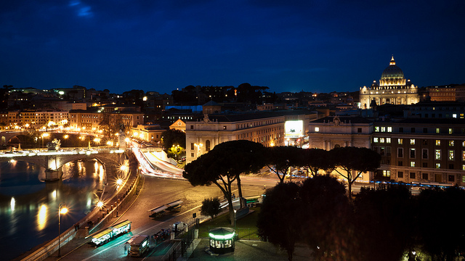
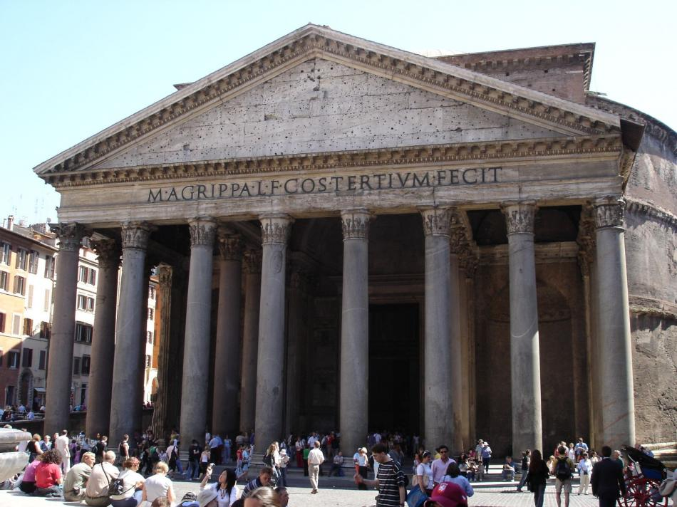
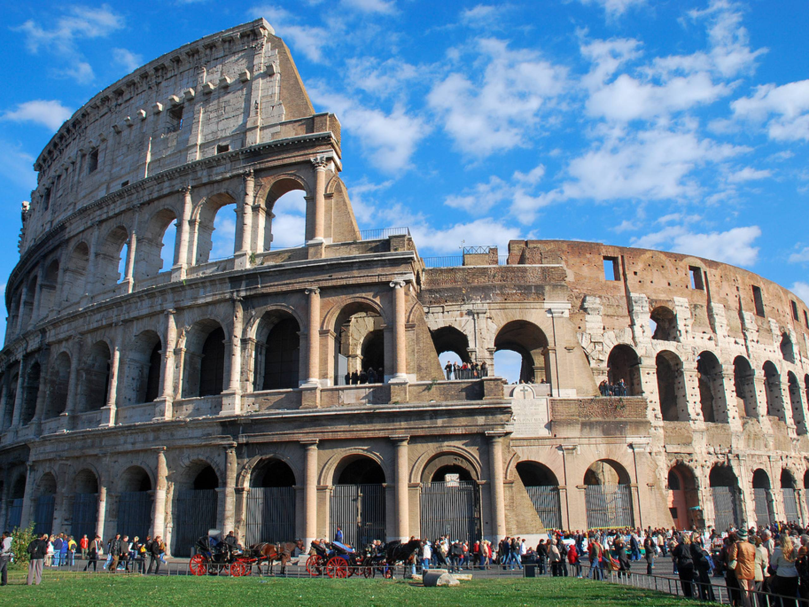
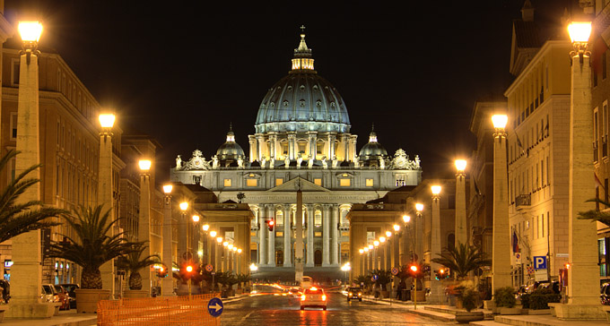
We’ve got 5 hours to visit Rome.
13

Slide 14
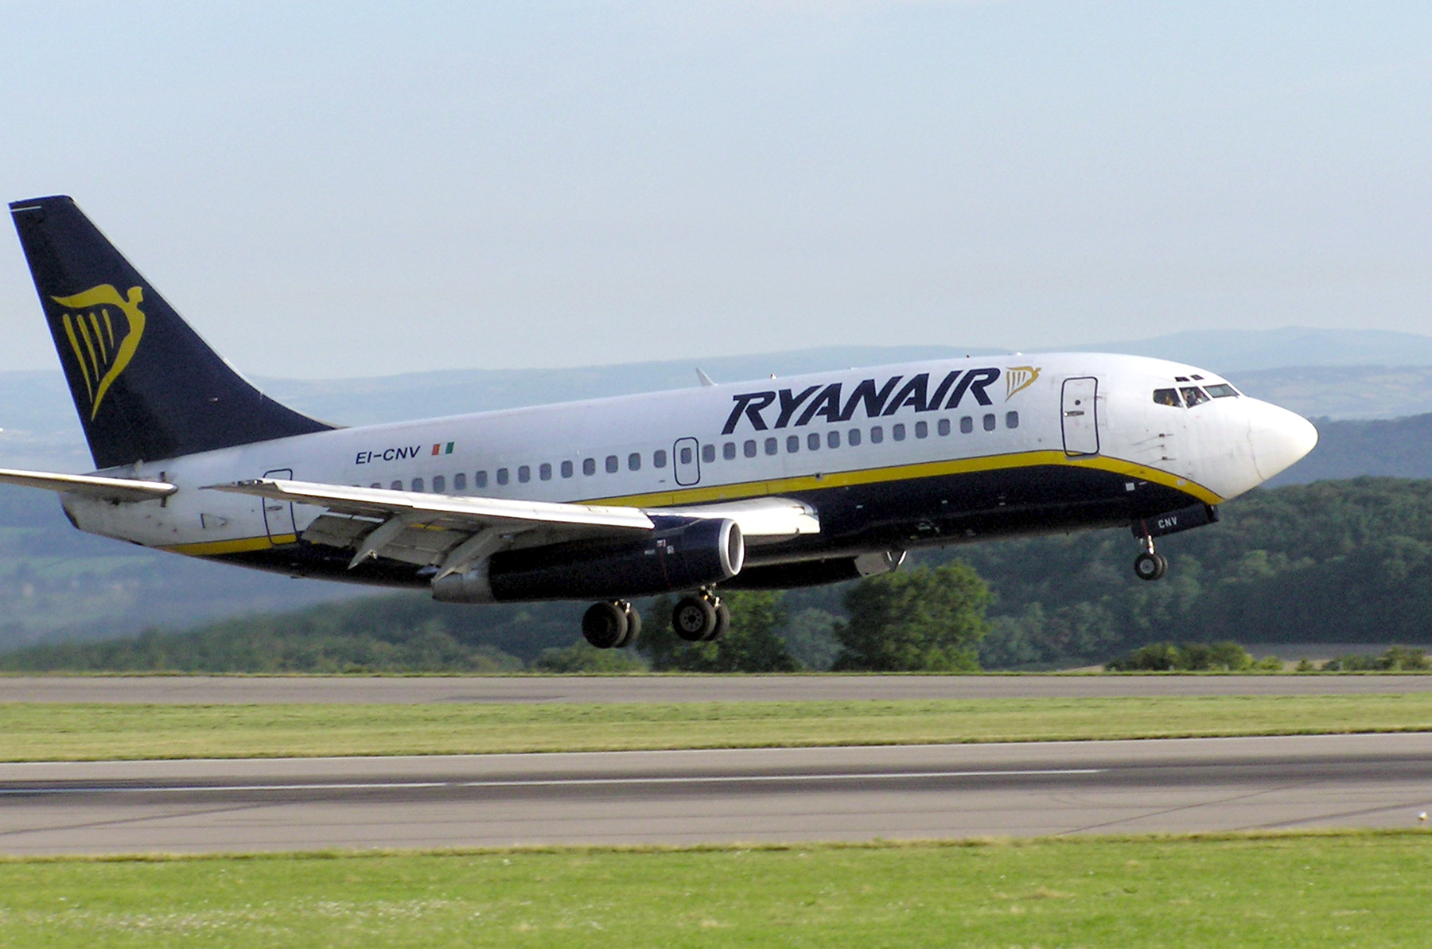
14
Rome-Catania – by plane
52zł per person * 20= 1040zł
We take off from Rome at 21.35
and we arrive in Catania at 23.05.

Slide 15
15
Catania - Sant'Agata Li Battiati
The partner school is paying for the trip ☺
Time - 20 minutes.
We arrive at the hotel at 24.00.
In Italy and Poland time is the same.

Slide 16
16
We will finish our journey in 16 hours.
The price of the one-way journey is 6484,80 zł -
one person will pay 324,24zł.
We have to survive all day
on the delicious sandwiches
made by our dear parents.
We have to remember to take the money
to buy something to drink in the shop, too.

Slide 17
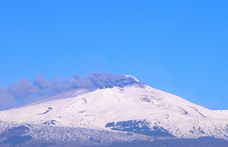
17
After eight days of staying
with our new friends from Europe,
we have to say goodbye and leave :C

Slide 18
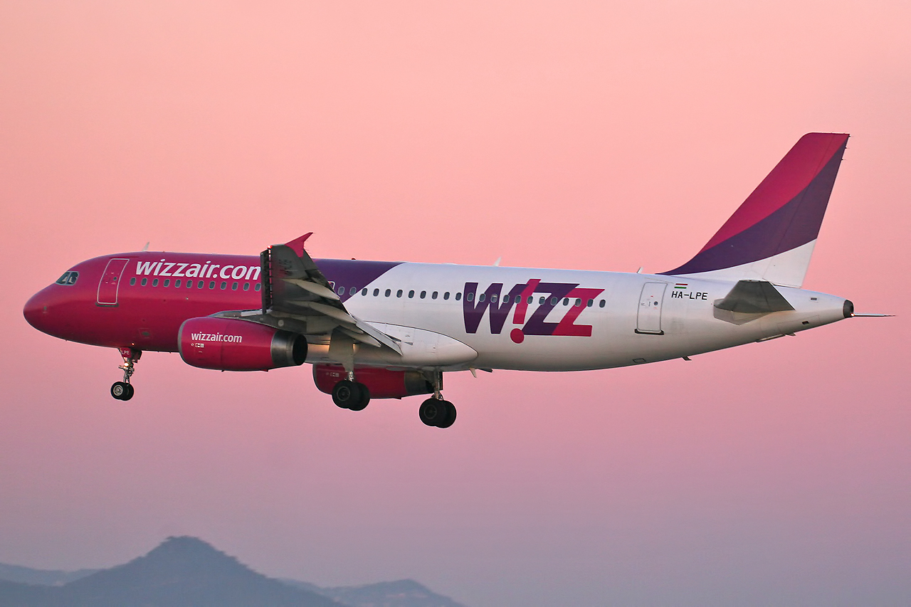
18
Catania – Warsaw
371zł * 20 = 7420zł
We will come back on 16 May,
starting at 15.45 and landing at 18.20.

Slide 19
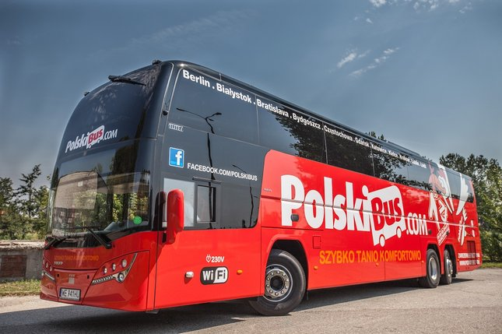
Warsaw - Rudki
2.8zł/km * 166km = 464.8zł
The expected come back to our village is at 21.00.
19

Slide 20
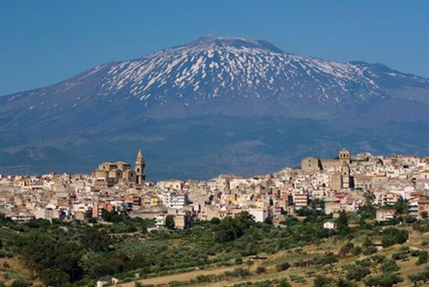
20
The price of our journey is 14369,60 zł,
so every person will pay 718,48 zł.

Slide 21
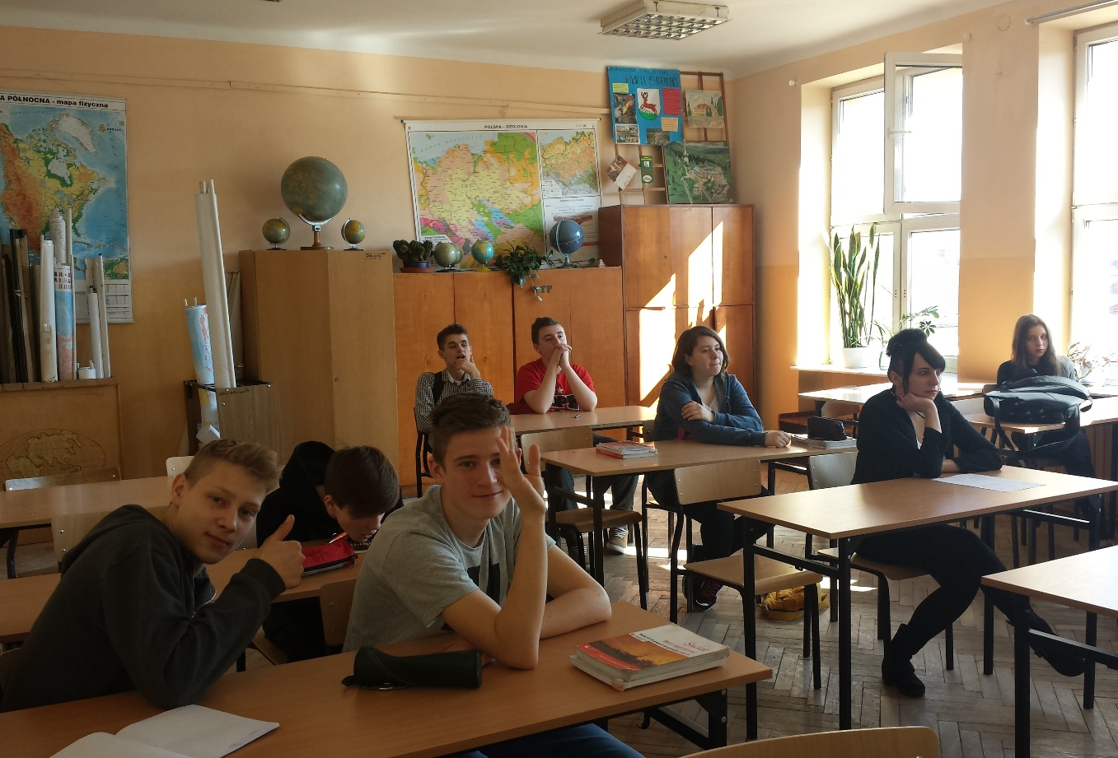
21
Thanks for watching!

