Slide 1
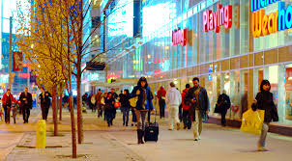
Weekend Typical Saturday
European Way of Life

Slide 2
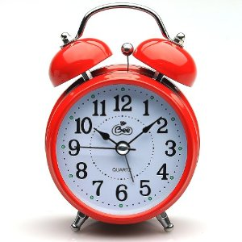
Wake Up….
Poland 10:00am
Italy 10:00am
Turkey 9:00am
Romania 9:00am
UK 10:00am

Slide 3
Washing Face ….
Poland 10:01am
Italy 10:01am
Turkey 9:01am
Romania 9:01am
UK Later …………

Slide 4
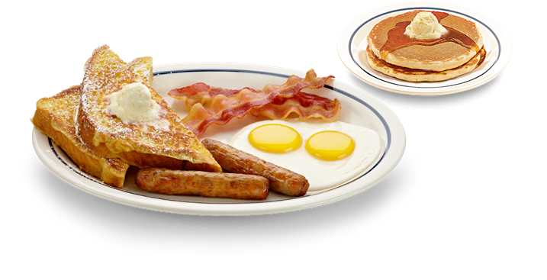
Breakfast….
Poland 11:00am
Italy 10:30am
Turkey 10:00am
Romania 9:30am
UK 10:30am

Slide 5
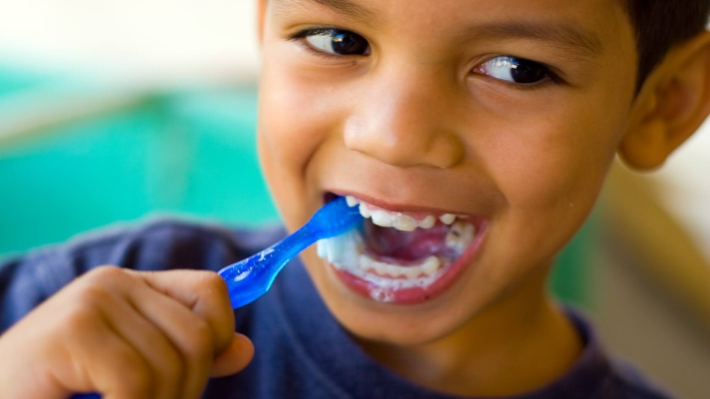
Brush our teeth ….
Poland 11:30am
Italy 10:50am
Turkey 10:30am
Romania 10.00am
UK …and wash face 11:00am

Slide 6
Morning Activity Time ….
Poland – Sports, Running, Shopping, Games, Resting, TV Friends
Italy – Sports, Tidy Room, Watch TV, Games,
Turkey – Shopping, Reading, Sports,
Romania- Computer Games, Facebook, TV, Sports, Shopping
UK – TV, Grocery shopping with family, Computer games
Poland 11:30am -2:-00pm
Italy 10:50am -1:30pm
Turkey 10:30am -2:00pm
Romania 10.00am -12:30pm
UK … 11:00am -12:00am

Slide 7
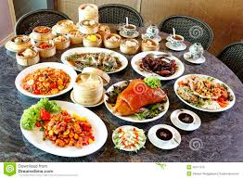
Lunch Time ….
Poland 2:00pm
Italy 1:30pm
Turkey 2:00pm
Romania 12:30pm
UK 12:00pm

Slide 8
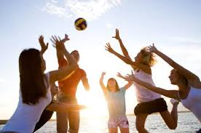
Afternoon Activity Time ….
Poland – Meeting Friends, Computer Games, Shopping, cinema
Italy – Homework, Shower, Meeting friends, shopping, cinema
Turkey – meeting friends, computer games, cinema, shopping, sport
Romania- meeting friends, computer games, sports, homework
UK- go out with friends, shopping, ride bike, computer games (depends on the weather)

Slide 9
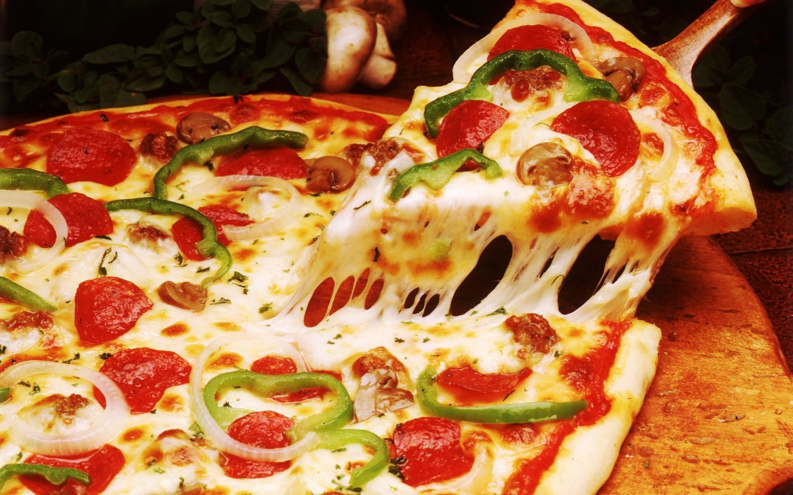
Dinner ….
Poland 6:00pm
Italy 9:30pm
Turkey 7:30pm
Romania 7:30pm
UK 5:00pm

Slide 10
Evening Activity Time ….
Poland –TV, Shower,
Italy –TV, Video Games, Brush teeth
Turkey – TV, Music, Coffee Time, Shower, Reading
Romania- TV , shower, friends, computer games
UK- TV, bath or shower, computer games, read magazine, watch DVD

Slide 11
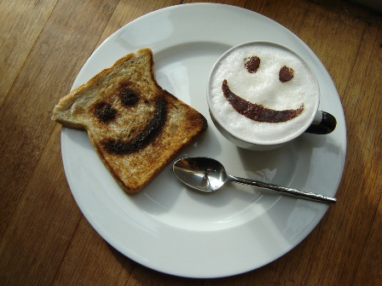
Supper ….
Poland 8:00pm
Italy NO
Turkey NO
Romania 10:30pm
UK – 9:30pm

Slide 12
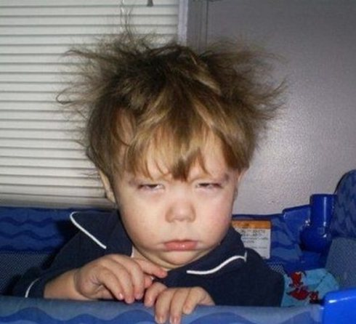
zzzzzzzz….
Poland 12:30am
Italy 11:30pm
Turkey 11:30pm Romania 12:00am UK 11:00pm

