Slide 1
Erasmus+ 2014-2016: Maths Is Everywhere!
STUDENTS’ WORKS FOR THE LOGO COMPETITION
Pendle Community High School – The UK

Slide 2
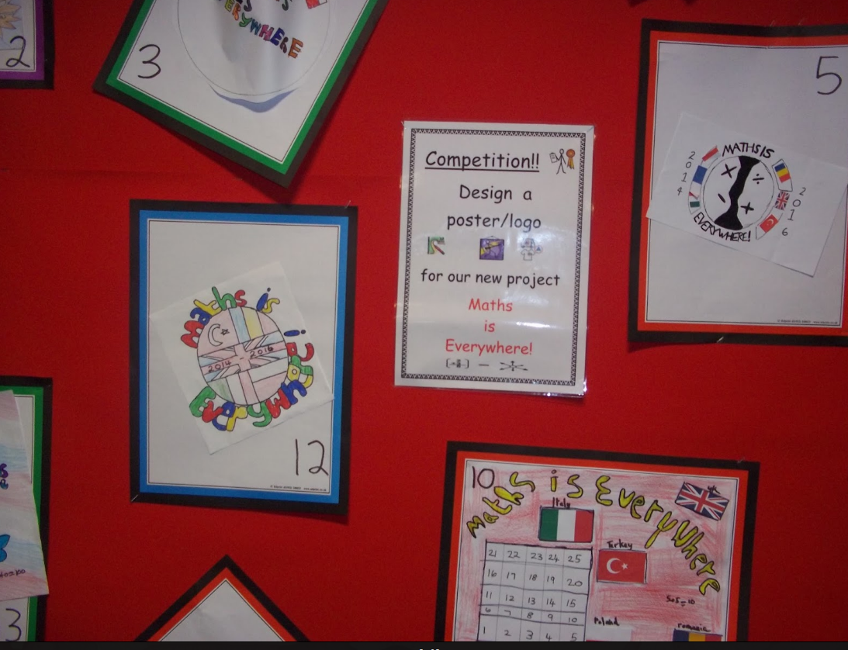

Slide 3
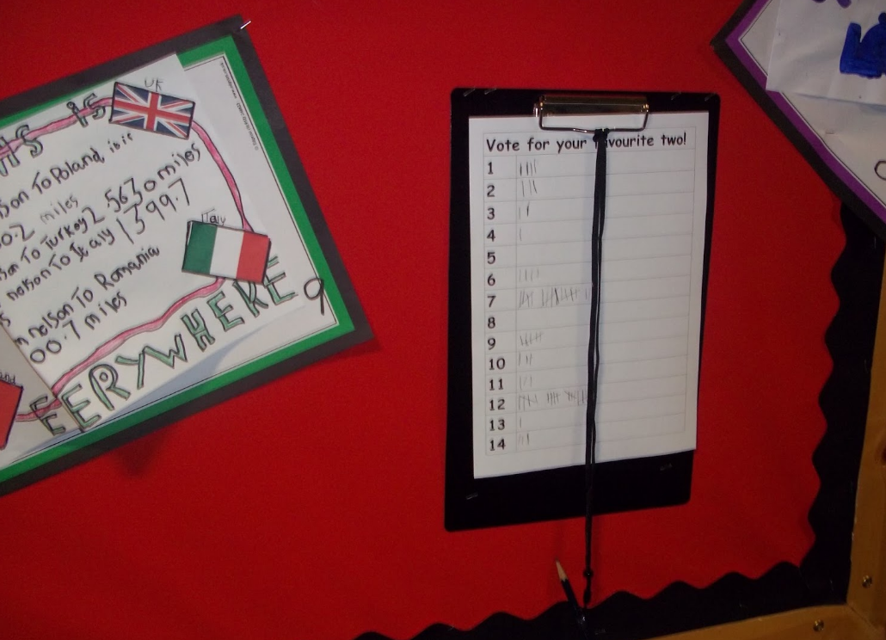

Slide 4
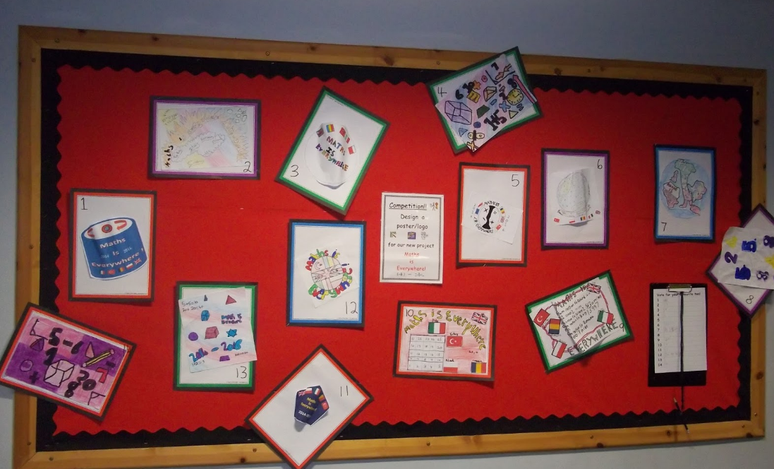

Slide 5
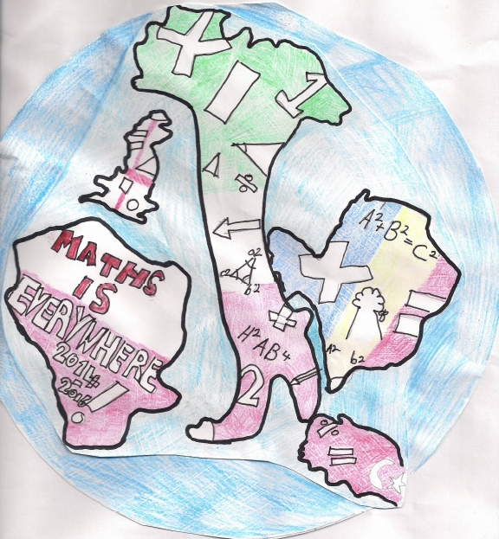
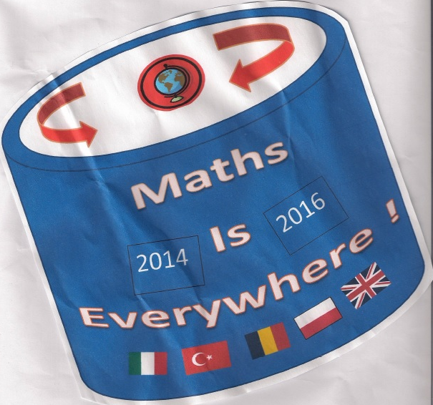

Slide 6
