Slide 1
MATHS AND TRAVEL
LEARNING AND TEACHING ACTIVITY
CATANIA
23-27th MARCH, 2015

Slide 2
Activity 3 MATHS AND TRAVELLING
For the “Maths and Travelling” activity our students calculated the time, distance and avarage speed for the places that they have visited whilst on the exchange to Catania

Slide 3
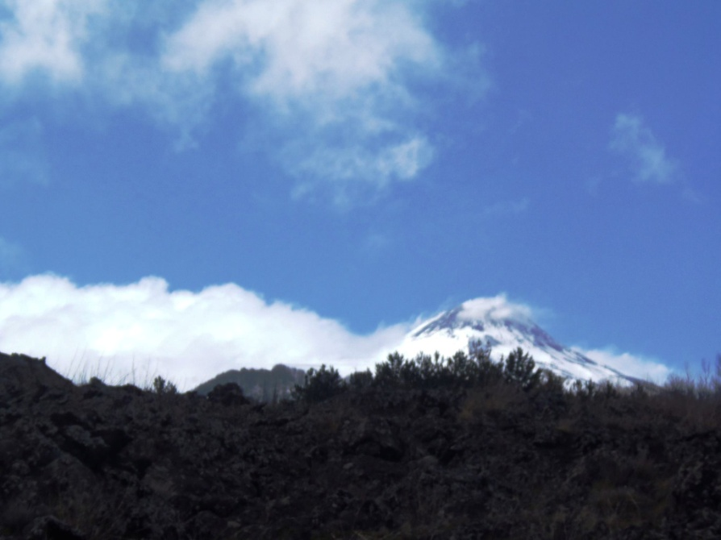
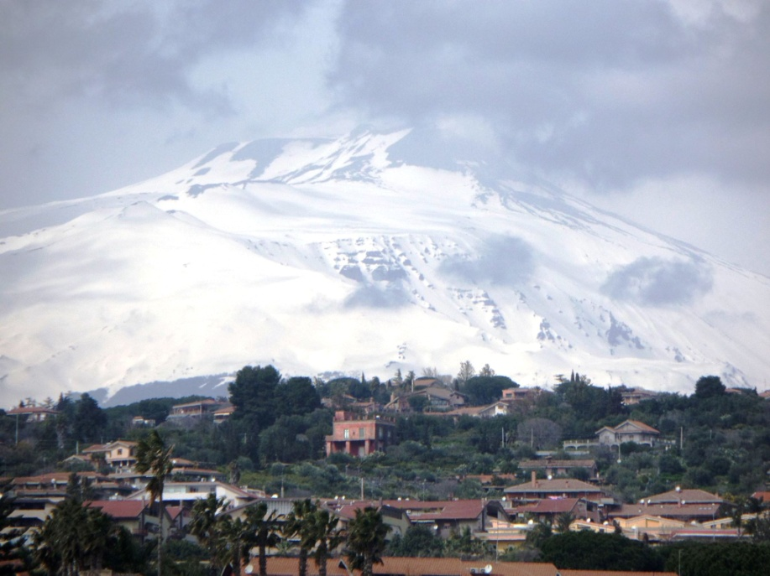
Travelling to Etna

Slide 4
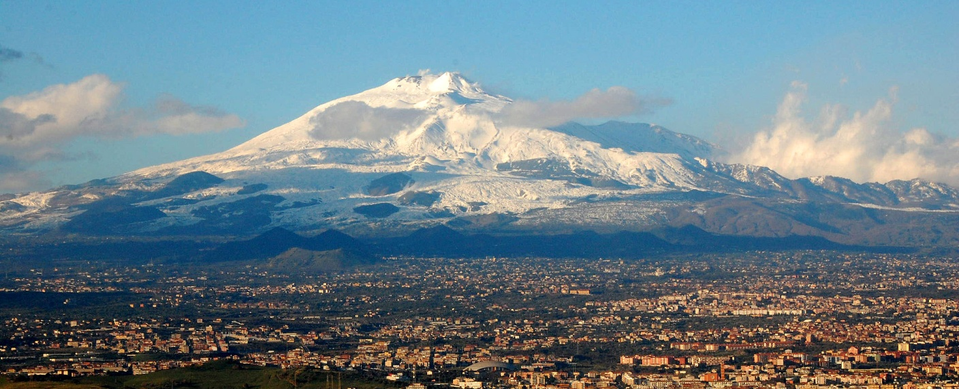
About Mount Etna
Mount Etna is an active volcano on the east coast of Sicily.
It is the tallest active volcano on the European continent, currently 3,329 m (10,922 ft) high
Mount Etna is one of the most active volcanoes in the world and is in an almost constant state of activity.

Slide 5
From B&B to School
Distance | Time of departure | Time of arrival | Time spent at travel | Average speed
7,4 km | 8:35 | 8:55 | 0:20 | 22.42 km/h

Slide 6
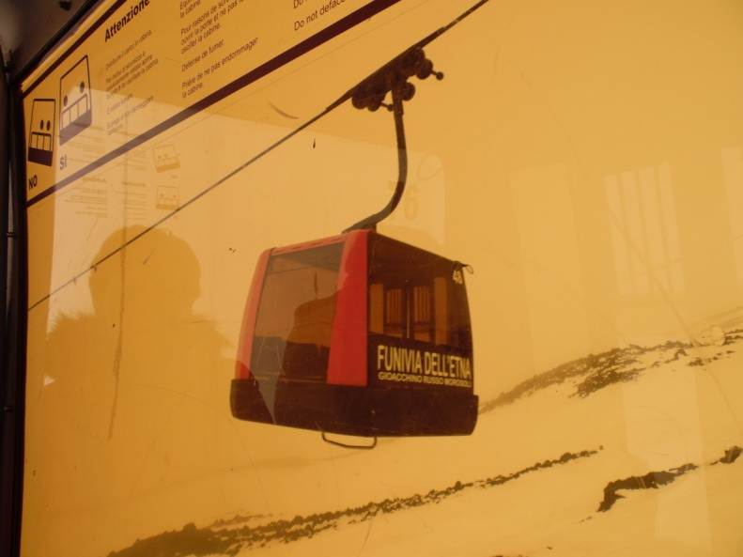
From School to Cable Car
Distance | Time of departure | Time of arrival | Time spent at travel | Average speed
39,8 km | 9:29 | 10:10 | 0:41 | 58.52 km/h

Slide 7
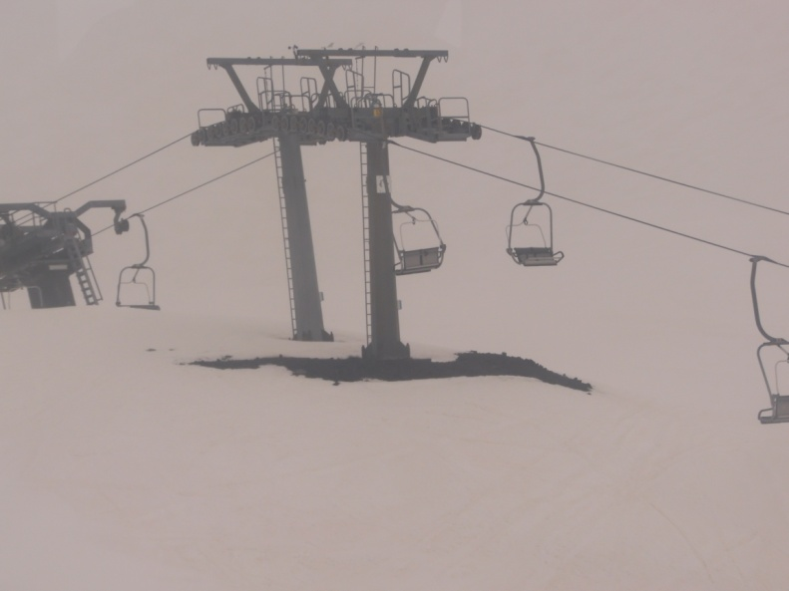
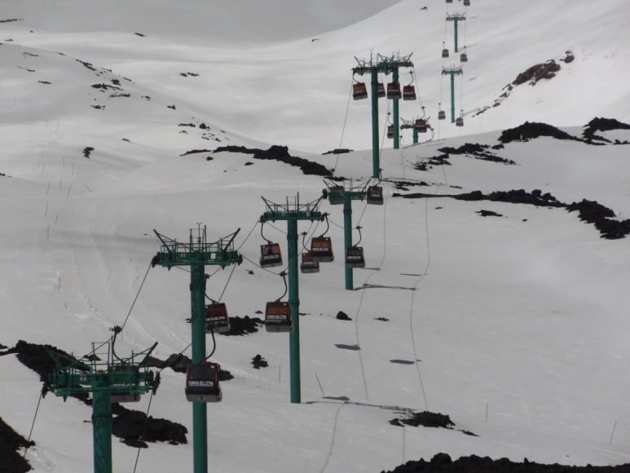
From Cable Car Station to Etna (2500m)
Distance | Time of departure | Time of arrival | Time spent at travel | Average speed
2,5 km | 10:45 | 11:03 | 0:18 | 8,3 km/h

Slide 8
From Etna (2500m) to Cable Car Station
Distance | Time of departure | Time of arrival | Time spent at travel | Average speed
2,5 km | 1:15 | 1:32 | 0:17 | 8.92 km/h

Slide 9
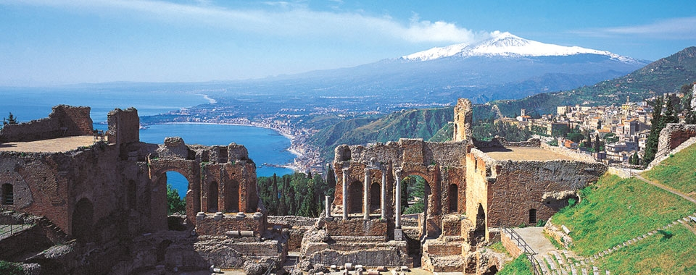
From Cable Car Station to Taormina
Destination | Time of departure | Time of arrival | Time spent at travel | Average speed
66,3 km | 2:00 | 3:17 | 1:17 | 51.79 km/h

Slide 10
From Taormina to School
Destination | Time of departure | Time of arrival | Time spent at travel | Average speed
51,3 km | 6:20 | 7:40 | 1:20 | 38.57 km/h

Slide 11
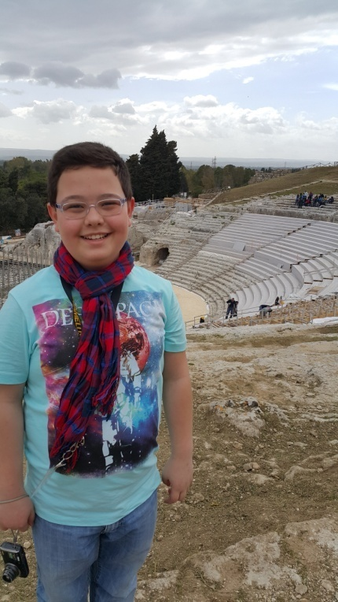
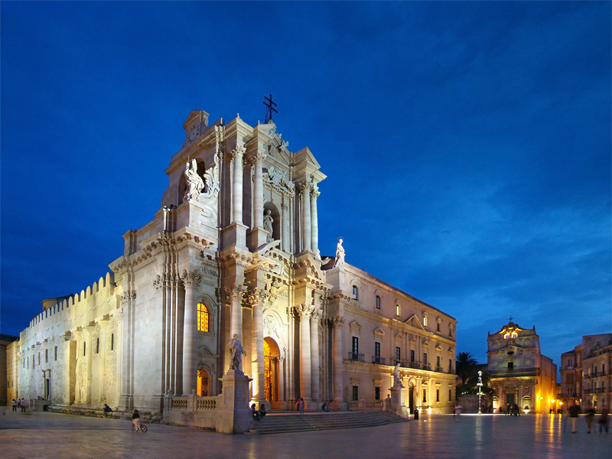
Traveling to Siracusa and the Island of Ortigia

Slide 12
Syracuse
Syracuse is a historic city in Sicily, the capital of the province of Syracuse. The city is notable for its rich Greek history, culture, amphitheatres, architecture and as the birthplace of Archimedes.
This 2,700-year-old city played a key role in ancient times, when it was one of the major powers of the Mediterranean world. Syracuse is located in the southeast corner of the island of Sicily, right by the Gulf of Syracuse next to the Ionian Sea.

Slide 13
From Hotel to School
Distance | Time of departure | Time of arrival | Time spent at travel | Average speed
7,4 km | 8:45 | 9:07 | 0:22 | 20.55 km/h

Slide 14
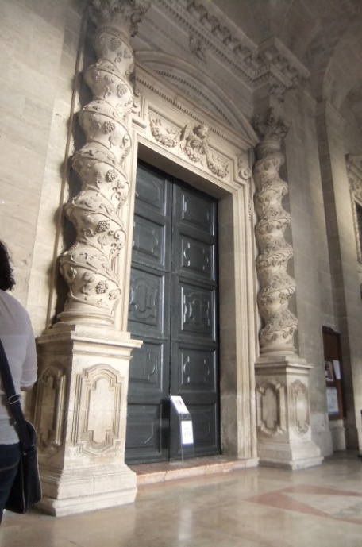
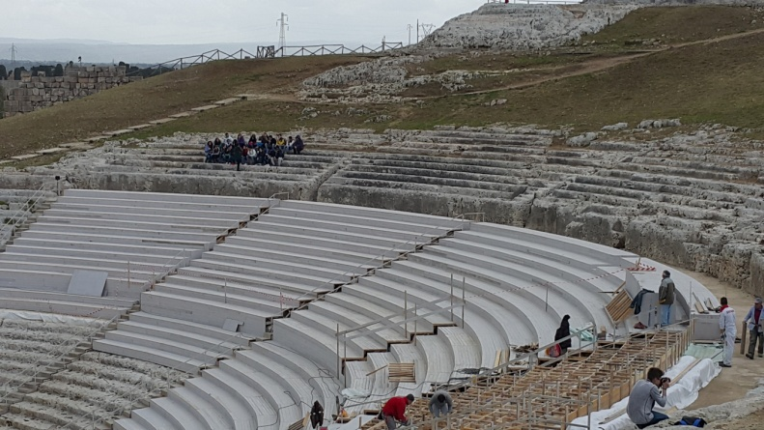
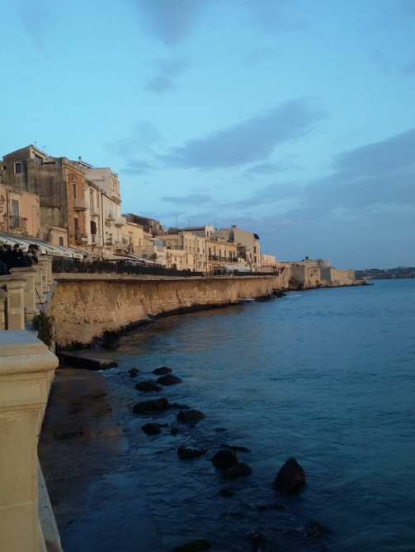
From School to Siracusa
Distance | Time of departure | Time of arrival | Time spent at travel | Average speed
74 km | 9:35 9:54-10:14 (break) | 10:56 | 1:01 | 73.26 km/h

Slide 15
From Siracusa to School
Distance | Time of departure | Time of arrival | Time spent at travel | Average speed
74 km | 18:50 | 20:22 | 1:32 | 48.36 km/h

