Slide 1
MATHS AND EVERYDAY LIFE
BALIKESİR KARESİ SECONDARY SCHOOL

Slide 2
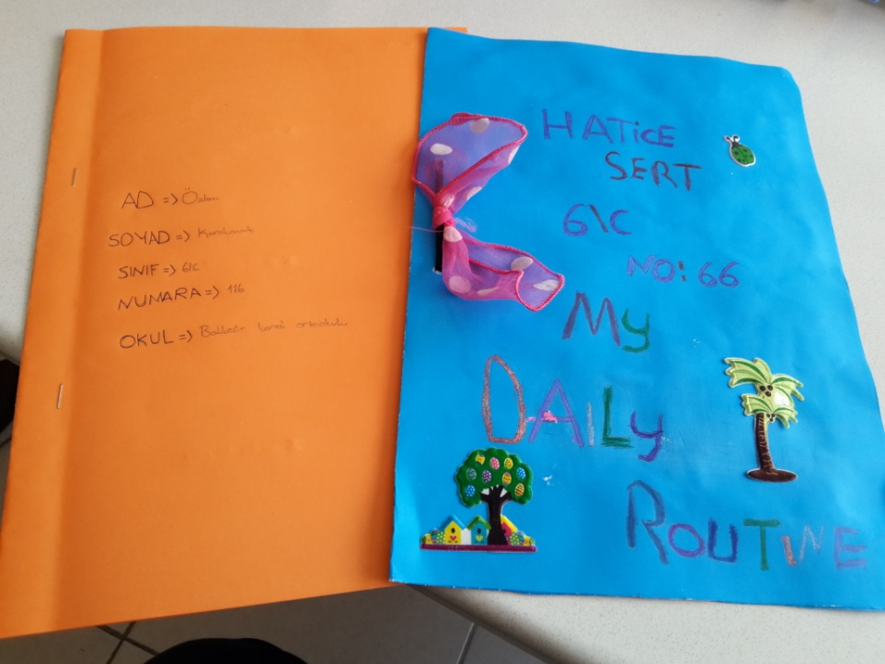
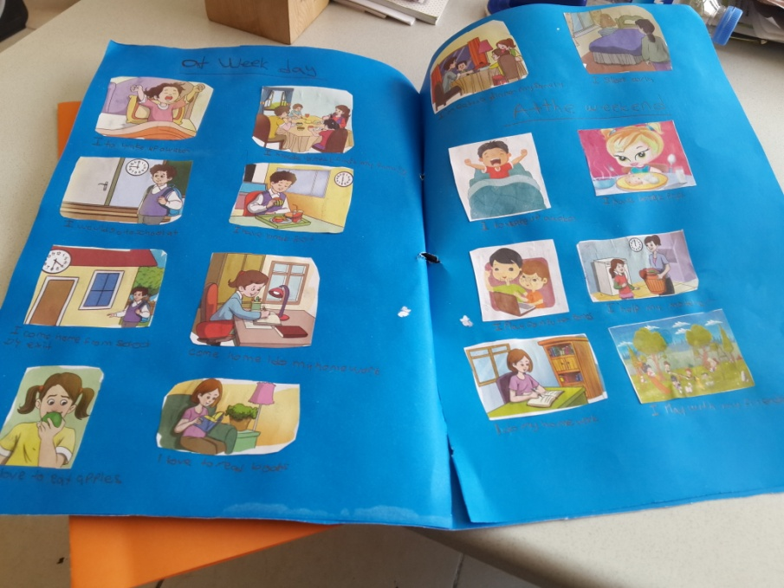
Fot this activity our students prepared their diaries for one of their week and weekend days

Slide 3
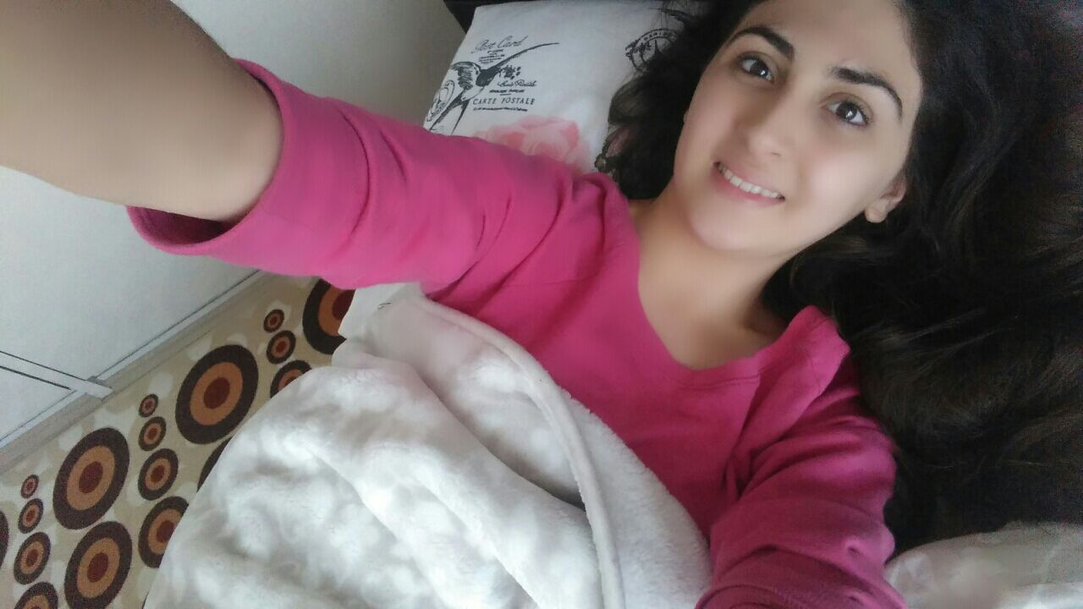
SCHOOL DAY OF A TURKISH STUDENT
Our school starts at 8:30 so our students get up between 7 and 7:30

Slide 4
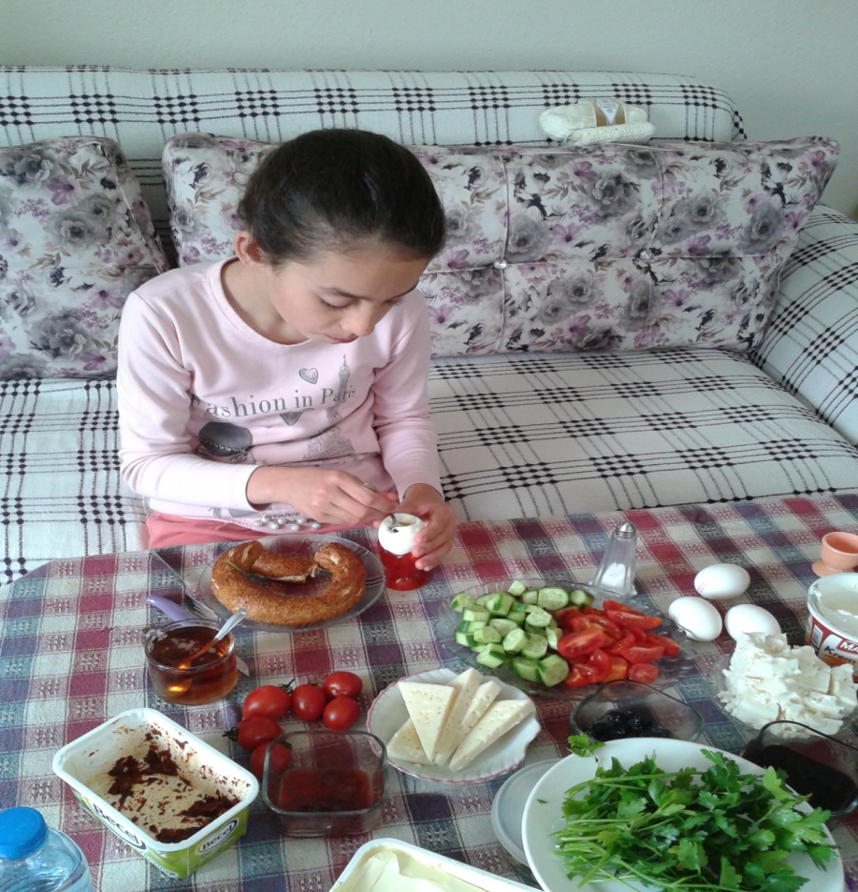
They have breaskfast before school around 8 o’clock

Slide 5
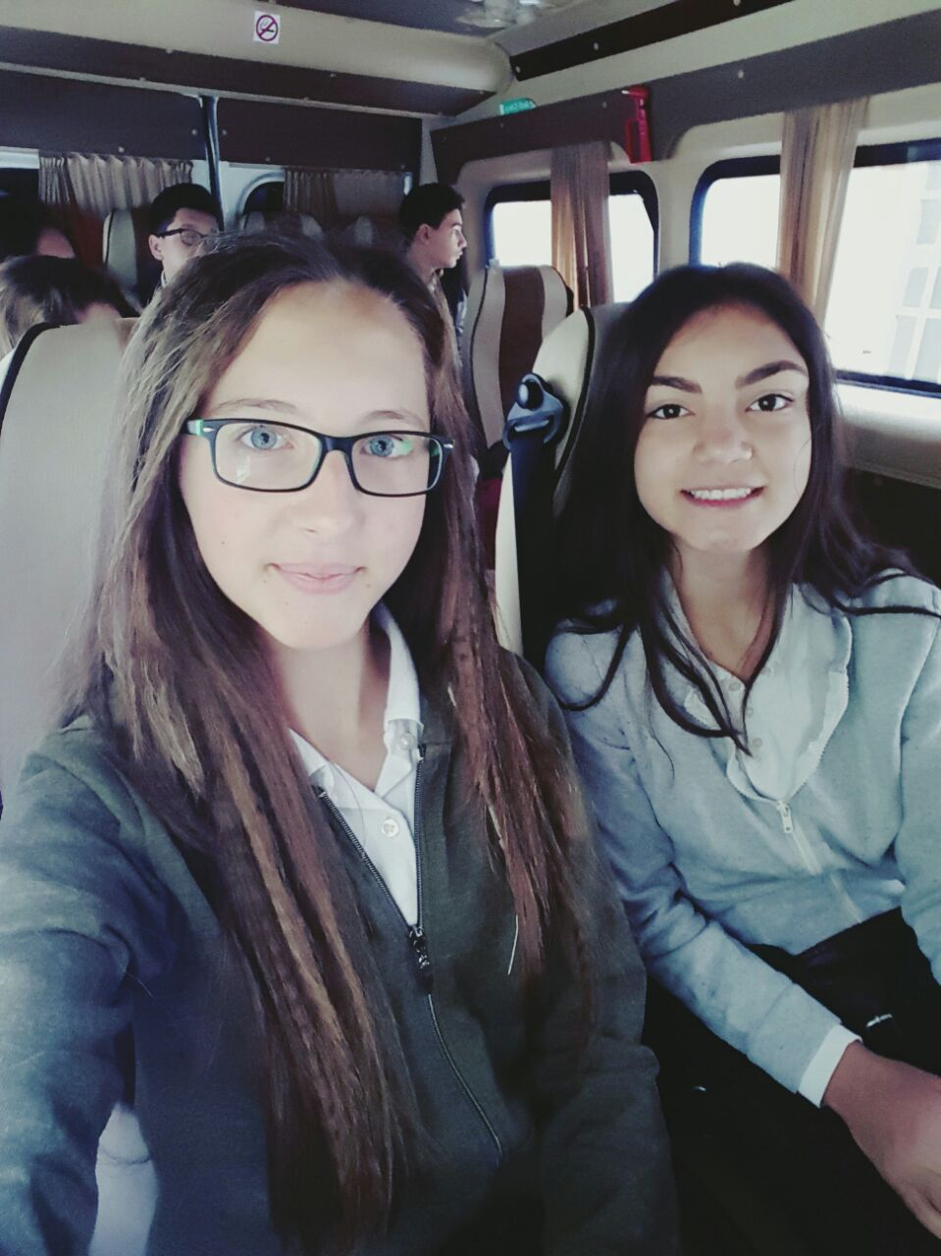
They come to school by walking or by school buses.

Slide 6
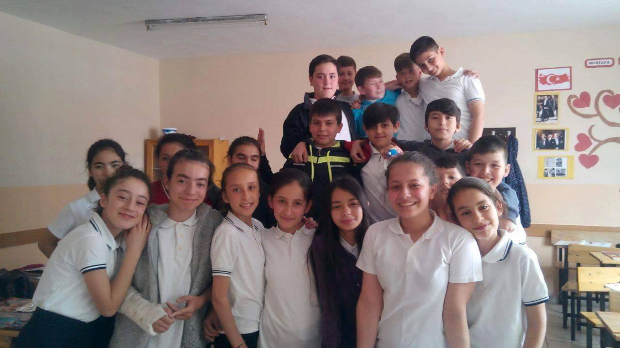
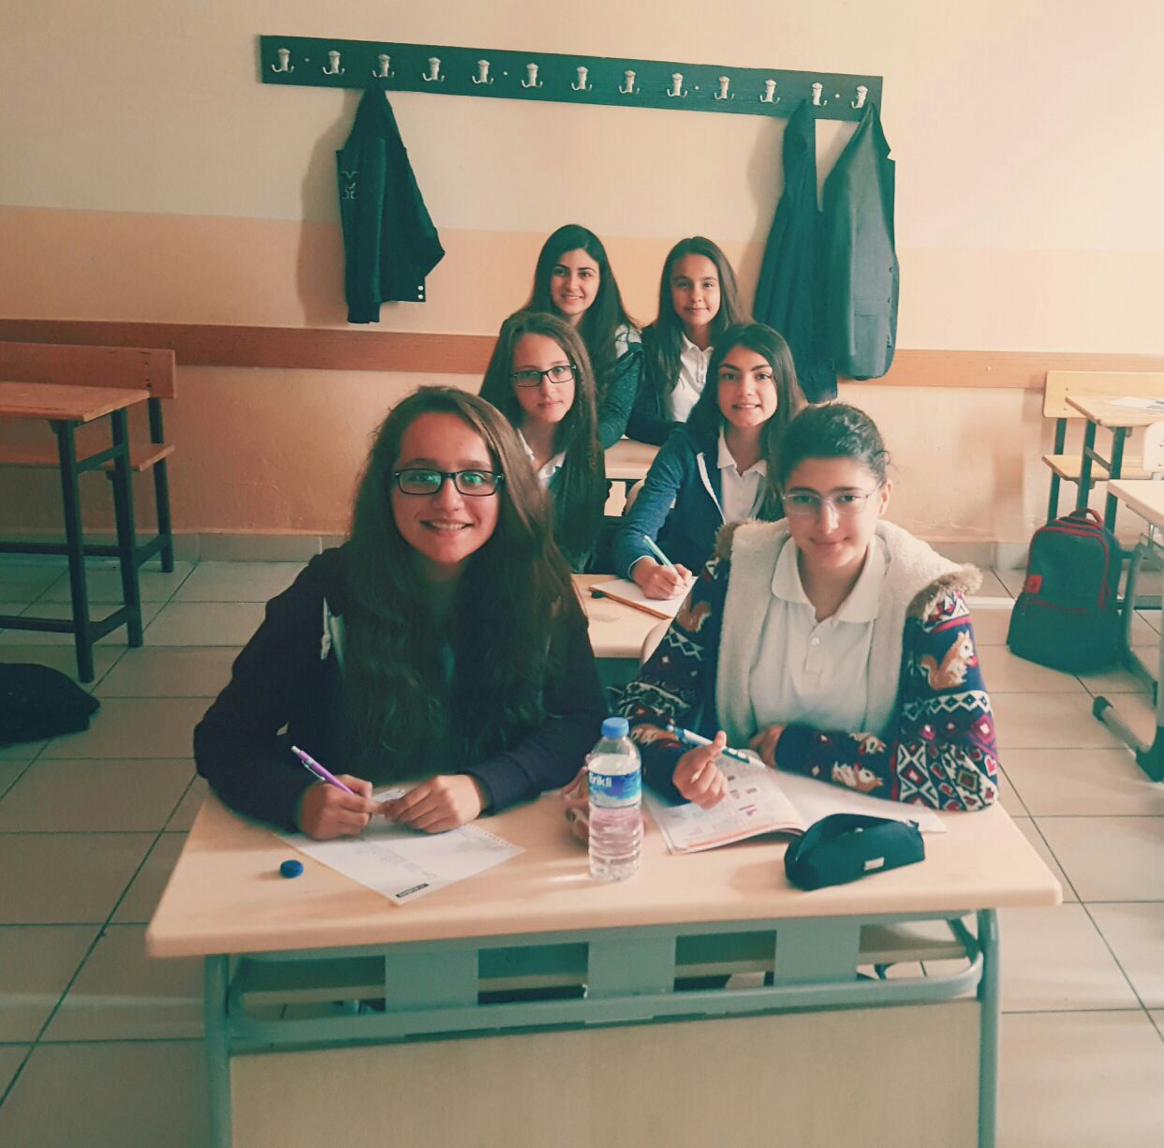
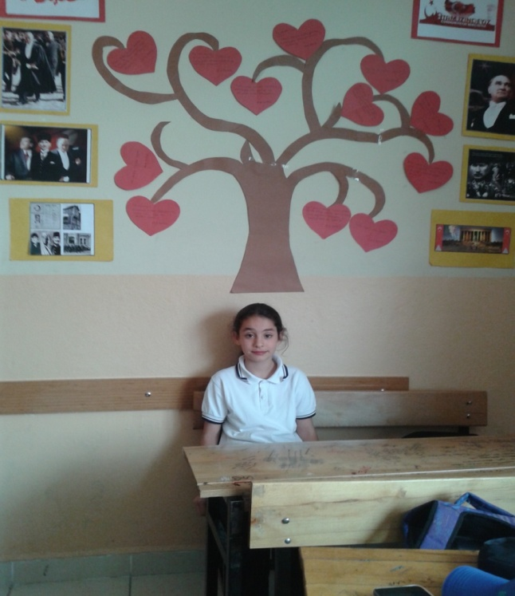
They are at school between 8:30 and 14:30

Slide 7
They have lunch at school between 12:40 and 13:00

Slide 8
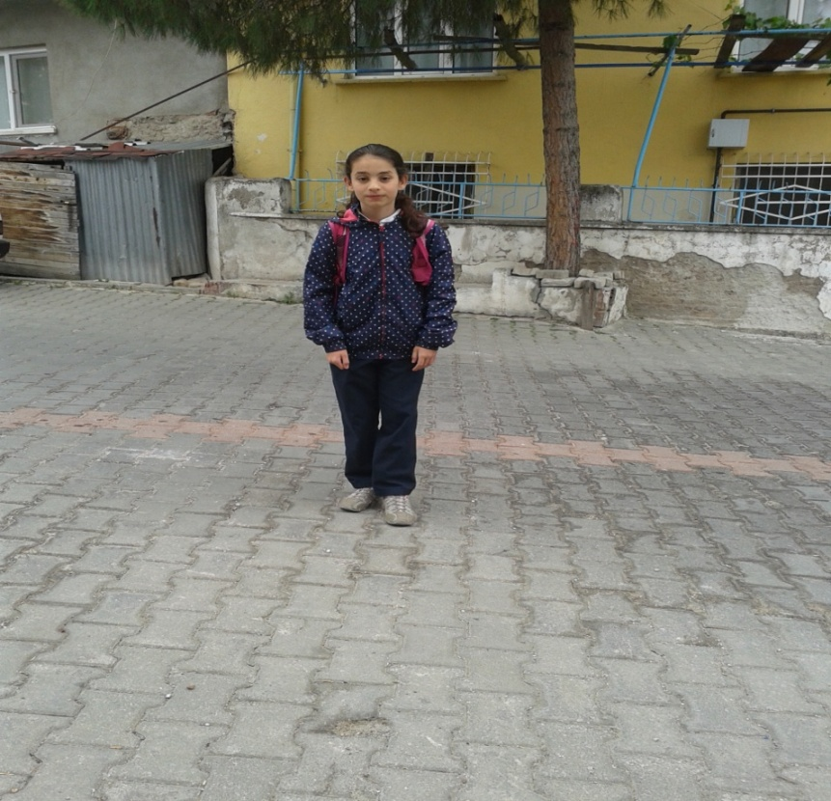
They finish school at 14:30 and go back to home

Slide 9
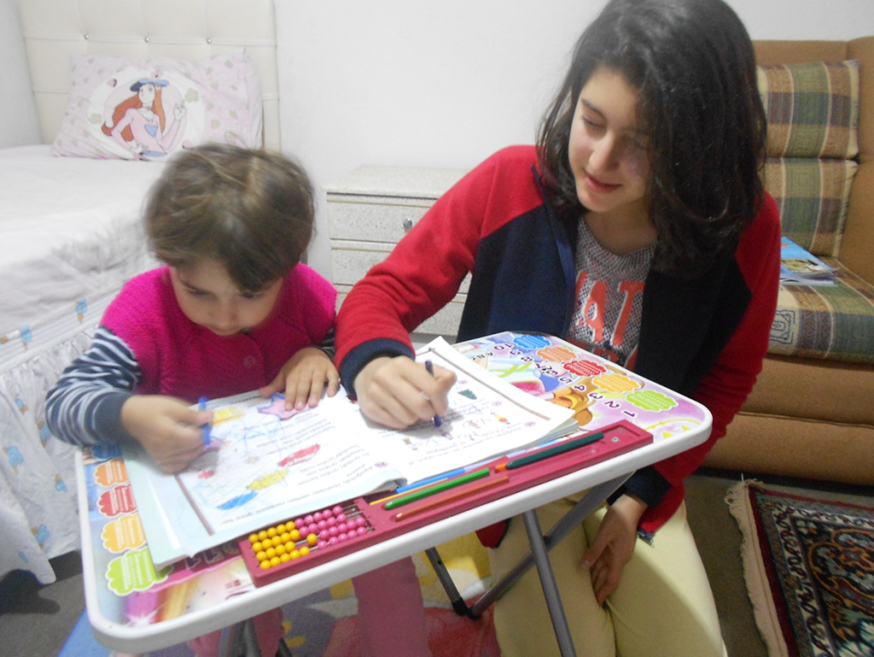
Between 14:30 and 18:00 they go home and do activities for relaxing.
Playing with siblings…
Reading…

Slide 10
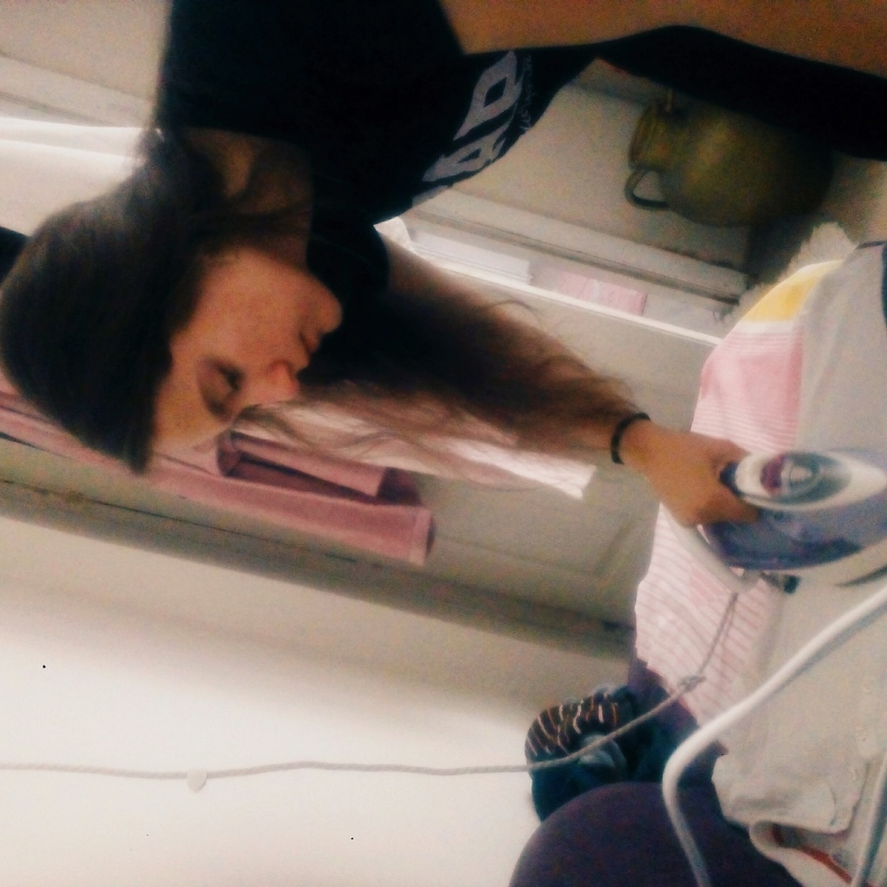
Some good girls help their mothers ☺

Slide 11
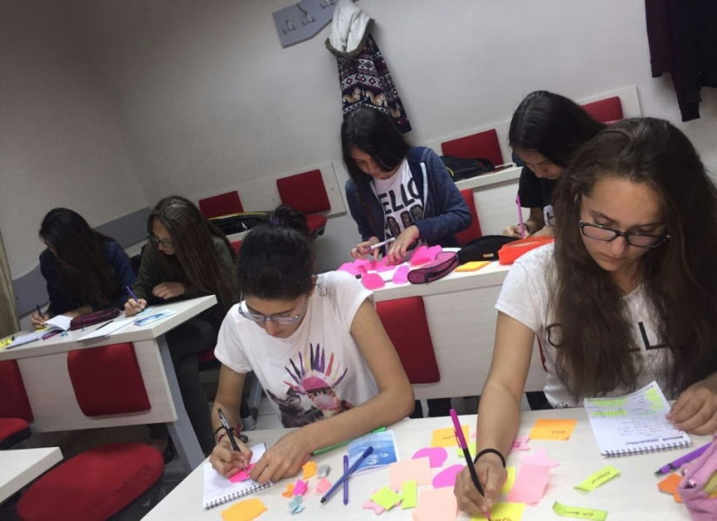
Some of them go to some language courses after 18:00

Slide 12
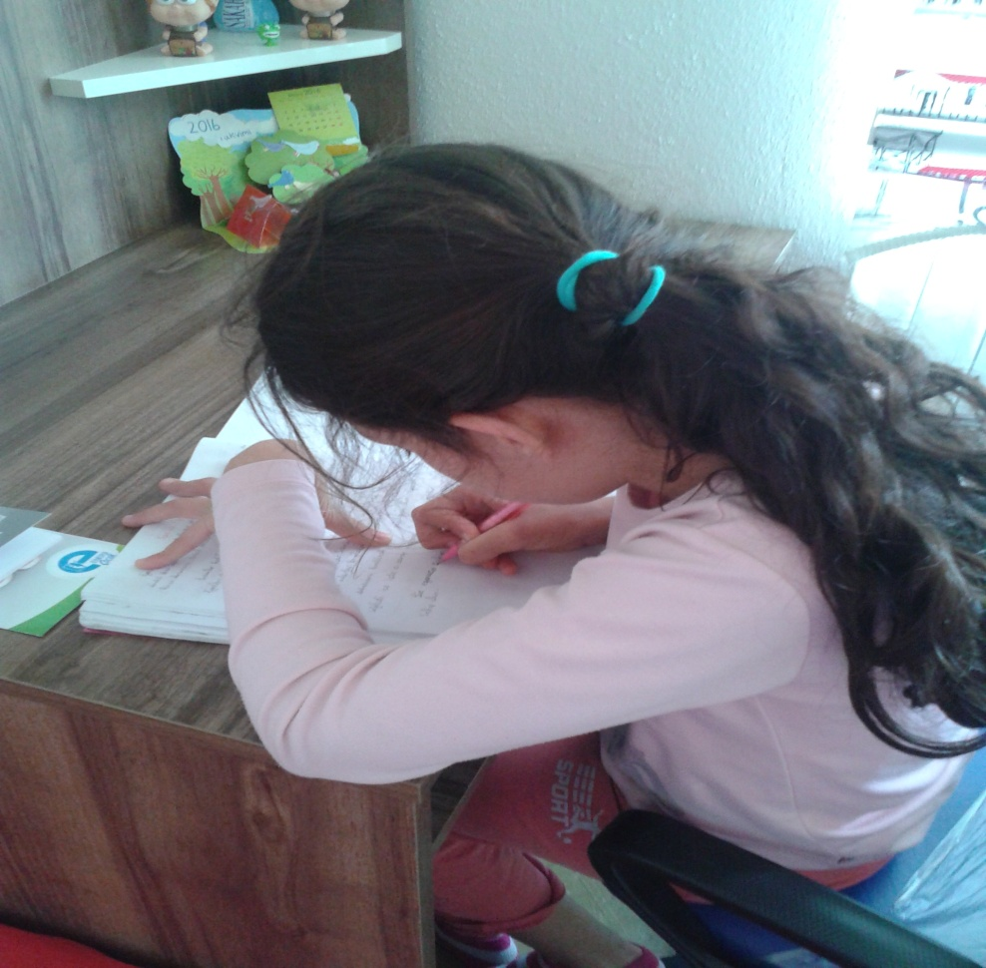
Some of them do homework

Slide 13
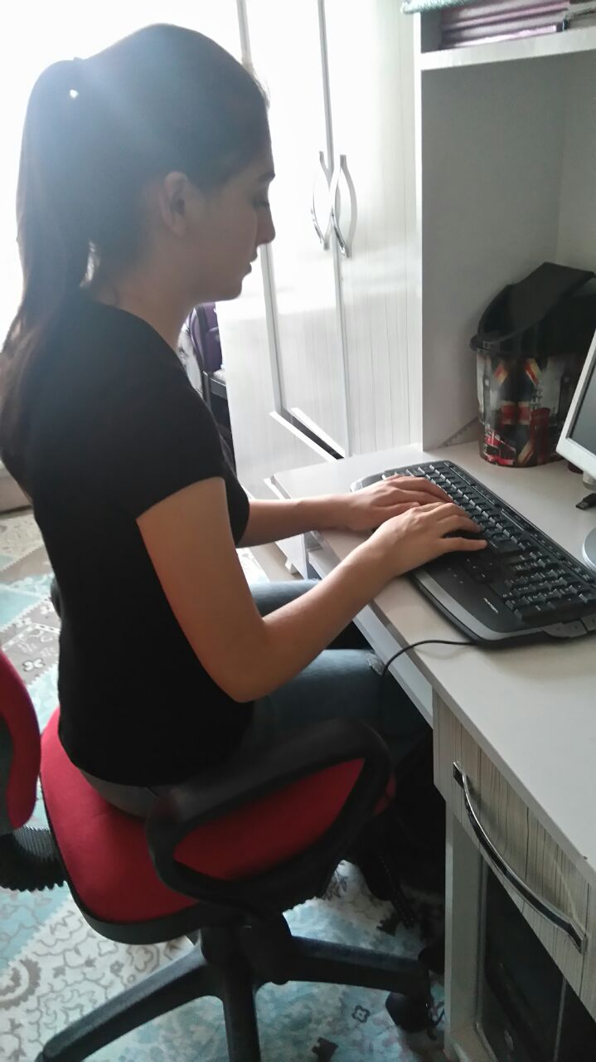
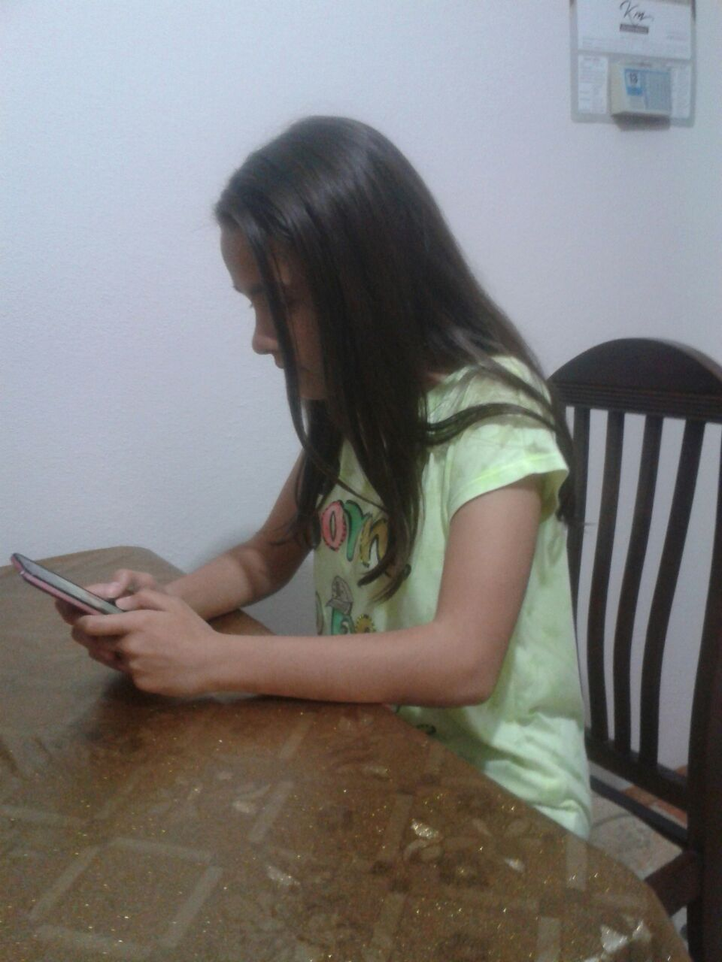
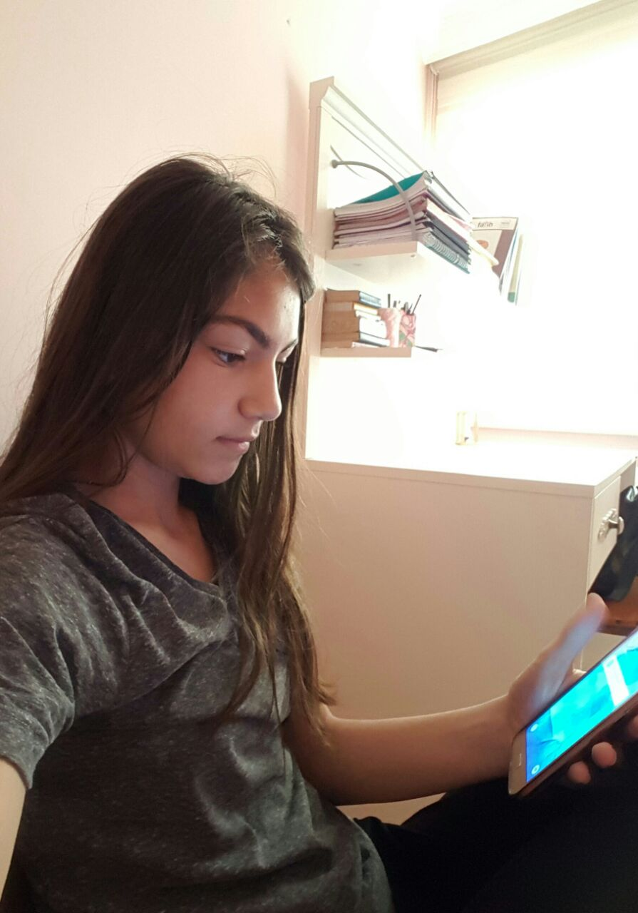
Some of them play with the computer instead of doing homeworks ☺

Slide 14
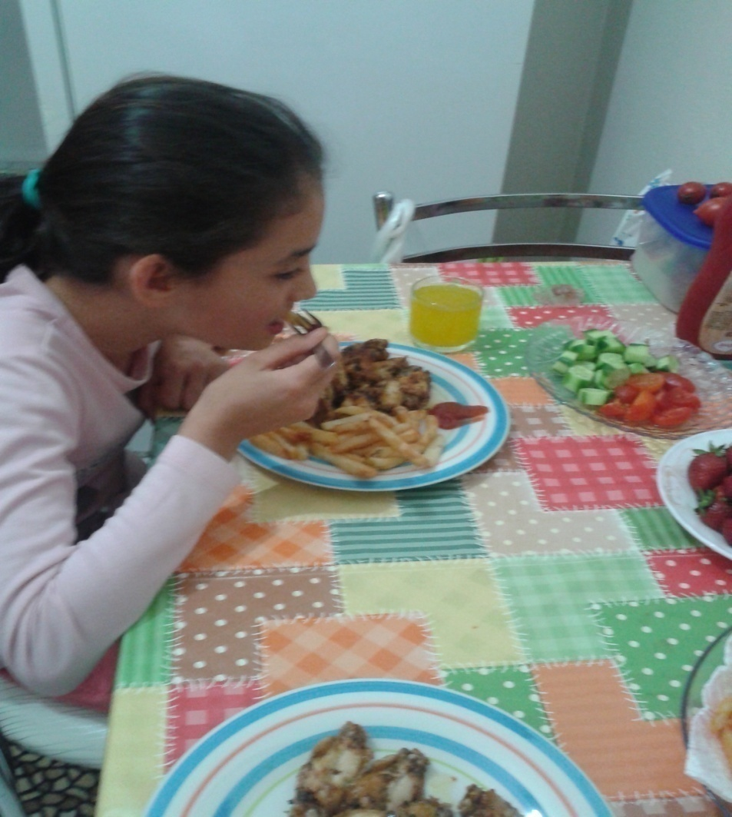
They usually eat dinner around 20:00

Slide 15
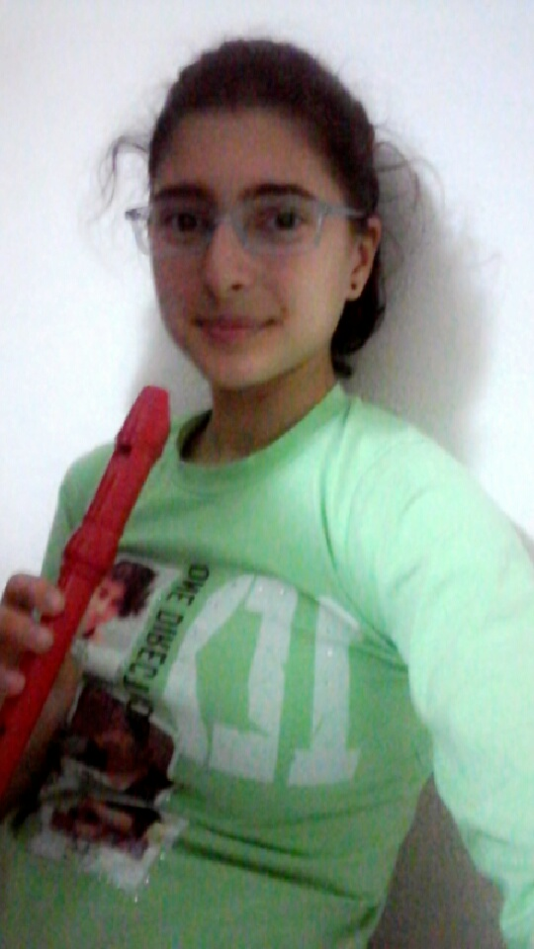
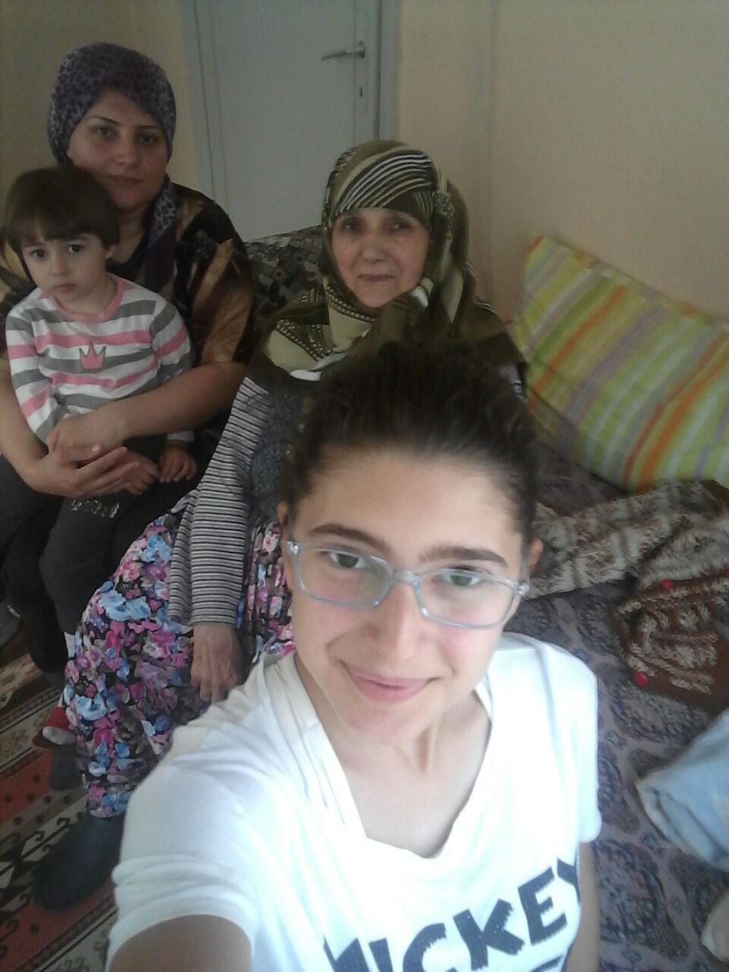
After the dinner they do some activities they love, study for the lessons, or spend time with the family.

Slide 16
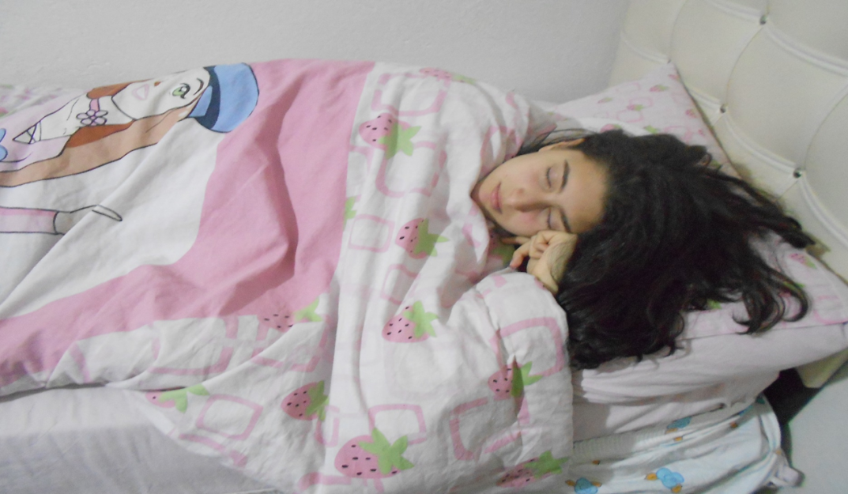
They usually go to bed around 22:00

Slide 17
Weekend of a Turkish Student
They wake up later than 8:00 at the weekend, about 10:00

Slide 18
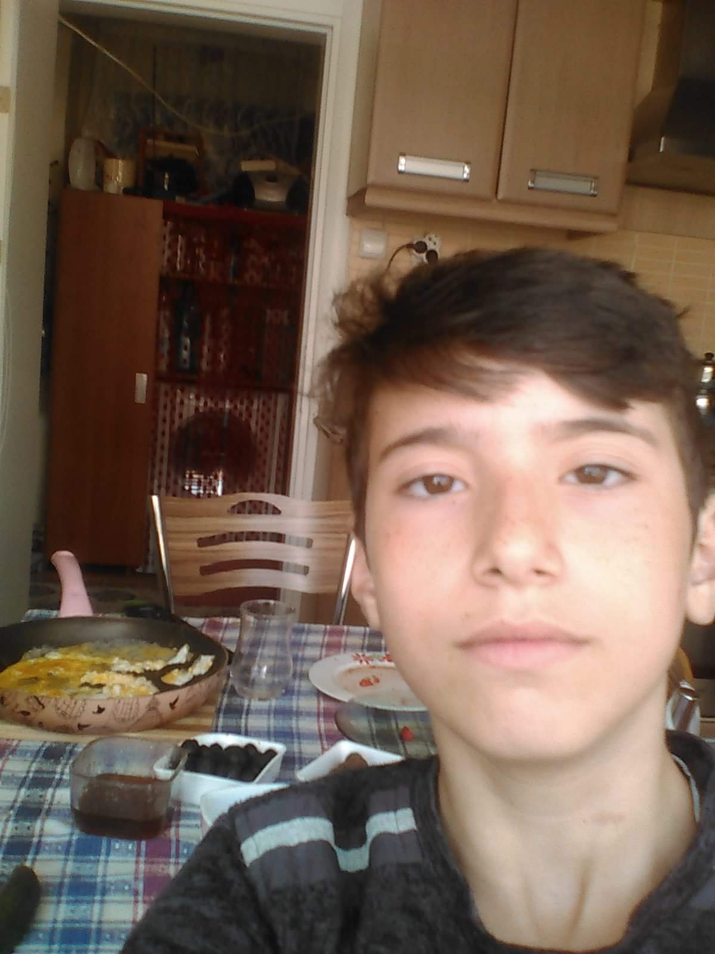
They have breakfast with the family, sometimes at home, sometimes out

Slide 19
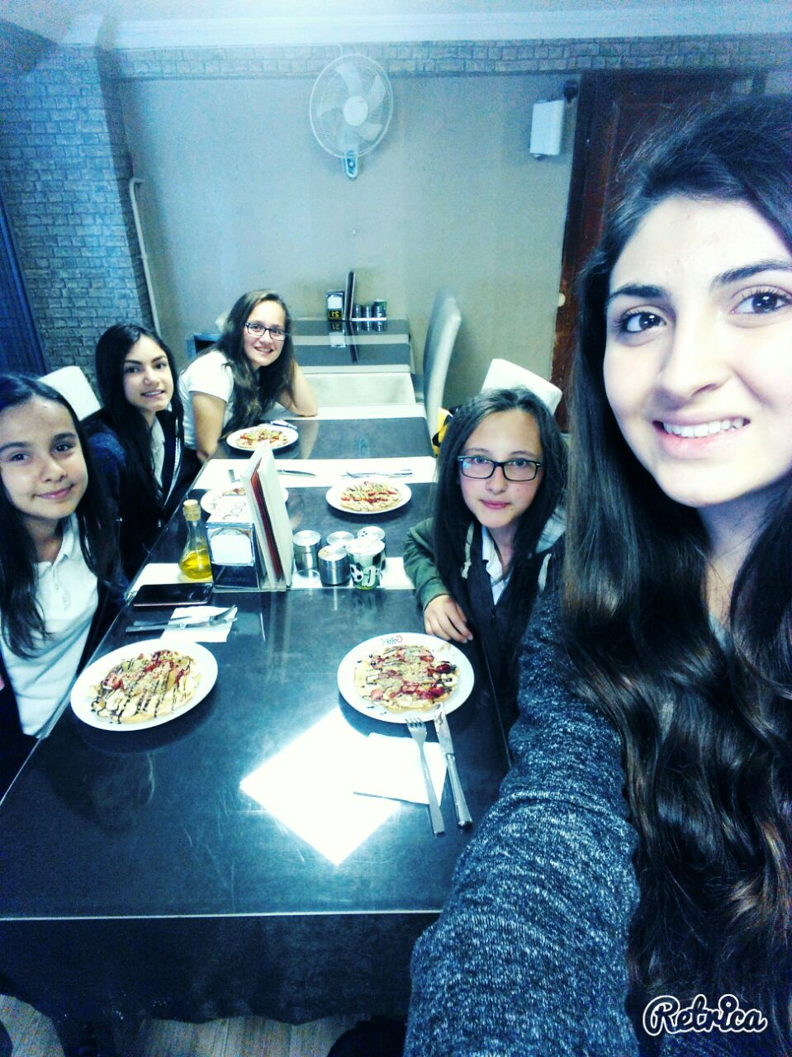
In the afternoon they go out with friends or spent time with them at home

Slide 20
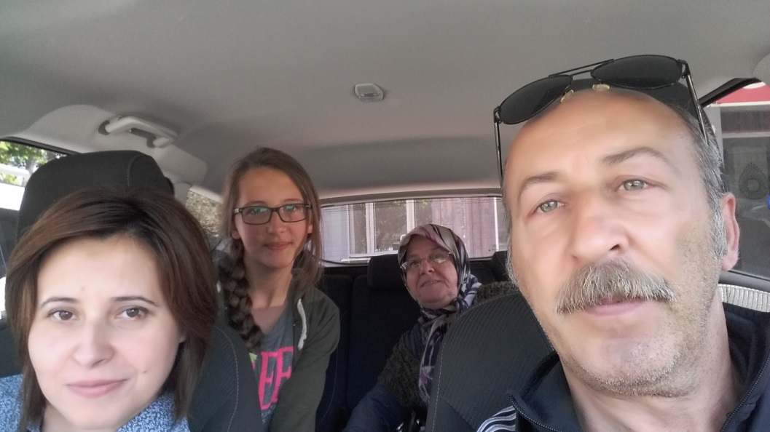
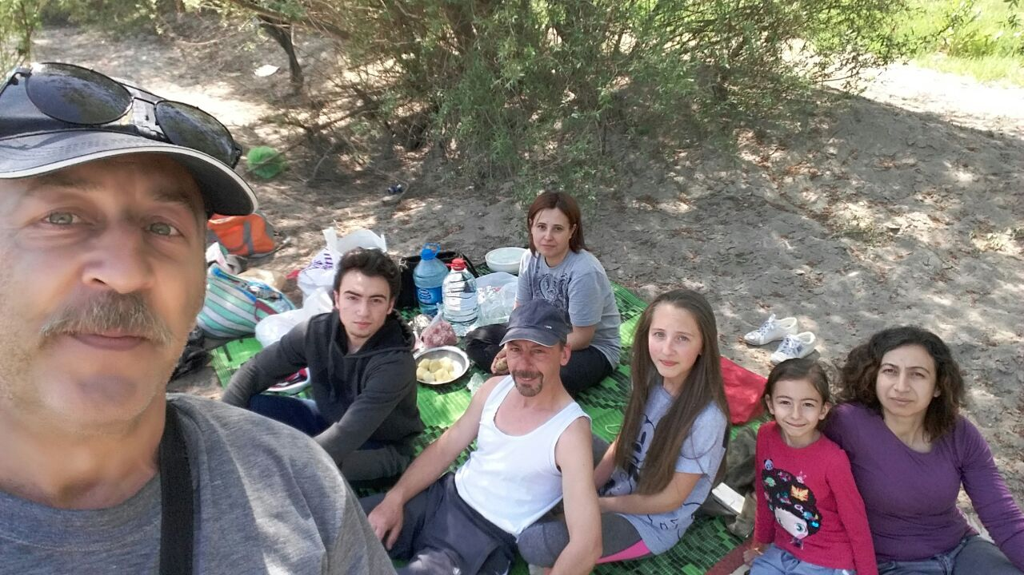
They sometimes go for journeys or picnic

Slide 21
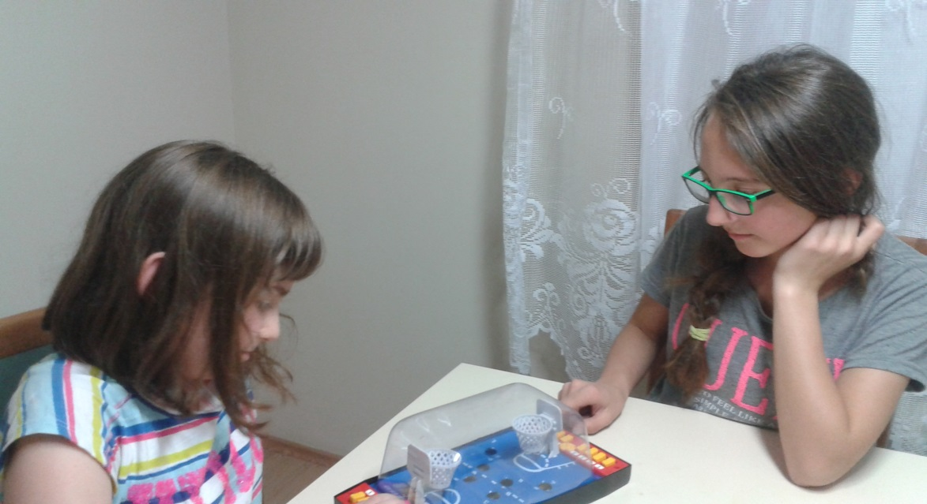
Or they spent time with the family

Slide 22
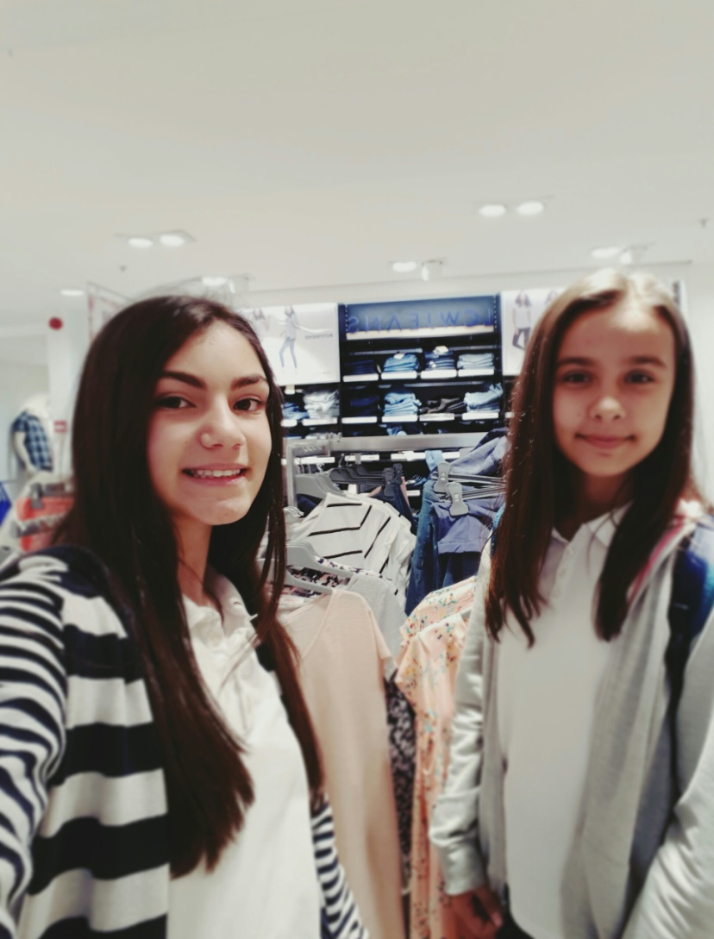
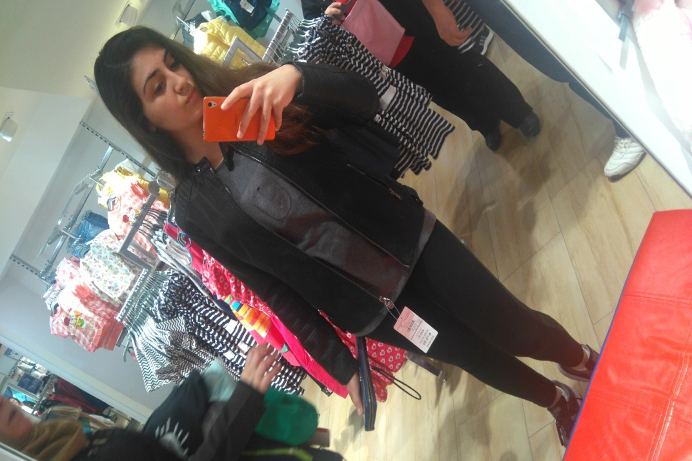
Or go to shopping ☺

Slide 23
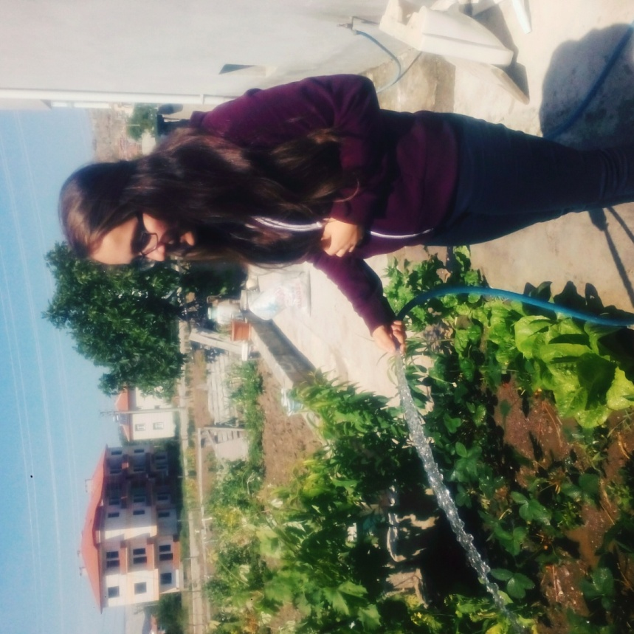
Sometimes help their family…

Slide 24
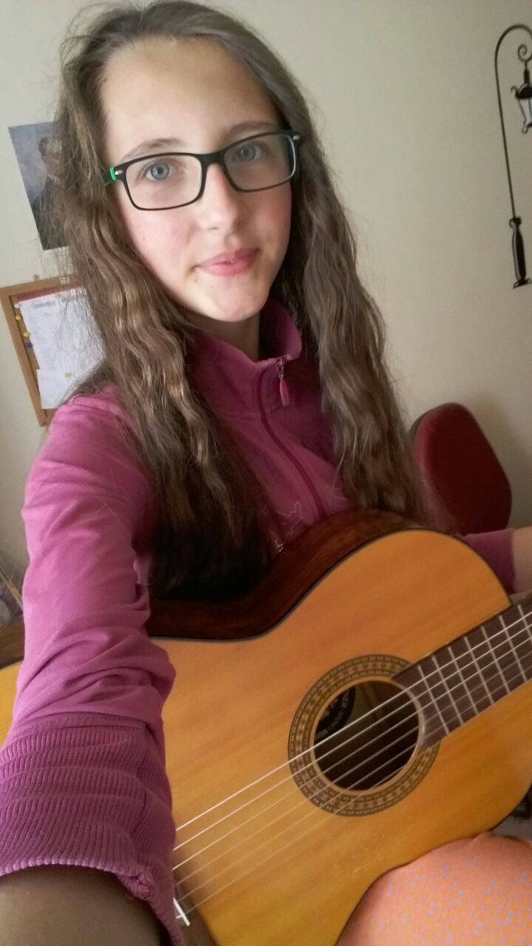
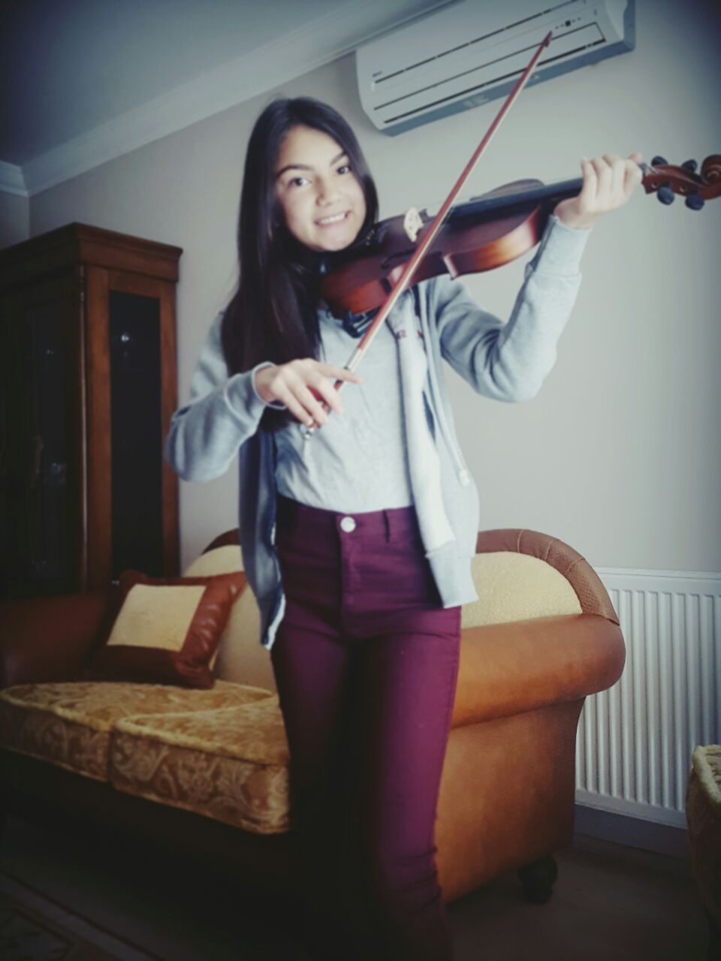
They play musical instruments

Slide 25
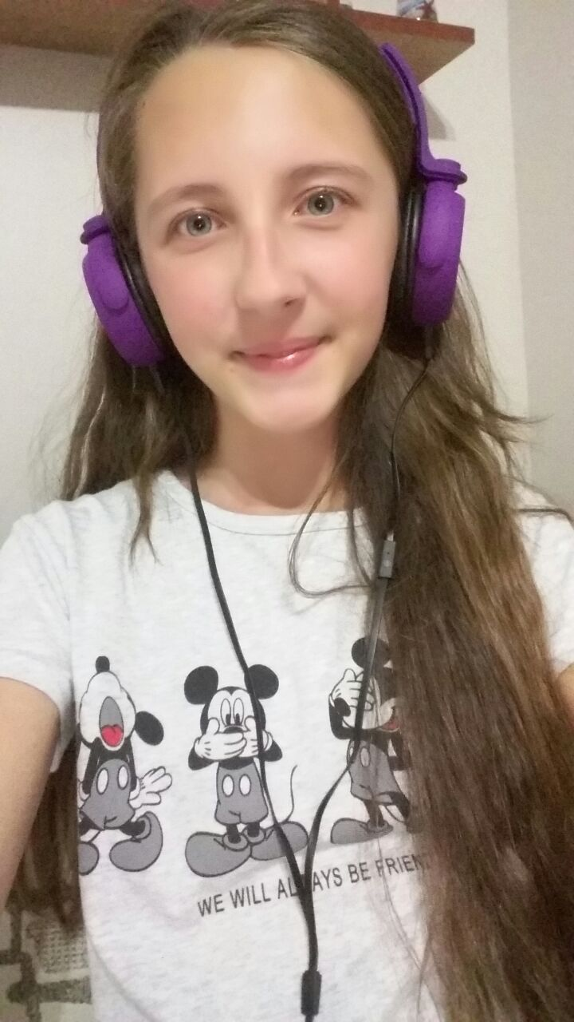
Sometimes read book at home…

Slide 26
In the evening they eat dinner with the family

Slide 27
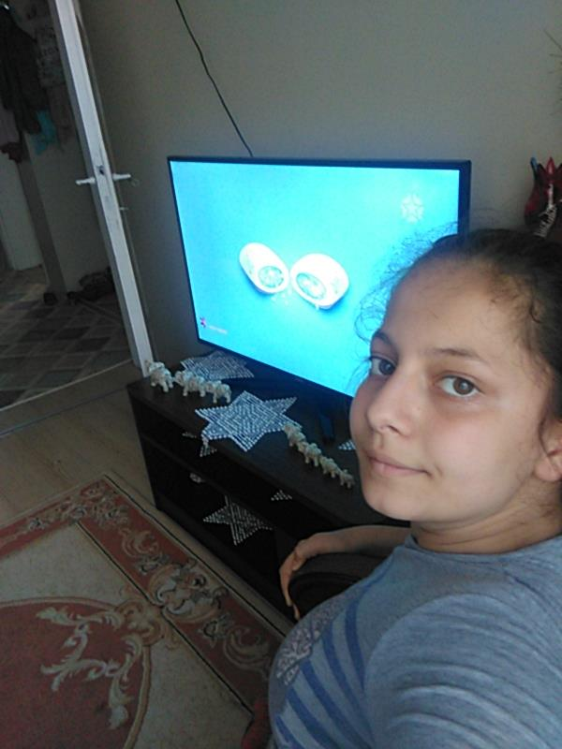
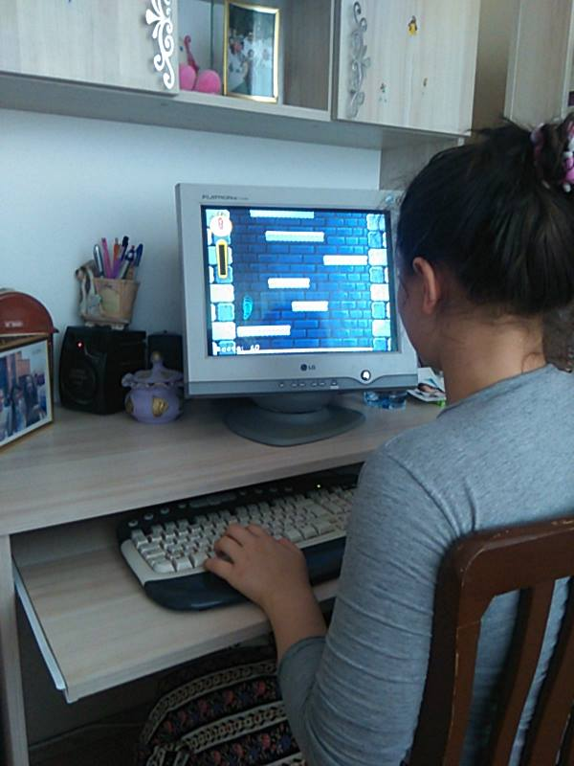
In the evening they stay at home and spend time with the tv, mobiles or computer Sometimes they go to the cinema or go to family visit.

Slide 28
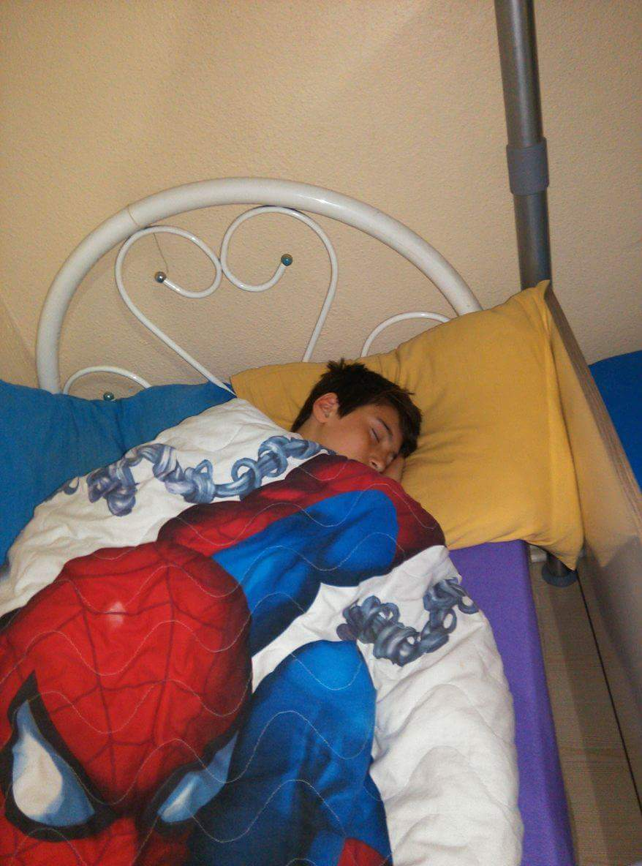
They usually go to bed later than the weekdays, at about 11 or 12 pm.

