Slide 1
ERASMUS+ 2014-2016 „Maths Is Everyw here”
TASK 1 – Maths Around Us
Zad. 1 – Matematyka wokół nas
By Maciej Kowalski

Slide 2
Rectangles – prostokąty/pictures-obrazki

Slide 3
Circles – koła/A cover and a wheel -wieczko i koło

Slide 4
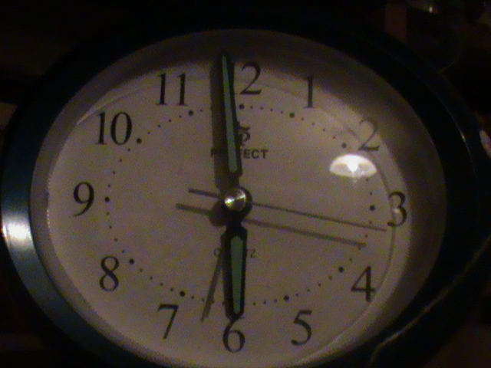
Digits – cyfry/ A calendar and a clock - zegar i kalendarz

Slide 5
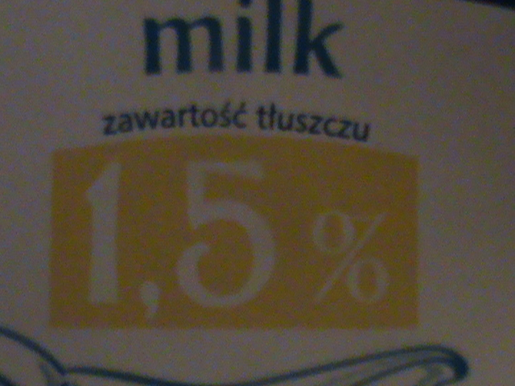
Percent – procent/ A carton of milk - karton mleka

Slide 6
Kilograms-kilogramy/flour- mąka

Slide 7
Litres - litry/ Oil - olej

Slide 8
Thanks for watching

