Slide 1
FUNDRASING FOR R.S.P.C.A
By YEAR 11

Slide 2
RSPCA
We did a survey. The R.S.P.C.A won the vote for who we should raise money for.
R.S.P.C.A 23
Cancer research 16
Water aid 8
Open doors (homeless) 4

Slide 3
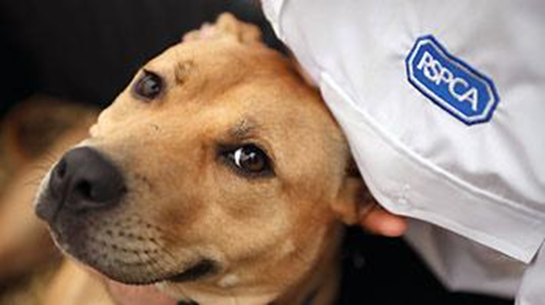
About the RSPCA
RSPCA means The Royal Society for the Prevention of Cruelty to Animals.
They were founded in a London coffee shop in 1824.
They have centres all over the country. The nearest is in Accrington.

Slide 4
What we had to do?
We had to choose and decide which charity
We had to ask Mr Wright if we could use the morning at school
We had to check with some of our teachers if the date was ok.
We had to decide what games to play
We had to decide how much to charge
We had to work out how much we would make from the buns and biscuits.
We had to make posters to tell everybody about what we were doing and deliver an assembly.
We had to make leaflets to ask staff to help us get things for the tombola
We had to get things ready.
We found out about the R.S.P.C.A

Slide 5
RSPCA
We thought about lots of ideas but we chose:
Dress up as animals for £1
Treasure island map
Guess how many sweets in the jar?
Sell biscuits/cakes
Name the teddy bear
Make posters
Pin the tail on the donkey
Tombola

Slide 6
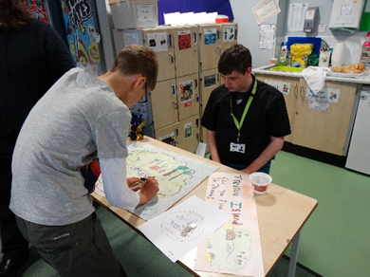
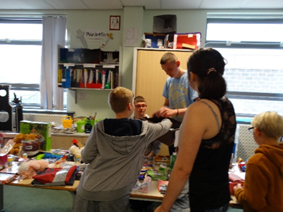
Dressing up as animals
Find the X on the treasure map to win a prize.
Tombola
Guess how many sweets in the jar

Slide 7
R.S.P.C.A
PRICE OF THINGS
We had to decide how much to charge.
Pin the tail on the donkey 20p
Tombola 10p a go.
Cake Sale 25p Biscuit sale 20p
Animal Dress competition Prize to be given.
Colouring competition Prize to be given.
Treasure map 20p
Guess the name of the teddy 20p
How many sweets in a jar? 20p

Slide 8
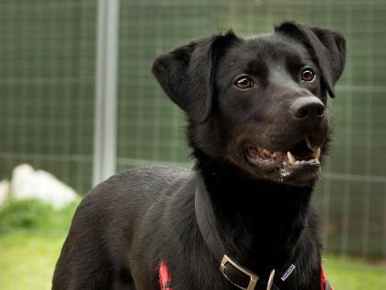
R.S.P.C .A.
What we do
The RSPCA rescue animals that are in danger, they look after them and make them better.
When they are better, they help to put them in a new safe home.
Type: Dog
Breed: Crossbreed/Unknown crossbreed
Colour: Black
Age: 2 Years (approx.)
Ref: 111

Slide 9
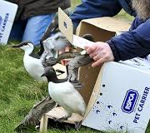
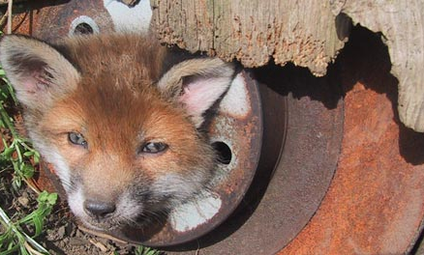
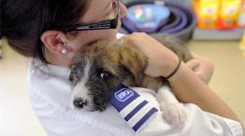
They help any creature.

Slide 10
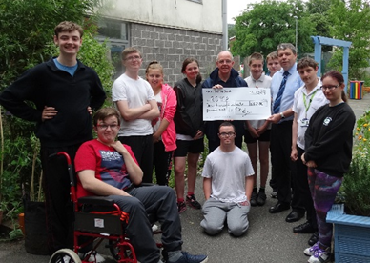
We had a great time!
We raised £322.50

