Slide 1
Maths is everywhere
The European Commission support for the production of this publication does not constitute an endorsement of the contents which reflects the views only of the authors, and the Commission cannot be held responsi­ble for any use which may be made of the information contained therein

Slide 2
Activity 8 –
The students chose a few sports disciplines for their research –
1) how long can you balance on your leg, 2) the best time in running for 50 metres,
3) the best time in hopping for 50 metres,
4) how many times can you bounce a ball in one minute

Slide 3
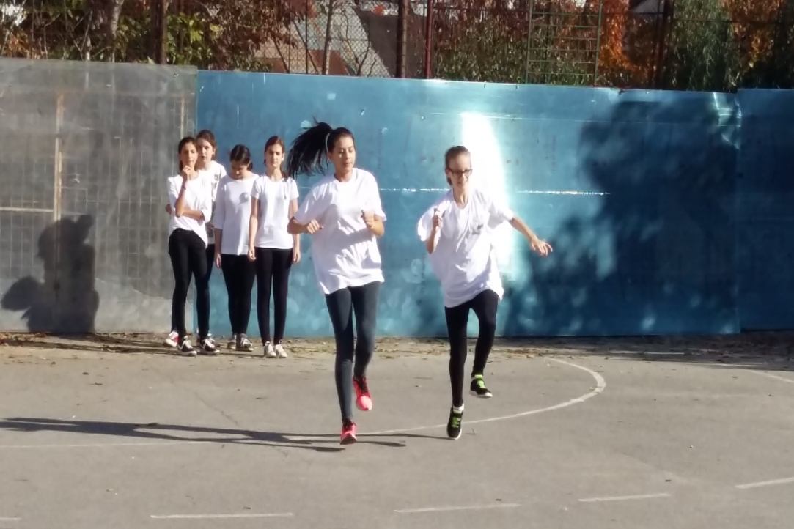
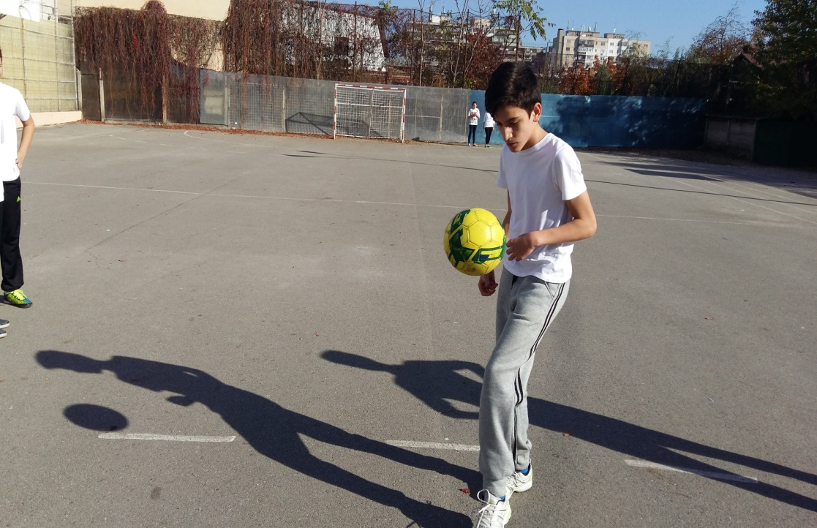
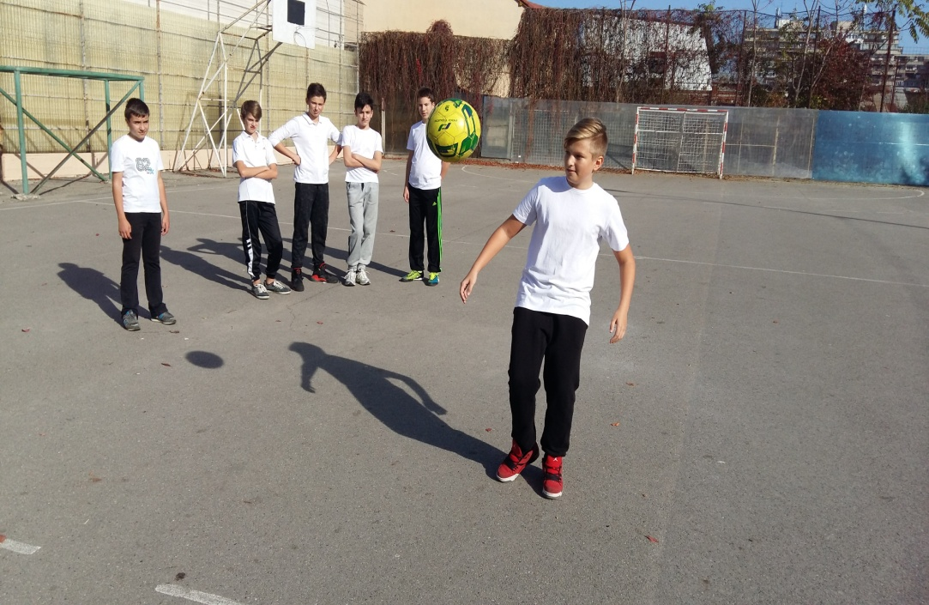
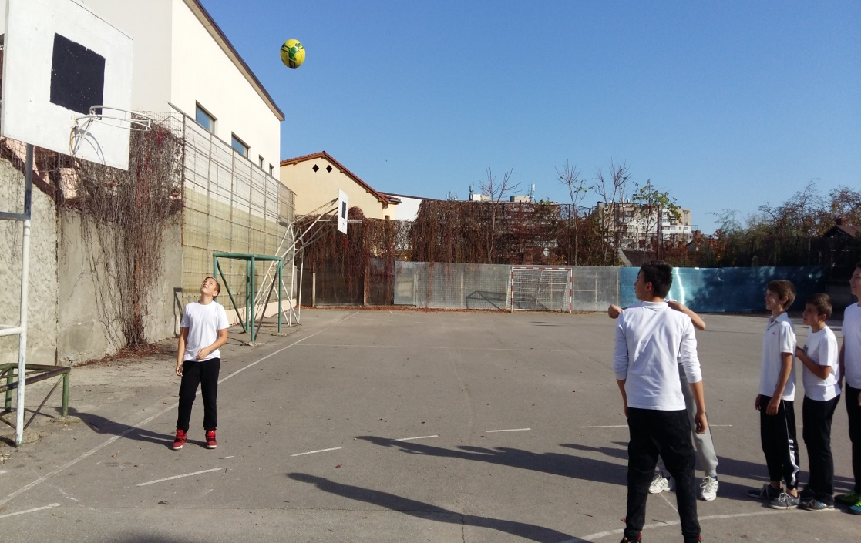

Slide 4
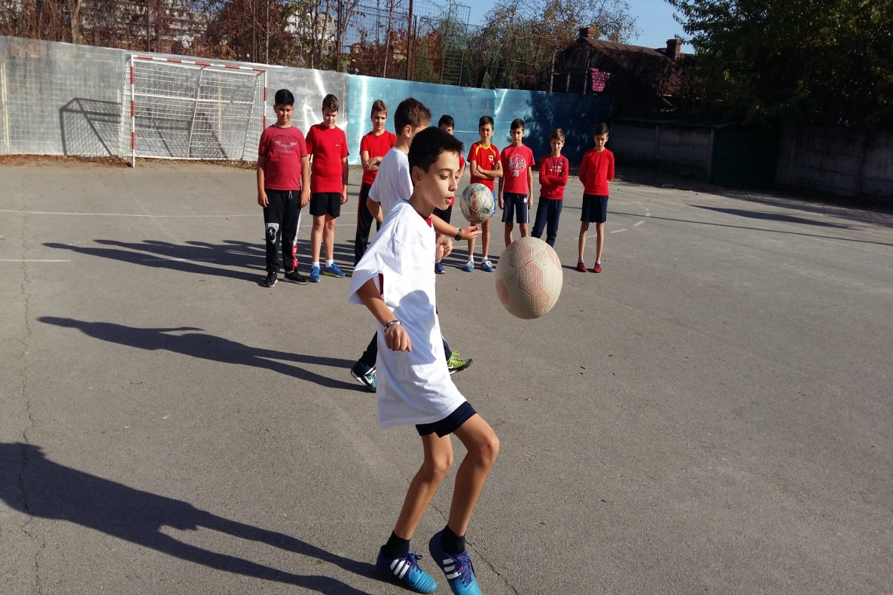
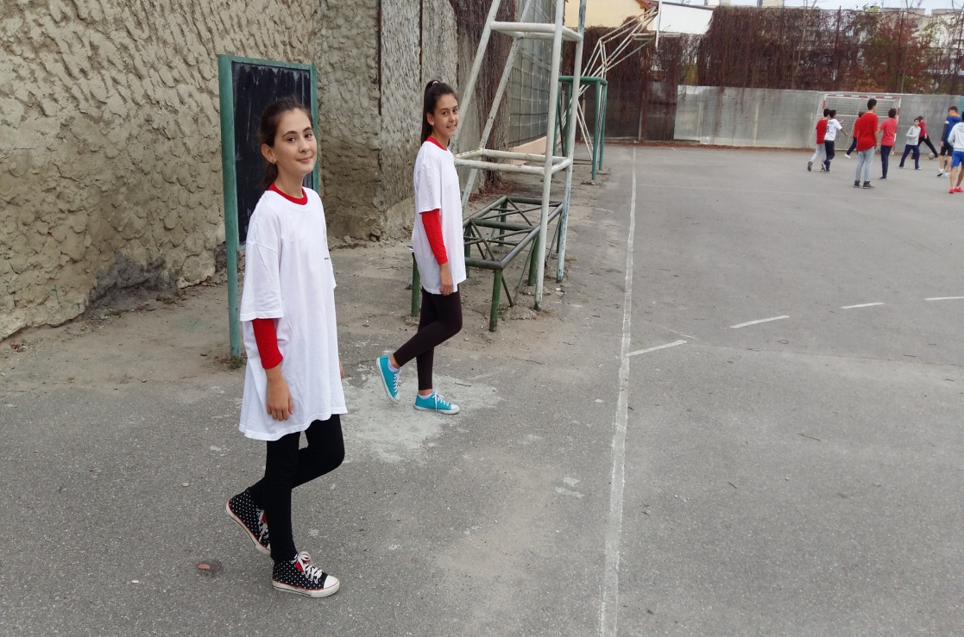

Slide 5
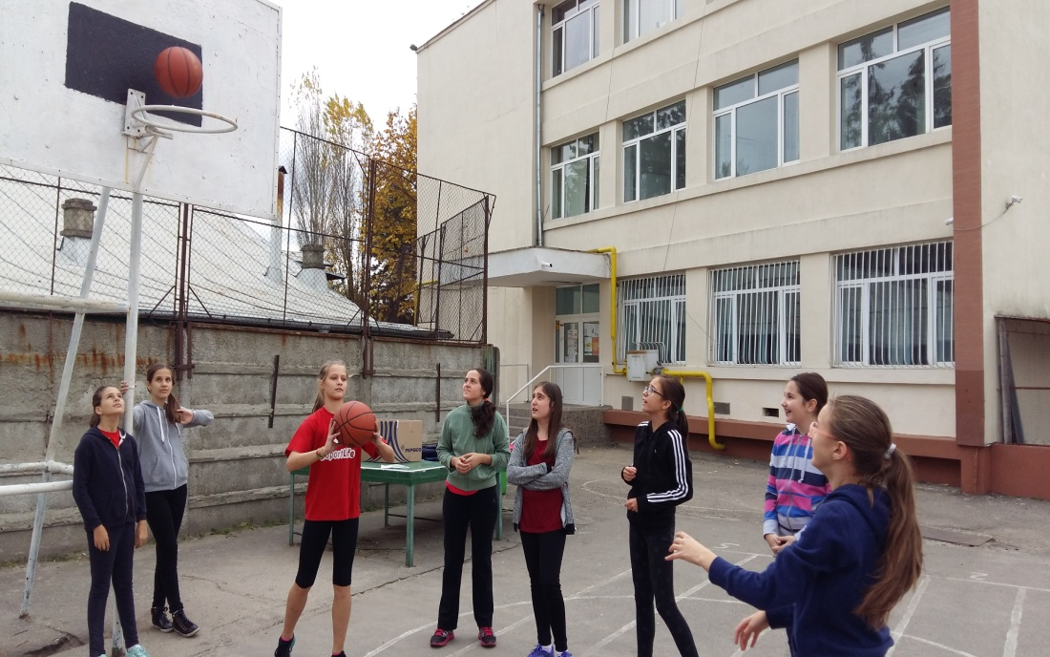
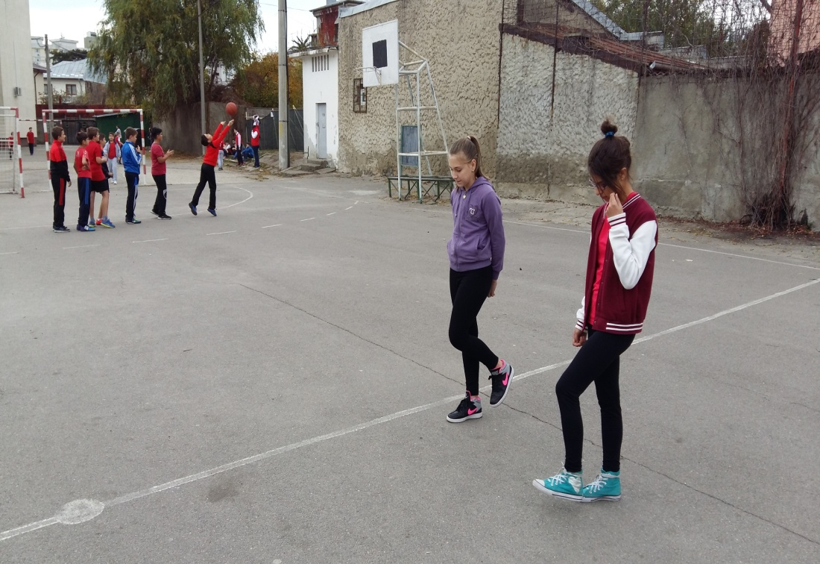

Slide 6
