Slide 1
2014-2016 MATHS IS EVERYWHERE!
Task VII: Maths In School Research
ZESPÓŁ SZKÓŁ W RUDKACH

Slide 2
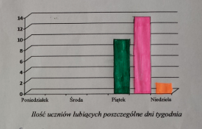
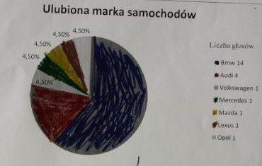
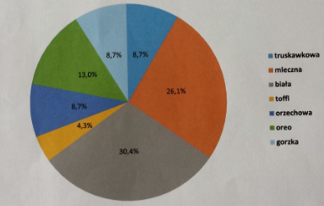
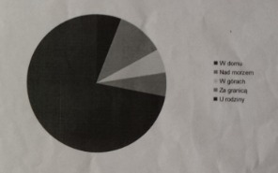
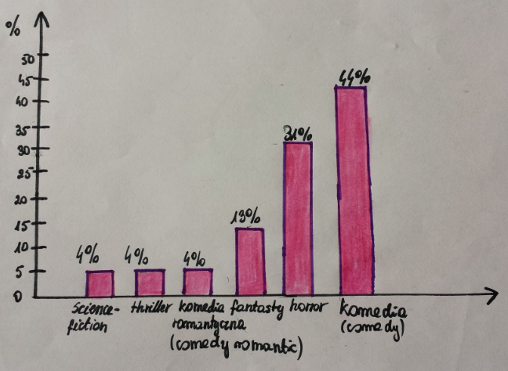
In TASK 7 - Maths In School Research – students had to do
research among their classmates.
The subjects of their research differred.

Slide 3
What’s your favourite sports discipline?
What’s your favourite day
of the week?
What’s/Who’s your favourite music band or singer?
What’s your favourite music style?
What’s your favourite
film genre?
What’s your favourite
car make?
Most referred to hobbies such as favourite sports, music or cars.

Slide 4
Where did you spend your last holiday?
Who would you like to sit with
at your school desk?
What’s your favourite type of chocolate?
Which mobile phone
would you prefer?
Some groups asked about other preferences –
mobile phones, chocolate, classmates or ways of spending holidays.

Slide 5
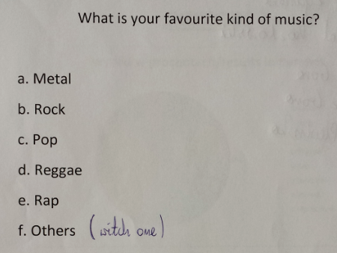
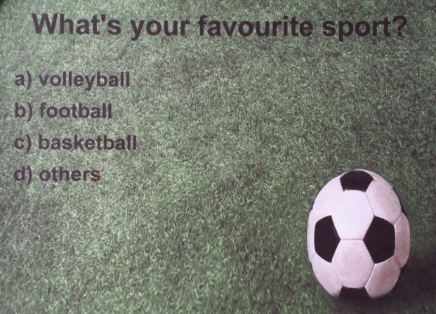
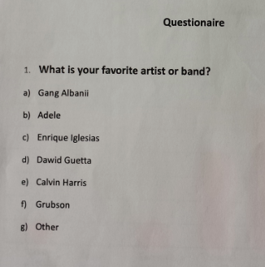
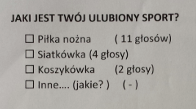
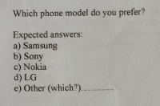
Having chosen the subjects, students composed their surveys
and asked their classmates to do them.

Slide 6
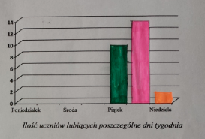
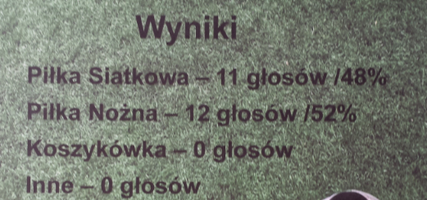
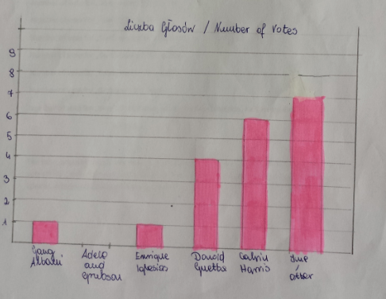
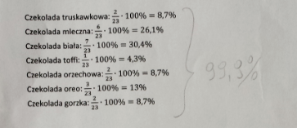
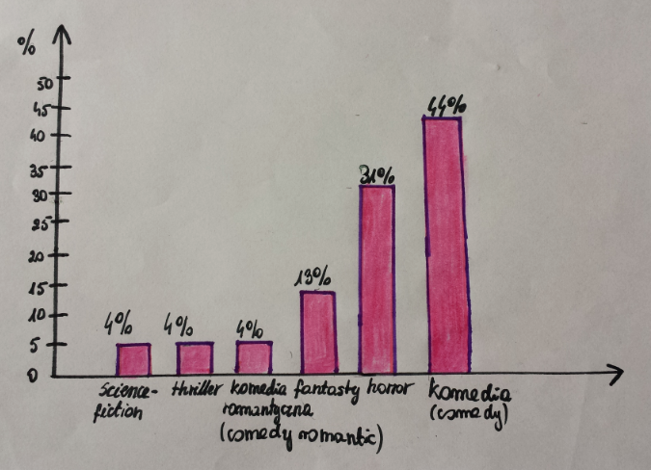
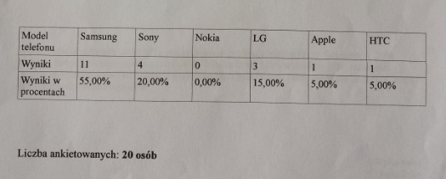
Next, they counted the votes and prepared charts or tables
to present the results of their surveys.

Slide 7
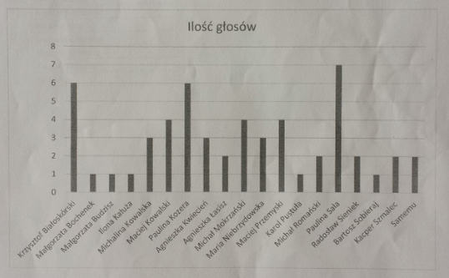
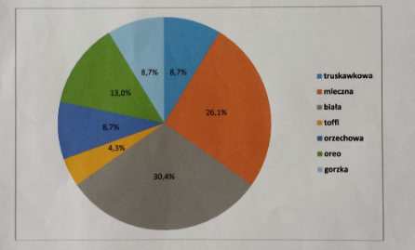
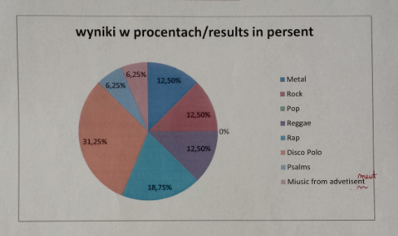
Some students used computer programmes to do the calculations and printed pie charts.

Slide 8
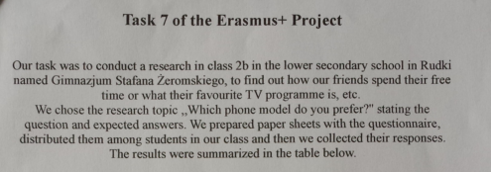
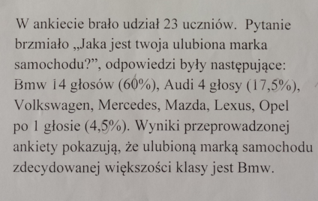
Finally, students wrote short summaries of their surveys.

Slide 9
You can follow us ON: 1) our school website: zsrudki.edupage.org 2) the twinspace: http://twinspace.etwinning.net/ 3) the blog: http://erasmusmaths.blogspot.com/

Slide 10
THANK YOU
FOR WATCHING ☺

