Slide 1
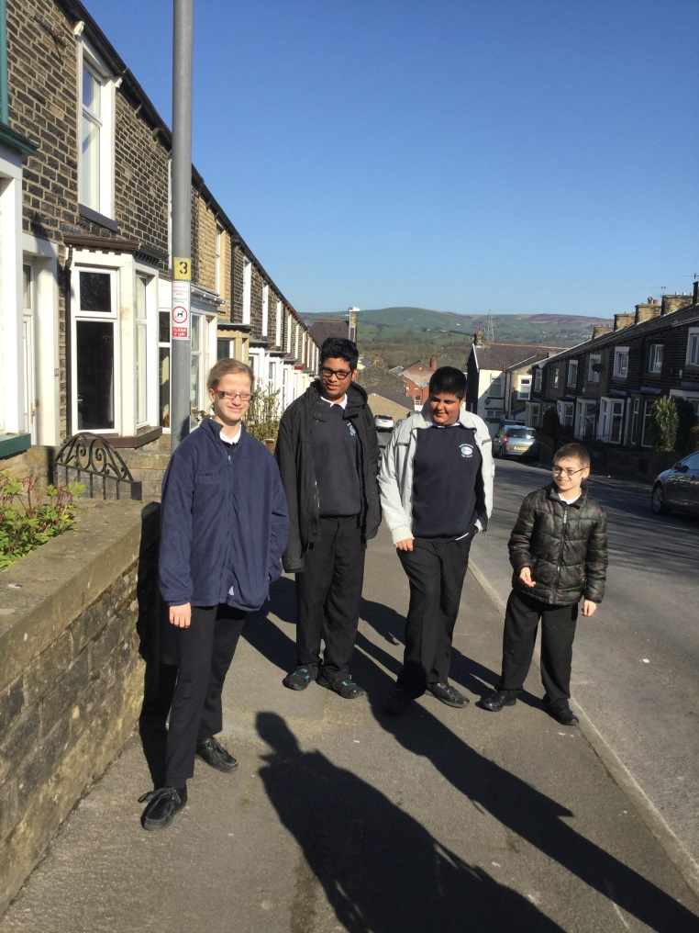
Trip to Burnley bus station
By Aimee, Abdul, Farhan & Joel

Slide 2
How we planned it
We looked at different types of transport.
We looked at the cost and time of using a bus or a train.
We decided that the bus would be the best choice for us.
We looked at the times for the bus .
We wrote a letter to parents for permission.
We then planned the trip of what were going to do. We all decided to get on the bus on Leeds Road go to Burnley Bus Station, look for shapes and numbers then visit the café. Then get the bus back to school.
We got the staff to help us check our work.

Slide 3
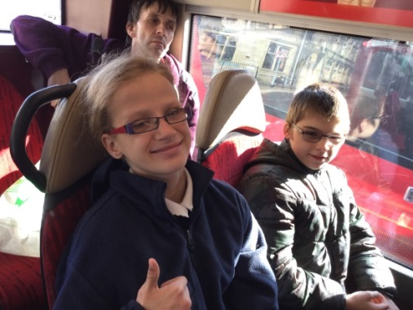
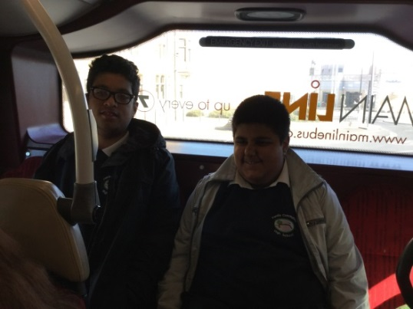
Our morning
We walked down to Leeds Road to get the bus which was due at 9.30am but it was 10 minutes late.
We got on the bus and paid the driver.
The cost for a child was £2.70 return ticket.
The cost for a adult was £4.40 return ticket.
On the way to Burnley bus station we looked at shapes, patterns and numbers.

Slide 4
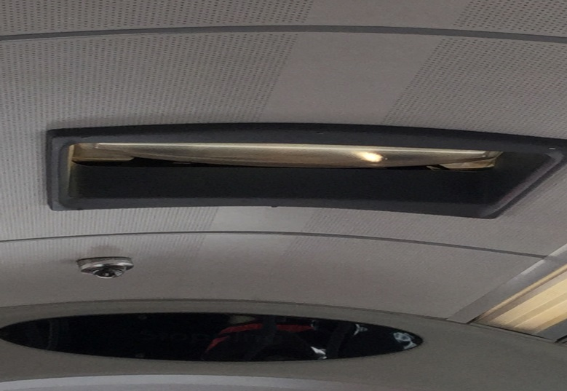
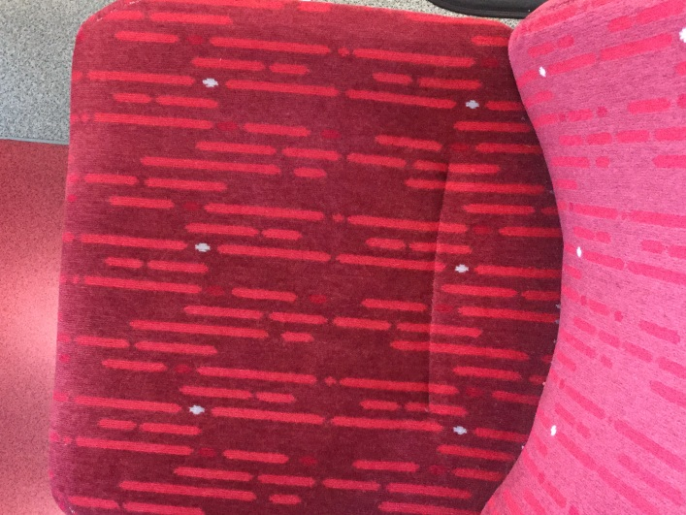
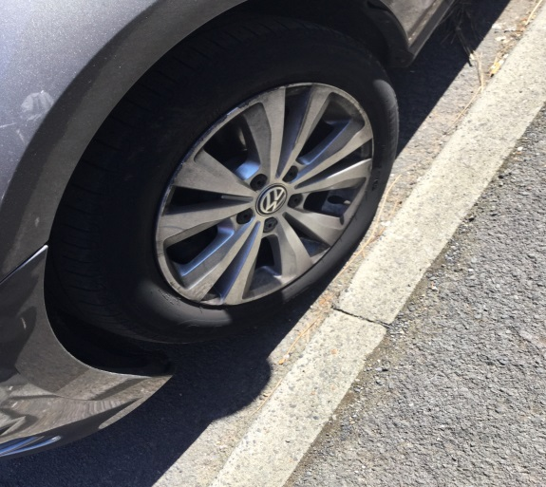
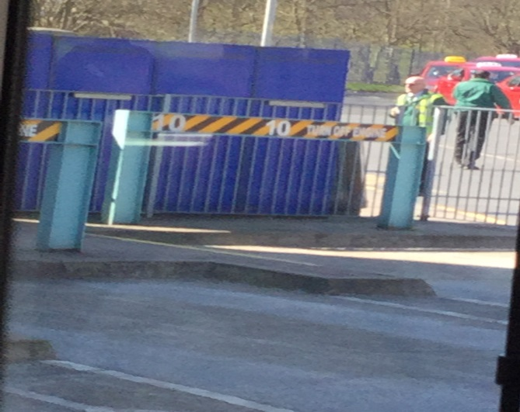
shapes, patterns and numbers.

Slide 5
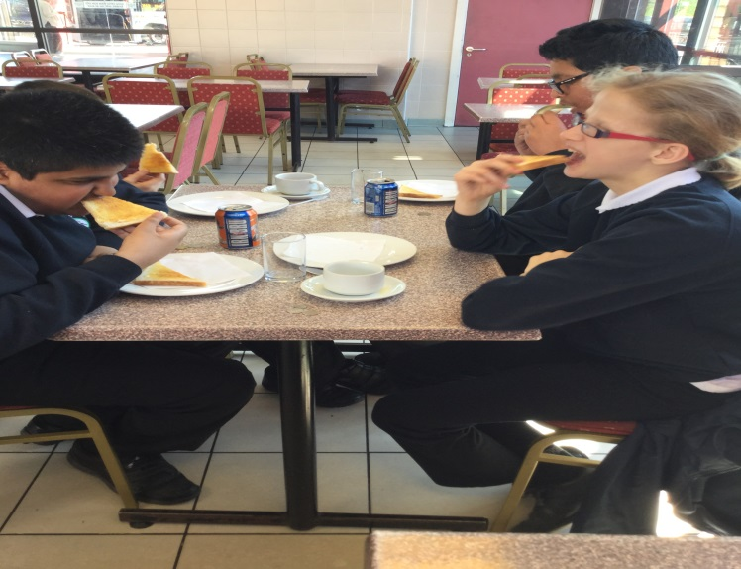
Cafe
We visited the café at the bus station. We all had a drink and some toast each. It was yummy!! We all paid for our own, by ourselves!!!

Slide 6
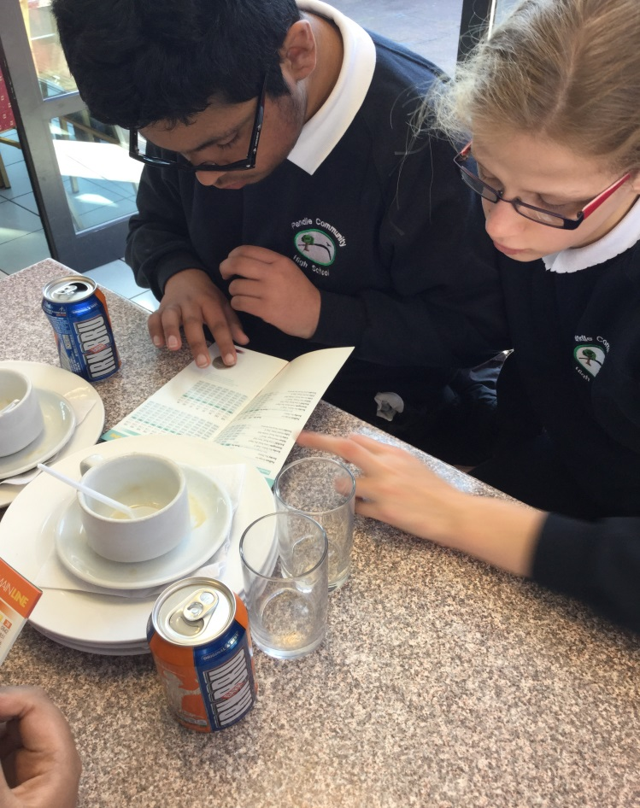
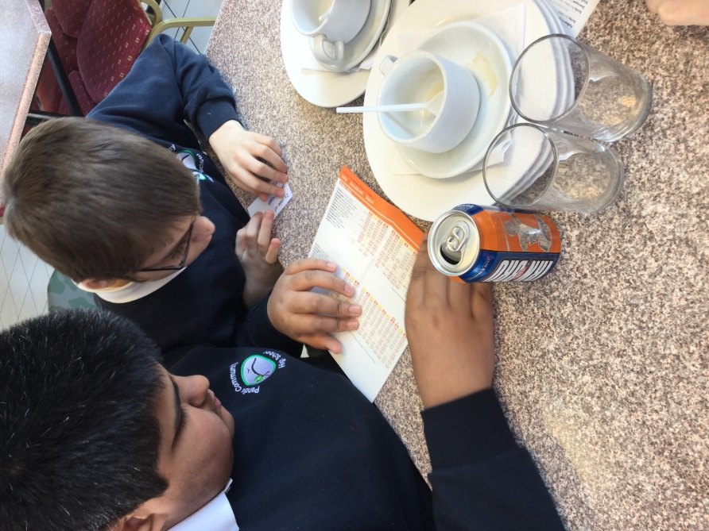
Time
We looked at the bus time table to see what time the bus was back to school. It was due in at 10.50am. We decided to get bus number 29.

Slide 7
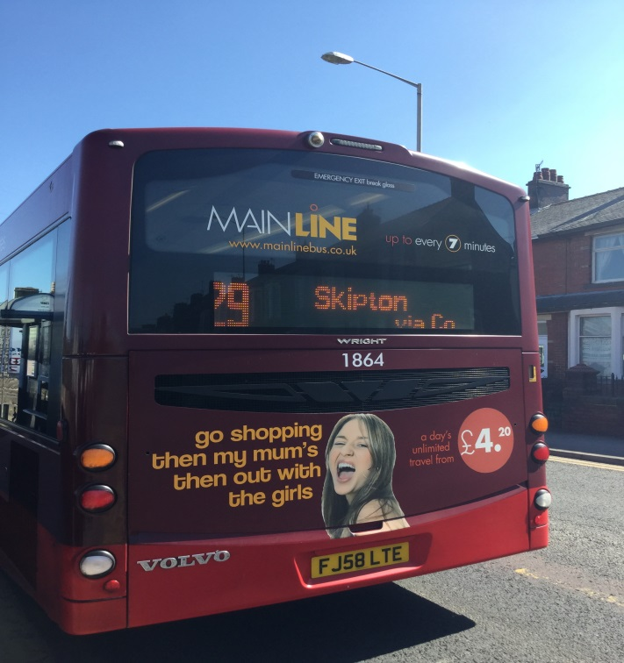
The journey back to school
We got on the bus and we gave the driver our ticket. We all sat together and looked for shapes, patterns and numbers.
We got off the bus on Leeds Road near school and walked back to school. We got back at school at 11.25am.

Slide 8
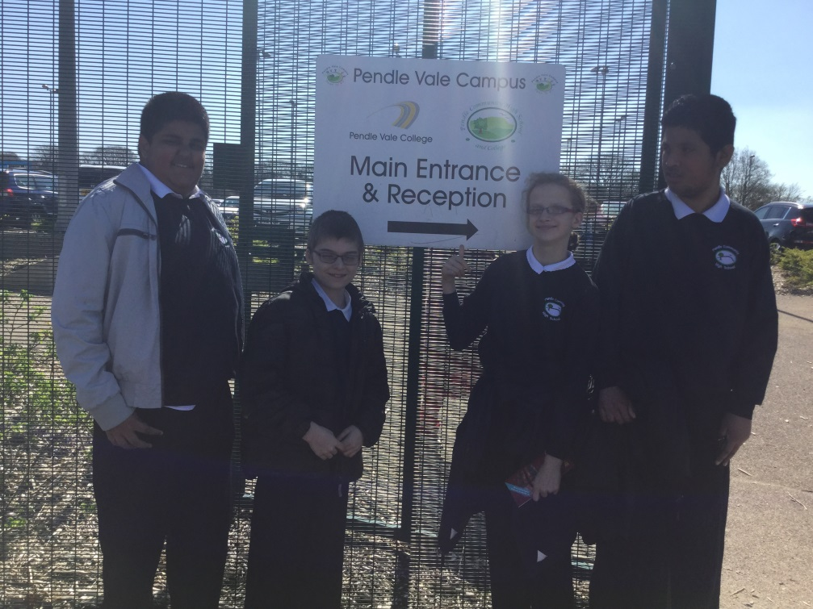
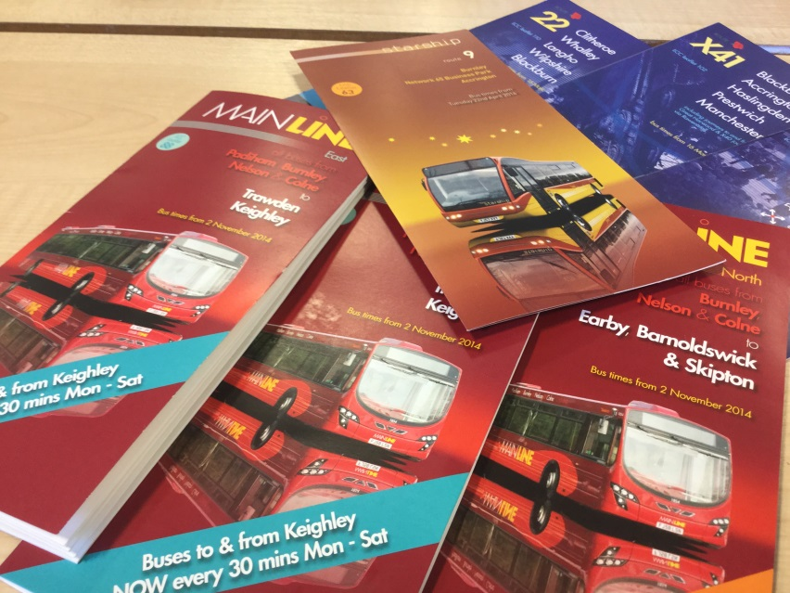
Back to school
We went back to our school and started our PowerPoint.
We took photos of the different bus timetable leaflets.

Slide 9
The end
I hope you like this power
Point

