Slide 1
Maths is everywhere
The European Commission support for the production of this publication does not constitute an endorsement of the contents which reflects the views only of the authors, and the Commission cannot be held responsi­ble for any use which may be made of the information contained therein

Slide 2
Activity 11 –
Students:
- divided in groups made cardboard games using logical maths clues
- made PowerPoint presentations of different mathematical logical games in English for others to solve.

Slide 3
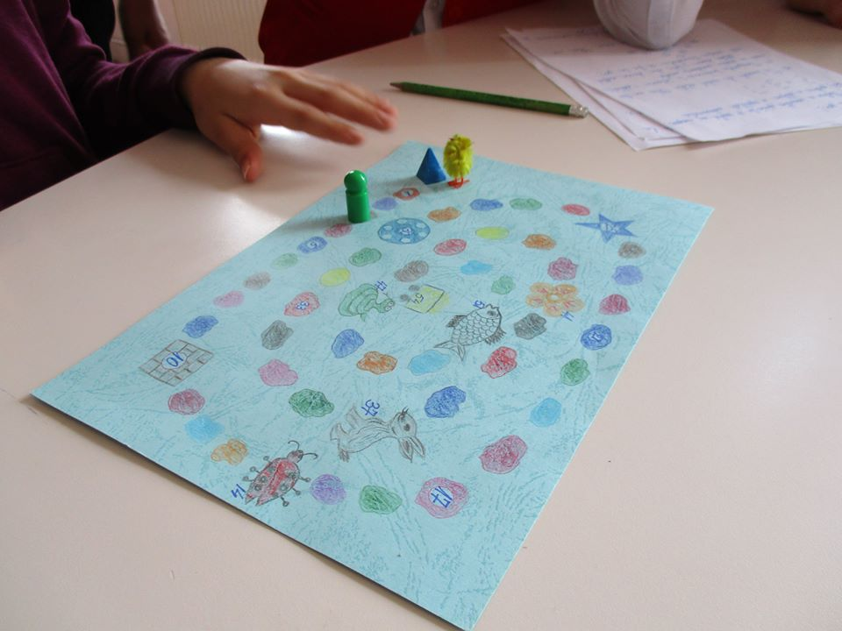
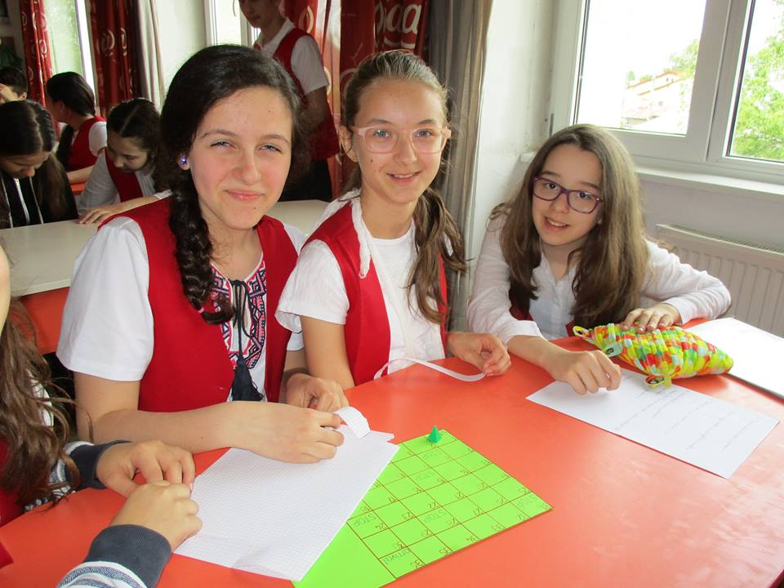
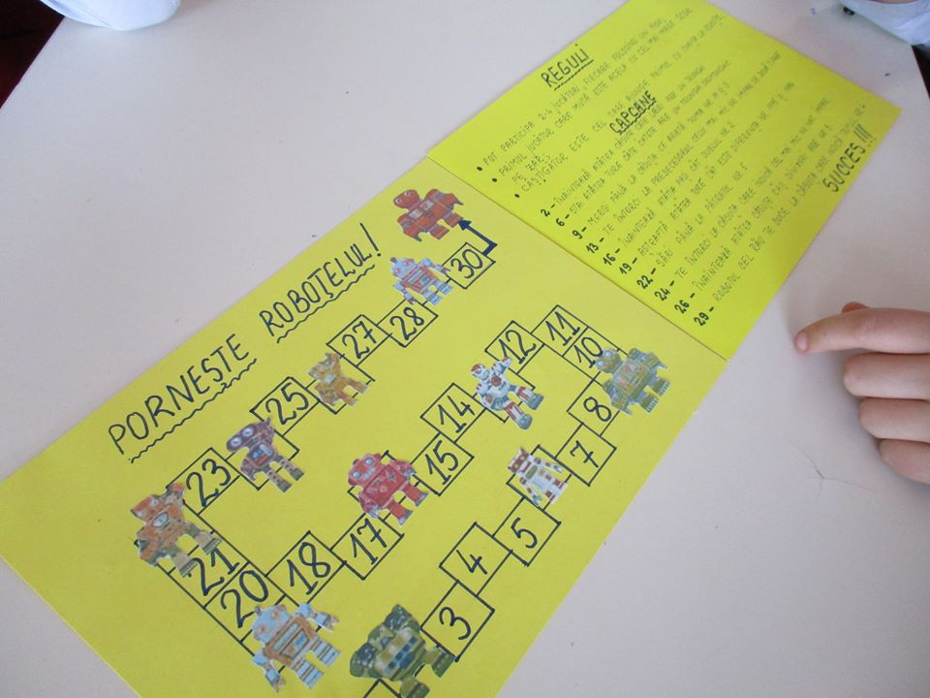

Slide 4
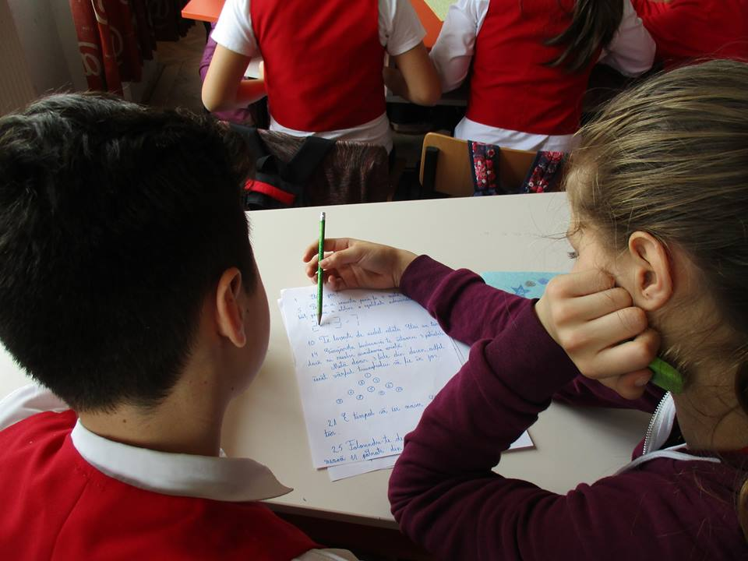
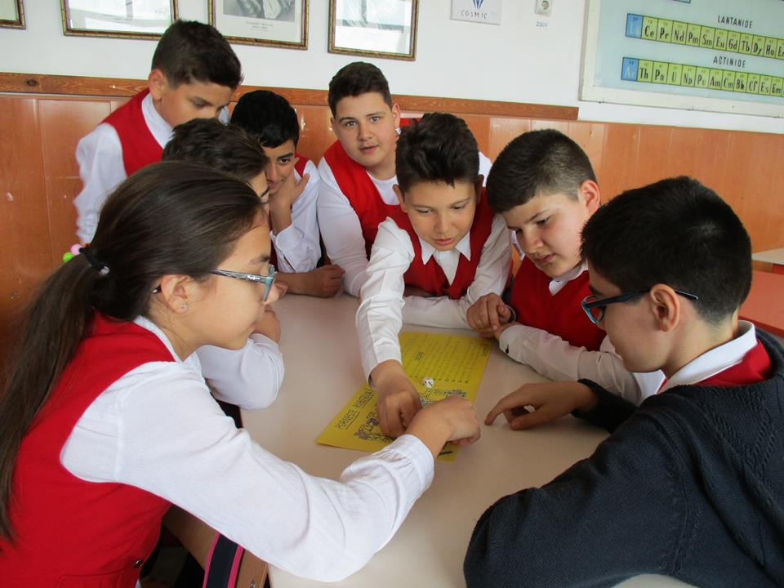

Slide 5
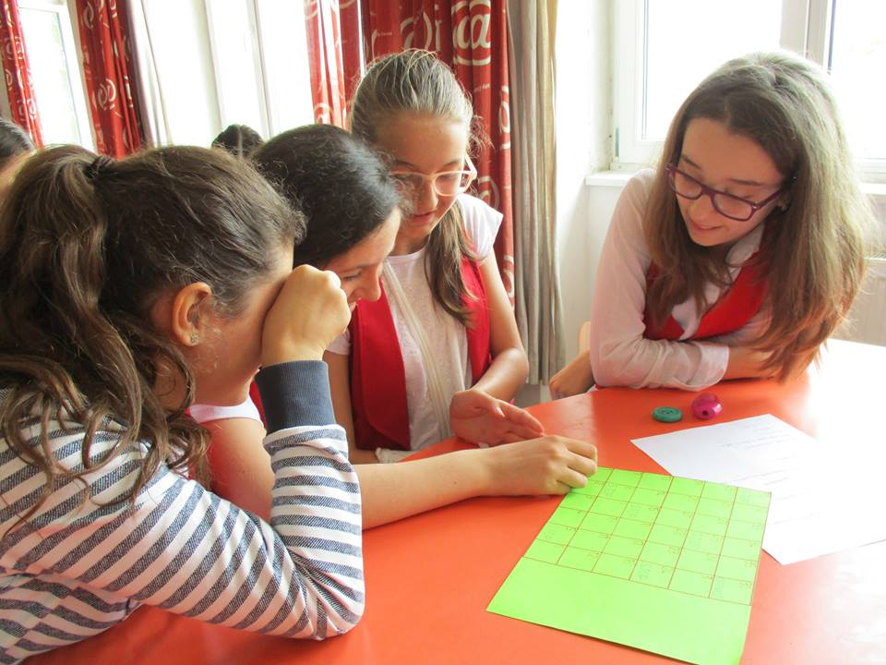
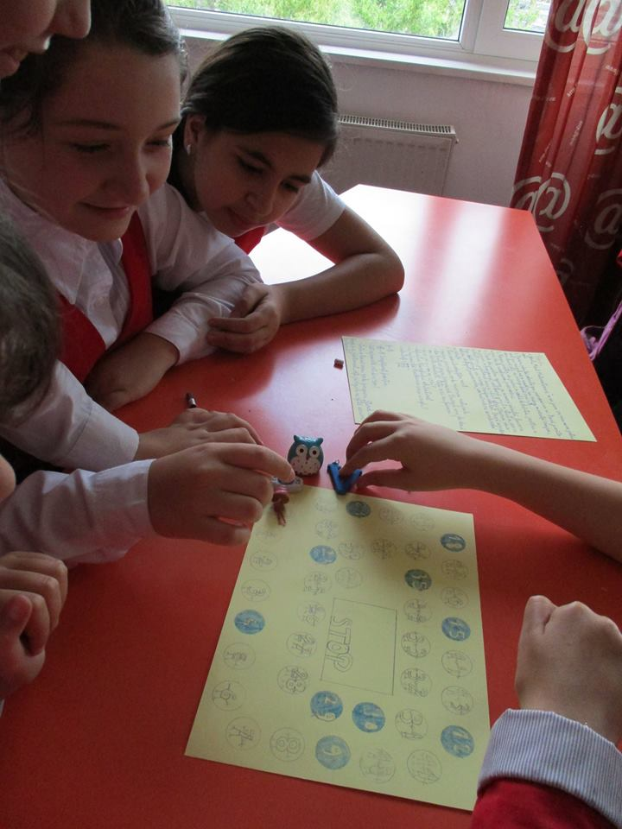
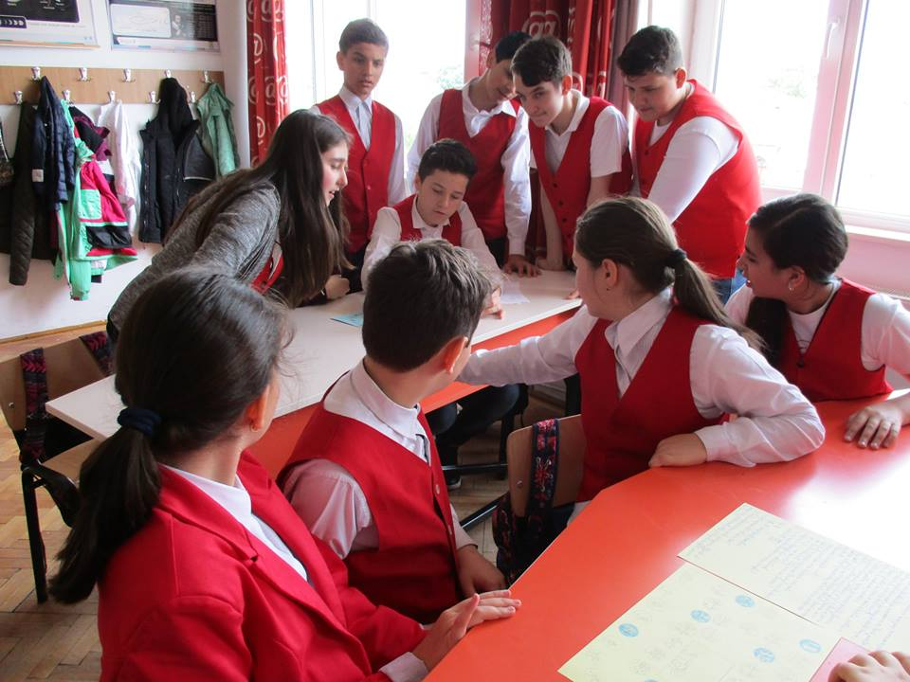

Slide 6
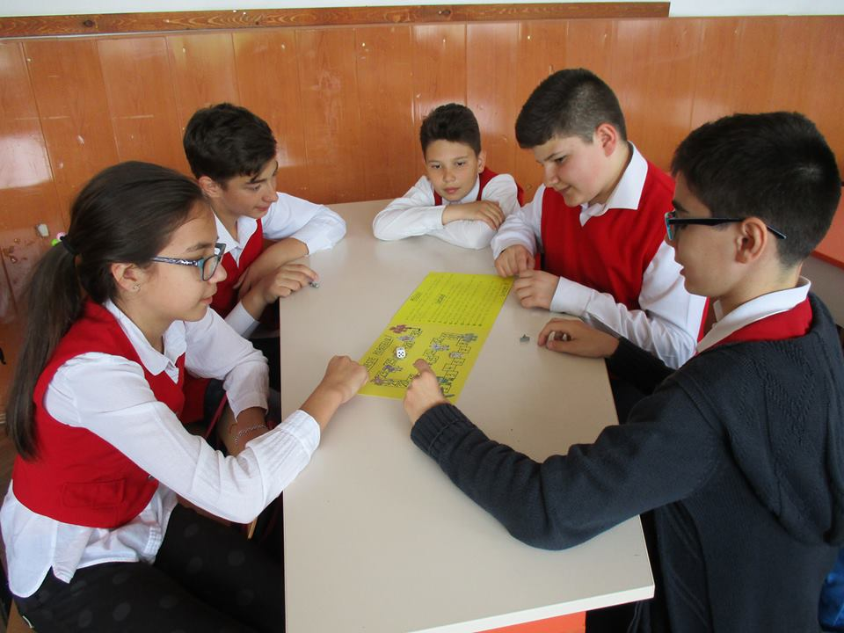
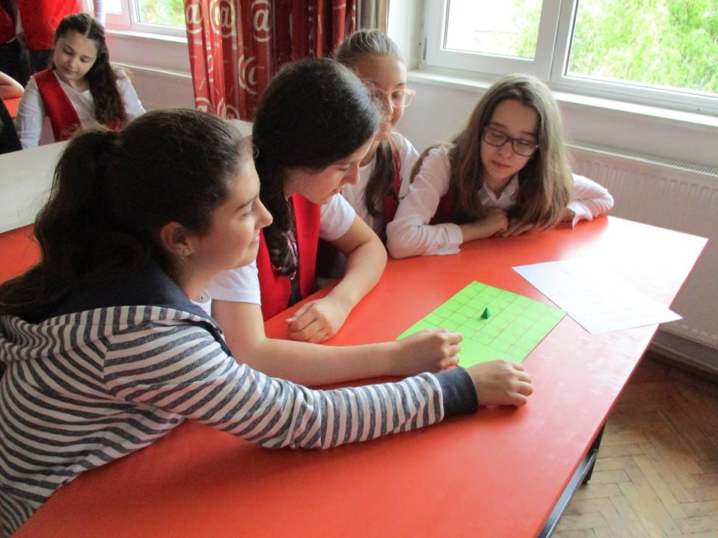

Slide 7
