Slide 1
Erasmus+ 2014-2016: Maths Is Everywhere!
STUDENTS’ WORKS FOR THE LOGO COMPETITION
Balikesir Karesi Ortaokulu - Turkey

Slide 2
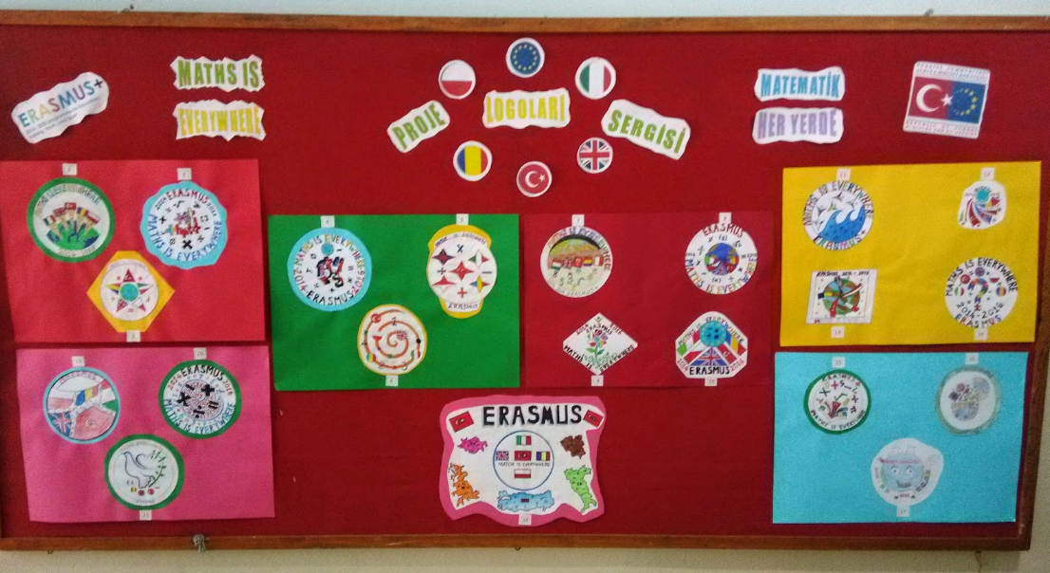

Slide 3
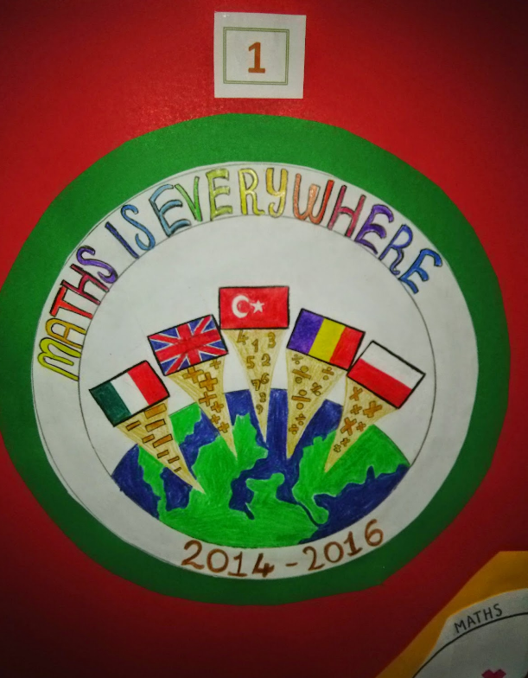
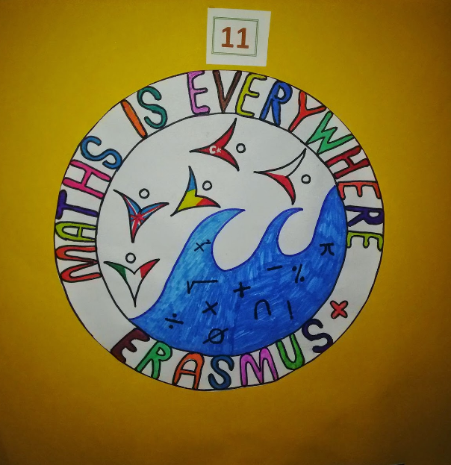

Slide 4
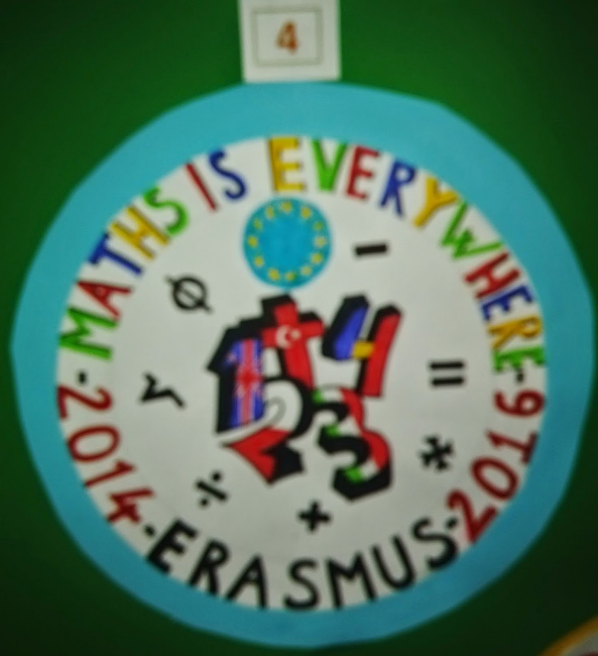
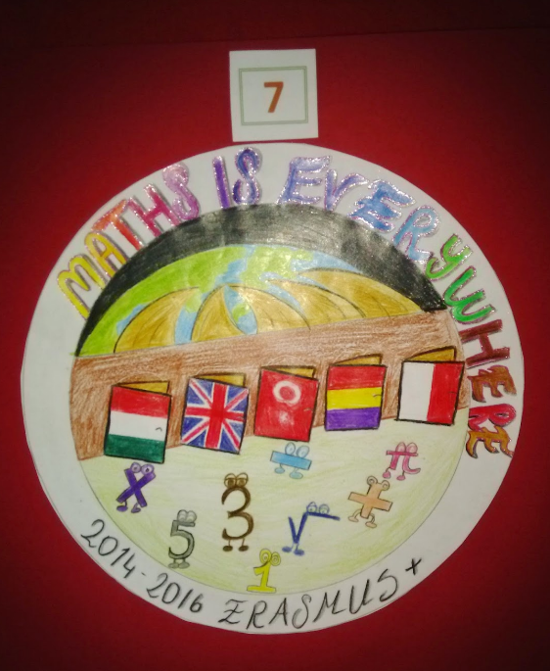

Slide 5
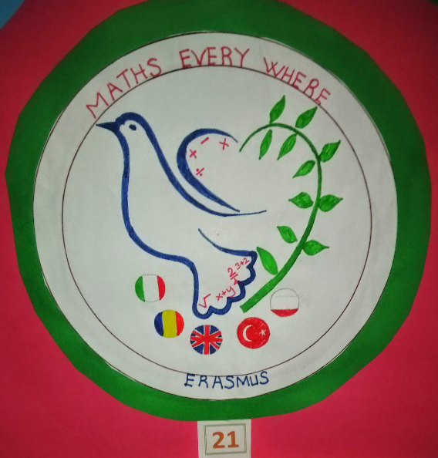

Slide 6
