Slide 1
Poland
By Tim and Josh

Slide 2
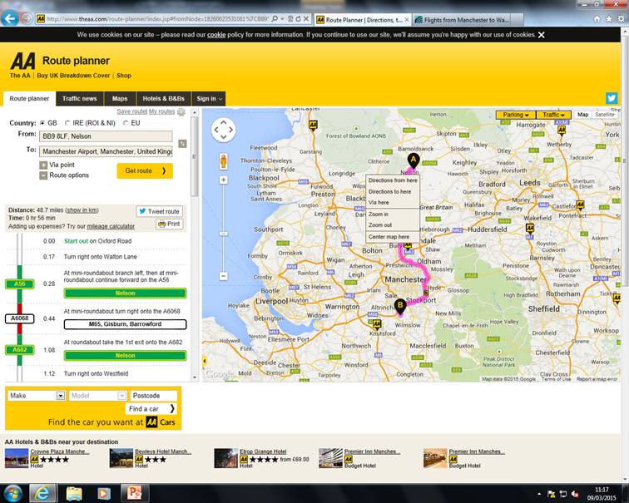
Distances and time
Our school to Manchester Airport takes 59mins in traffic by car
48.7 miles from school to Manchester Airport

Slide 3
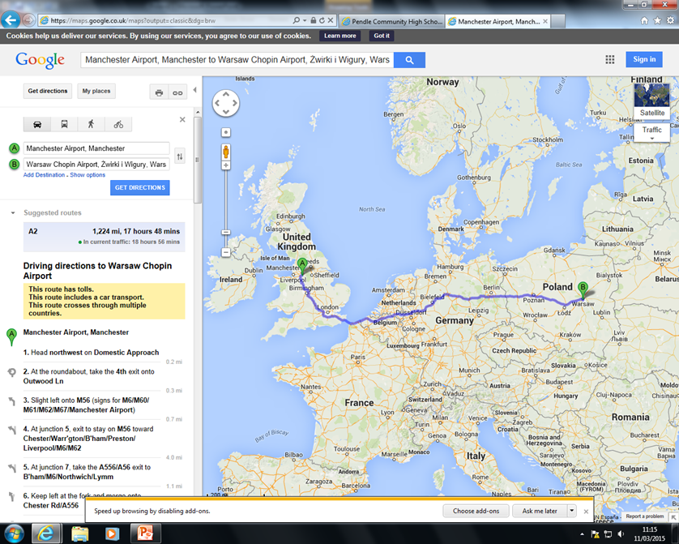
Distances and time part 2
To fly from Manchester Airport to Warsaw Airport takes 3hrs 15 mins.
If you travelled by car it would be 1224 miles and would take 17 hours and 40 mins.

Slide 4
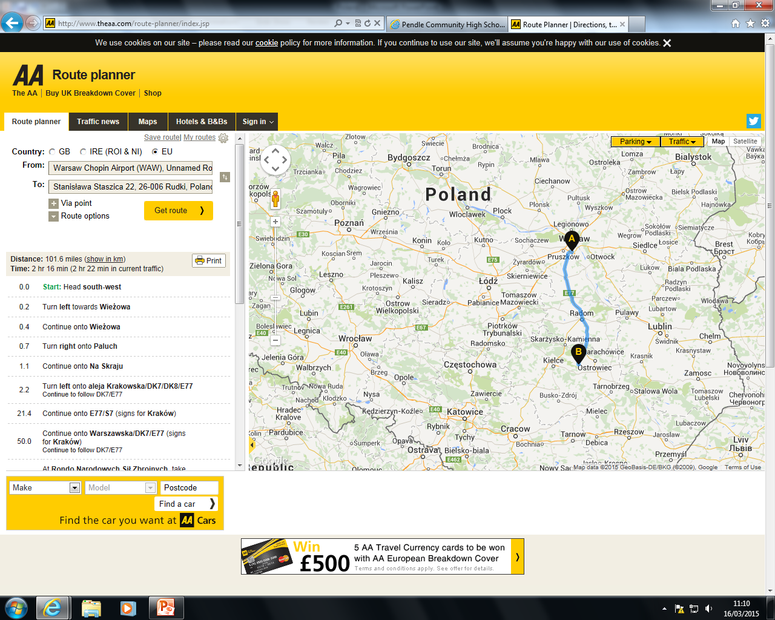
Distance and time part 3
From Warsaw airport to Rudki is 101.6 miles and would take 2hrs 16mins by car.

Slide 5
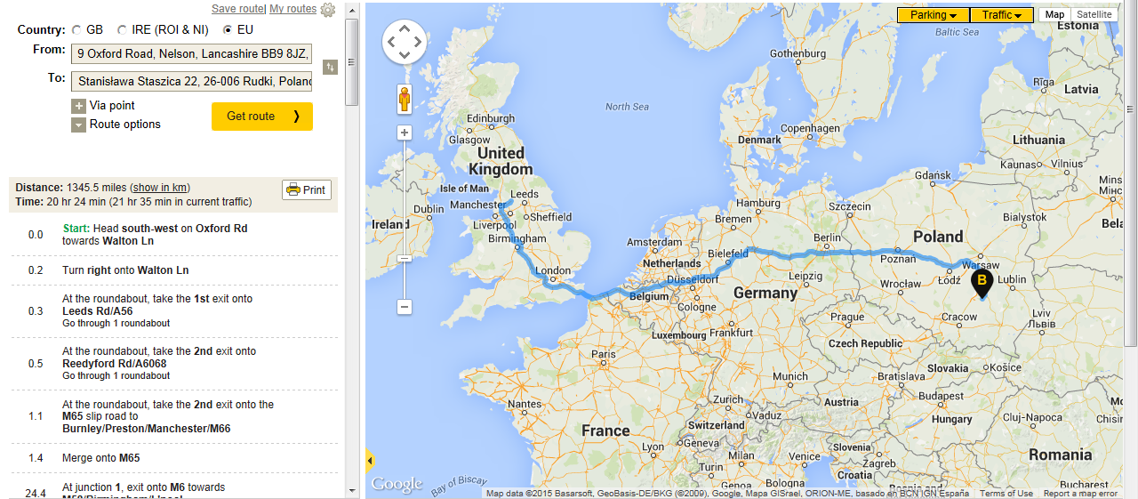
Total distances and times
From Nelson to Rudki is 1374.3 miles
It would take you 6hrs and 30 mins travelling by car and plane

