Slide 1
Important Polish writers
The authors:
Anna Jamróz & Julia Downar - Zapolska

Slide 2
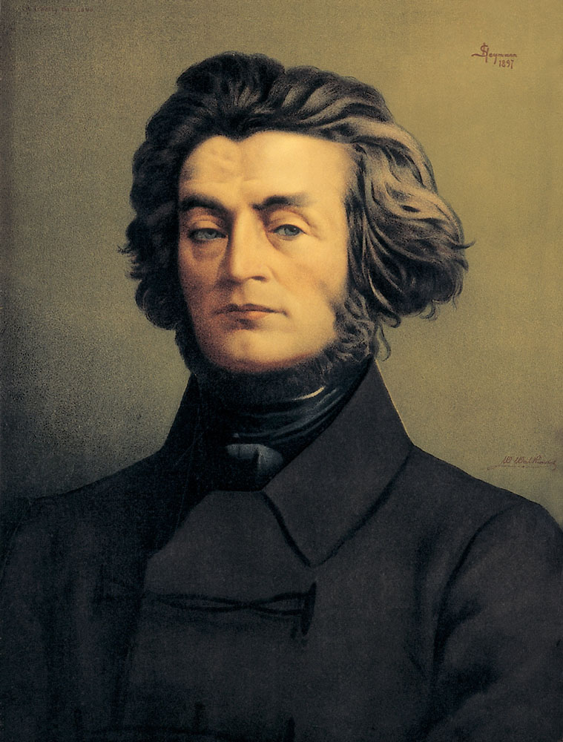
Adam Mickiewicz
24 December 1798 – 26 November 1855
He is regarded as national poet in Poland. A principal figure in Polish Romanticism, he is one of Poland's "Three Bards„ and is widely regarded as Poland's greatest poet.

Slide 3
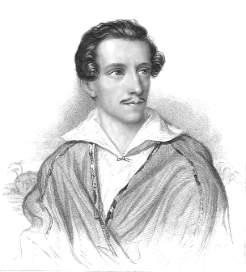
Juliusz Słowacki
4 September 1809 - 3 April1849
He was a Polish Romantic poet and the father of modern Polish drama. His works often feature elements of Slavic pagan traditions, Polish history, mysticism and orientalism. His style includes the employment of neologisms and irony.

Slide 4
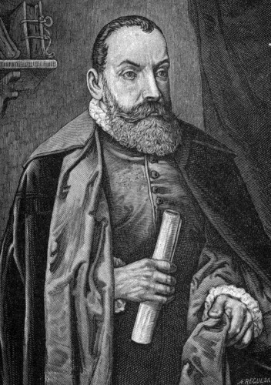
Jan Kochanowski
1530 – 22 August 1584
He was a Polish Renaissance poet who established poetic patterns that would become integral to the Polish literary language. He is commonly regarded as the greatest Slavic poet prior to the 19th century.

Slide 5
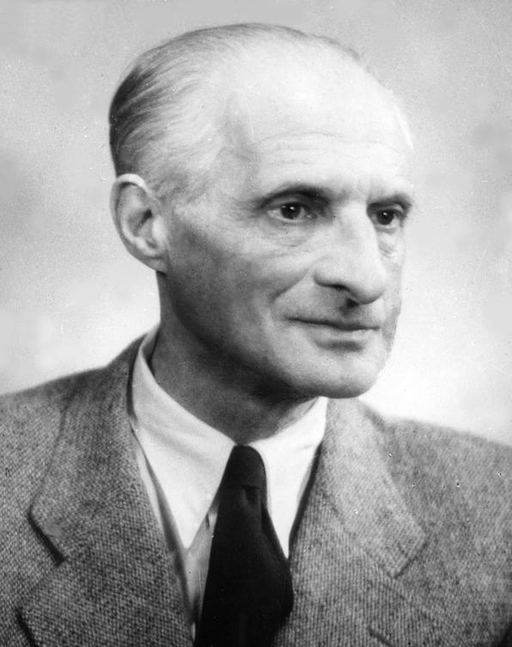
Julian Tuwim
13 September 1894 – 27 December 1953
After Poland's return to independence in 1918, Tuwim founded the Skamander group of experimental poets. He was a major figure in Polish literature, admired also for his contribution to children's literature.

