Slide 1
Famous Artists
Germany
Presented by DBS Felsberg

Slide 2
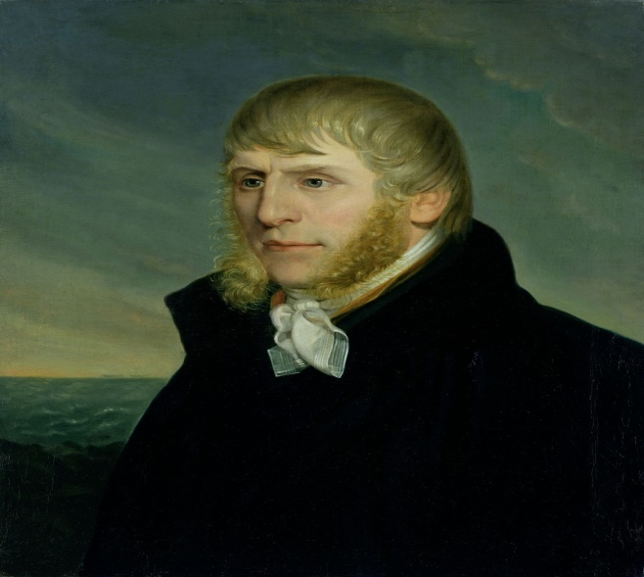
I. Caspar David Friedrich
Born May 5th 1774 in Greifswald ( Northern Germany, Eastern Sea)
Died May 7th 1840 in Dresden ( Southeast of Germany

Slide 3
Most famous german painter of the „Deutsche Romantik“ (German Romance) 19Th Century
German Romance:
Stylistic epoch in its realistic, soulful landscapes
by reproducing moods exactly and creating a never-ending expanse in his works.
“Wanderer über dem Nebelmeer” =Hikers above the sea of ​​fog

Slide 4
Biography
His family: Father candlemaker, mother died when Caspar was 7, 10 children
Once as a kid Caspar broke into the ice, and his brother died trying to save Caspar
Education as an artist:
Art Academy Kopenhavn/ Danmark: liberal, well knowned and without tuition fees 1794 – 1798
Dresden 1798 - 1801 Art Academy: Germanys best Academy

Slide 5
Comtemporaries: Caspar is a very melancholic man
Caspar seeks nature, not people…
„Winterlandschaft mit Kirche“ Winterlandscape with church (1811)

Slide 6
Leaving Dresden
1801 Caspar went to the Isle of Rügen ( Eastern Sea), where he creates his most famous painting
„Kreidefelsen auf Rügen“
(Chalk cliffs on Rügen)

Slide 7
Earned his living by selling his paintings
1808 Breakthrough as a painter: „Tetschener Alltar
1816 Member of the Dresdner Academy
1824 Professor of the Dresdner Academy, teaching art and painting

Slide 8
Comparism with Northern Hassia Unesco World heritage Kassel Bergpark Romance
Huttens Grab 1811
Aquaeduct ( built as a ruin 1792)

Slide 9
Comparism with Mediterranean Sea…
Junotempel in Agrigent (1830)
Actual picture…

Slide 10
Gerhard Richter „The Picasso of the 21th century“
His artworks belong to the most expensive of living artists in the world

Slide 11
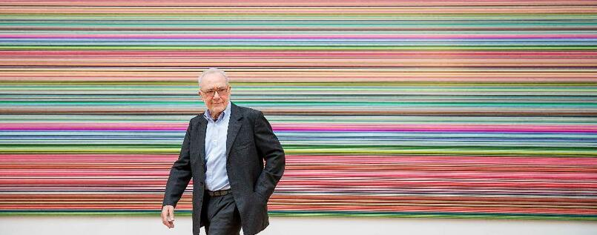
Biography
Born February 9th 1932 in Dresden
Sculptor, painter and photographer

Slide 12
Studies art at the Art Academy in Dresden 1951 -1957
Finishes his bacelor with..
„Abendmahl mit Picasso“ (1955) (Supper with Picasso) was covered/ no pictures
Escape to Western Germany 1961, many of his were destroyed in Eastern Germany, for example
„Lebensfreude“ (1956 Dresdner Hygiemuseum
Joy of Life
Professor for painting at the Art Academy Düsseldorf since 1971

Slide 13
Gerhard Richter Documenta X in Kassel 1965 Collection of Photographies

Slide 14
By the Way: The Documenta in Kassel
The most important exhibition of contemporary art of the world
Every 4/ 5 years for 100 days in Kassel („Museum of the 100 days“)
Next exhibition 2022

Slide 15
Gerhard Richter and Nature
„Landschaft“ 1992 (Landscape)
„Canarische Landschaften“ 1971
(Canarian Landscape)

Slide 16
Most expensive painting „Abstraktes Bild“ 1986( abstract image) 41 Million Dollars (2015)

Slide 17
Finish by a quote of Richter
„Die Kunst ist die höchste Form der Hoffnung”. (Art is the highest form of hope)

