Slide 1
Romanian Inventions

Slide 2
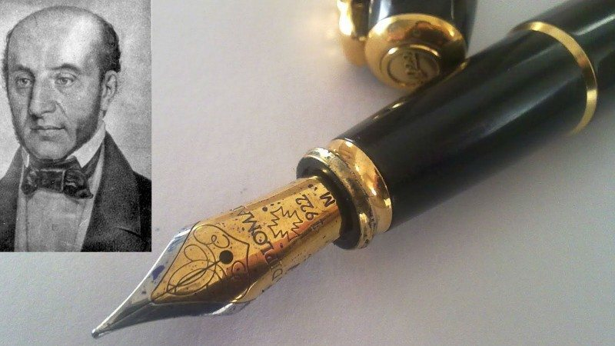
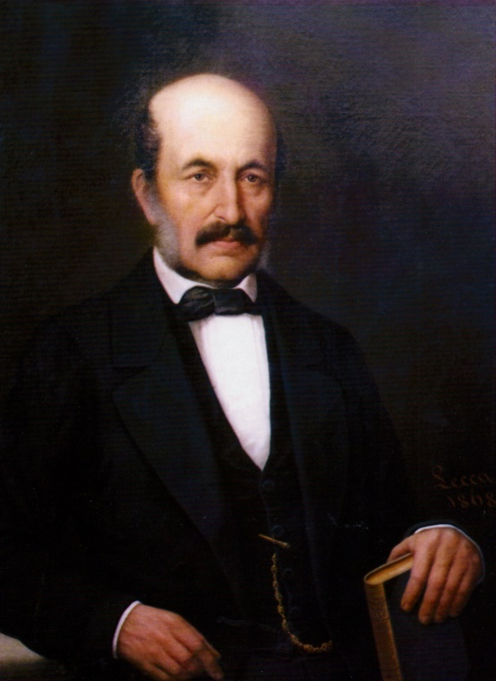
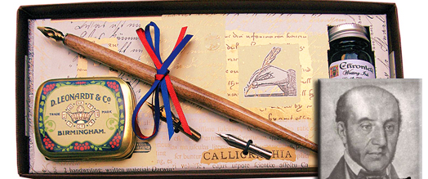
The fountain pen

Slide 3
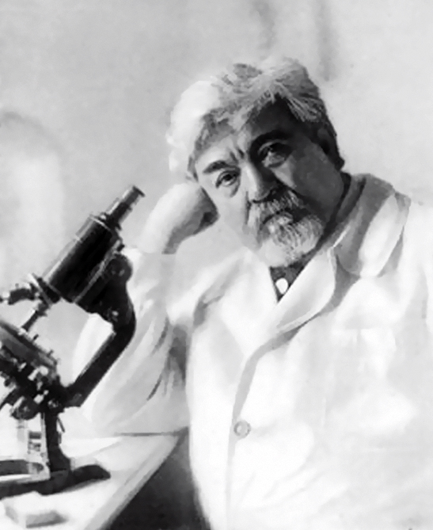
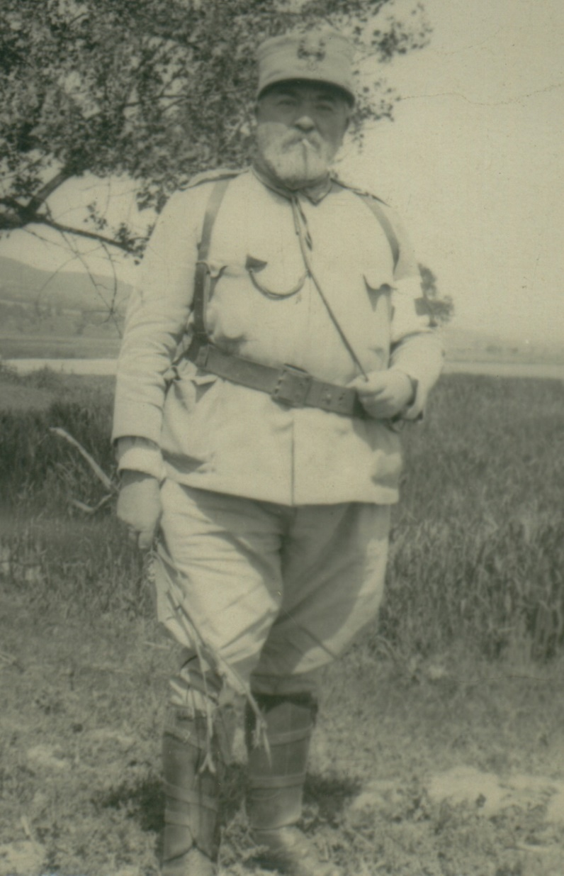
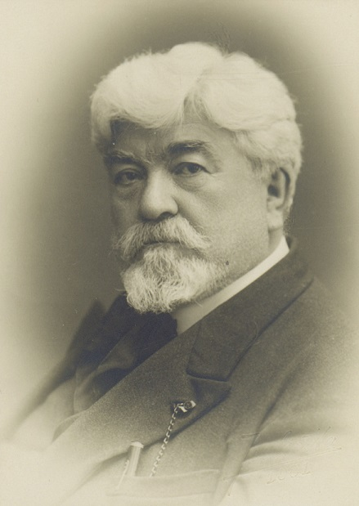
Cantacuzino Method

Slide 4
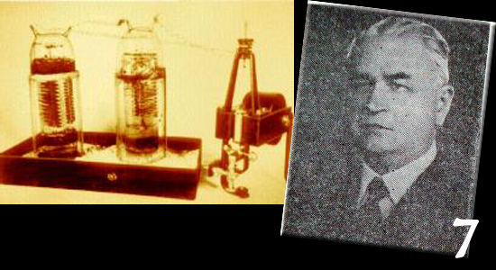
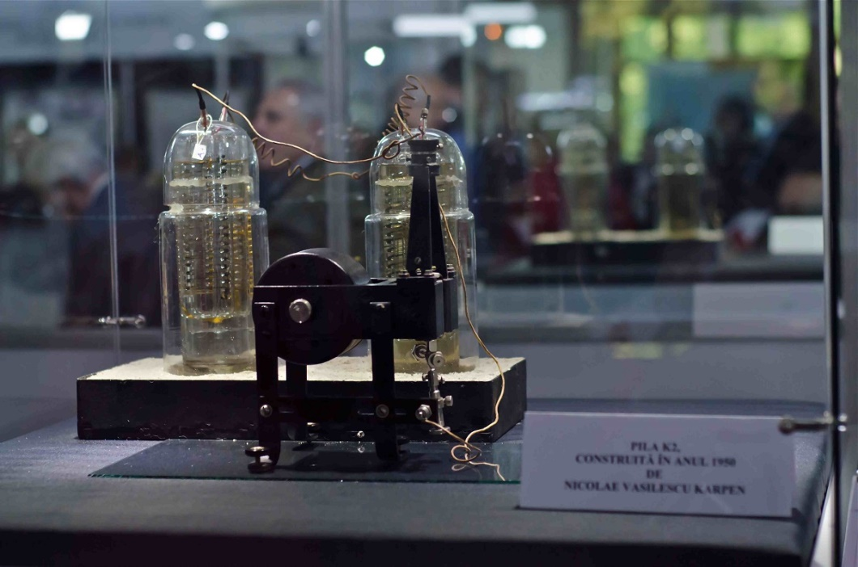
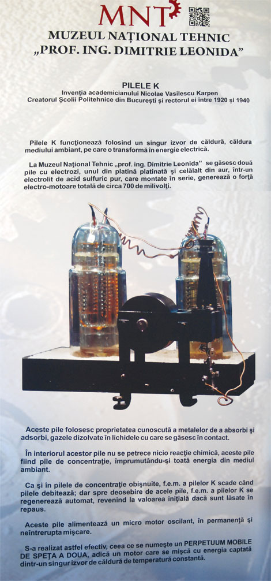
The perpetuum mobile

Slide 5
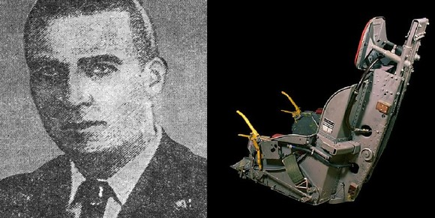
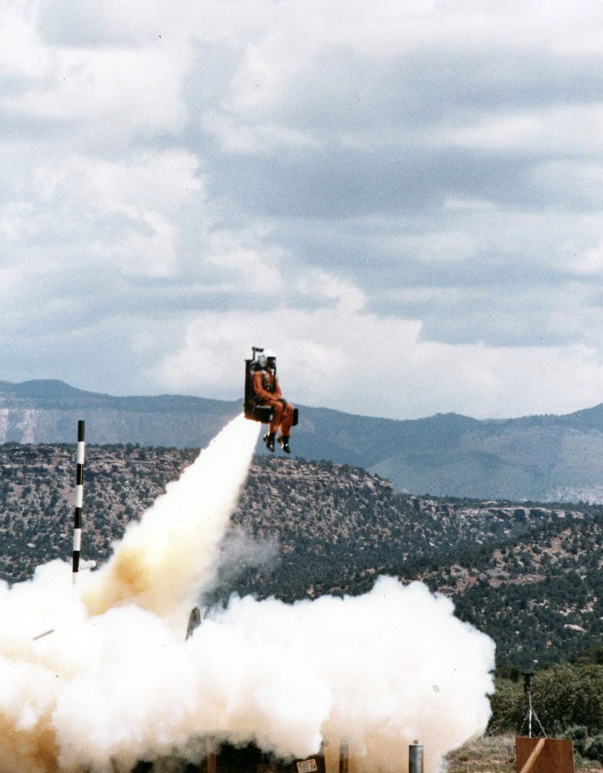
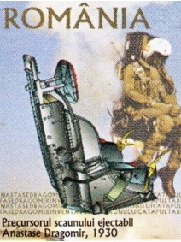
The ejector seat

Slide 6
THIS MATERIAL IS TO BE USED FOR THE ERASMUS + PROJECT,
SOS-SUSTAIN OUR SOULS
TEAM:
Varzaru Teodor
Hogas Sanziana
Costache Mark
Cirlan Raluca
Constantin Alexandru
Turcea Andrei
Vlad Andradda

