Slide 1
Historical places in Romania

Slide 2
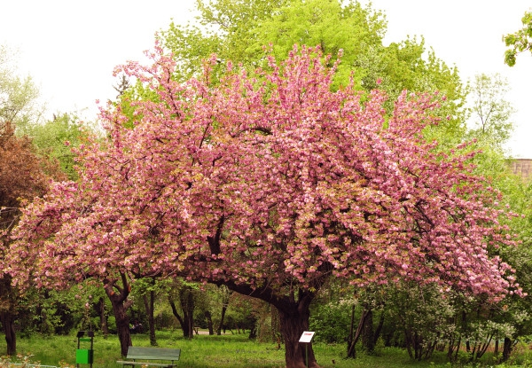
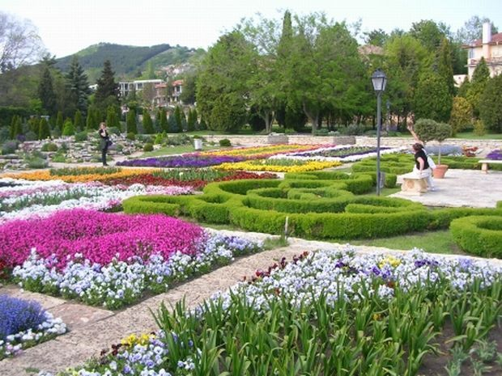
THE BOTANICAL GARDEN, BUCHAREST

Slide 3
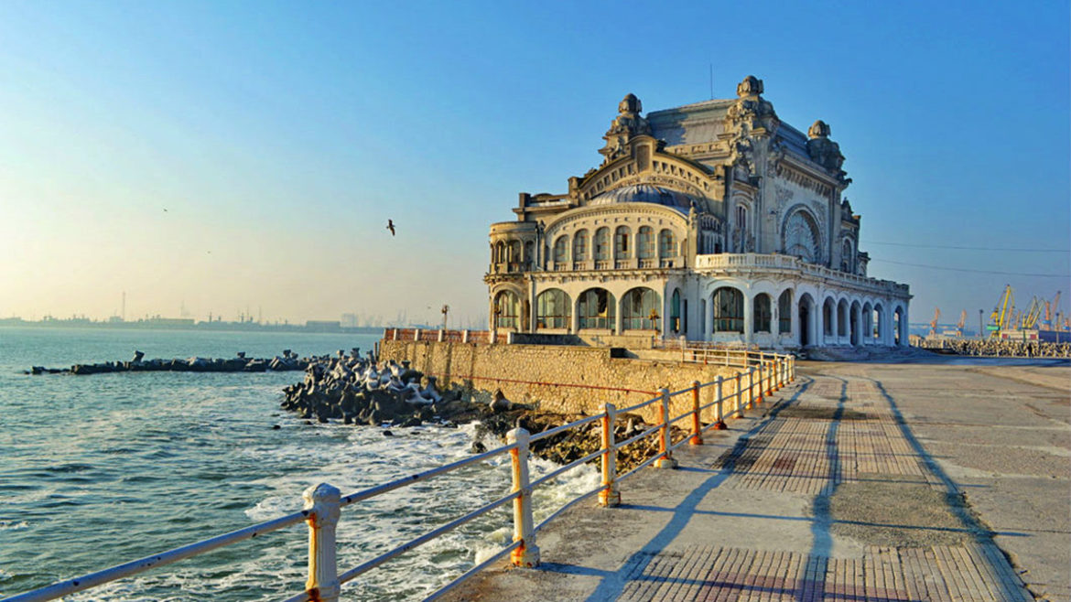
THE CASINO, CONSTANTA
The Constanta Casino

Slide 4
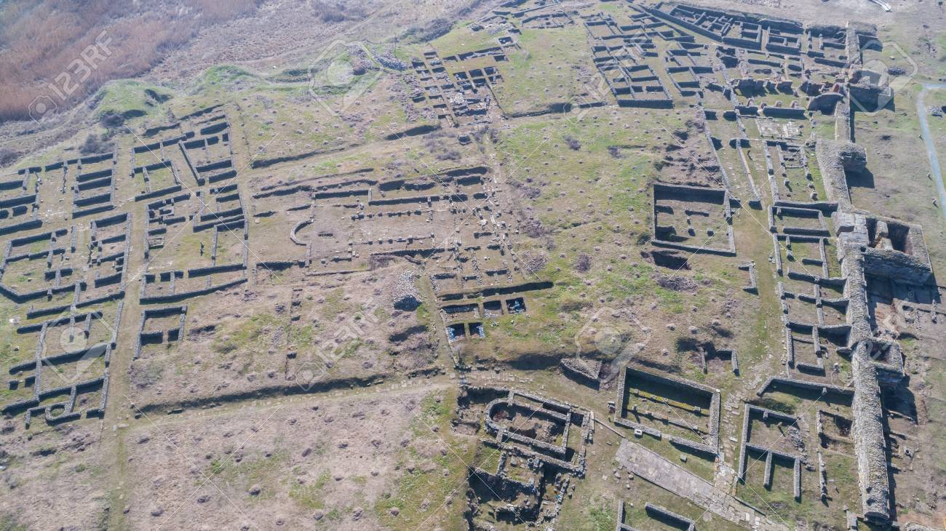
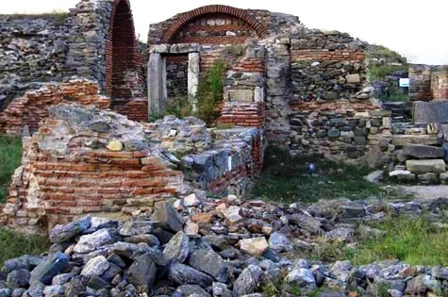
THE CITADEL OF HISTRIA

Slide 5
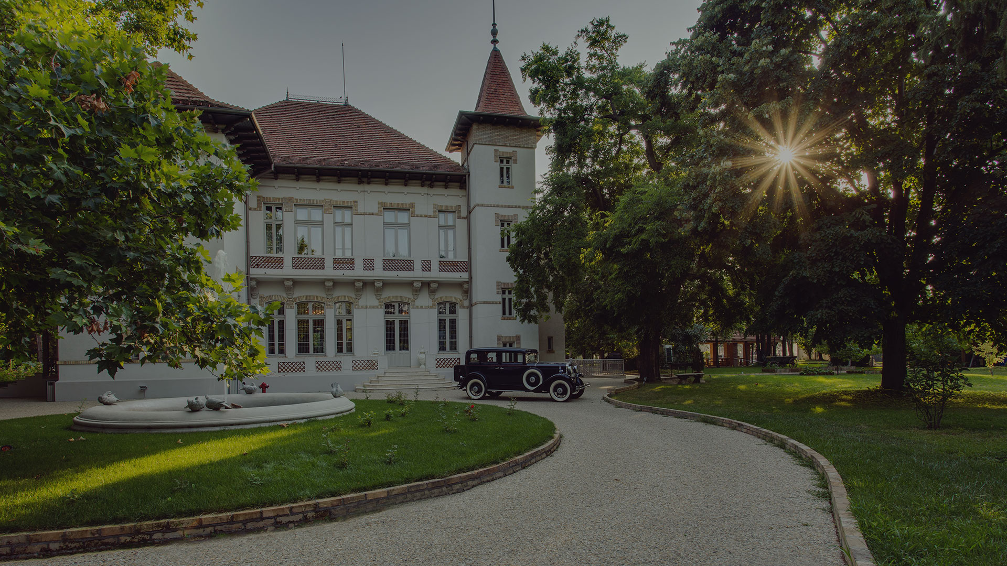
THE MANSION OF MANASIA

Slide 6
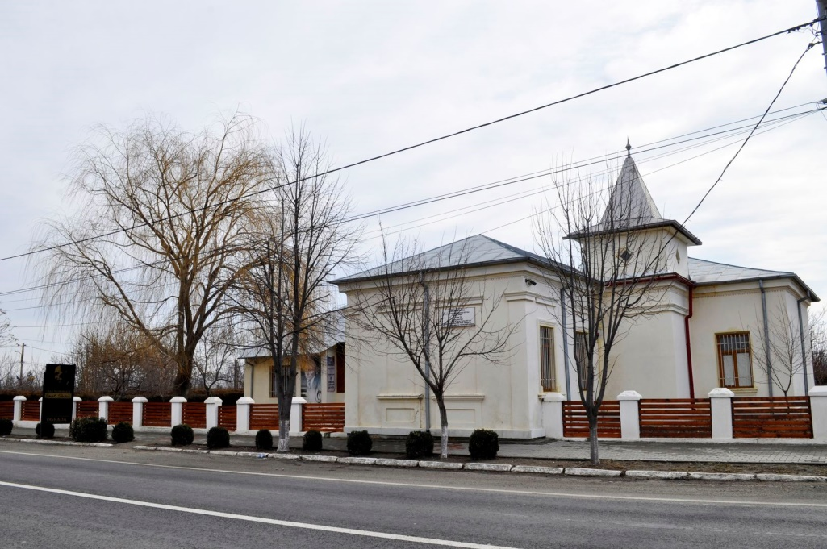
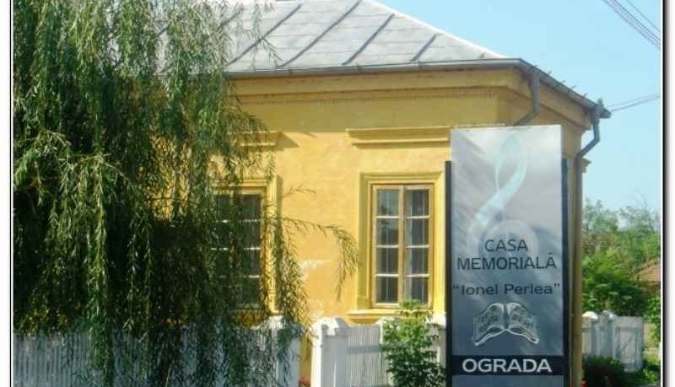
”IONEL PERLEA” MEMORIAL HOUSE

Slide 7
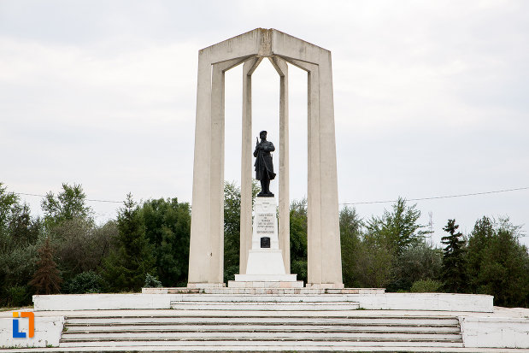
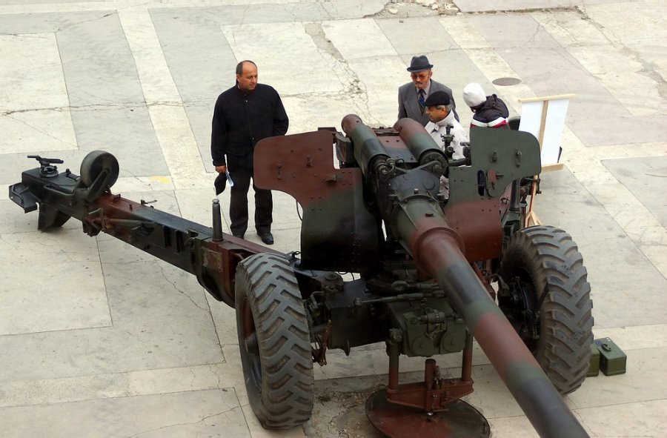
THE MONUMENT OF HEROS, SLOBOZIA

Slide 8
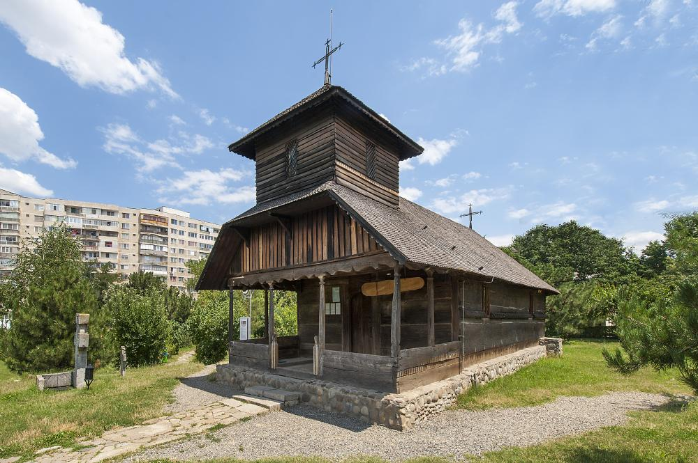
THE WOODEN CHURCH, SLOBOZIA

Slide 9
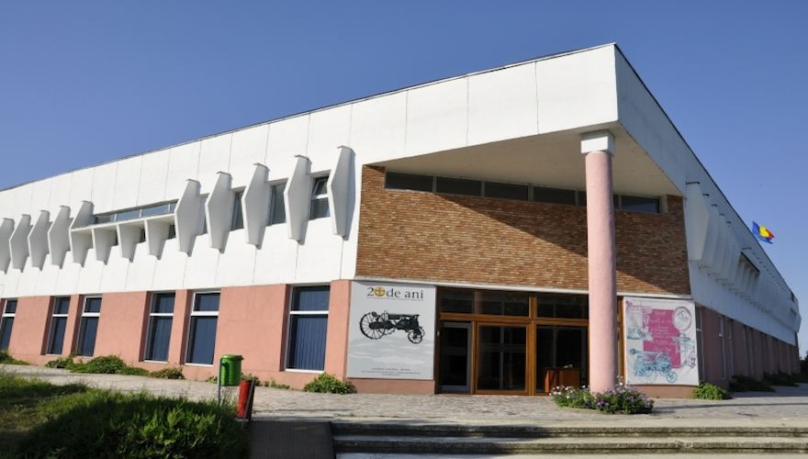
THE MUSEUM OF AGRICULTURE, SLOBOZIA

Slide 10
THIS MATERIAL IS TO BE USED FOR THE ERASMUS + PROJECT,
SOS-SUSTAIN OUR SOULS
TEAM:
Costache Mark
Cirlan Raluca
Constantin Alexandru
Turcea Andrei
Vlad Andradda
Hogas Sanziana
Varzaru Teodor

