Slide 1
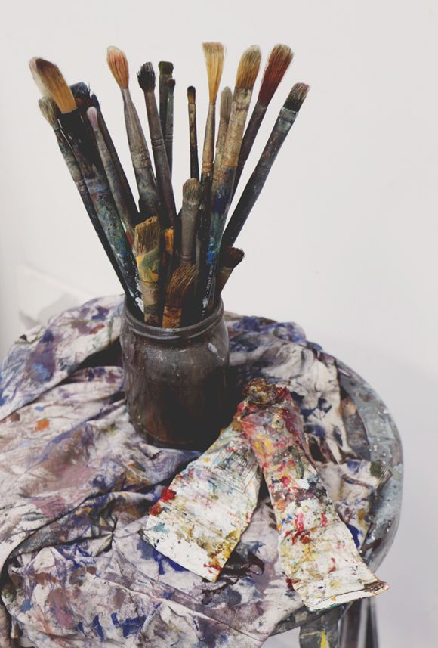
IMPORTANT ARTISTS
Who got inspired from nature

Slide 2
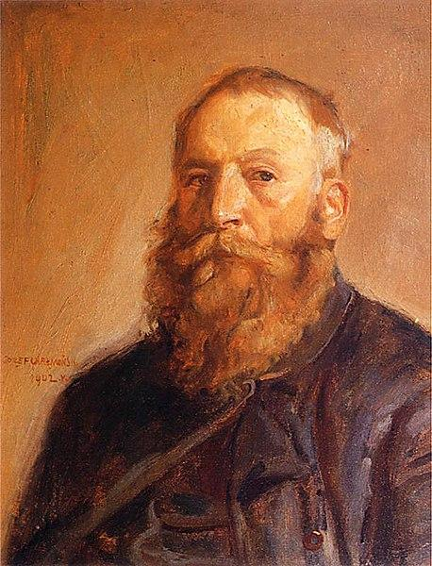
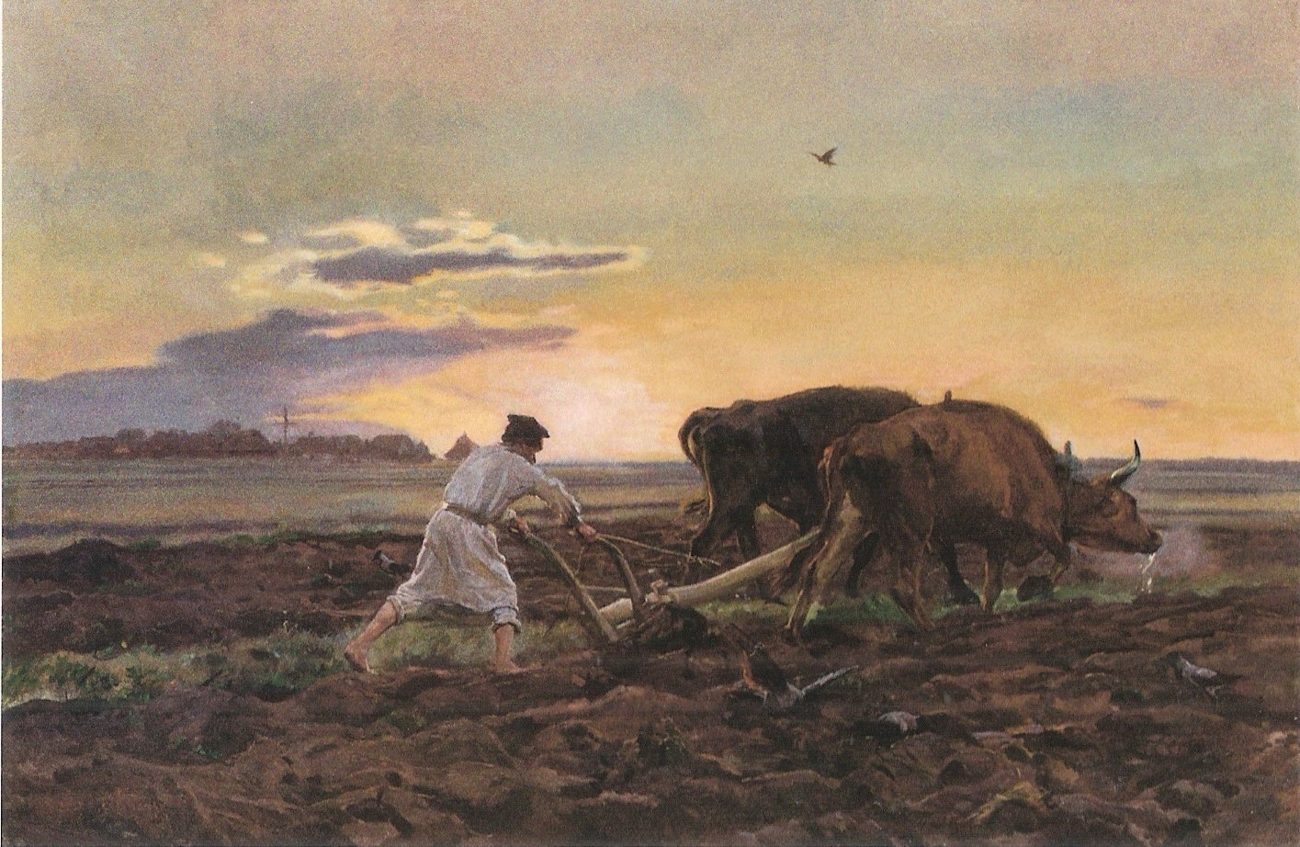
Józef Chełmoński (1849-1914)
Painter, illustrator, representative of realism
He studied at the Warsaw Drawing School and private studio of Wojciech Gerson.
He got inspired from Polish and Ukrainian countryside

Slide 3
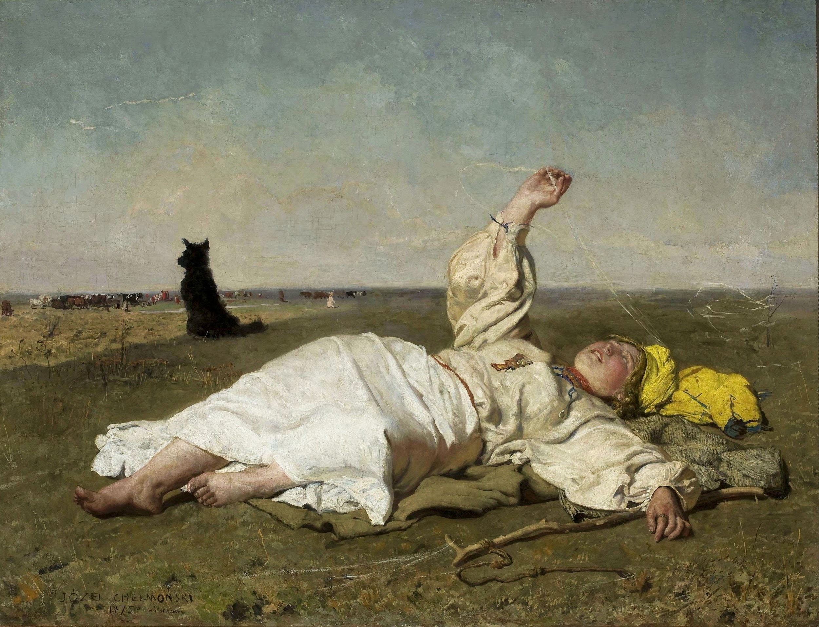
,,Indian Summer” (Babie lato),
1875, oil on canvas

Slide 4
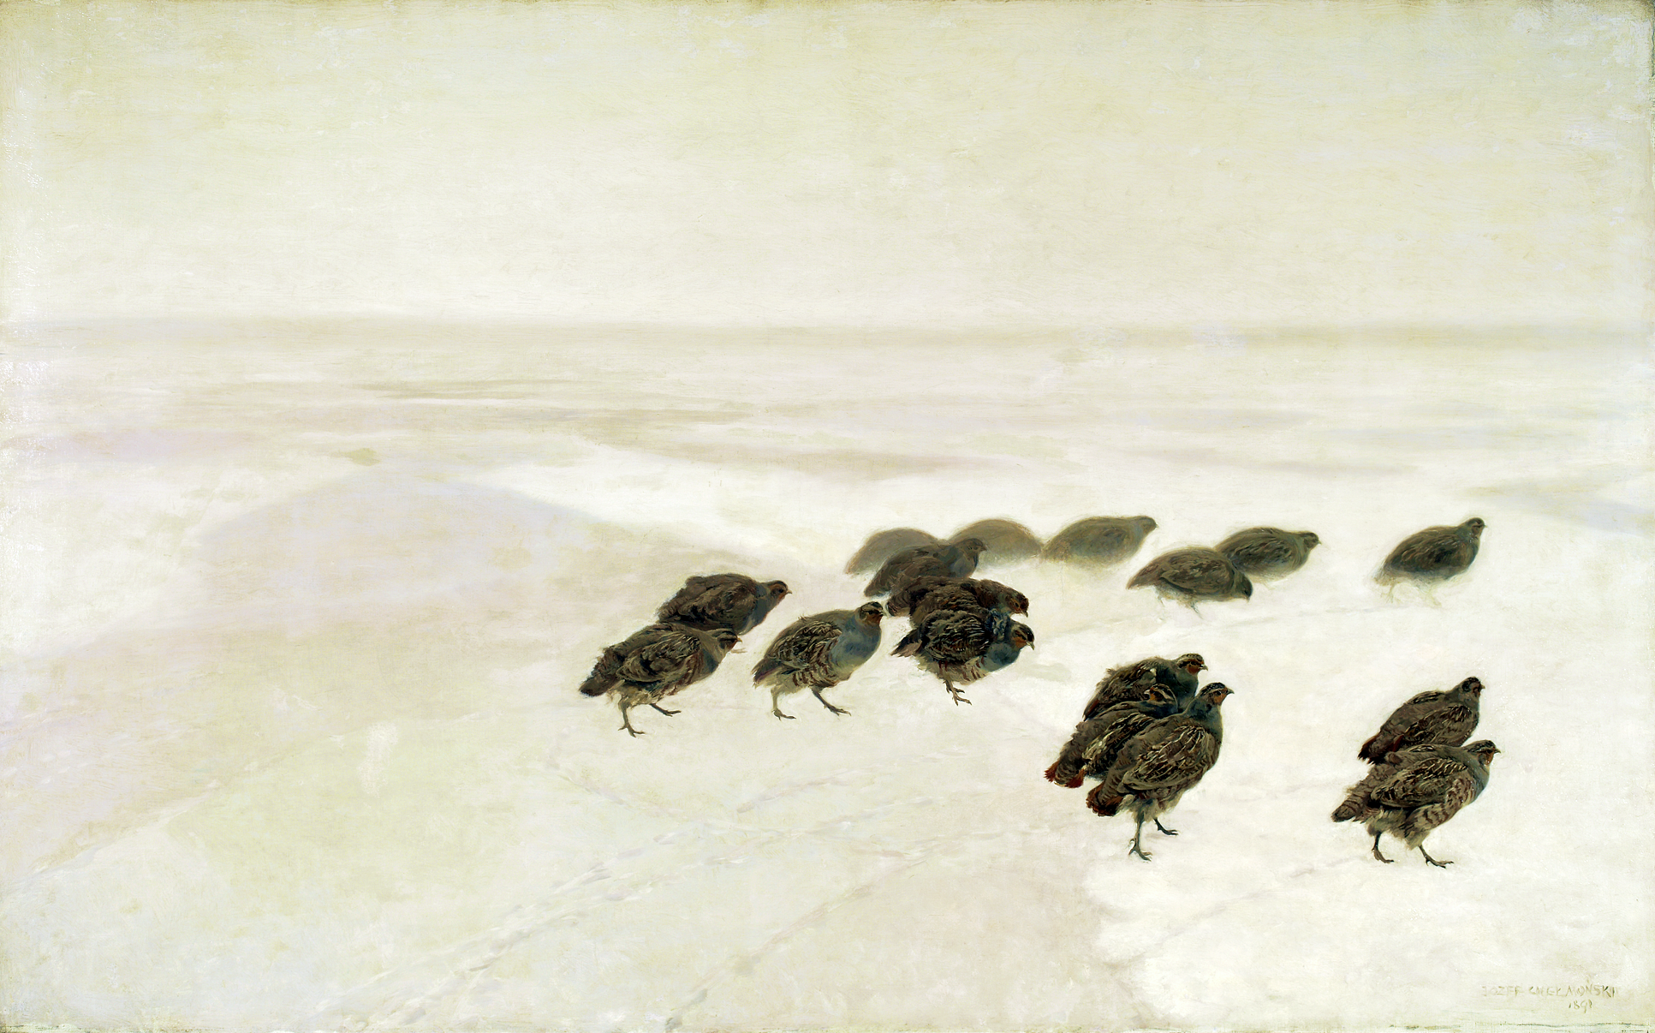
,,Patriges” (kuropatwy), 1891,
oil on canvas

Slide 5
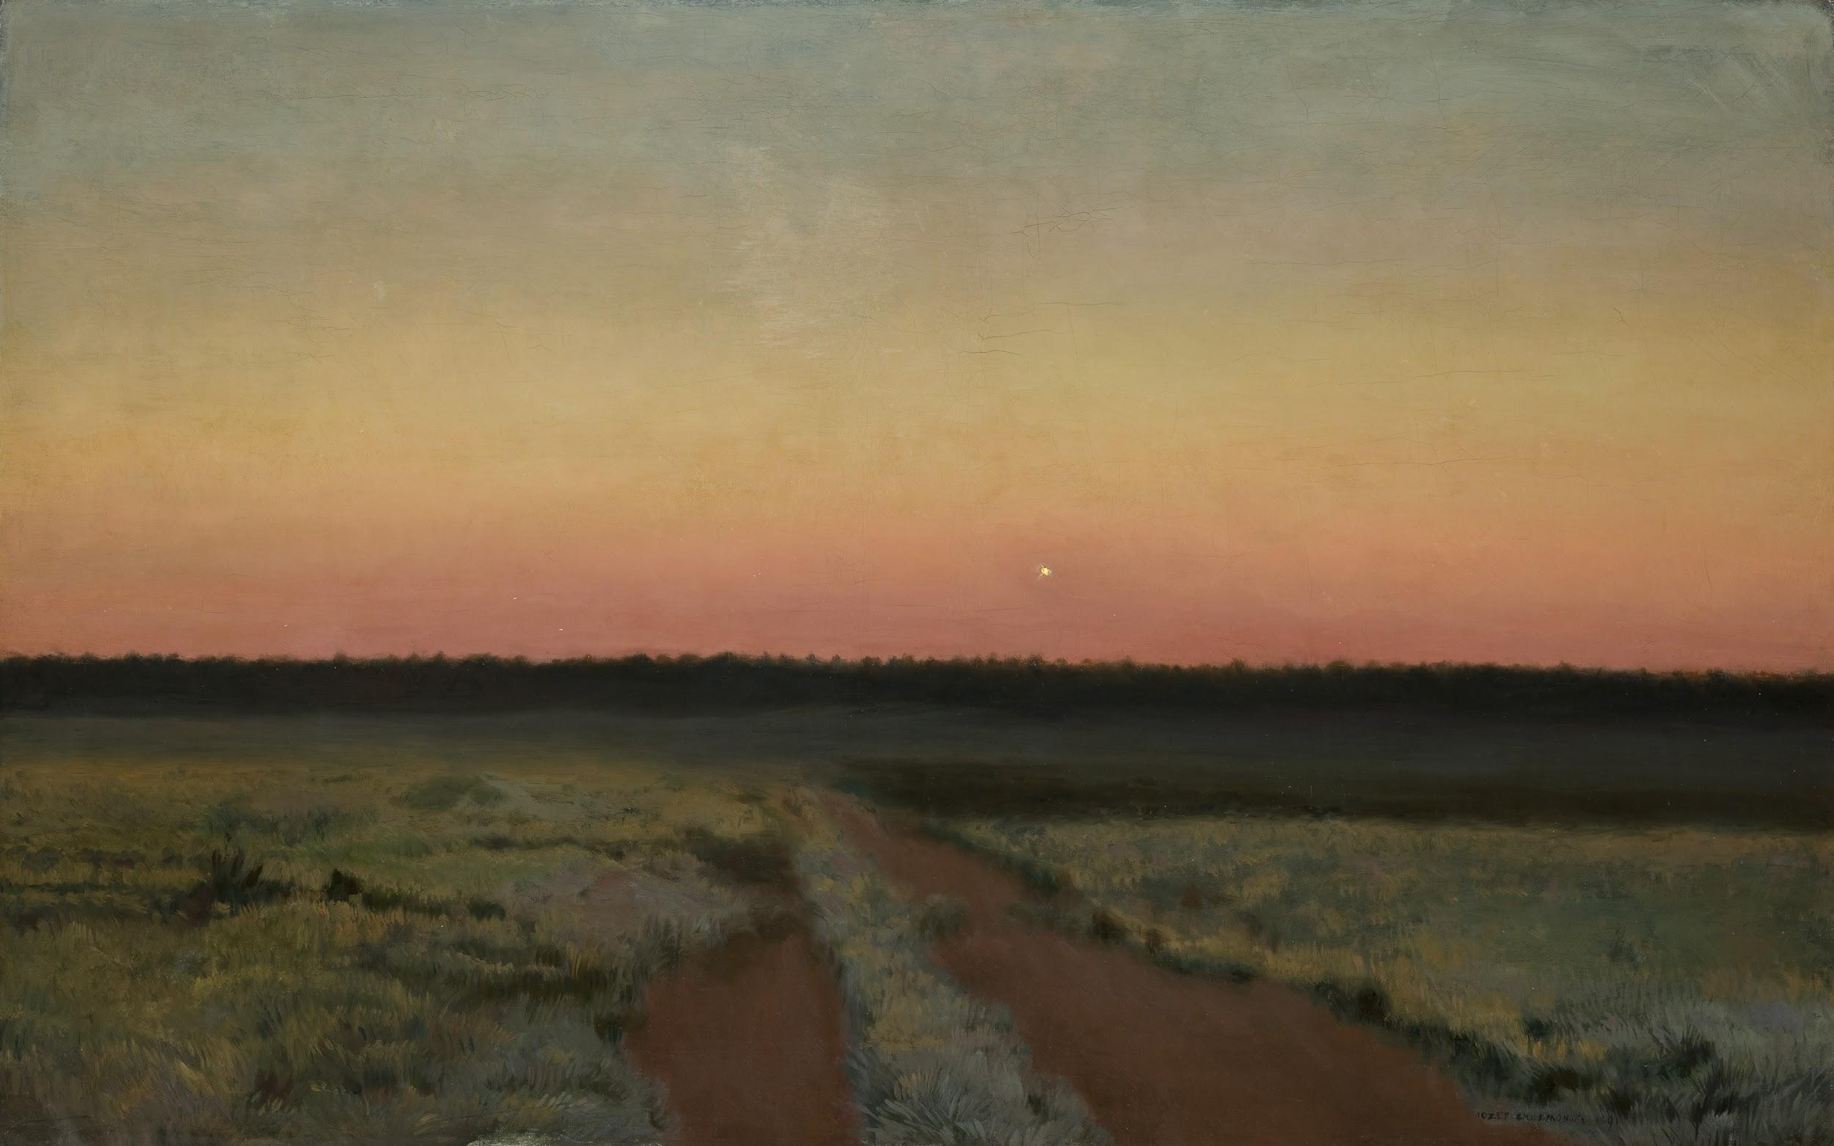
,,Morning star” (Jutrzenka), 1891,
oil on canvas

Slide 6
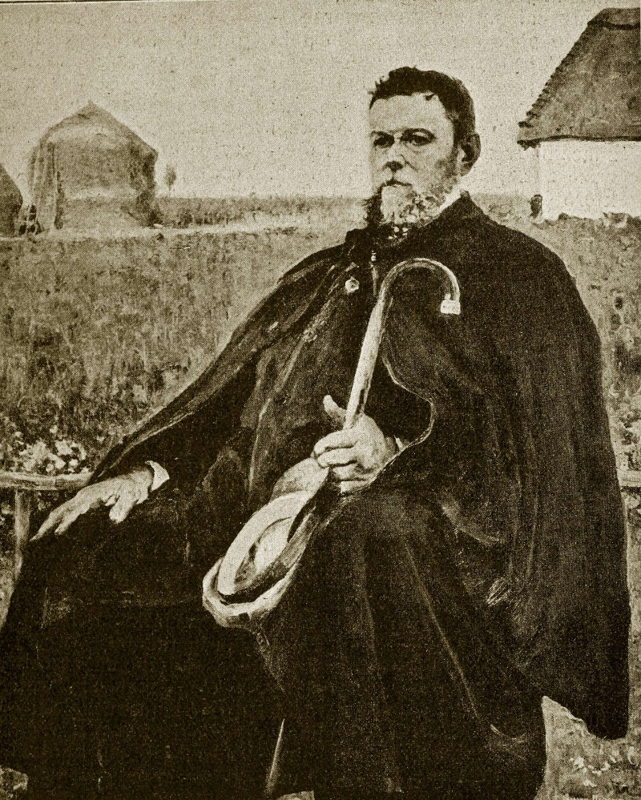
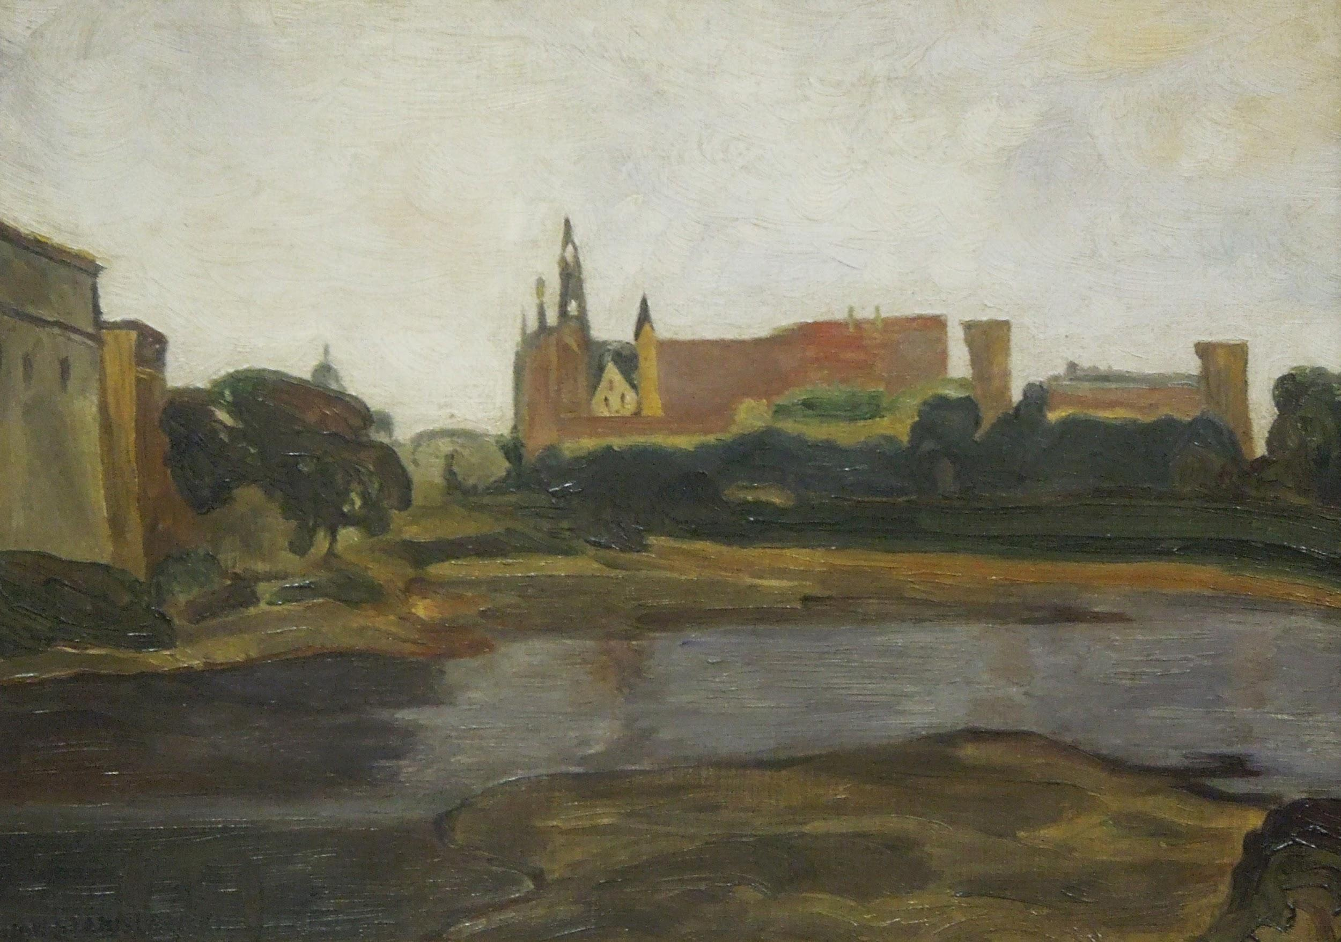
Jan Stanisławski (1860-1907)
Painter, leading representative of symbolism in Polish landscape painting
He actually studied math but he started his artistic education in the Warsaw Drawing Class
In Paris he became friends with Józef Chełmoński
In 1901 he joined the Polish Applied Art Society

Slide 7
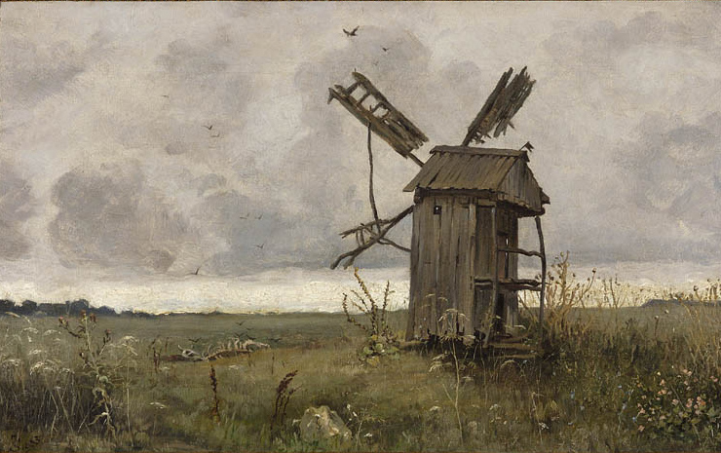
,,(Wiatrak ukraiński), 1883,
oil on canvas

Slide 8
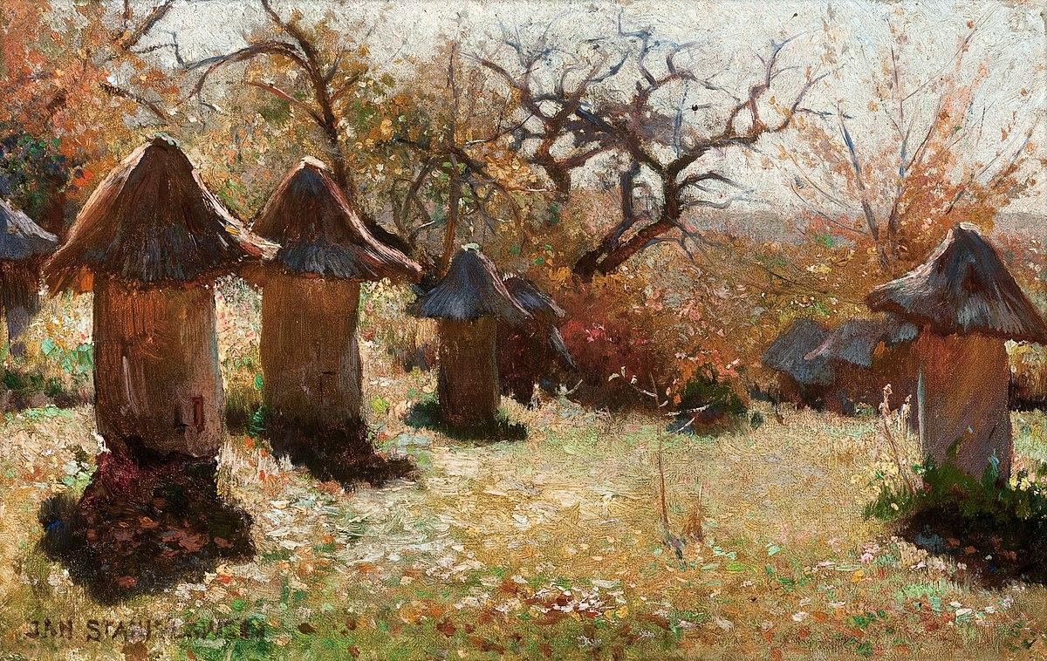
,,beehives in the Ukraine” (Ule na Ukrainie), 1895,
oil on canvas

Slide 9
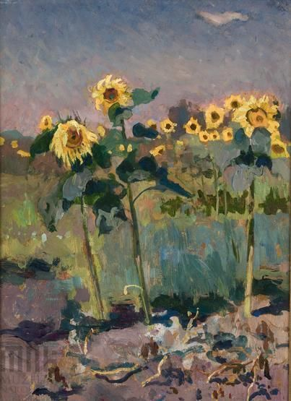
,,The sunflowers” (słoneczniki), 1903
oil on canvas

Slide 10
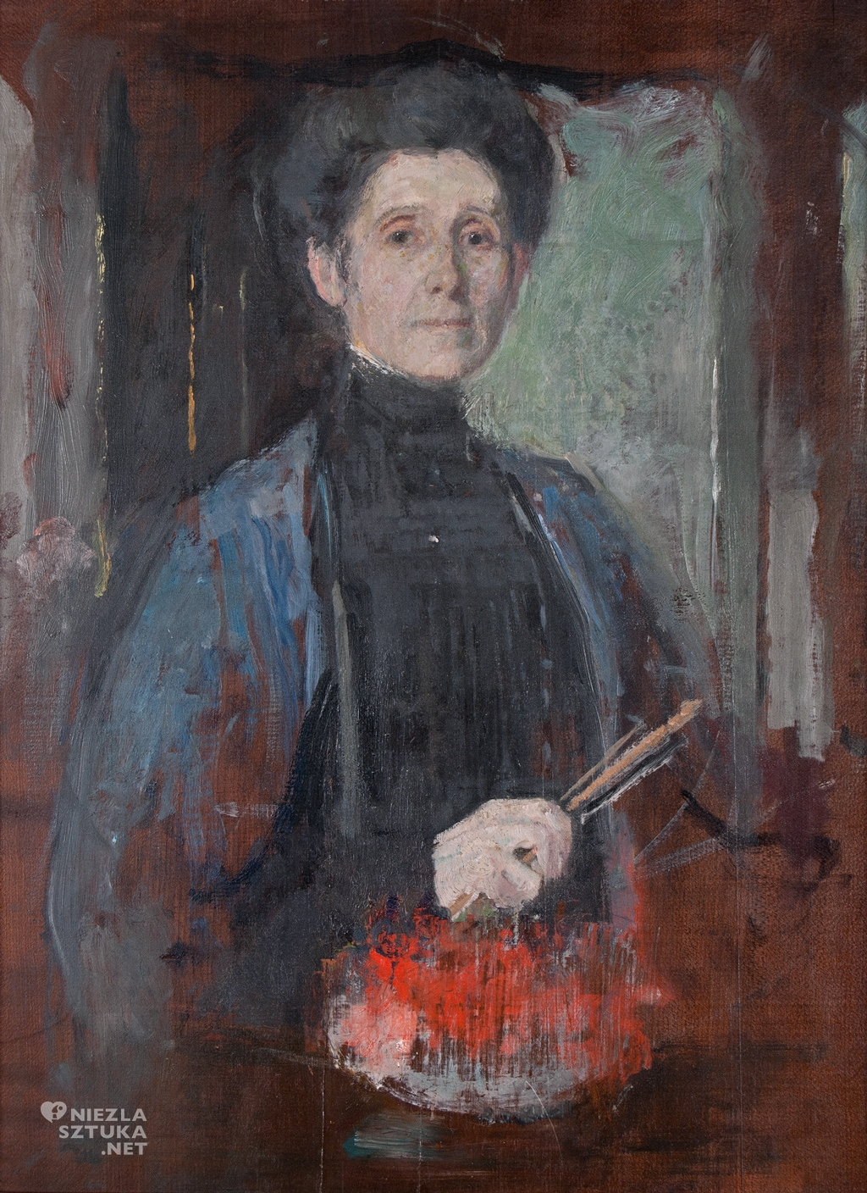
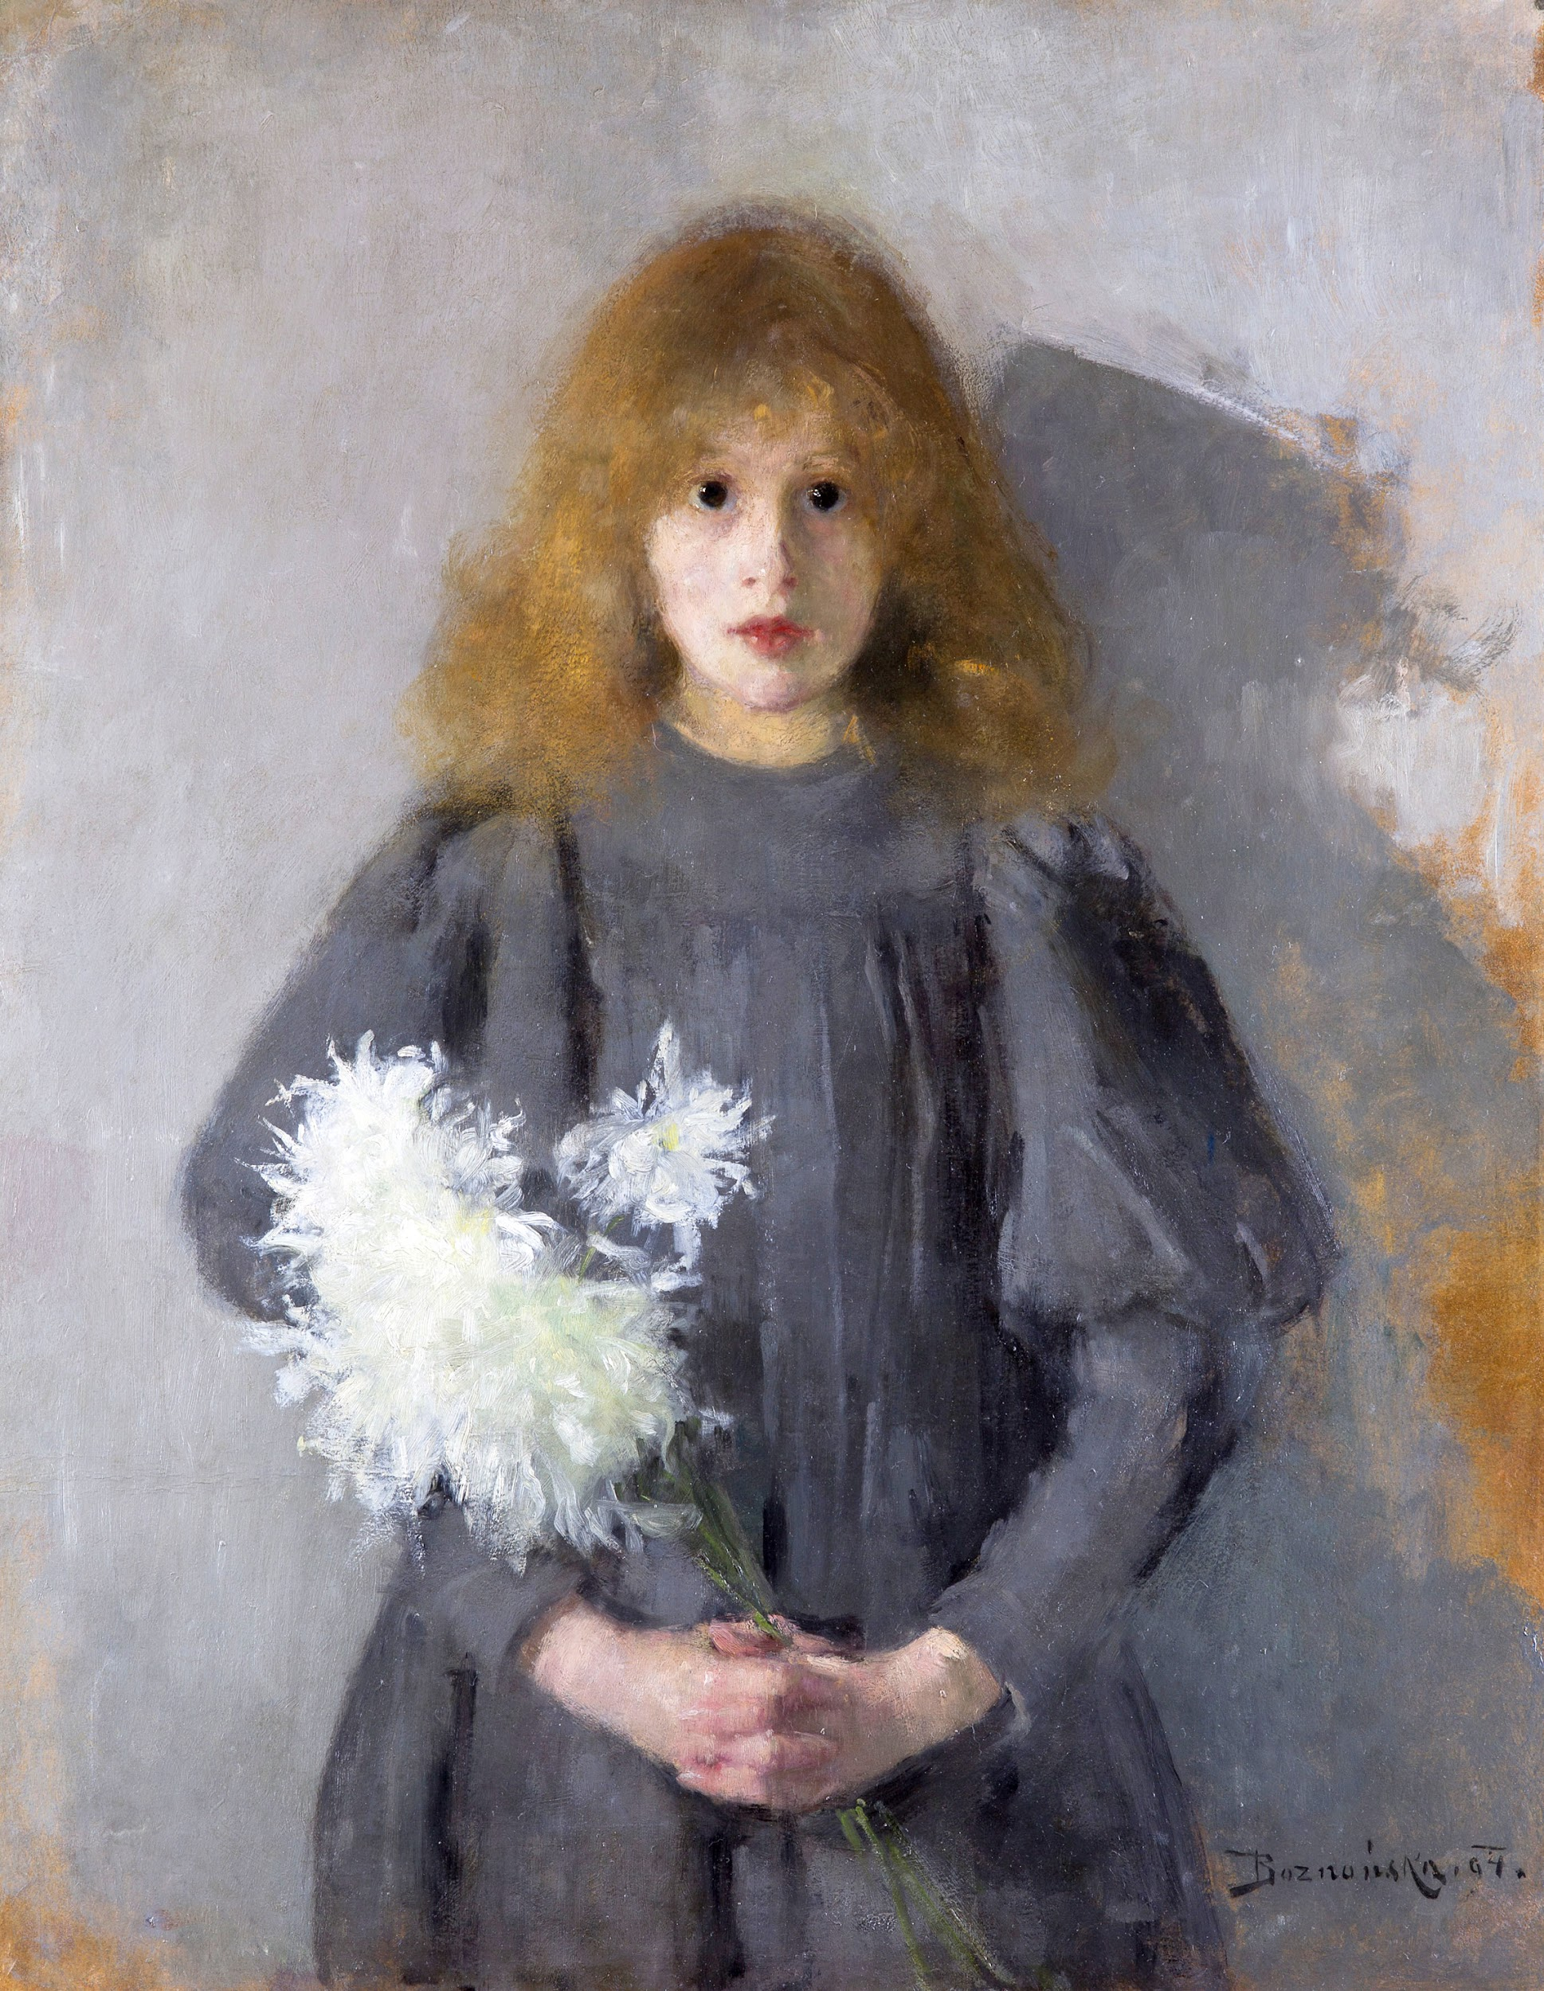
Olga Boznańska (1865 - 1940)
The greatest Polish painter of the Young Poland
She was active in Paris and Munich
Her first drawing teacher was her mother
She also was a member of the Polish Art Society

Slide 11
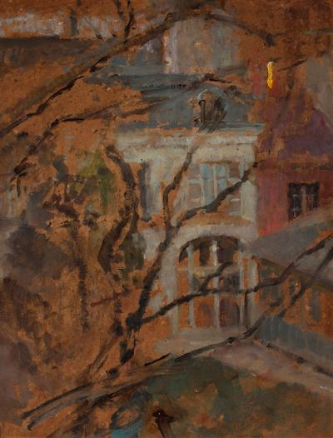
,,View from the window of the Krakow Studio” (Widok z okna pracowni krakowskiej), 1900
oil on cardboard

Slide 12
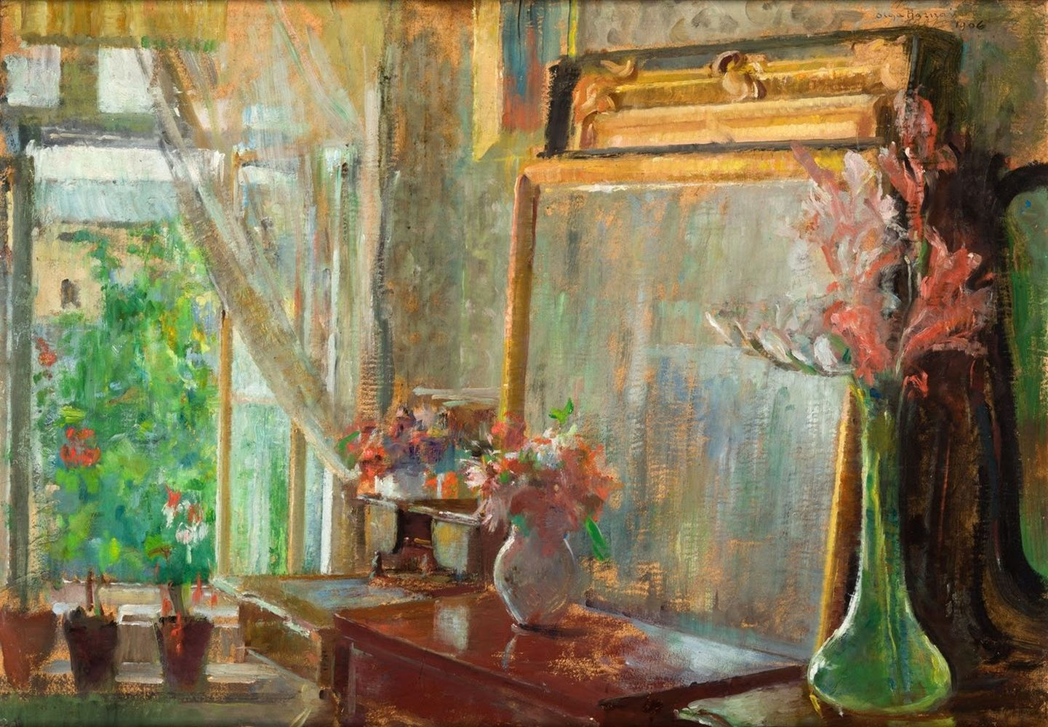
,,The interior of the Artist’s studio in Krakow” (Wnętrze pracowni artyski w Krakowie), 1906,
oil on cardboard

Slide 13
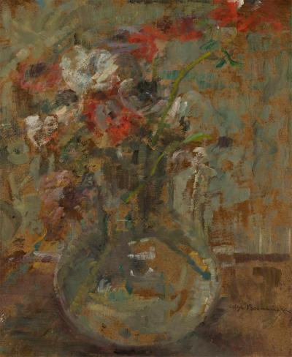
,,Poppies” (Maki), 1920,
oil on cardboard

Slide 14
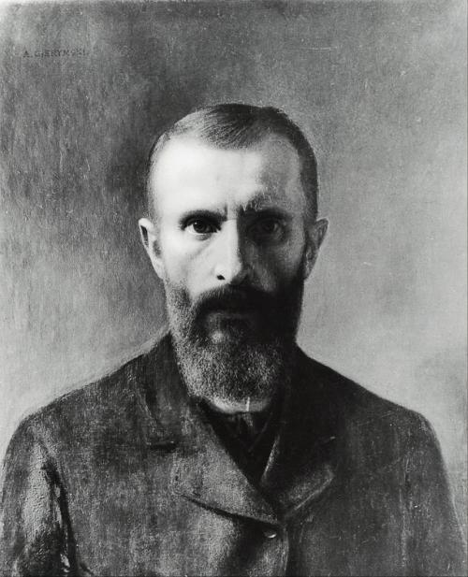
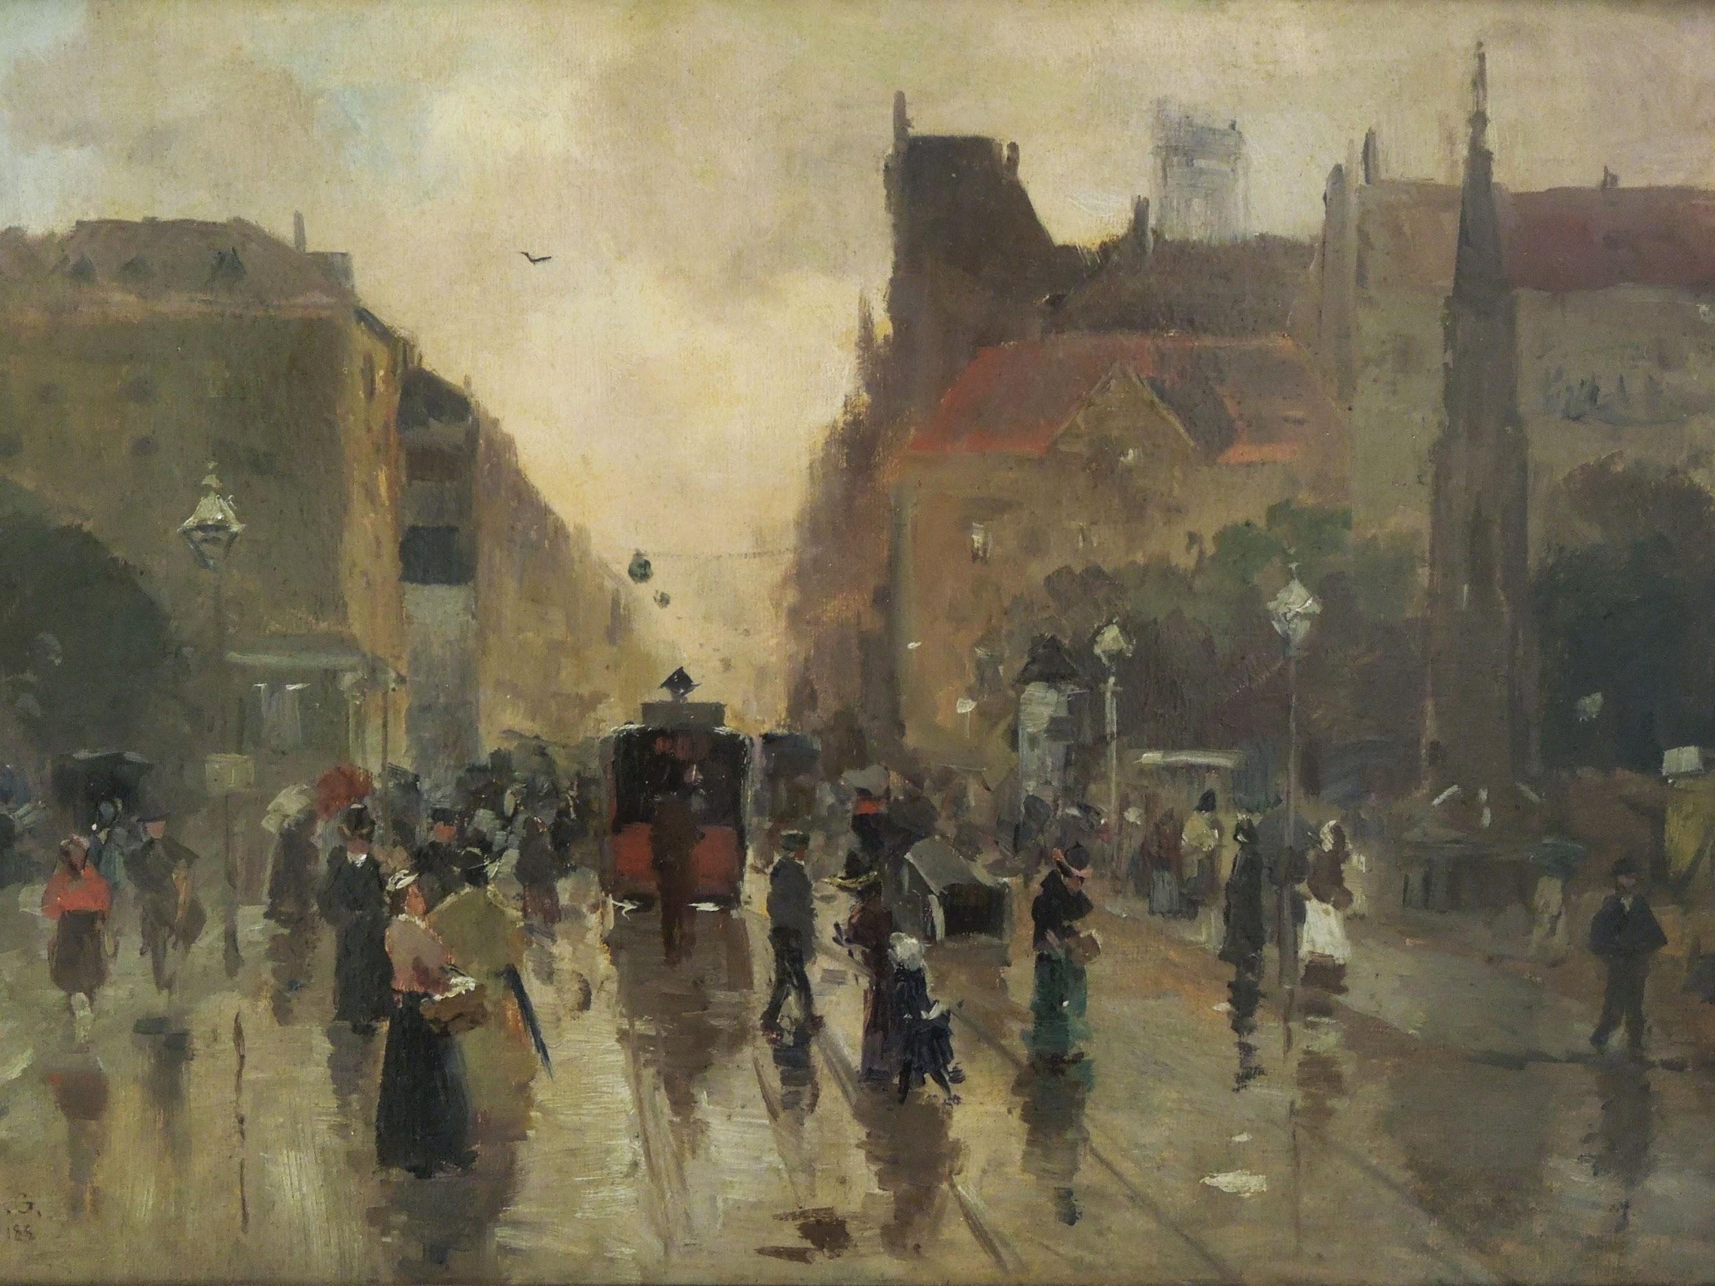
Ignacy Aleksander Gierymski
Representative of Realism and an important precursor of Impressionism in Poland.
In 1867 he began his drawing studies in Warsaw. Between 1868 and 1872 he studied at the Academy of Fine Arts in Munich
He cooperated with a group of young positivist writers and painters gathered around the magazine "Wędrowiec".

Slide 15
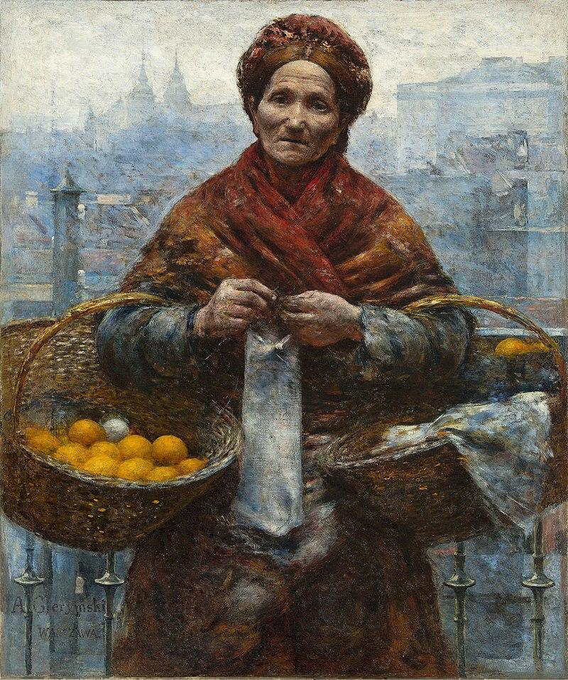
“Żydówka z pomarańczami”
“Jewess with oranges”,
1881, oil on canvas

Slide 16
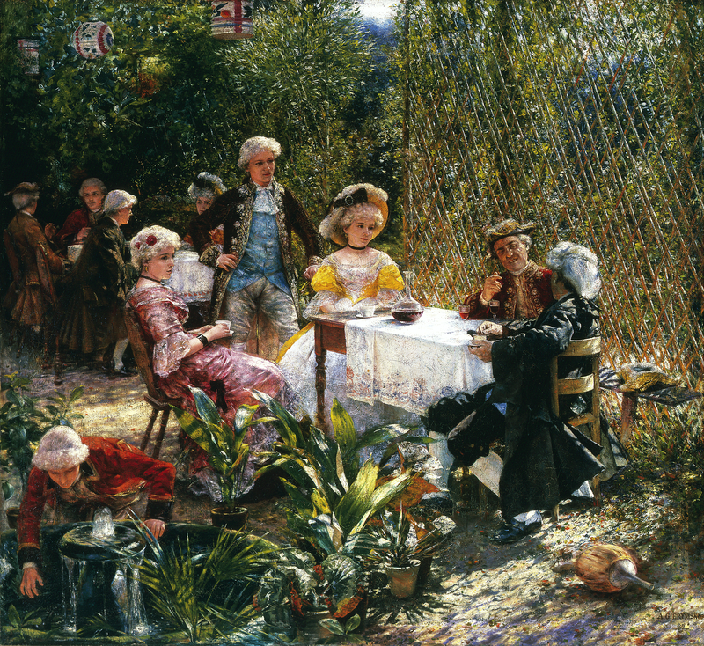
“W altanie” (“Gazebo”)
1882 , oil on canvas

Slide 17
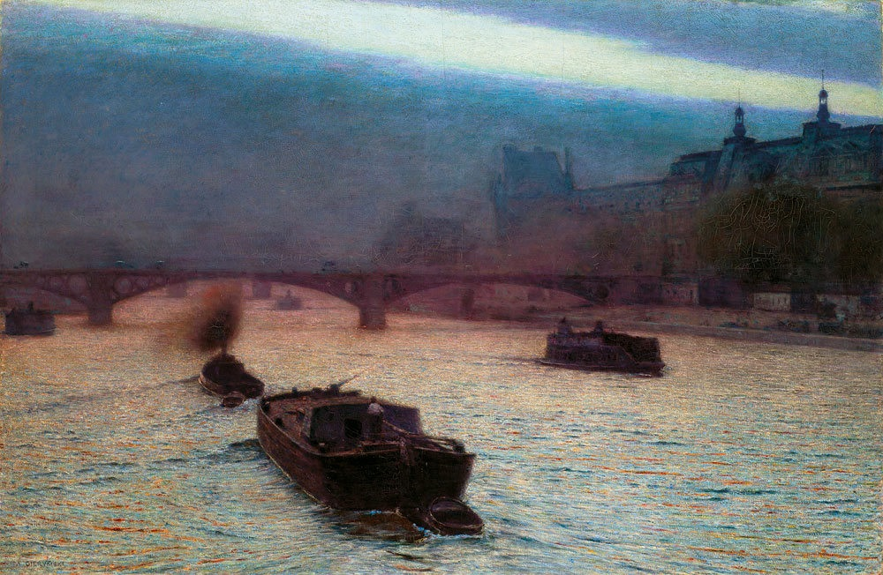
“Wieczór nad Sekwaną”,1893 (“Evening on the Seine”),
oil on canvas

Slide 18
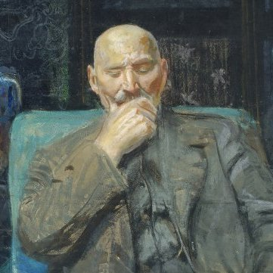
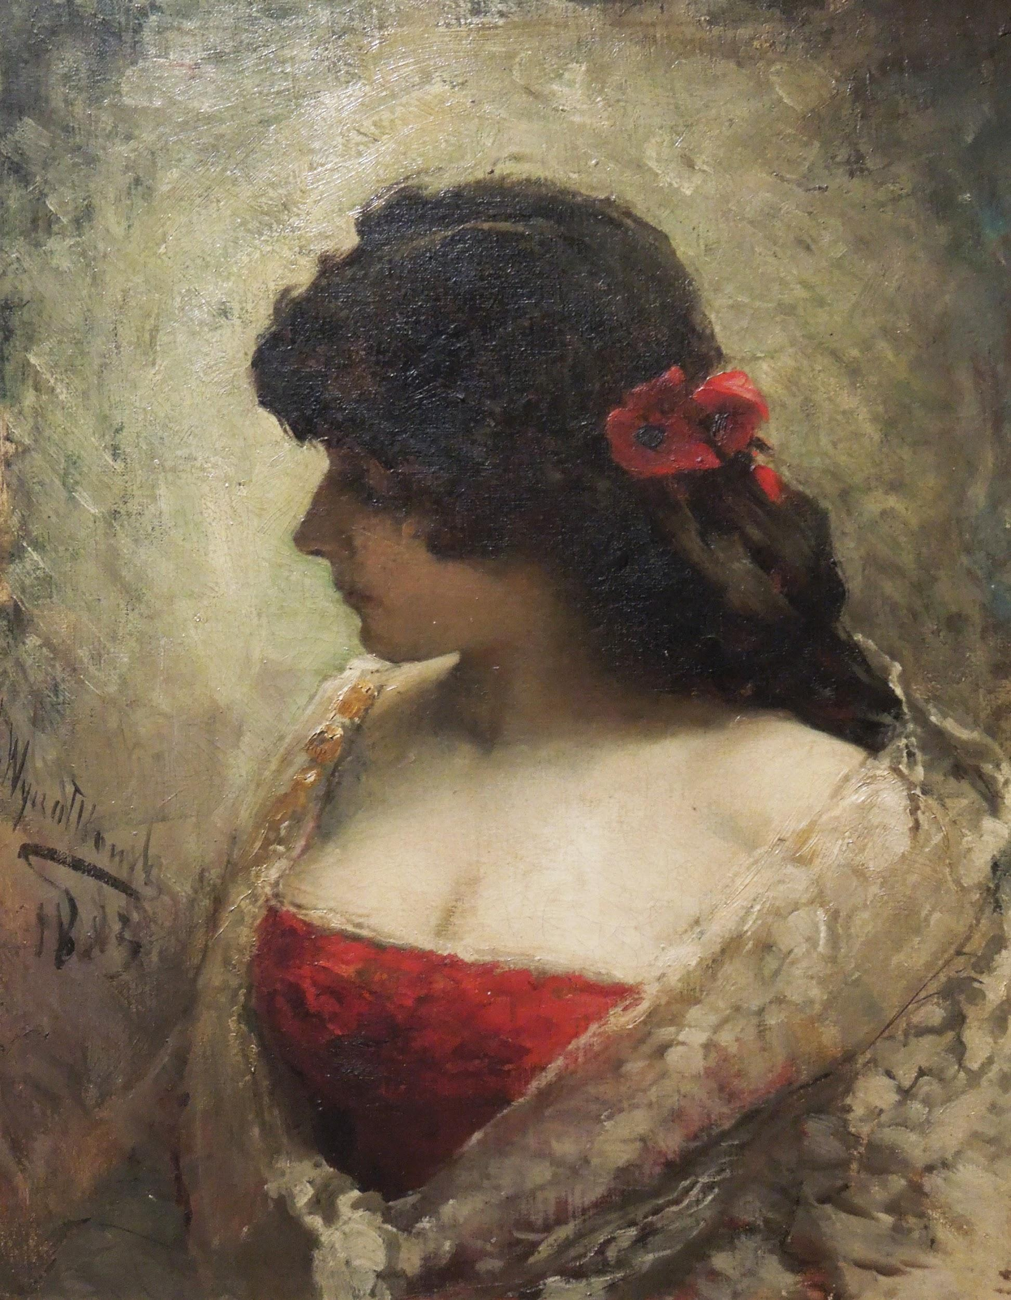
Leon Jan Wyczółkowski
One of the leading painters of the Young Poland movement, as well as the principal representative of Polish Realism
From 1895 to 1911 he served as professor of the Jan Matejko Academy of Fine Arts (ASP) in Kraków, and from 1934, ASP in Warsaw
He was a founding member of the Society of Polish Artists "Sztuka"

Slide 19
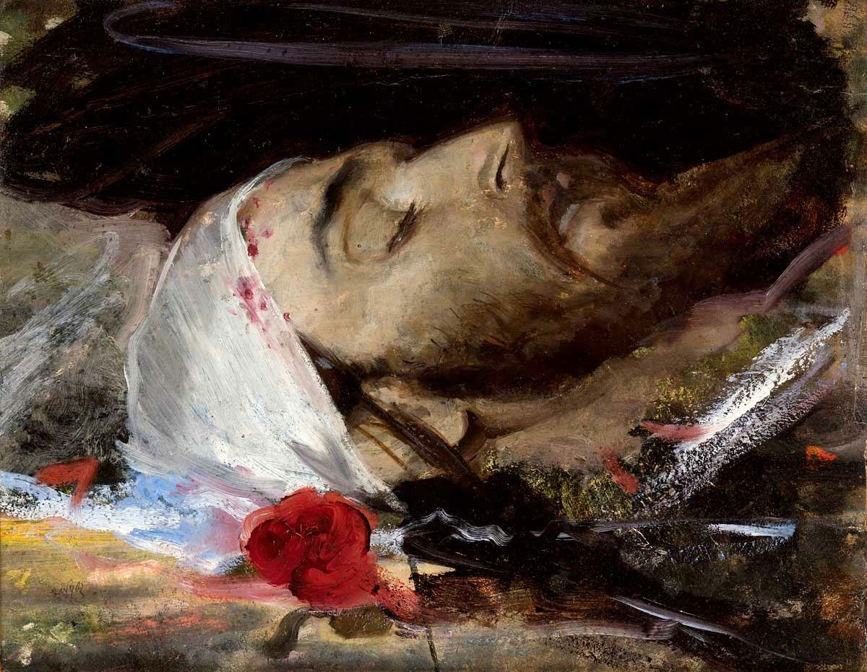
"Głowa Chrystusa"
"Head of Christ",
oil on canvas

Slide 20
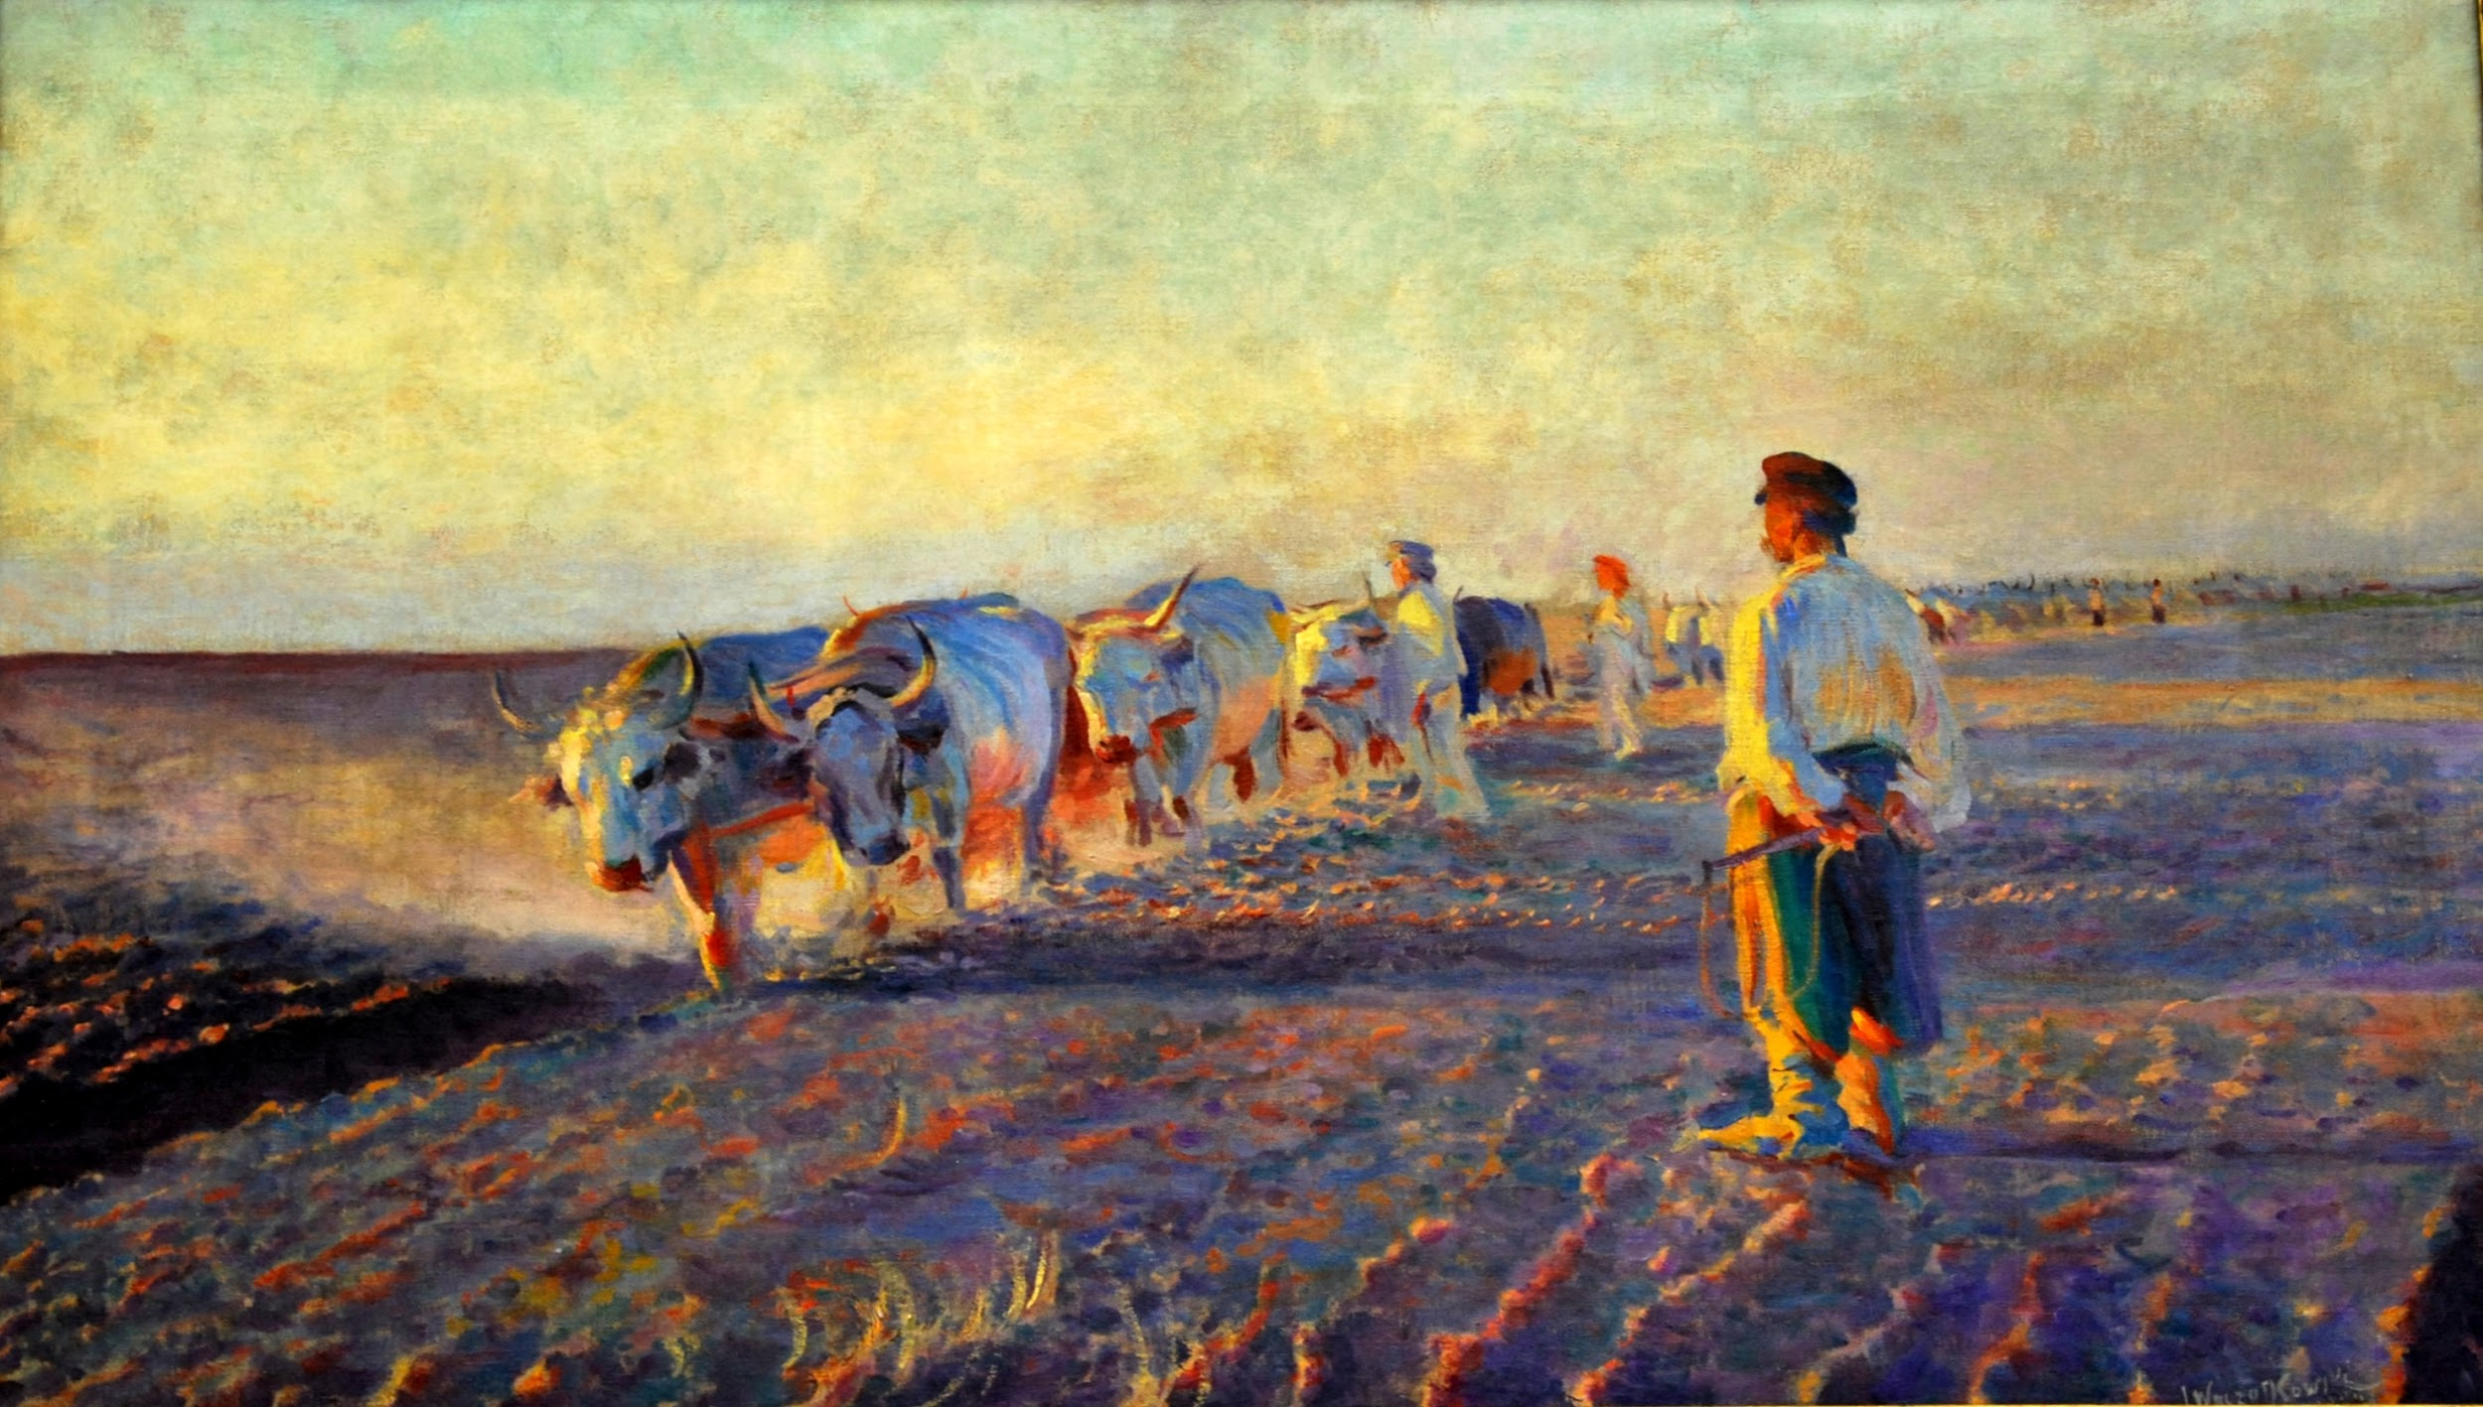
“Orka na Ukrainie”
“Plowing in Ukraine”,
oil on canvas

Slide 21
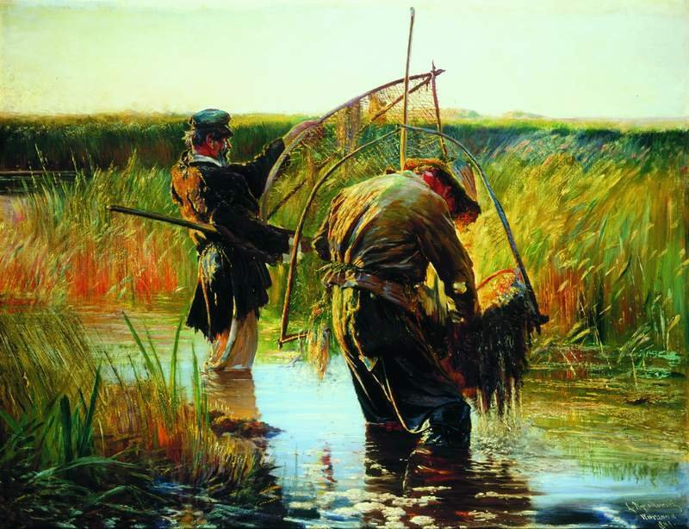
“Rybacy brodzący w wodzie”
“Fishermen wading in the water”
oil on canvas

Slide 22
Thank You for your attention
The authors: Martyna Bojanowska & Jan Przybylski

