Slide 1
Early Human
Migration

Slide 2
Timeline
10,000
15,000
35,000
200,000
years ago
150,000
60,000
45,000
20,000
NOW
11,000

Slide 3
NORTH AMERICA
EUROPE
ASIA
AFRICA
SOUTH AMERICA
we started here
AUSTRALIA

Slide 4
150,000
Modern human beings (homo sapiens) first appeared in Africa 150,000 years ago.

Slide 5
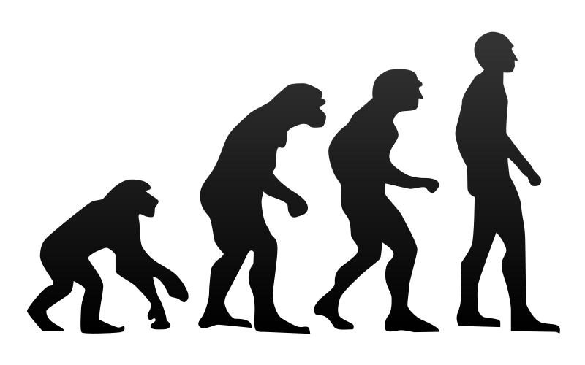
60,000 years ago
For thousands of years they stayed in Africa,but about 60,000 years ago,they started to migrate into Asia.

Slide 6
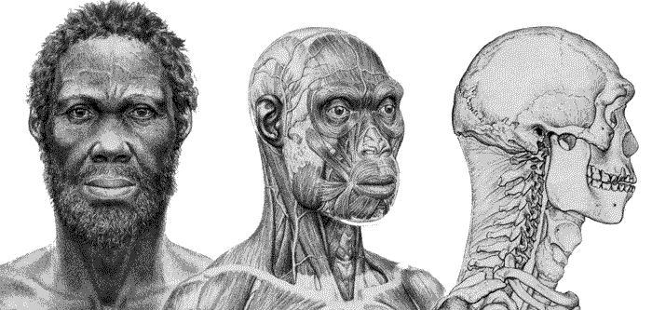
35,000 years ago
From there,some went north and arrived in Europe about 35,000 years ago.Europe was much colder than today,as this was the time of the ice Age.However,there was plenty of food there.Our ancestors hunted huge animals,like mammoths and woollly rhinoceroses.There were already other people in Europe,too.These were the Neamderthals.

Slide 7
200,000 years ago
They left Africa 200,000 years ago.They were bigger and stronger than our ancestors,but by 20,000 years ago,the Neanderthals were extinct.We do not know why.

Slide 8
45,000 years ago
Other groups of modern humans went east,further into Asia.From there,some went south into Australia.The first people reached Australia about 45,000 years ago.

Slide 9
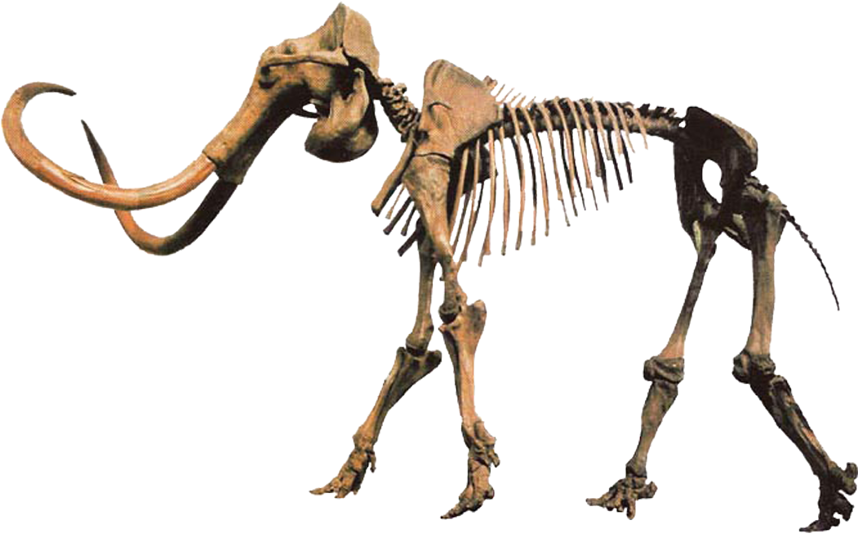
15,000 years ago
There was also a land bridge in the north between Siberia and Alaska.About 15,000 years ago,people walked across this land bridge into North America.

Slide 10
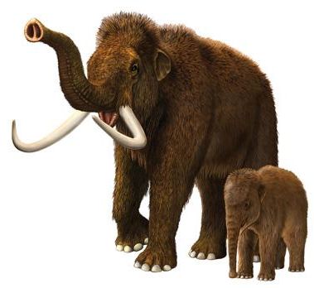
11,000 years ago
They moved to South America about 11,000 years ago.Human beings were now in every continent except Antarctica.

Slide 11
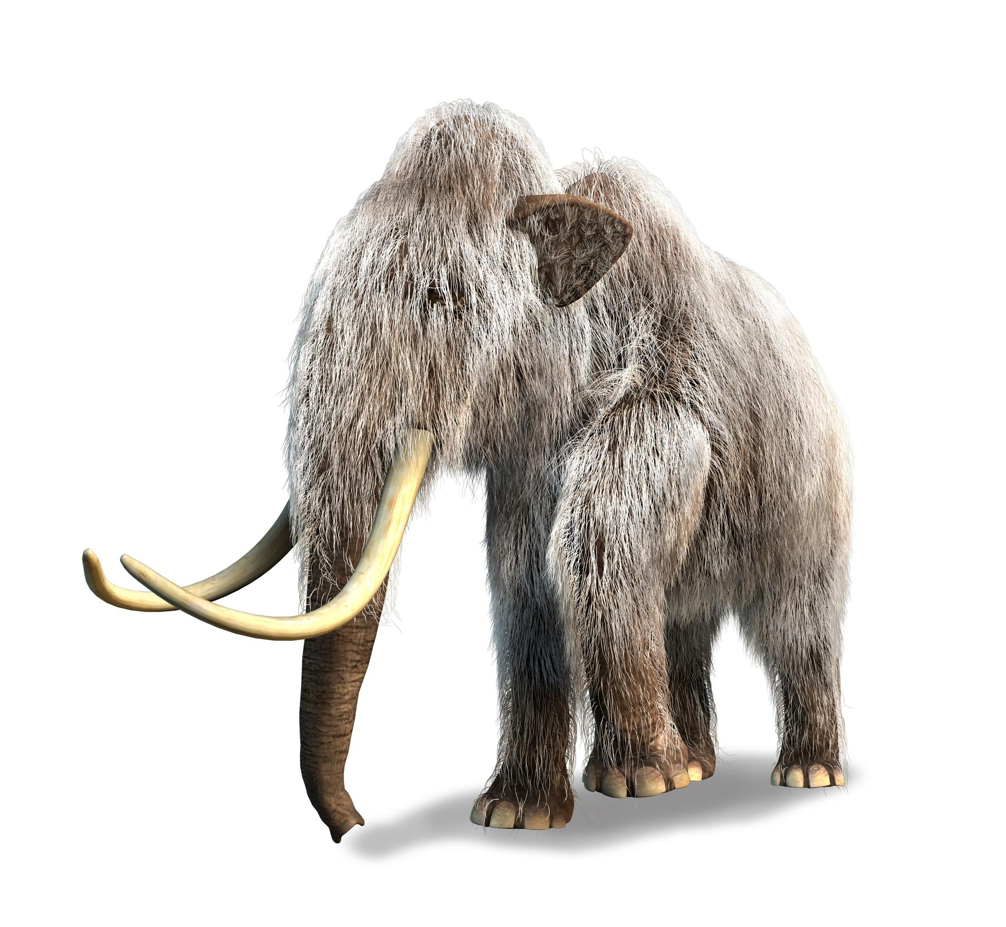
10,000 years ago
Soon after that - about 10,000 years ago - the last ice Age ended.As the ice melted,sea levels rose.Australia became an island again and the land bridge to North America disappeared.No new people arrived in these places until modern times.

Slide 12
The End.
Kornelia Tomaj , Elementary school Šumperk,Vrchlického 22, Czech Republic Šumperk, Europe

