Slide 1
Italy
Jakub Vavrečka

Slide 2
Flag

Slide 3
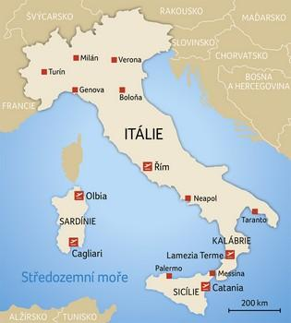
Map

Slide 4
Monuments

Slide 5
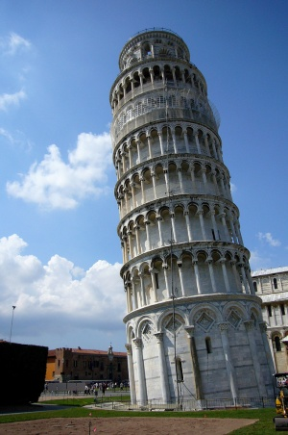
Leaning Tower of Pisa
Tower construction began during the 12th century construction, due to insufficient base on the ground too soft on one side, to properly support the weight of the structure. The slope has grown in recent decades before the structure was completed in the 14th century. It gradually increased until the structure stabilized (and the tilt was partially corrected) by the efforts at the end of the 20th and the beginning of the 21st century.

Slide 6
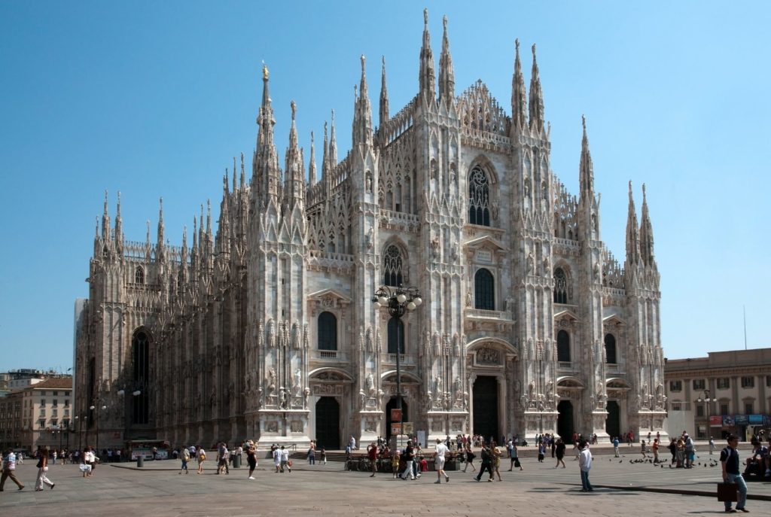
Duomo di Milano
The Cathedral of the Birth of the Virgin Mary in Milan is the fifth largest cathedral in the world, and the second largest in the Apennine peninsula (the first is St. Peter's Basilica in the Vatican). It is often the Duomo di Milano, the northern Italian city of Lombardy.

Slide 7
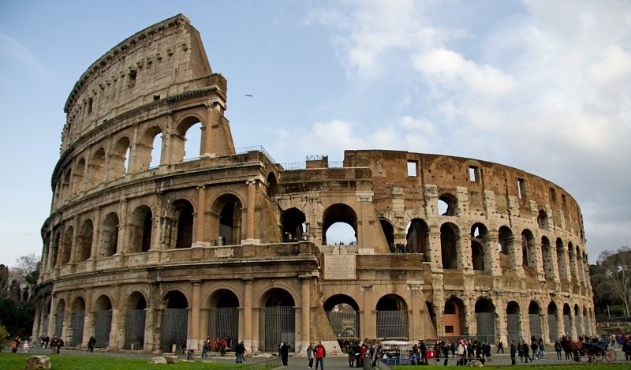
Colosseum
The Colosseum is an oval amphitheater located in the center of Rome. It was the largest building in Rome and is still a symbol of Romanesque architecture. The Colosseum is located on the eastern side of the Roman Forum on the site of an artificial lake in the garden of the Golden House of Emperor Neron. The construction started between 70 and 72 and organized gladiatorial matches. In the year 80, under the rule of Emperor Titus, the Colosseum was solemnly opened with games that lasted for 100 days.

Slide 8
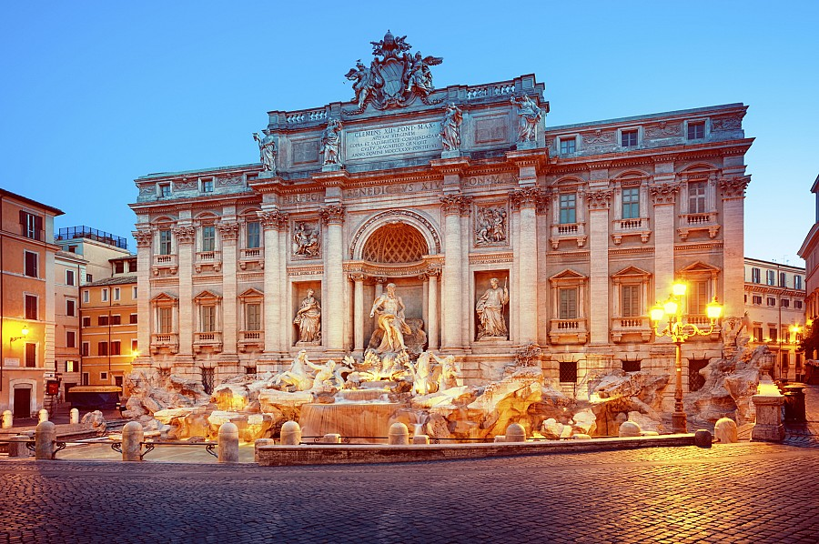
Fountai di Trevi
The Trevi Fountain is one of the most beautiful fountains in the world. Fountain is the remains of the aqueduct and its oldest part comes from the 19th century. Located on Trevi Square, which is famous for a number of tourists and businessmen. Statues in the fountain represent 4 seasons, health and abundance. According to the legend, who threw a coin into the fountain still returns to Rome. If you throw two coins, you will find love in Rome, and if you make one, you will have a wedding in Rome. Every day, about 2000 euros are collected and then used for charity.

Slide 9
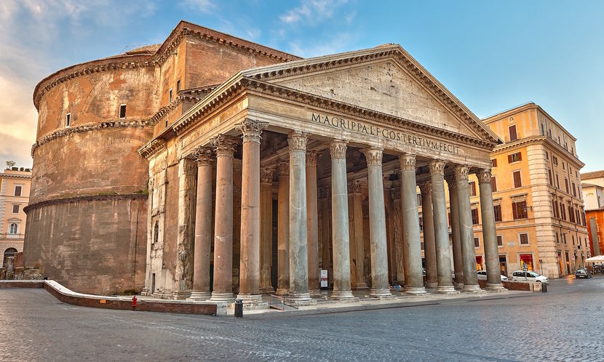
Pantheon
Is the most famous and most visited monument in Rome. Located on the Piazza Cannon Rotonda. In honor of the gods, Marcus Vipsanius Agrippa built it. Inside are the tombs of famous rulers, saints and famous personalities of Italy. The most sought after is the tomb of Renaissance artist Raffaello. Visitors are attracted by colorful marble tiles and entrance bronze doors.

Slide 10
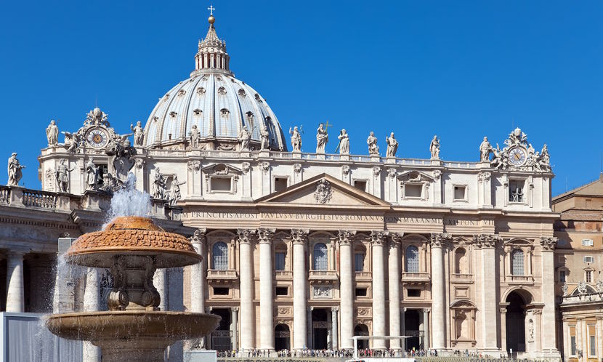
Basilica of Saint Peter
The temple stands in a place where St. Peter was crucified according to the legeng. Originally, the Church of St. Petra and in the 16th century it was rebuilt to the present temple. One of the most beautiful and largest basilicas in the world was the famous architect Michelangelo. The chapel also houses Michelangelo's Pieta and Bernini canopy. Access to the Basilica is free of charge.

Slide 11
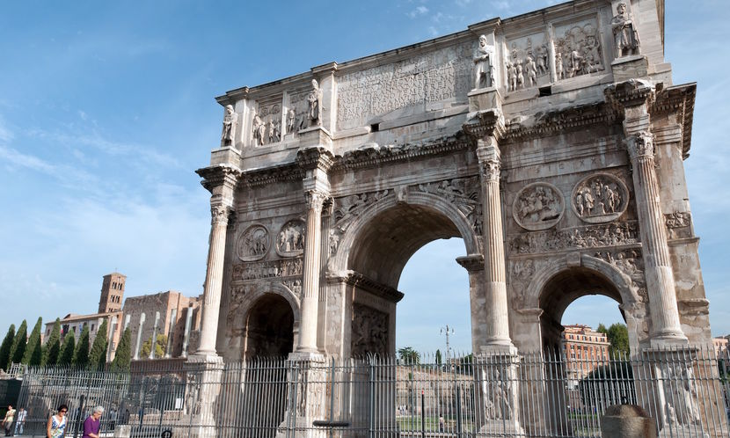
Konstantin's arch
Konstantin's arc of victory and is located near the Colosseum. The building is a symbol of the victory of Emperor Konstantin nad Maxenti in the Battle of the Milvius Bridge. The building is built of white marble with three passages.

Slide 12
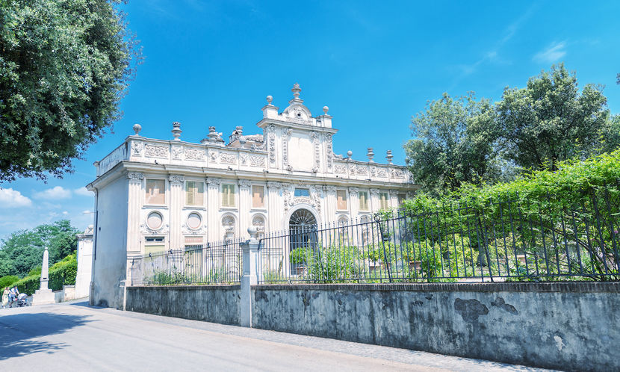
Borghes Gardens
The Borghes Gardens are next to the gallery, which carries the same name - the Borghes Gallery. You have to buy a ticket to the gallery, but the gardens are free for everyone. The gardens represent a beautiful park or for rest or walk, and in the past were the property of Cardinal Borghese.

Slide 13
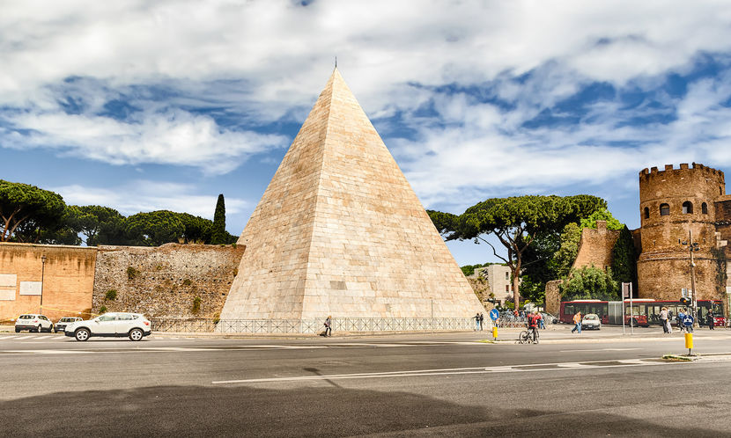
Ceti's pyramid
The only pyramid in Rome that you have to see. The tomb was built in 12 BC by Gaius Cestius Epulo and was to serve as his last resting place. Construction is made of concrete and is 27 meters high. Visitors are available for free.

Slide 14
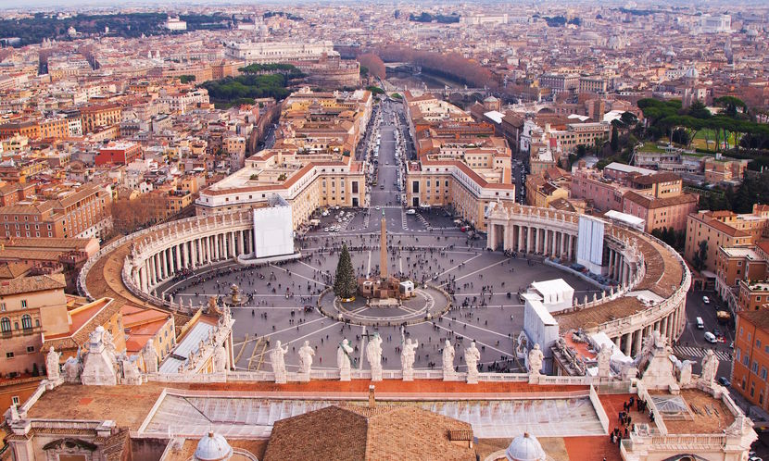
Vatican Museums
Speaking of St. Peter's Basilica, you certainly should not miss the Vatican Museums when visiting Rome. They feature a huge complex of museums and are full of art collections. There are also various collections of religious objects. Tickets to museums cost 15 euros, but they are free on the last Sunday of the month. So, if you're just in Rome right now, you should visit them.

