Slide 1
ITALY
Tomáš Franta

Slide 2
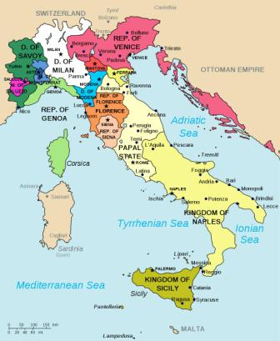
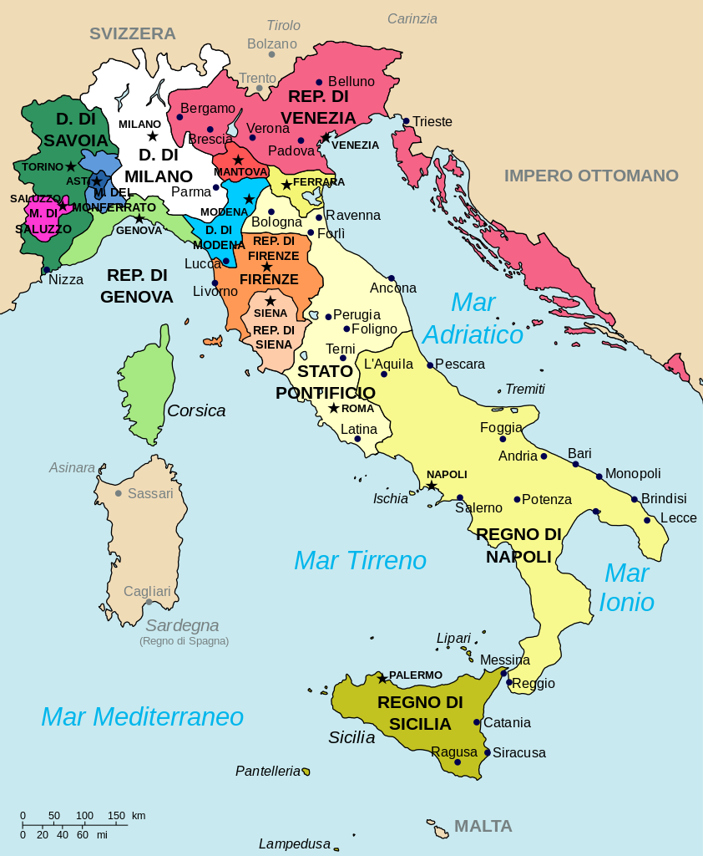

Slide 3
Colosseum
The Colosseum or the Roman Colosseum, originally the Flavius ​​Amphitheater (Latin: Amphitheatrum Flavium, Italian: Anfiteatro Flavio or Colosseo), is an oval amphitheater in the center of Rome, Italy. It is the largest amphitheater ever built in the Roman Empire. It is one of the great works of Roman architecture.

Slide 7
St. Peter's Basilica
The Papal Basilica of St. Peter in the Vatican (Italian: Basilica Papale di San Pietro in Vaticano), or simply St. Peter's Basilica (Latin: Basilica Sancti Petri), is an Italian Renaissance church in Vatican City, the papal enclave within the city of Rome.Designed principally by Donato Bramante, Michelangelo, Carlo Maderno and Gian Lorenzo Bernini.

Slide 8
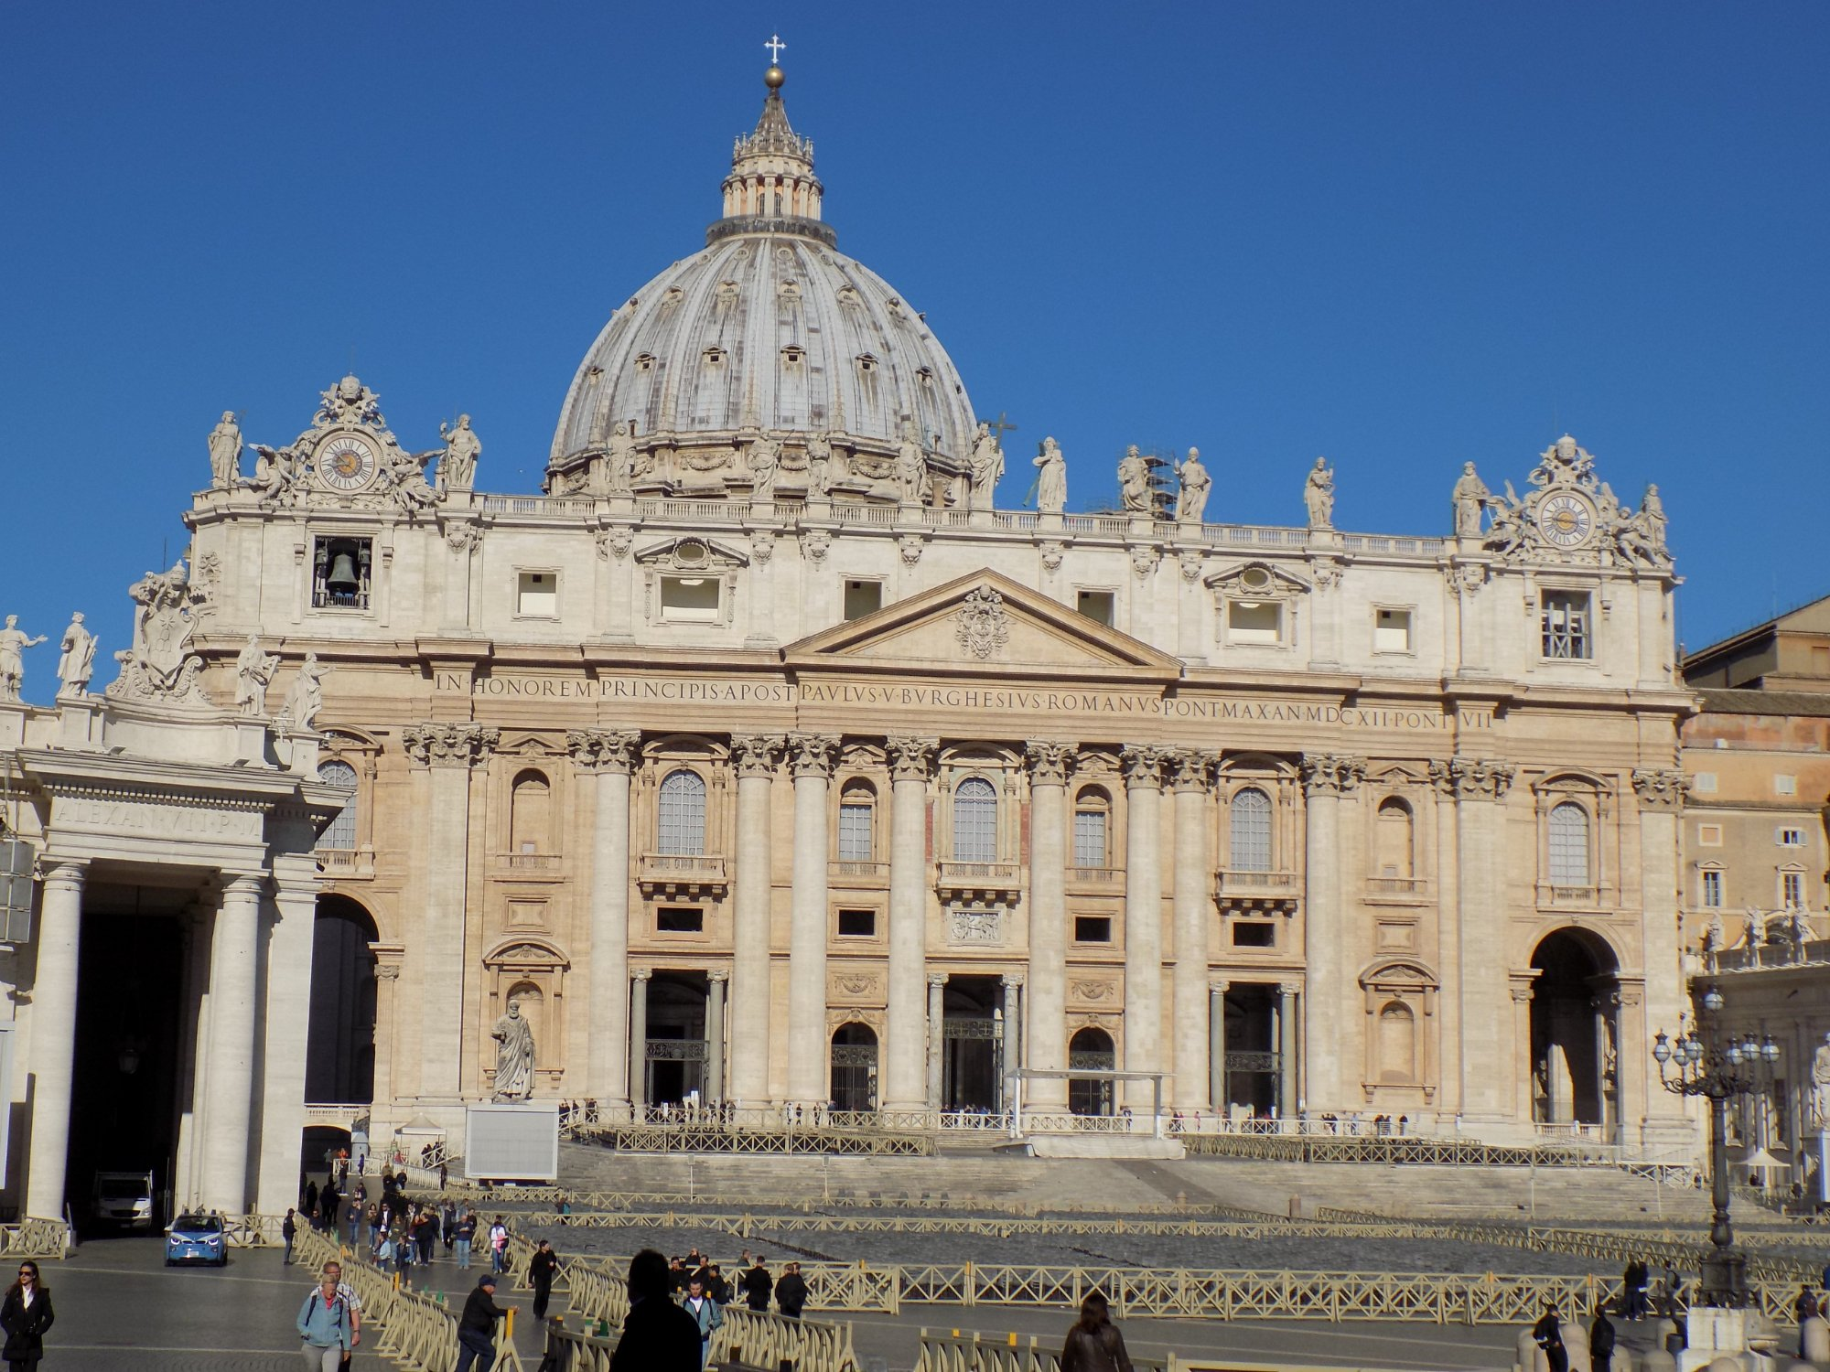

Slide 9
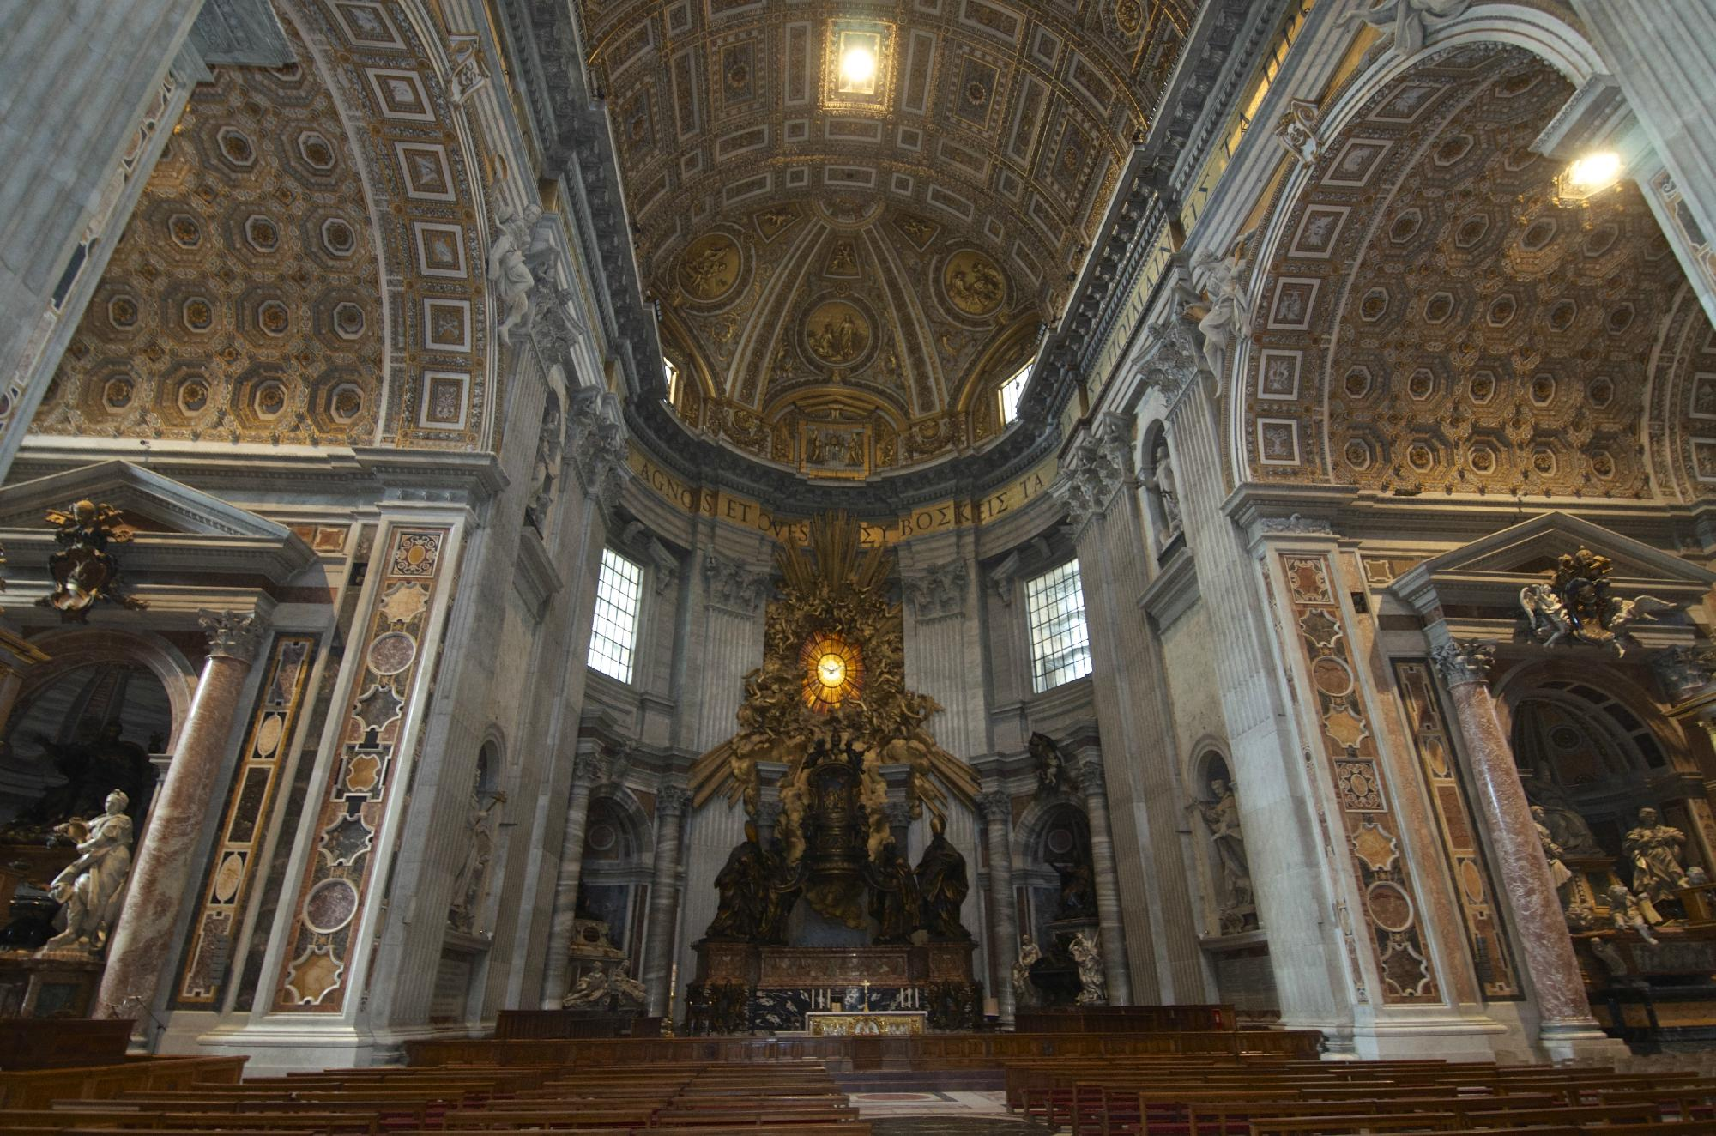

Slide 10
Doge's Palace
THE Doge's Palace (Italian: Palazzo Ducale; Venetian: Pałaso Dogal) is a palace built in Venetian Gothic style, and one of the main landmarks of the city of Venice in northern Italy. The palace was the residence of the Doge of Venice, the supreme authority of the former Republic of Venice, opening as a museum in 1923. Today, it is one of the 11 museums run by the Fondazione Musei Civici di Venezia.

Slide 11
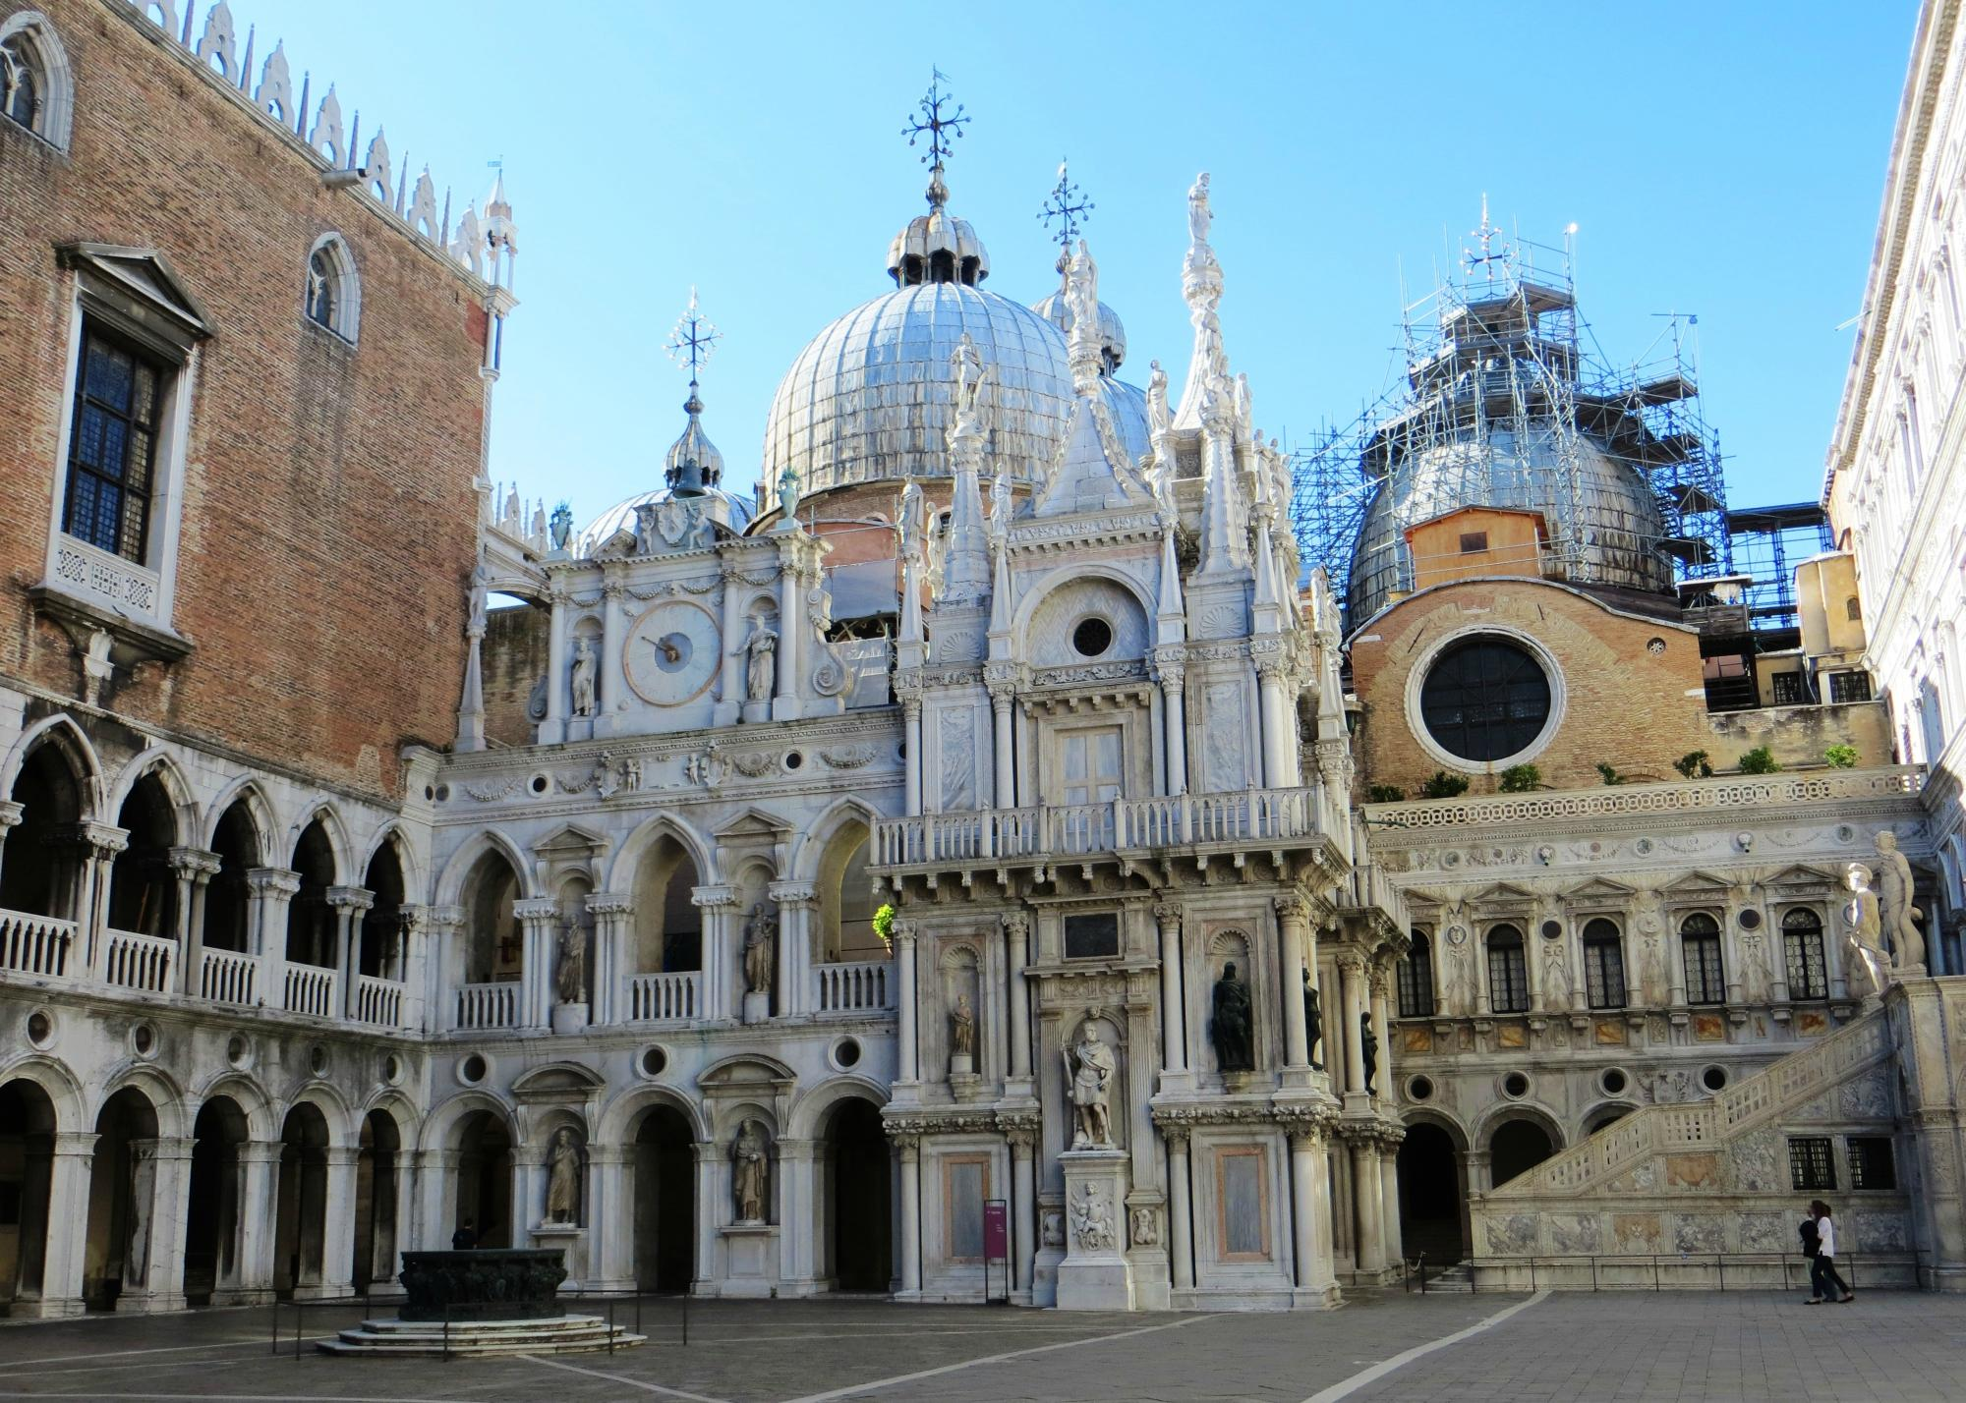

Slide 12
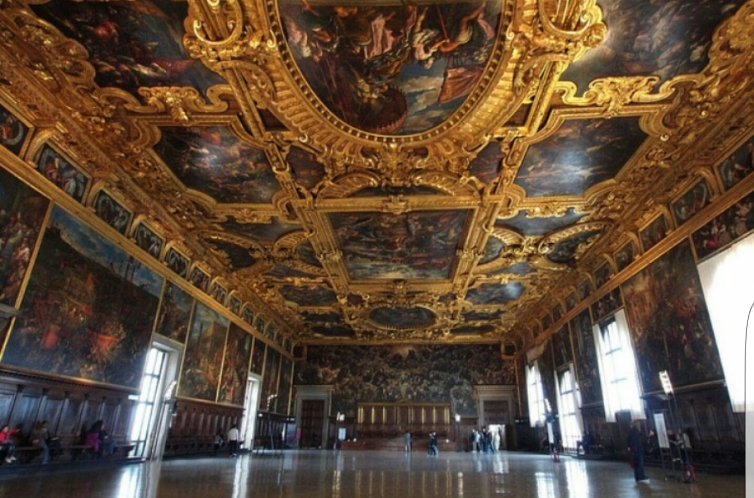

Slide 13
Duomo di Milano
The Basilica Metropolitan Cathedral of the Nativity of the Blessed Virgin Mary, better known as Milan Cathedral (Dòmm de Milan in Milanese dialect, is the cathedral of the archdiocese of Milan. Symbol of the Lombard capital, and located in the homonymous square in the center of the metropolis, it is dedicated to Santa Maria Nascente. By surface it is the sixth Christian church in the world It is home to the parish of Santa Tecla in the Duomo of Milan .

Slide 16
Templi Greci di Paestum
Paestum, the Latin name of the term Paistom with which it was defined after its conquest by the Lucanians, is an ancient city of Magna Grecia called by the founders Poseidonia in honor of Poseidon, but very devoted to Hera and Athena. The extension of its inhabited area is still well recognizable today, enclosed by its Greek walls, as modified in the Lucanian and then Roman times. In the past it was also known as Pesto.

Slide 19
Scrovegni Chapel
The Scrovegni Chapel (Italian: Cappella degli Scrovegni, also known as the Arena Chapel), is a church in Padua, Veneto, Italy. It contains a fresco cycle by Giotto, completed about 1305 and considered to be an important masterpiece of Western art. The nave is 20.88 metres long, 8.41 metres wide, and 12.65 metres high. The apse area is composed of a square area (4.49 meters deep and 4.31 meters wide) and a pentagonal area (2.57 meters deep).

Slide 20
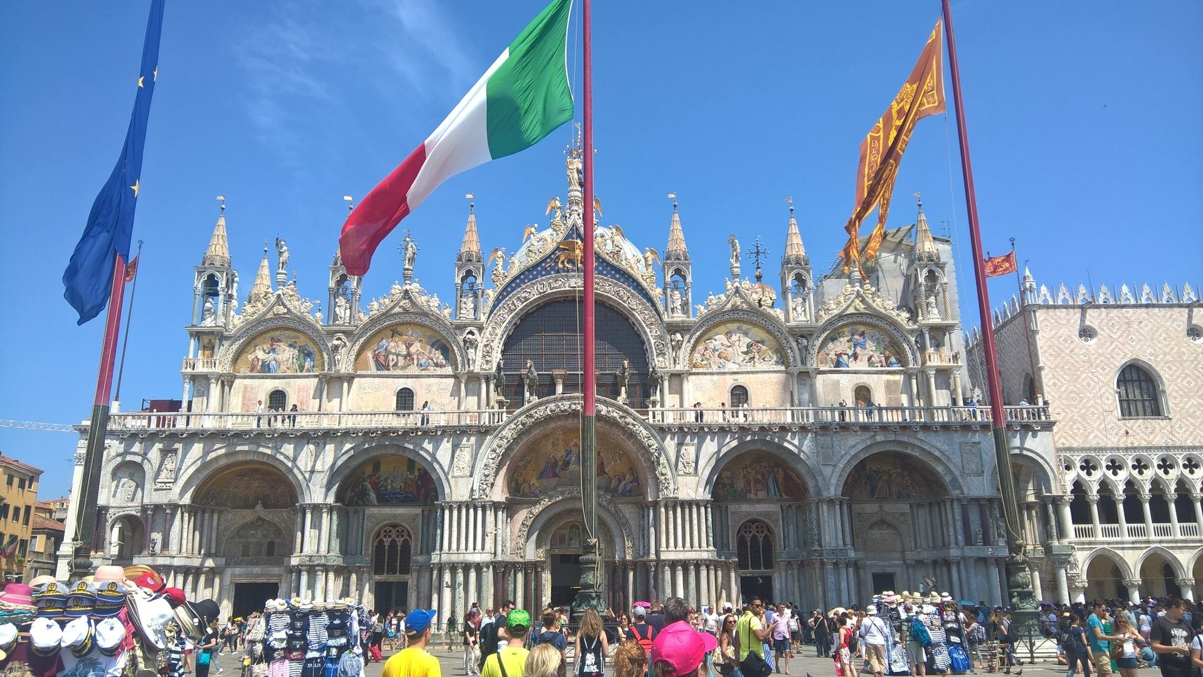

Slide 21
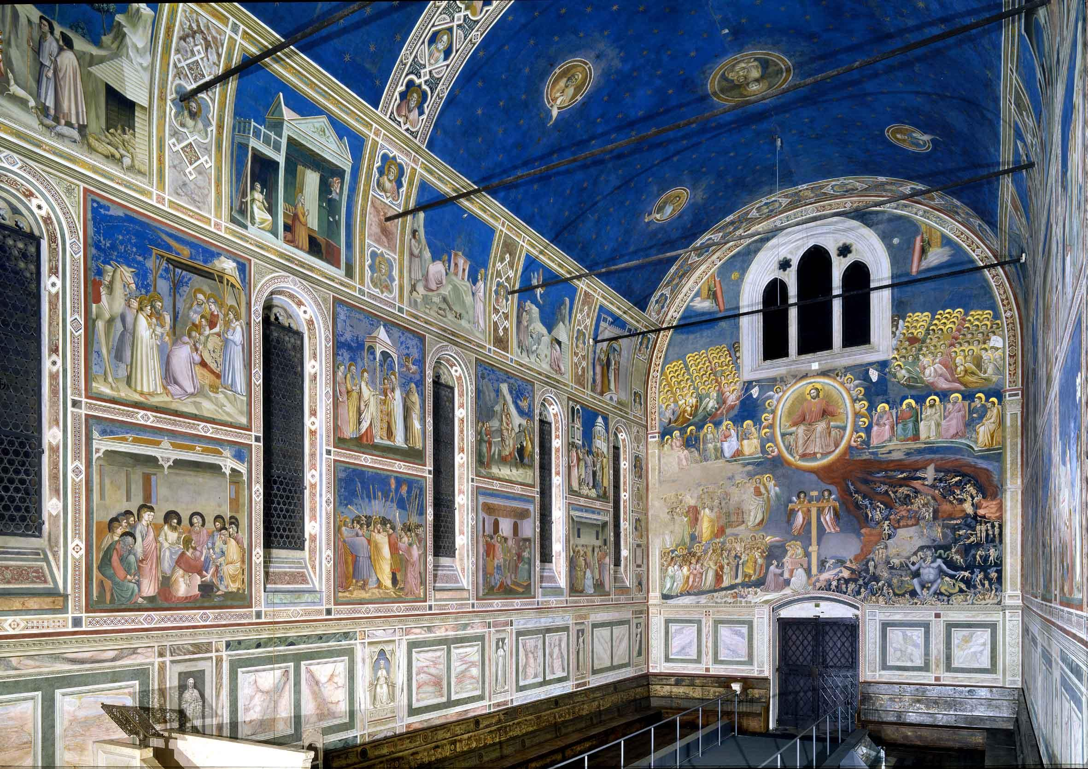

Slide 22
Basilica San Vitale
The "Basilica of San Vitale" is a church in Ravenna, Italy, and one of the most important examples of early Christian Byzantine art and architecture in Europe. The Roman Catholic Church has designated the building a "basilica", the honorific title bestowed on church buildings of exceptional historic and ecclesial importance, although it is not of architectural basilica form. It is one of eight Ravenna structures inscribed on the UNESCO World Heritage List.

Slide 23
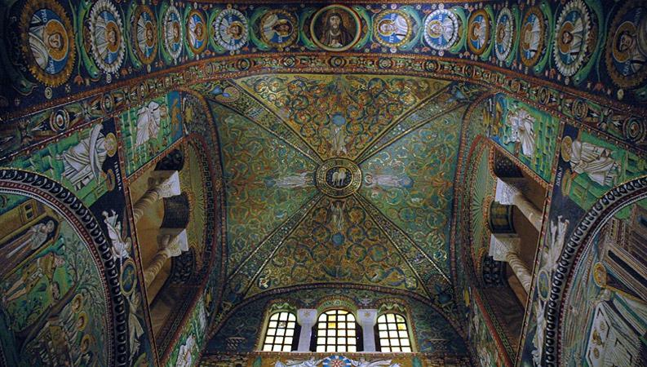

Slide 24
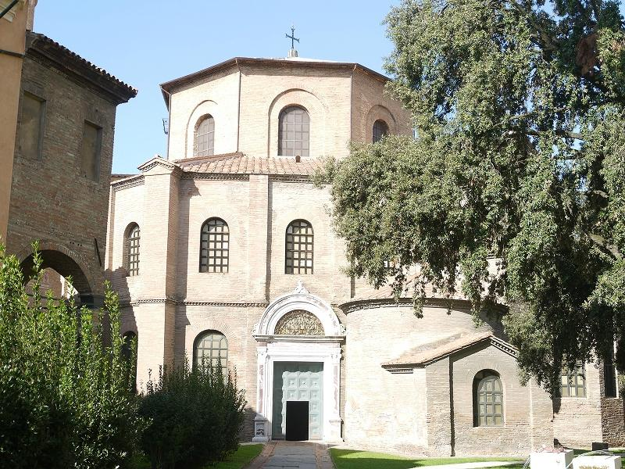

Slide 25
Villa Romana del Casale
The Villa Romana del Casale (Sicilian: Villa Rumana dû Casali) is a large and elaborate Roman villa or palace located about 3 km from the town of Piazza Armerina, Sicily. Excavations have revealed one of the richest, largest and varied collections of Roman mosaics in the world,for which the site has been designated as a UNESCO World Heritage Site. The villa and artwork contained within date to the early 4th century AD.

Slide 26
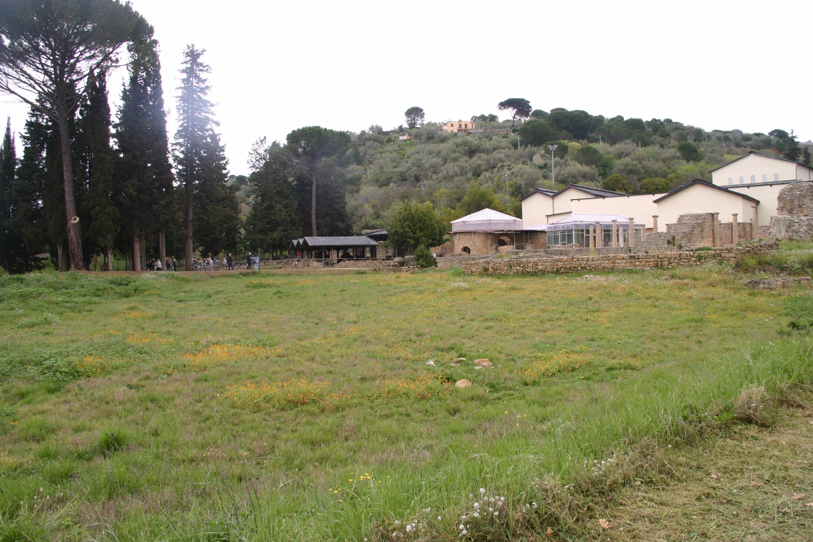

Slide 27
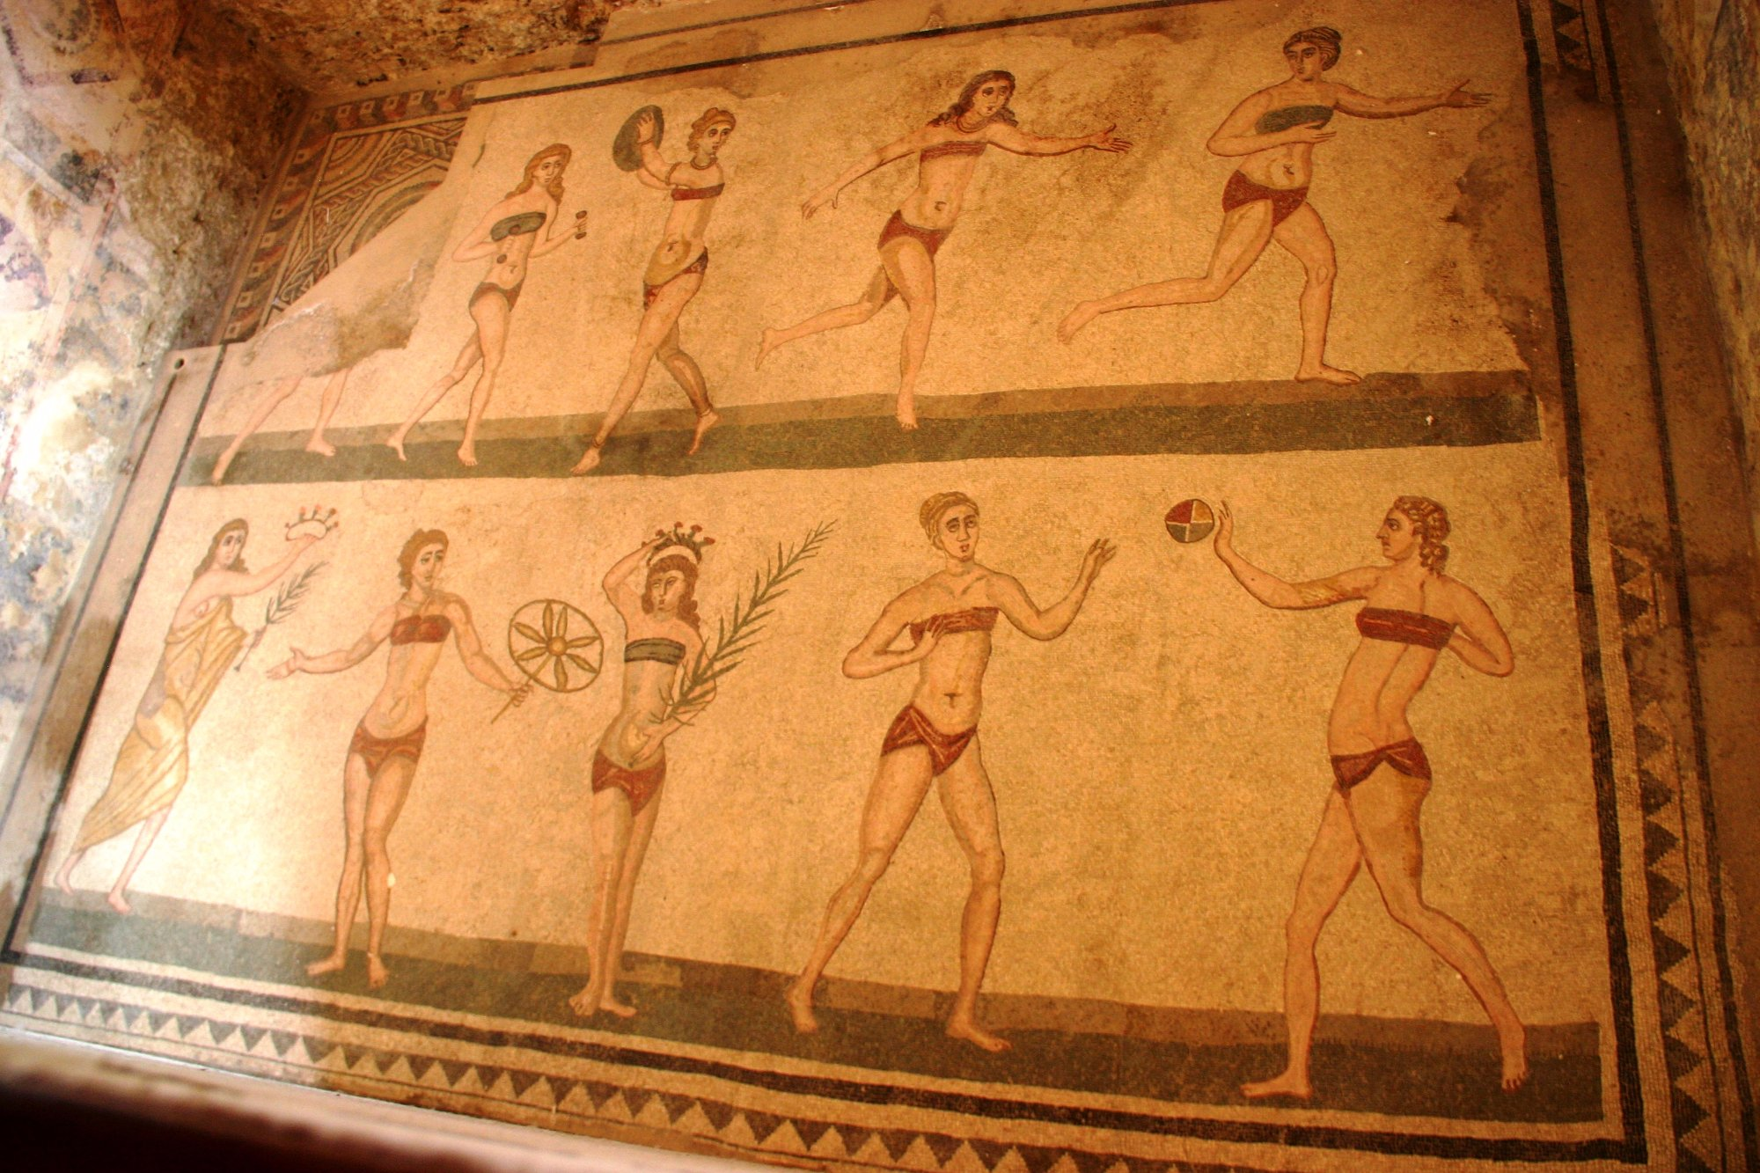

Slide 28
Museo Cappella Sansevero
The Cappella Sansevero (also known as the Capella Sansevero de' Sangri or Pietatella) is a chapel located on Via Francesco de Sanctis 19, just northwest of the church of San Domenico Maggiore, in the historic center of Naples, Italy. The chapel is more properly named the Chapel of Santa Maria della Pietà, or the Pietatella. It contains works of art by some of the leading Italian artists of the 18th century.^{[1]}

Slide 29
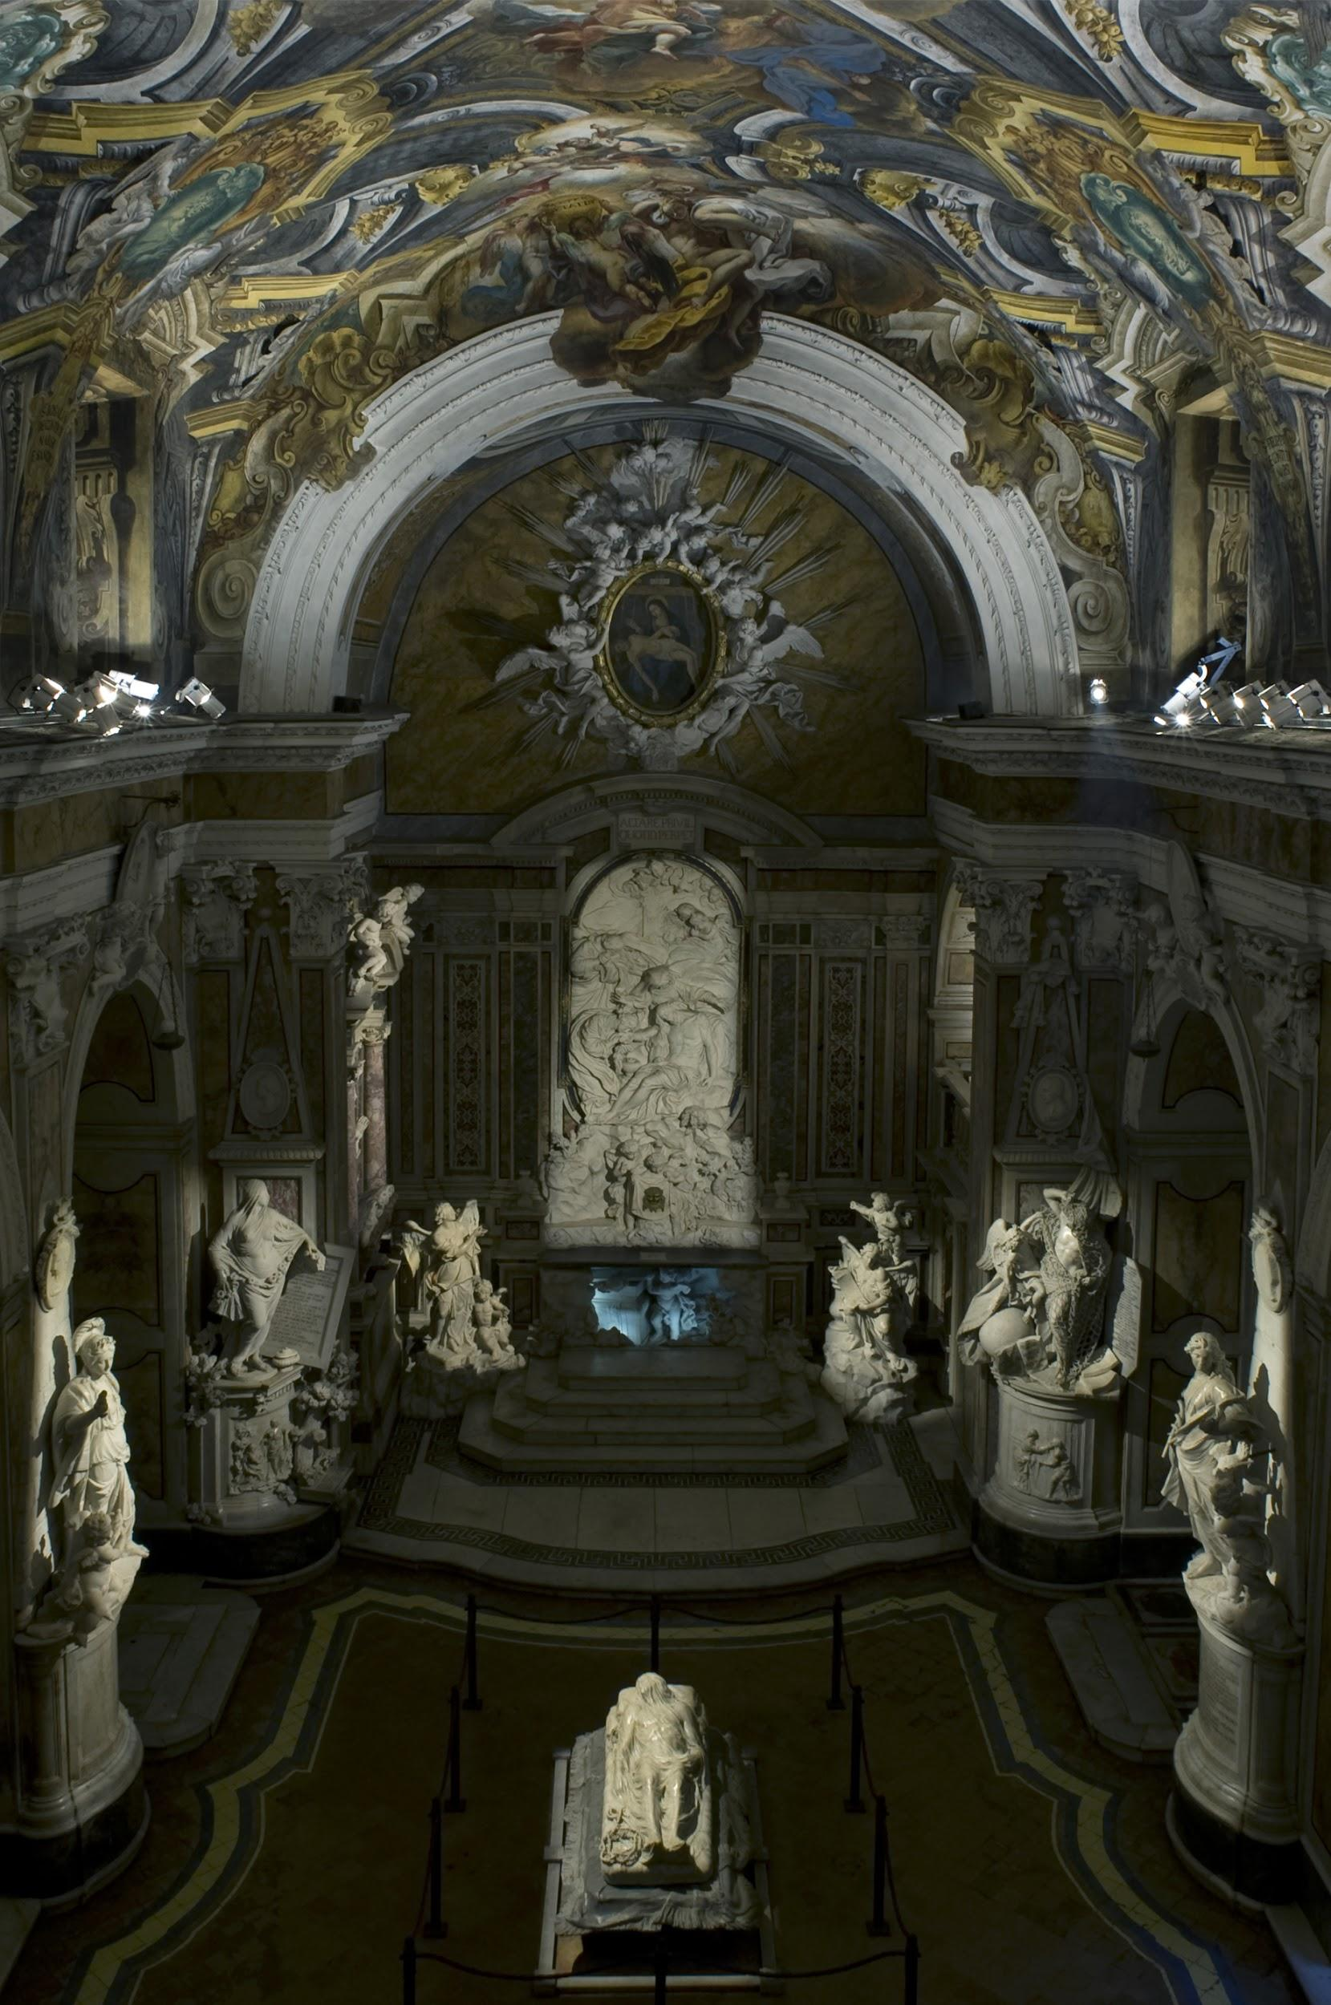
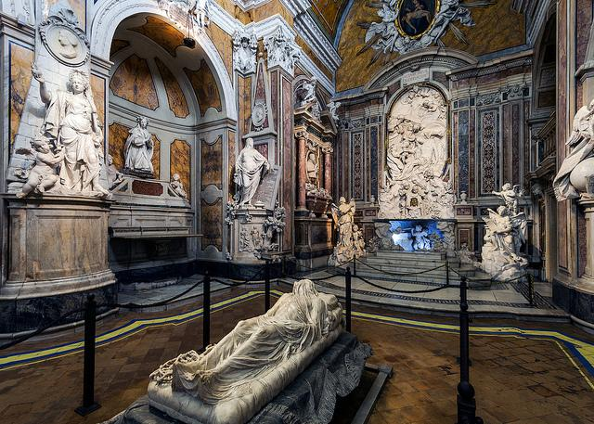

Slide 30
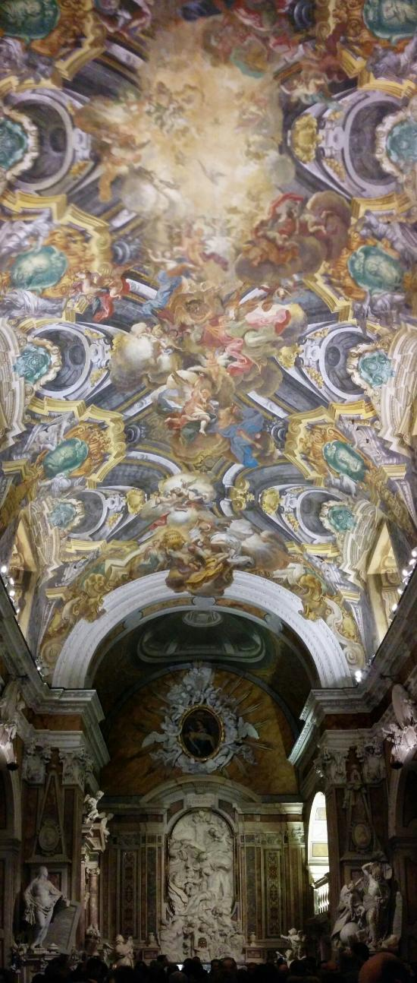
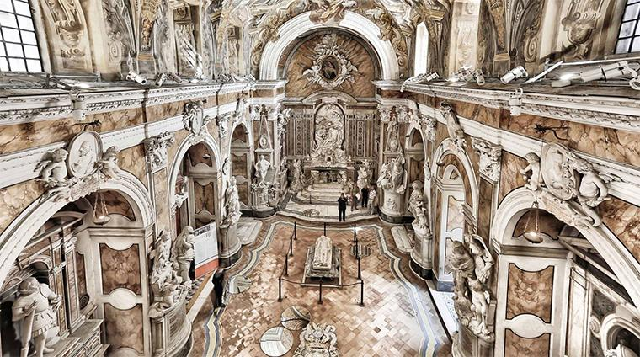

Slide 31
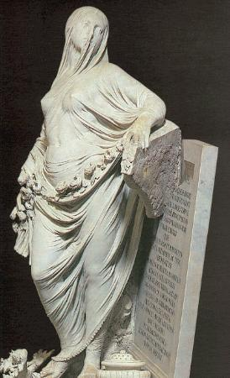

Slide 32
Pantheon
The Pantheon Latin: Pantheum, from Greek Πάνθειον Pantheion, "[temple] of all the gods") is a former Roman temple, now a church, in Rome, Italy, on the site of an earlier temple commissioned by Marcus Agrippa during the reign of Augustus (27 BC – 14 AD). The present building was completed by the emperor Hadrian and probably dedicated about 126 AD.

Slide 33
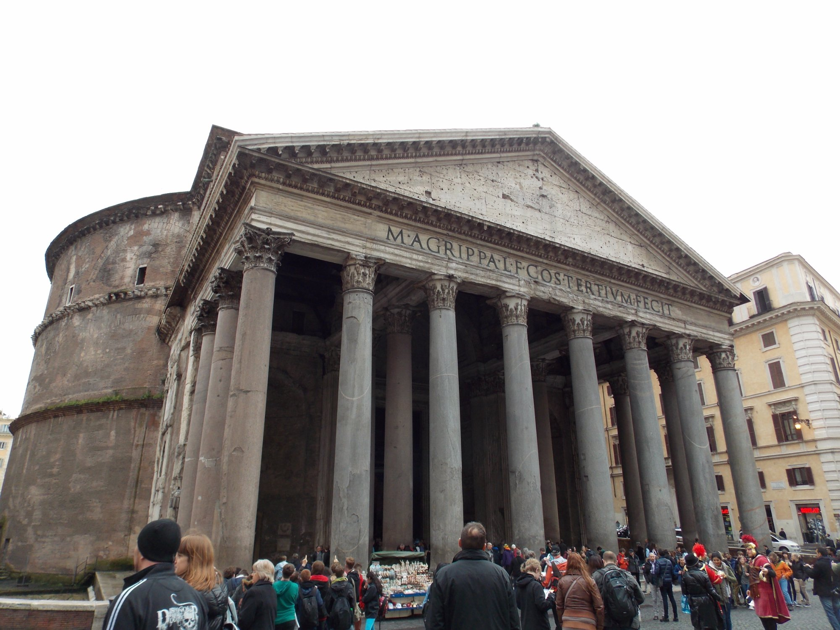

Slide 34
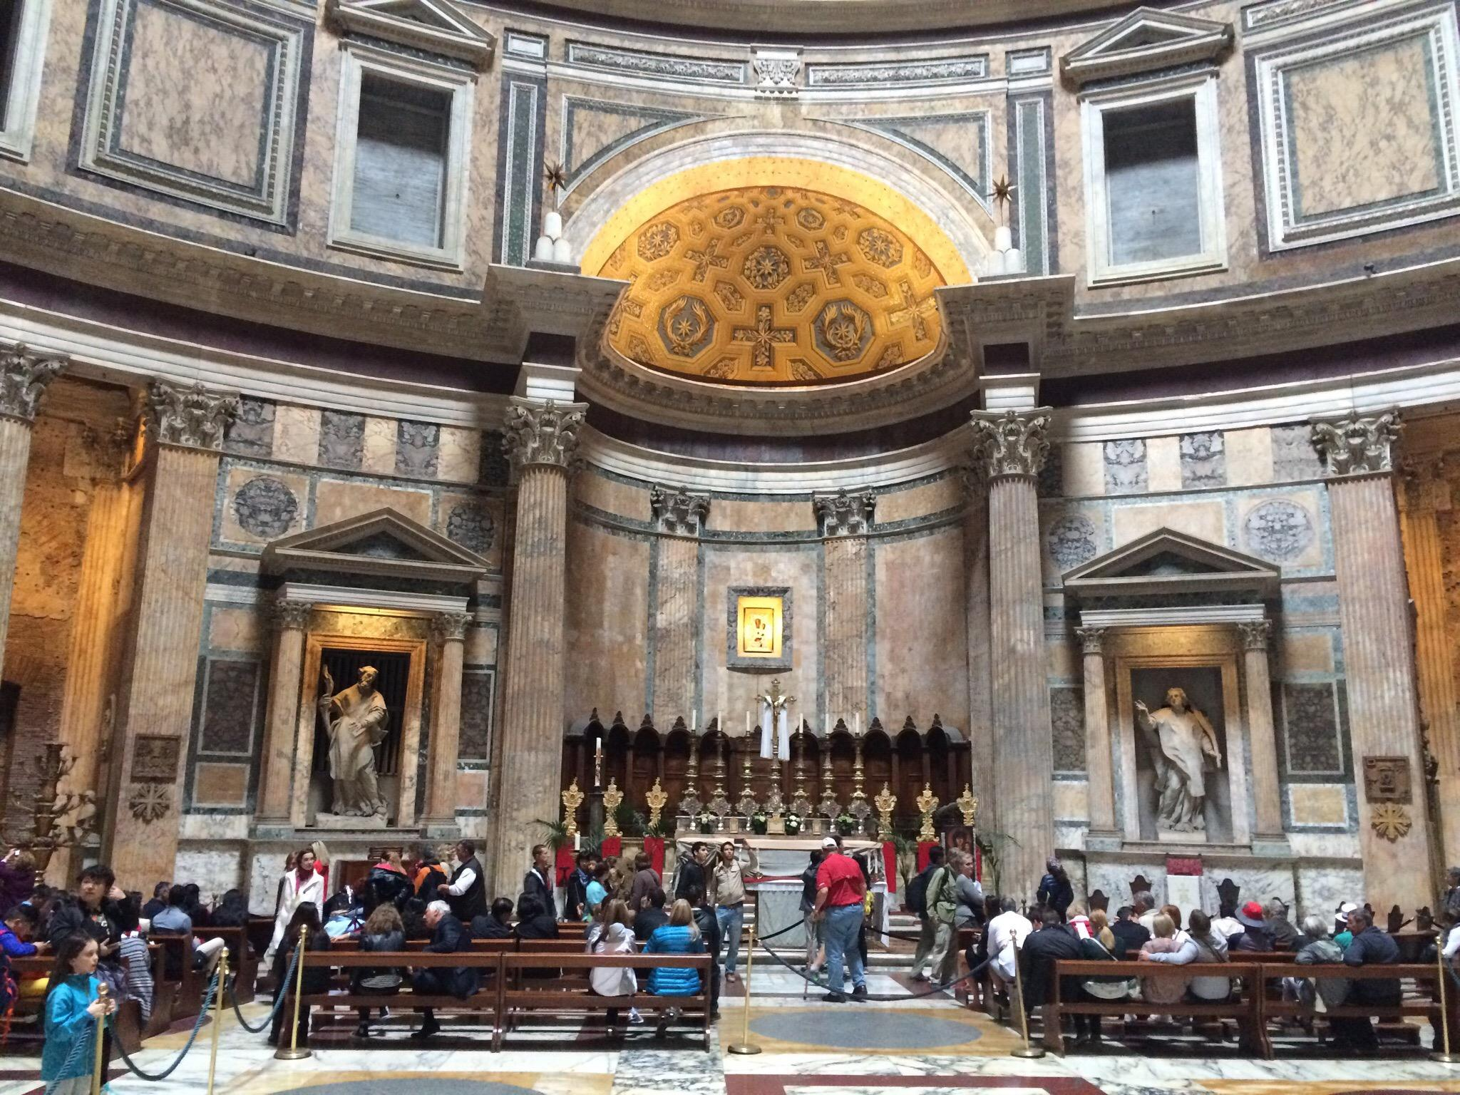

Slide 35
THE END
This is the end I hope you enjoyed my presentation

