Slide 1
International Christian Outreach Ministry -- ICOM --

Slide 2
Peace of the Lord Jesus Christ be with you

Slide 3
Šumperk 13. March 2018

Slide 4
Migration and its effect on the local people and culture

Slide 5
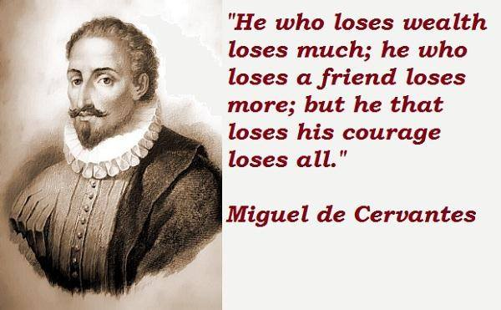

Slide 6
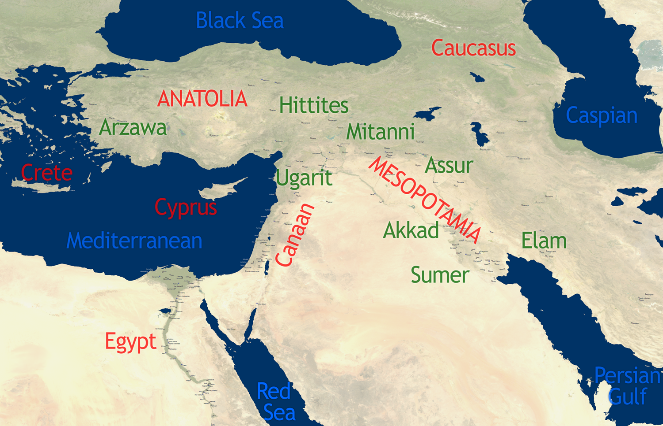

Slide 7
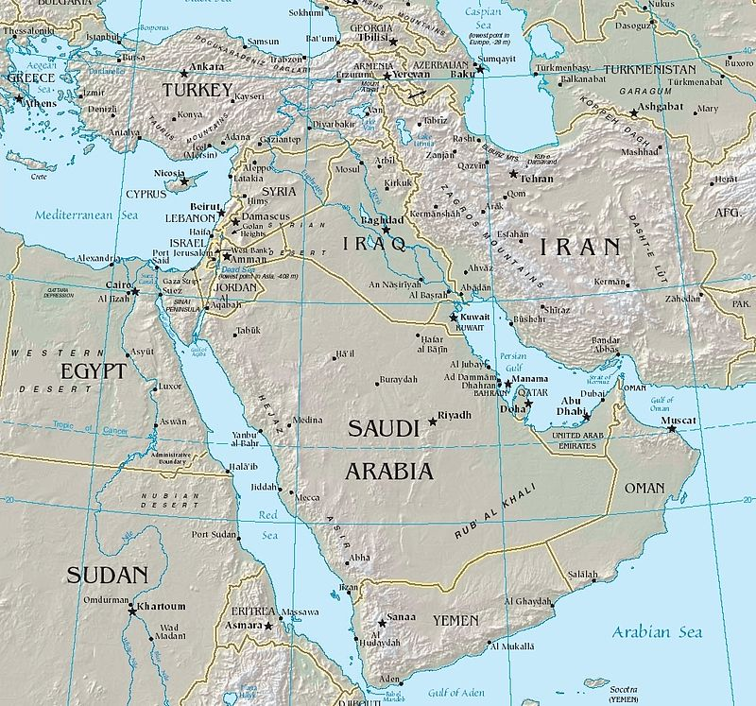

Slide 9
Migration, minorities and their effect Throughout the whole history of mankind, migration and migrant played a very vital role either in destroying or building existing civilizations. Today it is not different and one could tell the positive or mostly negative effect of such minorities on the host country. Especially Islamic migration has the most devastating negative effect on all societies, as stated by Muslim historians and others. The so called ‚Intercultural Dialogue‘ is a tool used by Islam over the centuries to establish Islam, impose Sharia and destroy the host country. Not knowing the whole truth about such fact, does not free us from the responsibility to be aware of such consequences. A wise and unbiased look at the Classical Civilizations and their destruction, as well as modern history, could help us understand HOW to act. RE-acting is NOT a solution, because there are Dynamics which we can NOT influence, when a moment-of-no-return is reached. Nearly in every country on this earth, there are minorities; the destruction of Mesopotamian Civilization began when a small Muslim minority arrived there – today the Cradle of Civilization is no more!

Slide 10
Migration in the Bible We have many examples in the Bible about migration and how it affected the course of history. 1. From the very beginning Adam and Eve had to ‘migrate’ and leave the Garden of Eden. Their son Cain had to do the same later. 2. Noah, because of the flood, had to migrate to a ‘strange land’ and landed upon Mount Ararat – Armenians trace their ancestry back to him. 3. Abraham migrated from Ur the Chaldean– todays Iraq– up to Haran then to Canaan – today’s Israel. 4. Moses fled Egypt and took refuge out of it. 5. The Israelites fled Egypt to the Promised Land—Canaan. 6. David was a refugee…by the enemies of Israel at that time. 7. Jesus with His family were refugees too 8. The Apostles…including Paul, were refugees…

Slide 11
A Look Backward Many do NOT know much about Christianity in the Middle East, its roots and the cultural revival it caused. But also little is known, especially in the West, about Islamic Migration and its effect on the local population, their culture and destiny.All seems happening faraway from home/Europe! In this Seminar I want to take you with me to a forgotten period of time, where the Middle East and the Mediterranean Region was the heart of Civilization. The present European Civilization has its roots deep in that period; there are dangers though that YOUR fate and destiny won’t be better than that of the Middle East and Christianity there. A wakening up and a change of direction is necessary to survive the onslaught and to save your civilization and way of life !

Slide 12
Video No.1 Migrant in Paris

Slide 13
Video No. 1a UK-Tommy Robinson and camera woman and I were violently attacked

Slide 14
When we talk about Islam apologists hear: ‘Muslims’! We are talking about political doctrine and NOT people!
This is Islam
This is Muslim

Slide 15
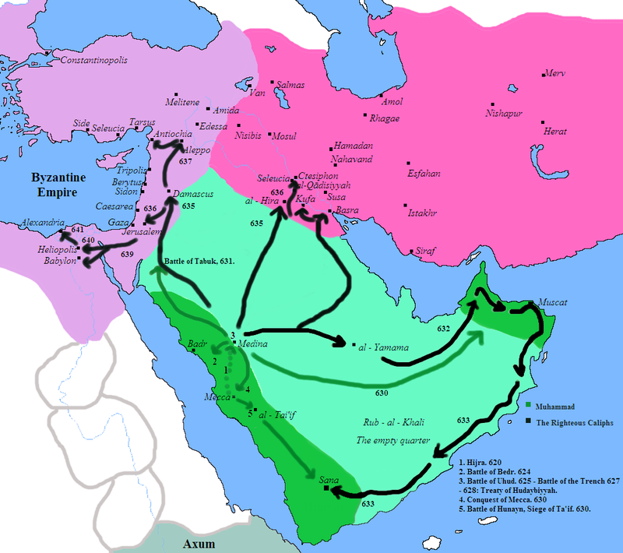
All began at the Conquests of Mohammed (green lines) in the 6th century then the Rashidun Caliphs(black lines). Shown: Byzantine Empire (North and west) and Sassanid-Persian Empire (North east).

Slide 16
The Christian Middle East There was a rich history in the region of the Middle East, ancient sites could be found even today. Through excavations and still-standing monuments that could be seen today; they speak loud about a rich and civilized history. Who doesn’t know Babylon, ancient Nineveh in Iraq or the Pyramids in Egypt? We will mention only some countries and their Christian history, but also what happened to them because of migration…Islamic migration. 1. Persia/Mesopotamia/Iraq; 2. Aram/Syria; former the Levant; 3. Anatolia/Turkey; 4. Copt/Egypt.

Slide 17
Video No.2 Sweden-‘Almost a war zone

Slide 18
Video No.2a How Islam overtakes the native population

Slide 19
Migration and the Ancient Civilizations

Slide 20
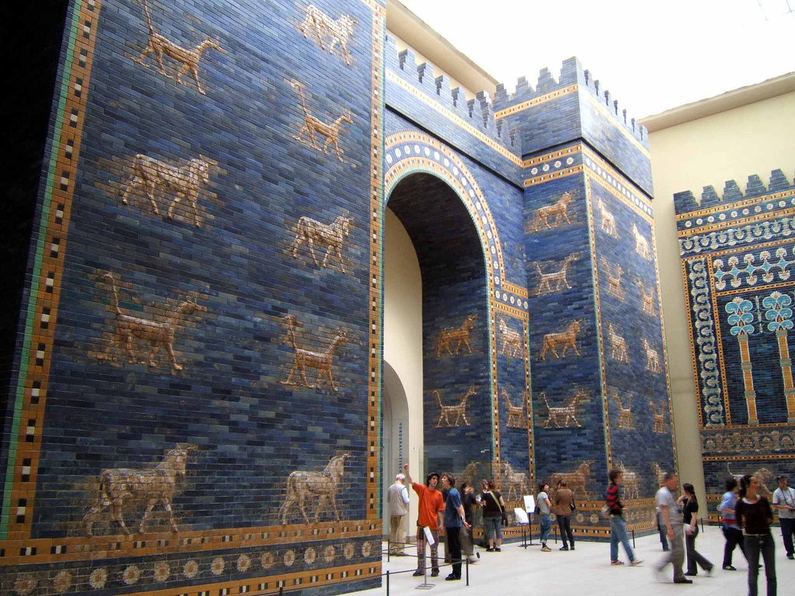
Ishtar Gate at Berlin Museum was constructed in 575 BC by order of King Nebuchadnezzar II on the north side of the city

Slide 21
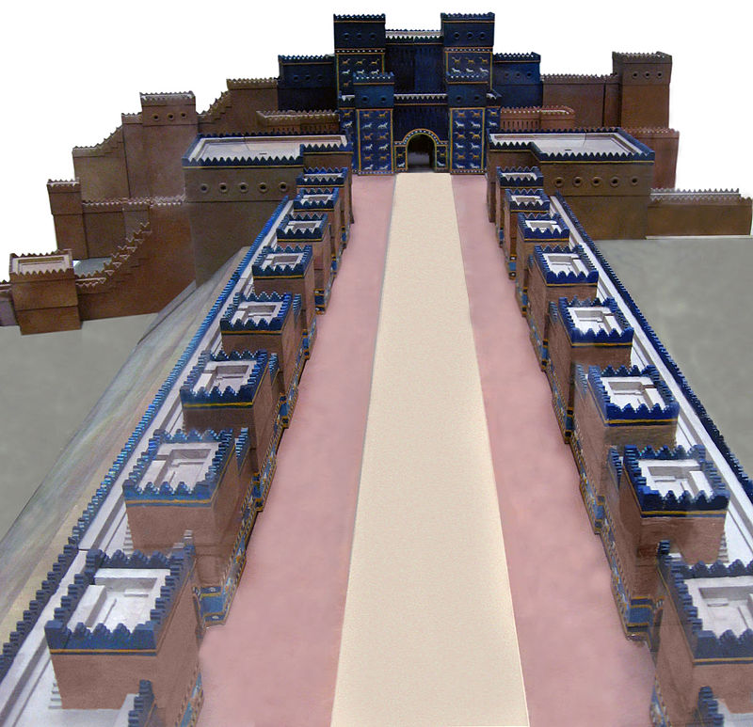
Model of the main Procession Street (Aj-ibur-shapu) towards Ishtar Gate in Babylon

Slide 22
Last year I was standing at the same place

Slide 23
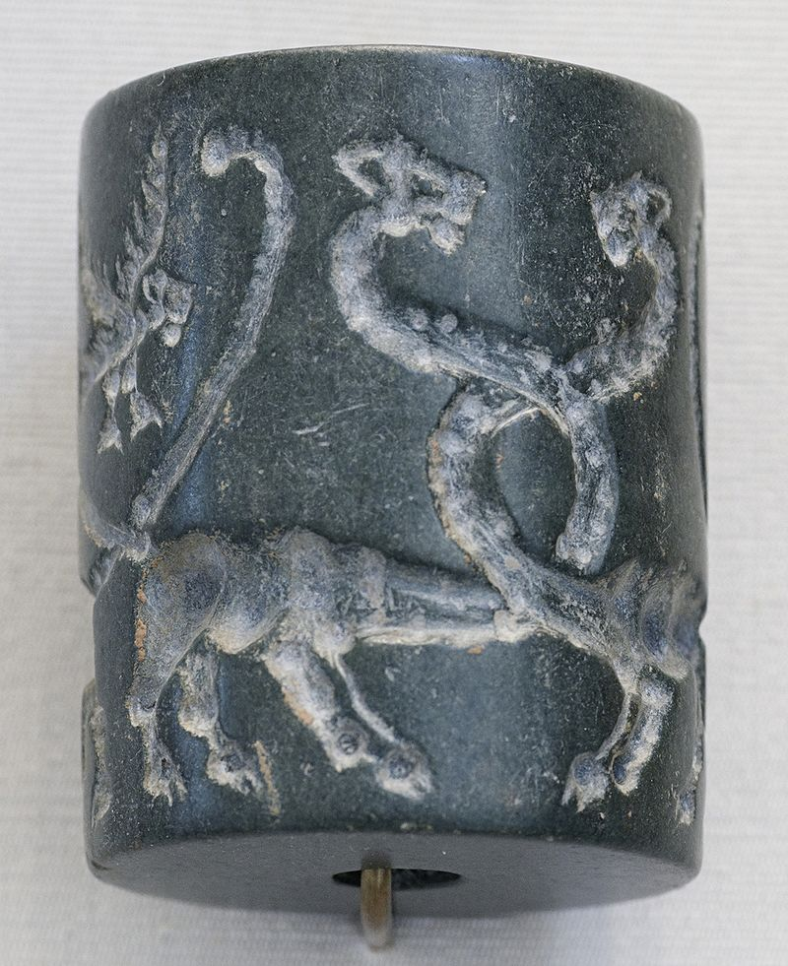
Ancient Mesopotamian cylinder seal around 2000 BC

Slide 24
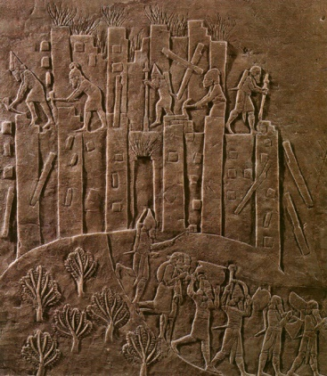
King of Assyria, Ashurbanipal's brutal campaign against Elam in 647 BC is recorded in this relief

Slide 25
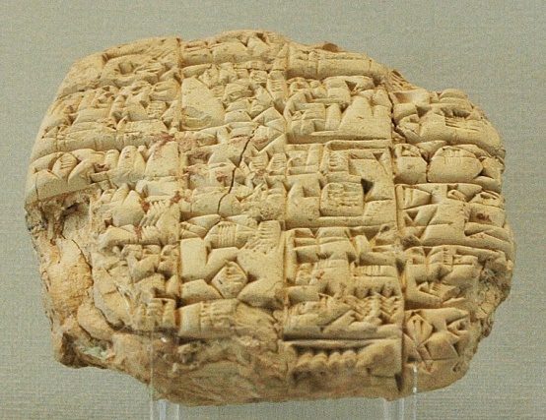
Letter sent by the high-priest Lu'enna to the king of Lagash (maybe Urukagina), informing him of his son's death in combat, c. 2400 BC, found in Girsu.

Slide 26
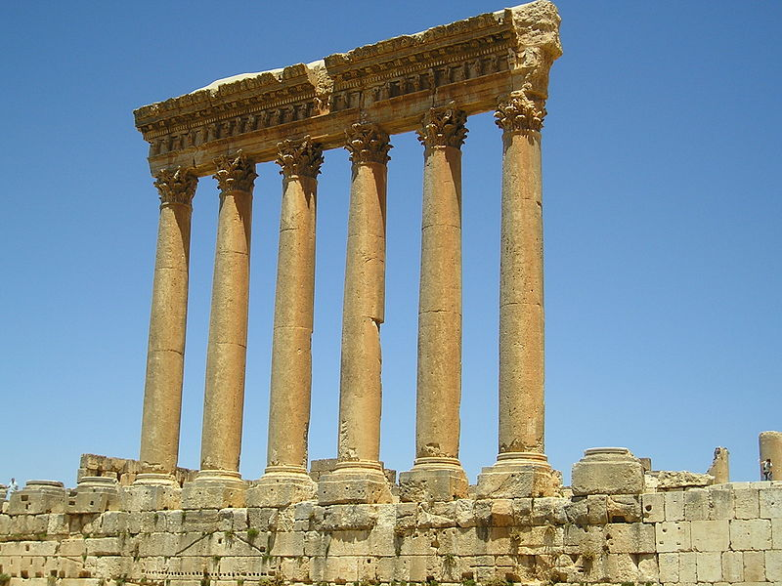
The Temple of Jupiter in today’s Lebanon

Slide 27
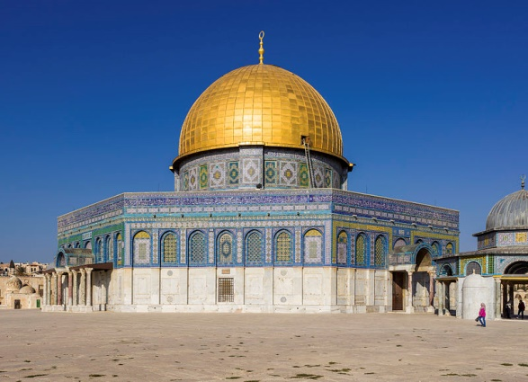
It was a small prayer house built by Caliph Umar, which was rebuilt and expanded by the Umayyad Caliph Abdul-Malik and finished by his son Al-Walid in 705 AD exactly on the holiest place for the Jews: The Temple!

Slide 28
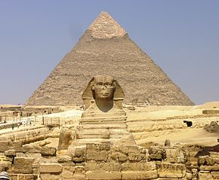
Giza Plateau - Great Sphinx with Pyramid of Khafre in background

Slide 29
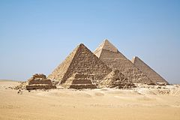
Pyramids of Giza

Slide 30
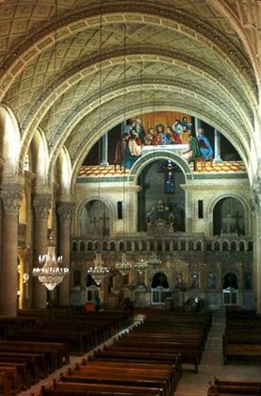
Saint Mark Coptic Orthodox Cathedral in Alexandria

Slide 31
Christians in Iraq The history of Christianity in Iraq goes back to the FIRST century. The Christians of Iraq are considered to be one of the oldest continuous Christian communities in the world. Christianity was brought to Iraq (then Assyria/Athura and Babylonia or Asorostan) in the 1st century AD by Thomas the Apostle and Mar Addai (Thaddeus of Edessa) and his pupils Aggai and Mari. Thomas and Thaddeus belonged to the twelve Apostles. Iraq's Eastern Aramaic-speaking Assyrian communities are believed to be among the oldest in the world. The Assyrian people adopted Christianity in the 1st century A.D. and Assyria in northern Iraq became the centre of Eastern Rite Christianity and Syriac literature from the 1st century AD until the Middle Ages. Christianity initially lived alongside Mesopotamian religion among the Assyrians, until the latter began to die out during the 4th century AD.

Slide 32
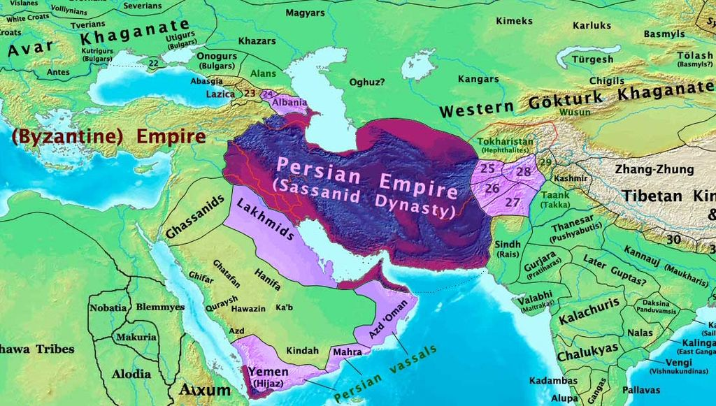
Arabian Peninsula, Byzantine and Sassanid-Persian empires in 600 A.D. on the eve of the rise of Islam…and Migration Jihad

Slide 33
Christians and Christianity in Iraq The vast majority are indigenous Eastern Aramaic-speaking ethnic Assyrians, descendants of the ancient Mesopotamians. There is a small community of Armenians, as well as a small number of Kurdish, Arab and Turcoman Christians extant. Christians live primarily in Baghdad, Basrah, Mosul, Arbil and Kirkuk and in Assyrian towns and regions such as the Nineveh Plains in the north. Assyrian Christians live primarily in northern Iraq; and in regions bordering it in northeastern Syria, northwestern Iran and Southeastern Turkey, an area roughly corresponding to ancient Assyria. On the 19th of March 2003 America and the UK trumped a case against Iraq in order to get rid of Saddam Hussain. The Christians were the main victims after Saddam’ ousting! The Christians are numbered about 1.5 millions in 2003, representing just over 6% of the population of the country down from 12% on 1947 in a population of 4.7 million.

Slide 34
Christian history in Iraq In the early centuries after the Arab Islamic conquest of the 7th century AD, Assyria (also known as Athura and Asorostan) was dissolved by the Arabs as a geo-political entity, however native Assyrian (known as Ashuriyun by the Arabs) scholars and doctors played an influential role in Iraq. However, from the late 13th century AD through to the present time, Assyrian Christians have suffered both religious and ethnic persecution, including a number of massacres. Northern Iraq remained predominantly Assyrian, Eastern Aramaic speaking and Christian until the destructions of Tamerlane at the end of the 14th century, when the ancient city of Ashur was finally abandoned by the Assyrians after a 4000 year history

Slide 35
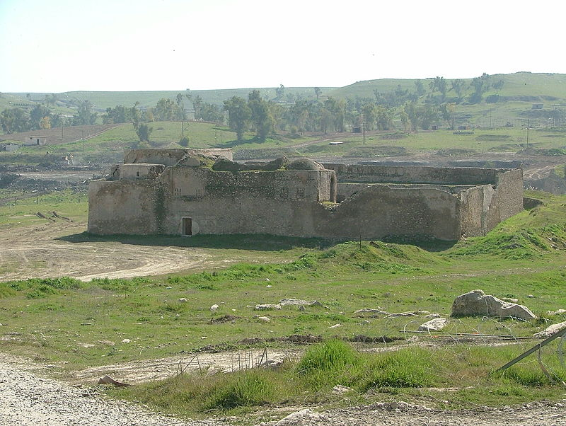

Slide 36
Video No.3 Islam and the future of Europe

Slide 37
Church history The Assyrian Church of the East has its origin in what is now South East Turkey and Assuristan (Sassanid Assyria). By the end of the 13th century there were twelve Nestorian dioceses in a strip from Peking to Samarkand. When the 14th-century Muslim warlord of Turco-Mongol descent, Timur (Tamerlane), conquered Persia, Mesopotamia and Syria, the civilian population was decimated. Timur had 70,000 Assyrian Christians beheaded in Tikrit, and 90,000 more in Baghdad. A new epoch began in the 17th century when Emir Afrasiyab of Basrah allowed the Portuguese to build a Church outside of the city.

Slide 38
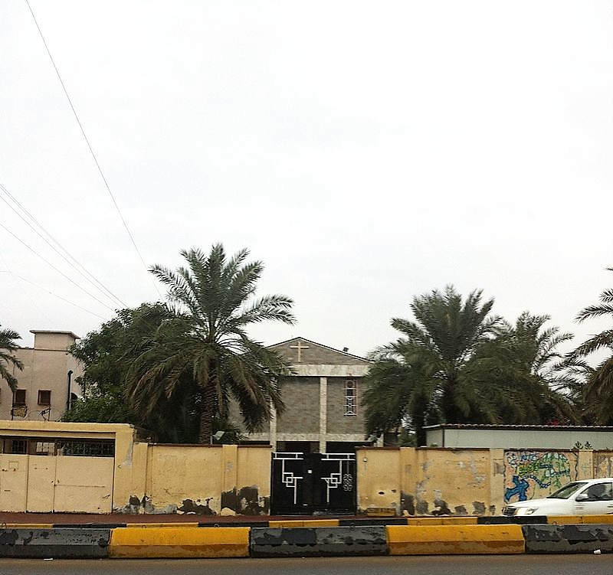

Slide 39
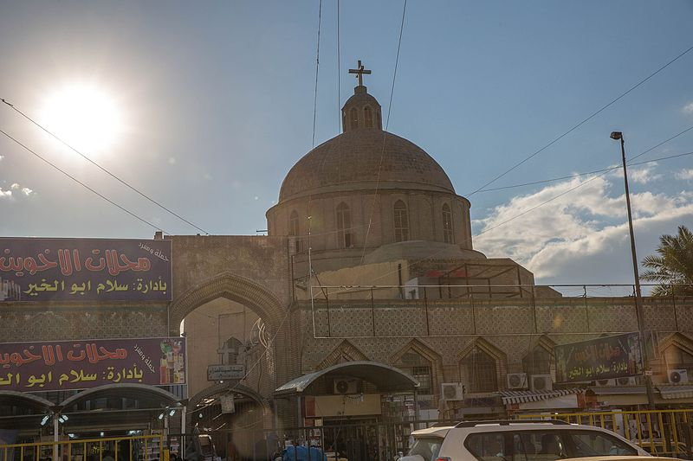
One of few remaining Churches in Shorjeh, Baghdad; most were destroyed through car-bombs…

Slide 40
Seven Popes were from Syria: 1 Petrus:33–64/67 Bethsaida-Gaulanitis-Syria, Roman Empire 11 ANICETUS:155-166 Emesa, Syria 82 IOANNES Quintus:12.7.685–2.8.686(1 year) – Antioch, Syria 84 St Sergius I :15.12.687–8.9.701(3 years)- Sicily,Italy for Syrian parents 87 Sisinnius:15.1.708 –4.2.708 (21 days)- Syria 88 Constantine:25.3.708 – 9.4.715 (7 years+)- Syria- Last Pope to visit Greece until John Paul II in 2001 90 Gregory III18.3.731—28.11.741( 10 years+)

Slide 41
Video No.4 Rome Conquered by Muslim Migrants

Slide 42
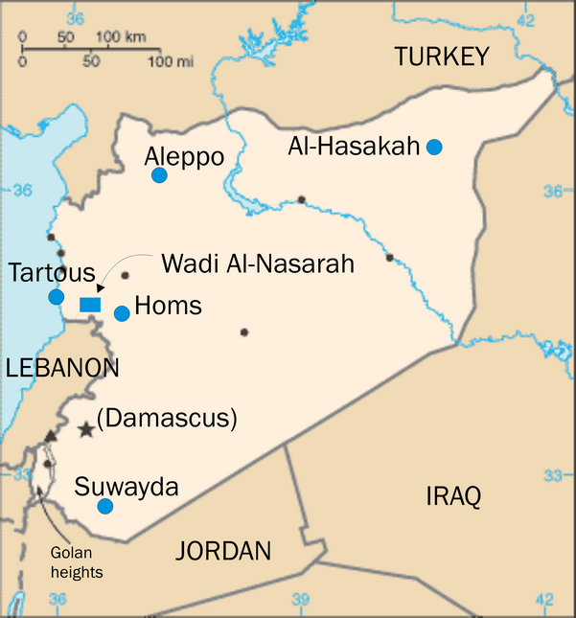
Christianity in Syria today is there, despite all destruction of the Islamic State…which is no different from the Caliphate…

Slide 43
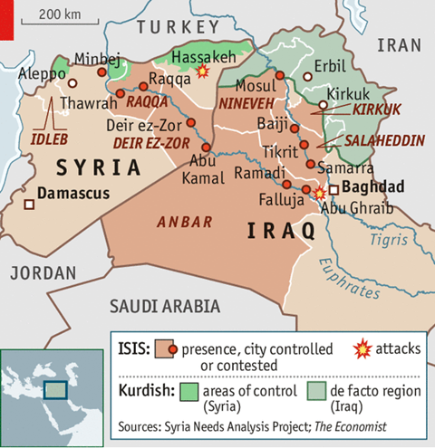
Today the Islamic State controlling the same area and doing exactly what the Arab Muslim invaders did…

Slide 44
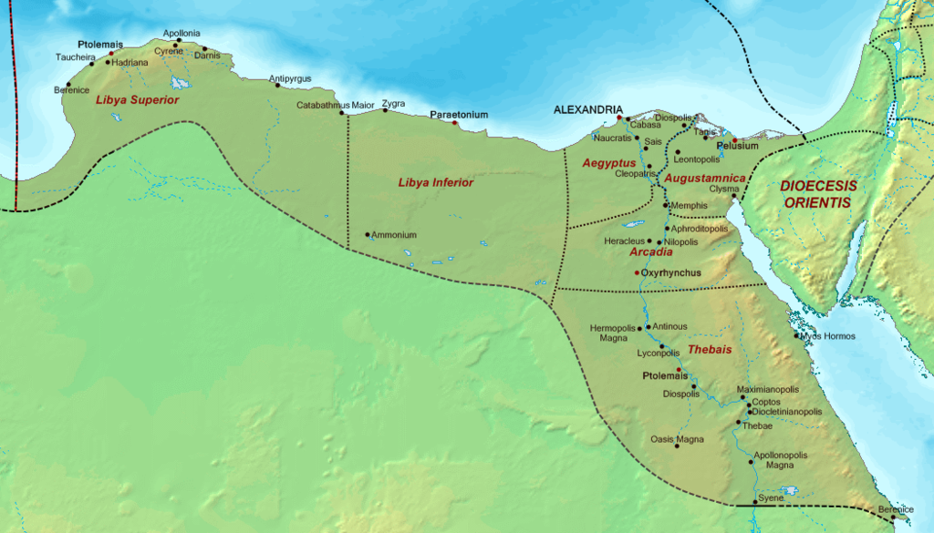
The Diocese of Egypt (c. 400 AD)

Slide 45
a

Slide 46
5. Christianity in Asia Minor/Anatolia during Roman times Anatolia (from Greek Ἀνατολή, Anatolḗ – "east" or "(sun)rise Jewish influences in Anatolia were changing the religious makeup of the region as Rome consolidated its power. In about 210 BC, Antiochus III of the Seleucid Empire relocated 2,000 families of Jews from Babylonia to Lydia and Phrygia, and this kind of migration continued throughout the remainder of the Empire's existence. Additional clues to the size of the Jewish influence in the area were provided by Cicero, who noted that a fellow Roman governor had halted the tribute sent to Jerusalem by Jews in 66 BC, and the record of Ephesus, where the people urged Agrippina to expel Jews because they were not active in their religious activities.

Slide 47
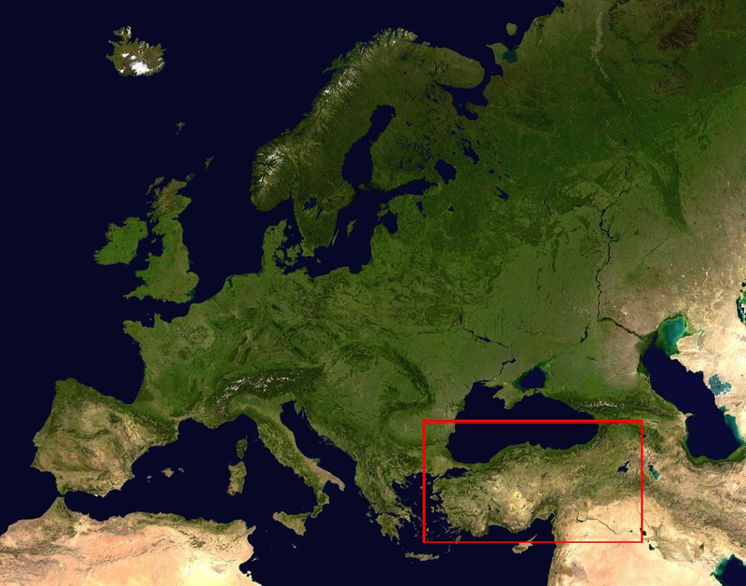
Asia Minor/Anatolia

Slide 48
The Christian history in Asia Minor/Anatolia The blossoming religious following of Christianity was evident in Anatolia during the beginning of the 1st century. The letters of St. Paul in the New Testament reflect this growth, particularly in his home province of Asia. From his home in Ephesus from 54 AD to 56 AD he noted that "all they which dwelt in Asia heard the word" and verified the existence of a Church in Colossae as well as Troas. Later he received letters from Magnesia and Tralleis, both of which already had Churches, bishops, and official representatives who supported Ignatius of Antioch. After the references to these institutions by St. Paul, the Book of Revelation mentions the Seven Churches of Asia: Ephesus, Magnesia, Thyatira, Smyrna, Philadelphia, Pergamon, and Laodicea. Even other non-Christians started to take notice of the new religion. In 112 the Roman governor in Bithynia writes to the Roman emperor Trajan that so many different people are flocking to Christianity, leaving the temples vacated.

Slide 49
Creation of the Byzantine Empire The constant instability of the Roman Empire as a whole gradually made it more and more difficult to control. Upon the ascension of the emperor Constantine in 330, he made a bold decision by removing himself from Rome and into a new capital. Located in the old city of Byzantium, now known as Constantinople after the Emperor, it was strengthened and improved in order to assure more than adequate defense of the whole region. What added to the prestige of the city was Constantine's favor of Christianity. He allowed bishops and other religious figures to aid in the government of the empire, and he personally intervened in the First Council of Nicaea to prove his sincerity.

Slide 50
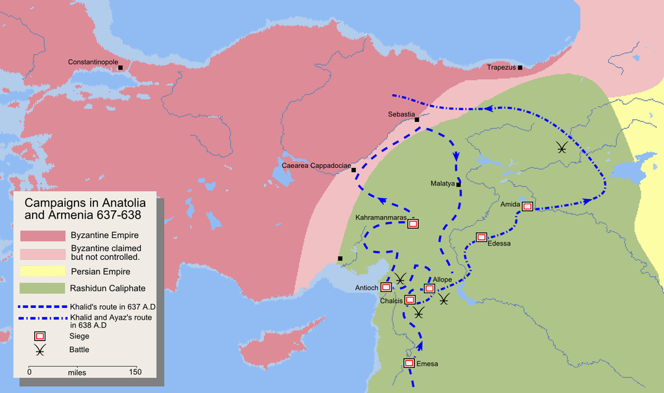
Map detailing the route of Khalid ibn Walid's invasion of Armenia in 638.

Slide 51
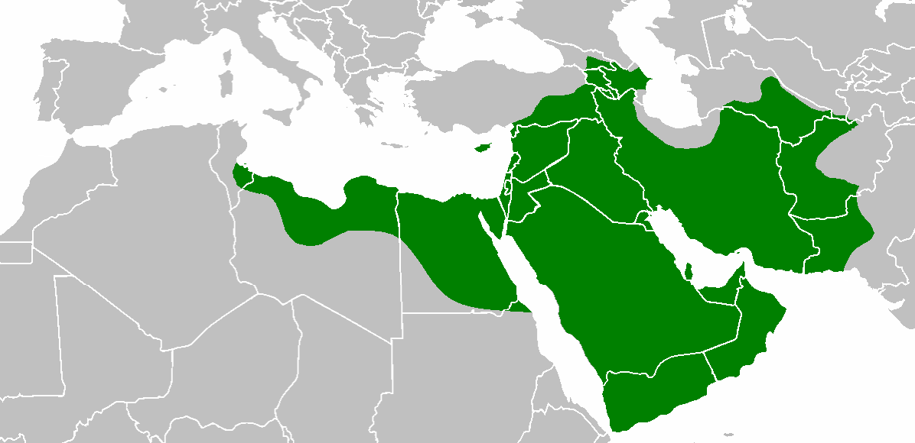
Rashidun Empire at its peak under third Rashidun Caliph, Uthman 654 AD

Slide 52
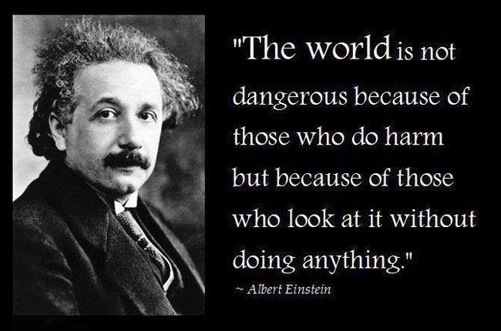

Slide 53
Look at these simple facts: 1. North Africa and Egypt used to be Christian and it was European and centre of Christian Civilization. 2. Syria, Lebanon, Iraq and the rest of the Middle East were Christian. 3. Turkey used to be Greek Anatolia. 4. Afghanistan and all of the rest of the Silk Route countries were Buddhists…and had Christians too. 5. Pakistan and Bangladesh used to be Buddhist and Hindu; many were Christians since Thomas time! Today all of those nations are Islamic… Did Islam ‘just happen’ or was there a process that took centuries to change those countries? How did Christian Greek Anatolia become Islamic Turkey? The history of ‘Islamification’ is a non-history. It does NOT exist according to our ‘experts’!

Slide 54
Video No.5 Muslims conquering London

Slide 56
The Tatars and migration The meaning of the word Tatar originated from Turkish and Persian (tātār, “Mounted Messenger"). The name "Tatar" likely originated amongst the nomadic Tatar confederation in the north-eastern Gobi desert in the 5th century. The name "Tatar" was first recorded on the Orkhon inscriptions:Kul Tigin(732AD) and Bilge Khagan (735 AD) monuments; Otuz Tatar Bodun ('Thirty Tatar' tribe) and Tokuz Tatar ('Nine Tatar') referring to the Tatar confederation. Those migrant left central Asia and went to all directions, including to today’s Russian Federation. As various nomadic groups became part of Genghis Khan's army in the early 13th century, a fusion of Mongol and Turkic elements took place, and the invaders of Rus' and the Pannonian Basin became known to Europeans as Tatars or Tartars.

Slide 57
Mongol Migration The Mongol dominance in Central Asia was absolute during the 14th and 15th centuries. The Crimean-Nogai raids into Russia aimed especially at the capture of slaves, most of whom were exported to the Ottoman Empire. The raids were an important drain of the human and economic resources of the invaded countries. They largely prevented the settlement of the "Wild Fields" – the steppe and forest-steppe land that extends from a hundred or so miles south of Moscow to the Black Sea. The raids were also important in the development of the Cossacks.

Slide 58
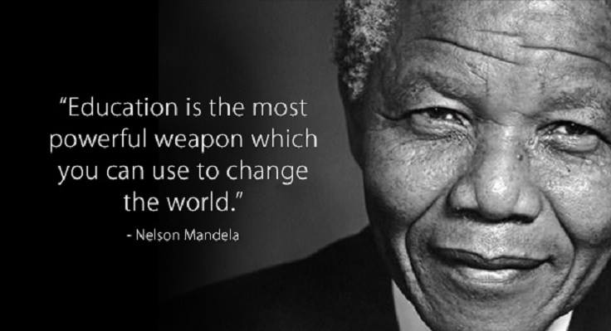

Slide 59
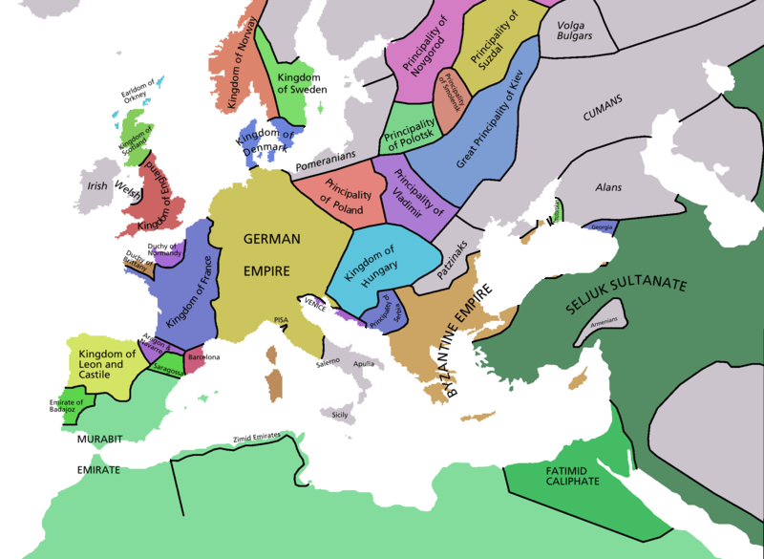

Slide 60
Arriving in Hlavni Nadraži in Prague, I saw such ‘activists’ openly and under the eyes of the Law helping illegals; in the Czech Law it is a crime to do so…but it seems they don’t care

Slide 61
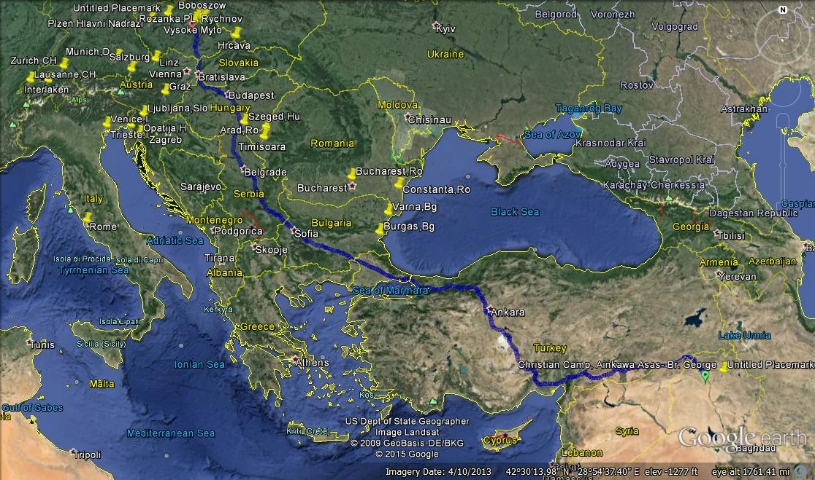
According to this ‘shortcut’ the distance is 3553 km; a real refugee without documents and money can NOT make it!

Slide 62
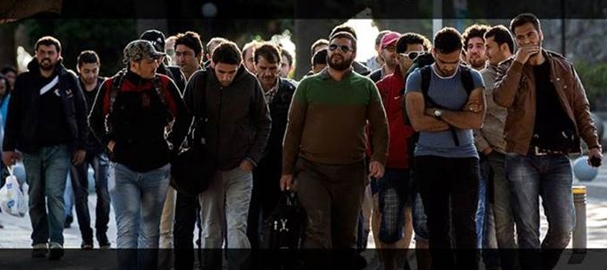
Islam changed their homes to hell…what do they carry to Europe with them: Islam!

Slide 63
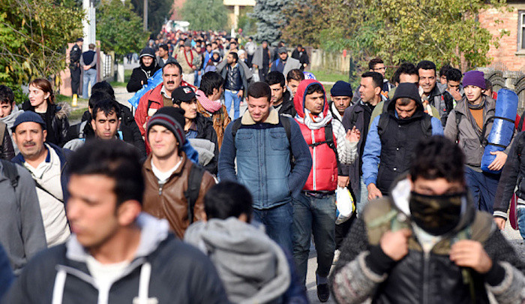
They are coming, not knowing anything about the future, but they were told some lies…

Slide 64
Hungary US wants to fill Europe with Muslim migrants Published May 19, 2016, Associated Press Chief of staff of Hungarian Prime Minister Viktor Orban said Thursday, 19th of May. President Barack Obama and the United States favor illegal migration in Europe because they want to fill it up with Muslims, the "Not so long ago while visiting Europe, President Obama clearly spoke out in favor of the importance of migration, settlement and even the forced settlement (of migrants)," Lazar said at a news conference. Obama and America "are following a very strong pro-migration, pro-illegal migration policy in the interests of having as many Muslims as possible in Europe.“

Slide 65
Slovakia The Prime Minister, Robert Fico, has been one of the more outspoken European leaders on the subject of Muslim immigration. ‘‘Islam has no place in Slovakia,’’ Fico told reporters in May. He warned that ‘‘migrants change the character of our country,’’ and declared he wouldn’t allow such change to affect his nation. Fico, like other politicians from Eastern and Central Europe, has argued both that his country has no obligation to house migrants and that, unlike the United States and leading Western European nations, has little experience of Muslim immigration. ‘‘Since Slovakia is a Christian country, we cannot tolerate an influx of 300,000-400,000 Muslim immigrants who would like to start building mosques all over our land and trying to change the nature, culture, and values of the state,’’ he said in 2015.

Slide 66
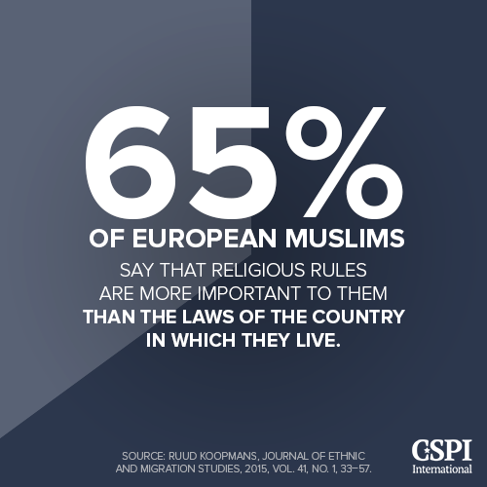

Slide 67
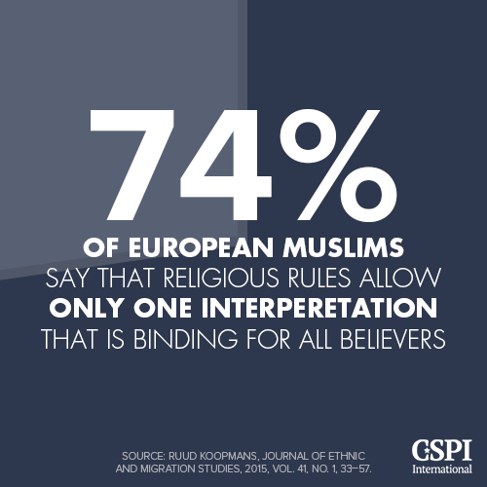

Slide 68
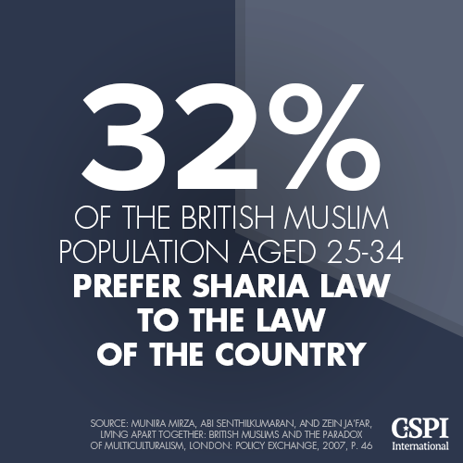

Slide 69
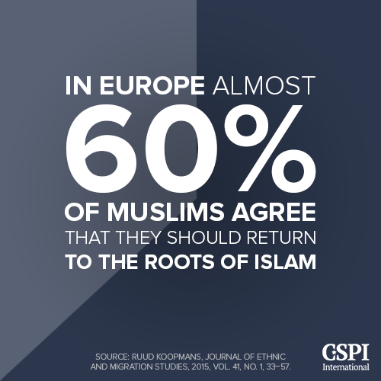

Slide 70
What do the ‘refugees’ who arrived and settled in Europe do?

Slide 71
Sweden killer claims truck rampage for IS 'caliphate' Gaël BRANCHEREAU--AFP--20 February 2018 An Uzbek asylum seeker who mowed down shoppers in a truck claimed at his trial Tuesday that he killed them in the service of the Islamic State group -- but his accusers insisted he acted alone. Rakhmat Akilov, 40, is on trial on terrorism charges for the rampage on a busy shopping street in Stockholm, in which he killed five people and injured 10 more in April last year 2017. He has admitted carrying out the attack and claims to have had the blessing of the Islamic State (IS) extremist group, but prosecutors do not believe that he had direct help. The method of the attack resembled other vehicle assaults in Europe in 2016, including Nice in France and Berlin -- but unlike those attacks, the Stockholm killings were never claimed by IS.

Slide 72
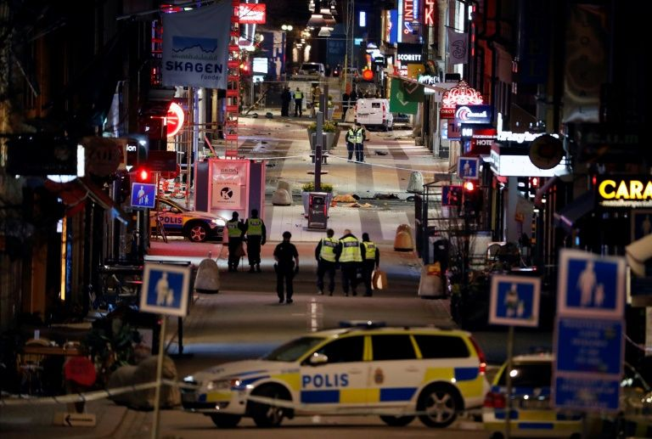

Slide 73
Investigations have failed to conclude whether he received any financial or material assistance. Chief prosecutor Hans Ihrman said Akilov "sought support" from outside contacts but they did not have a "decisive" role in the attack. "Akilov had planned and prepared the attack on his own" and "wasn't dependent on other people," Ihrman told reporters after the hearing. Akilov told the court he wanted "Sweden to end its participation in the fight against the caliphate, to stop sending its soldiers to war zones." Sweden has around 70 military personnel based mainly in northern Iraq to provide training as part of the US-led coalition against IS. After arriving in Sweden in 2014, at the start of a wave of migration to Europe, Akilov's application for residency was rejected in June 2016. He later went on the run to avoid expulsion and worked odd jobs in construction. The father of four drank alcohol and used drugs, according to colleagues and acquaintances.

Slide 74
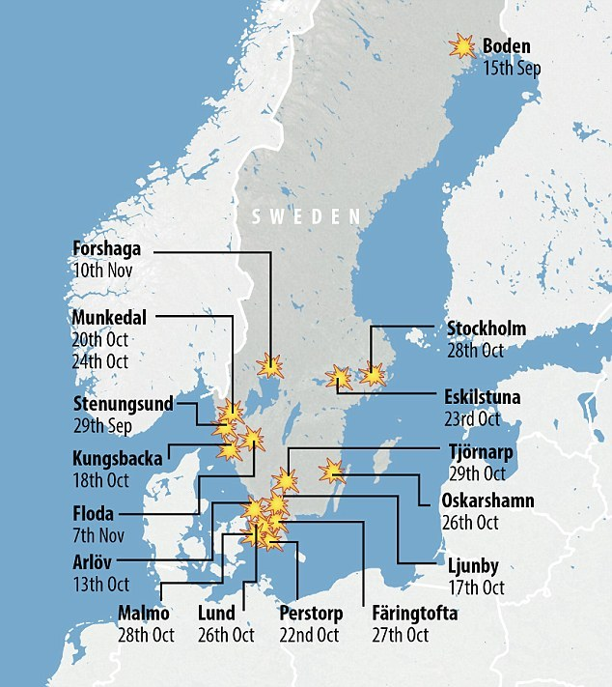

Slide 75
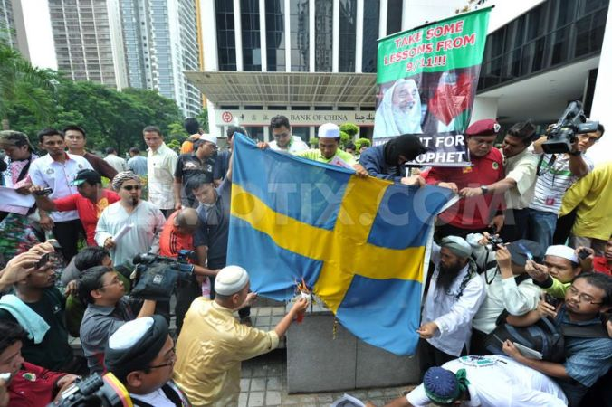

Slide 76
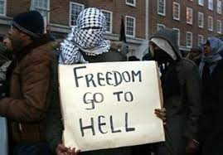

Slide 77
Finland knife attacker He was fully aware of his actions: psychiatric assessment ---- Business Insider UK•9 March 2018 HELSINKI (Reuters) - A Moroccan man charged with two murders and eight attempted murders "with terrorist intent" was criminally responsible for his knife attacks in Finland last August, a psychiatric assessment showed on Thursday. The trial of Abderrahman Bouanane, who was 22 at the time at the attacks, is due to begin in the city of Turku later this month. The state prosecutor has demanded a life sentence for him if the court rules he was fully aware of his actions. Bouanane has admitted the attacks but has denied that his motive was terrorism. The police have concluded that he was a "lone wolf" who saw himself as a soldier for the Islamic State militant group. ISIS did not take responsibility for the act. Bouanane arrived in Finland in 2016, lived in a reception center in Turku and had been denied asylum. It is the Nordic country's first terrorism-related attack. A life sentence in Finland means at least 12 years in prison.

Slide 78
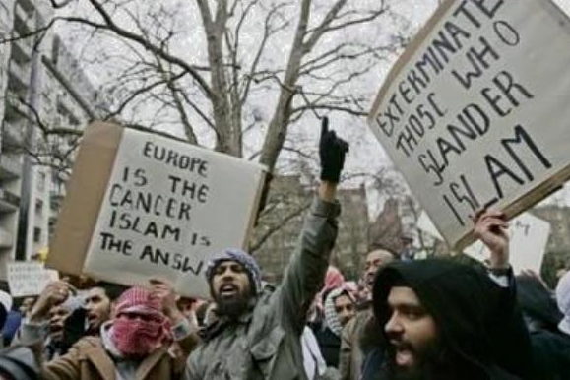

Slide 79
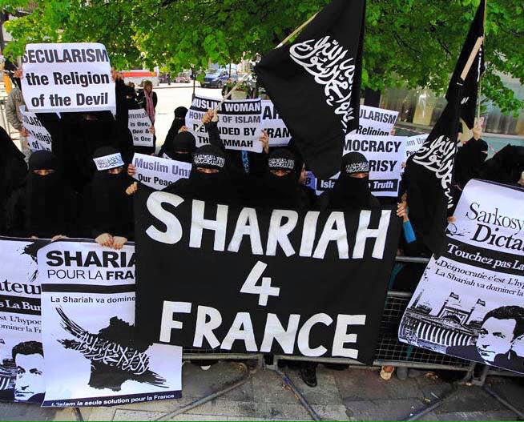

Slide 80
Norway: Child brides living with their adult Muslim migrant husbands in asylum centers— MAR 12, 2018 9:30 AM BY ROBERT SPENCER Why is this happening in Norway? Because Norwegian authorities don’t have the spine to stand up for their own principles and mores. They are letting Muslim migrants become the masters of the country, and child marriage is Islamic: OSLO (Reuters) — Some child brides are living with older husbands in asylum centers in Scandinavia, triggering a furor about lapses in protection for girls in nations that ban child marriage. Authorities have in some cases let girls stay with their partners, believing it is less traumatic for them than forced separation after fleeing wars in nations such as Afghanistan or Syria. “The Prophet wrote the (marriage contract) with Aisha while she was six years old and consummated his marriage with her while she was nine years old and she remained with him for nine years (i.e. till his death)” Bukhari 7.62.88

Slide 81
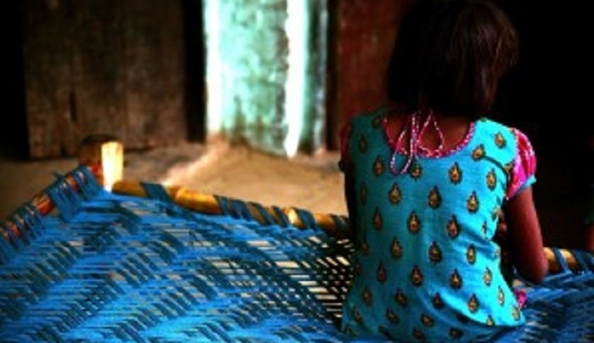

Slide 82
Some girls have also passed themselves off as adults…. Of 31,000 asylum seekers who arrived in Norway in the past year or so, 10 of those aged under 16 — the minimum local age for sex or marriage — were married and four had children, the Norwegian Directorate of Immigration (UDI) said. Of the 10 “some live in adult asylum centers, some in their own rooms and some with their partners,” it said in emailed replies to Reuters questions….

Slide 83
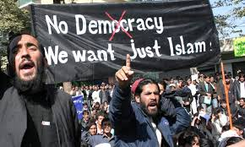

Slide 84
Video No.6 Migrants want Germans out of Germany!

Slide 85
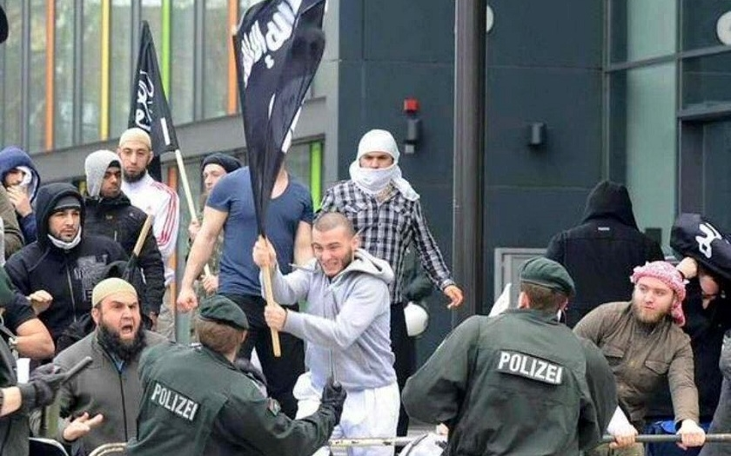
The moment the ‘refugees’ arrive and enjoy the freedom, they begin to disrespect the law of your country!

Slide 86
Salafist distributing Qurans freely in Europe; he arrived as a ‘poor’ refugee, but now an active Muslim spreading Islam!

Slide 87
Osmania Germania Die Welt- February 1, 2018 German Muslims have established a self-styled biker gang, Germany’s Muslims, which is said to be modeled on the Hells Angels and aimed at protecting fellow Muslims from the “ever-growing hatred of Islam,” according to Die Welt. The emergence of the group, which aspires to open chapters in cities and towns across Germany, has alarmed German authorities, who have warned against the growing threat of vigilantism in the country. Muslim vigilantes enforcing Islamic justice have become increasingly common in Germany. The government’s inability or unwillingness to stop them has led to the rise of anti-Muslim counter-vigilantes. Germany’s BfV intelligence agency, in its latest annual report, warned that an escalating action-reaction cycle could result in open warfare on German streets.

Slide 89
The gang, which calls itself “Germanys Muslims” (the possessive apostrophe is not used in German), is based in Mönchengladbach and now has offshoots in Münster and Stuttgart. It was founded by Marcel Kunst, a German convert to Islam who also uses the name Mahmud Salam. The gang’s uniform consists of a black leather jacket with a logo depicting a one-fingered salute, the “Finger of Tawheed,” which represents belief in the oneness of Allah. The logo also includes the number 1438, which represents the current year in the Muslim calendar, as well as the number 713, which stands for GM (Germanys Muslims), the seventh and thirteenth letters of the alphabet. Police say they do not know how many people belong to the gang, which was established in May. The group’s Facebook page, which has more than a thousand followers, describes itself as a “citizens’ initiative” which advocates for the “peaceful coexistence between Muslims and non-Muslims in Germany.” A mission statement dated June 15 reads:

Slide 90
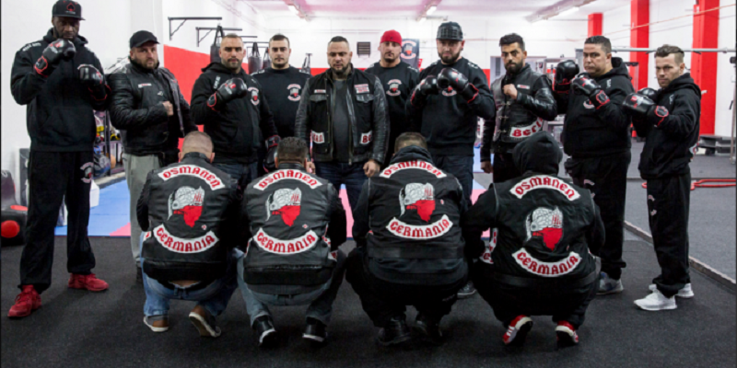

Slide 91
“Our organization has been founded for only one purpose: To protect and support our brothers and sisters from the ever-growing hatred of Islam!!! To all non-Muslims who read this post, pay attention. The following could change your perception of us!!! We respect every religion and, as dictated by the Quran, do not force our faith on anyone!!! We do not sympathize with the Islamic State and are against compulsion in faith and in marriage!!! ISLAM DOES NOT RECOGNIZE HONOR KILLINGS AS IS OFTEN SUPPOSED!!! The raised finger in our logo is not from the so-called Islamic State. In our faith it symbolizes that there is only one God!!! We have summarized 40 commandments from the Quran for you….IMPORTANT.

Slide 92
Video No.7 Islamic Teaching

Slide 93
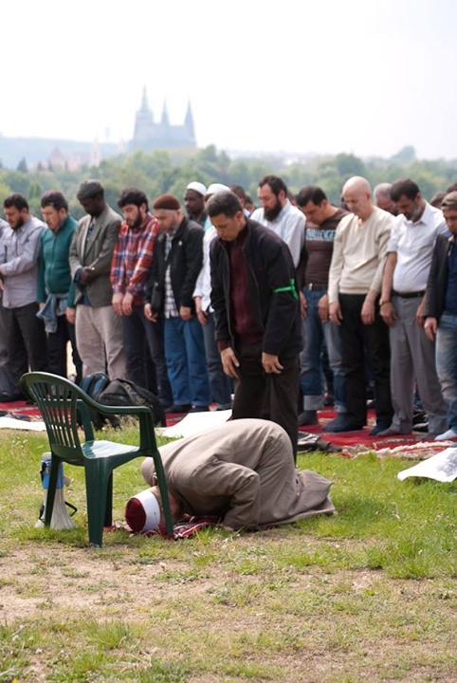

Slide 94
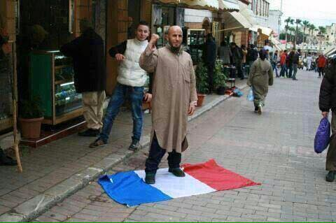
He came as a refugee…today he shows his gratitude towards France and its people!

Slide 95
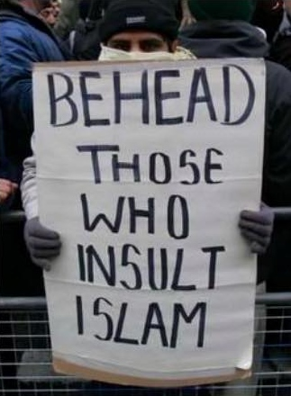

Slide 96
UK– Attacks by Muslims There has been an angry reaction online after the right-wing commentator Tommy Robinson claimed that police have refused to investigate an incident on Saturday where he was attacked by hooded and masked Migrant (Antifa?!) thugs in London. My camera woman and I were violently attacked by far left thugs and the police refused to investigate. No arrests. These are the foottroops of our left wing establishment. Share to show the world how these people really behave. 6 masked men VS 1 woman. That last comment was referring to the fact that he was accompanied by a female who was taking video at the time of the incident, and to be honest if his claim about the police is correct that makes this whole situation far worse.

Slide 98
Switzerland- Afghan man held after bomb threat near Bern stationA young Afghan man was arrested in Bern on Friday following a bomb threat near the city's train station and the discovery of "suspicious objects" in a nearby church, local police said.Shortly after 1:30pm Bern police were informed of a bomb alert at the nearby Holy Spirit church, a police statement said. Officers were sent to the scene and noticed a man behaving strangely. "Initial information has identified him as an Afghan man," police spokesman Ramona Mock told AFP. The young man was arrested and all those inside the church were allowed to leave, but the area remained closed for several hours, police said. Two suspicious objects found in the man's possession were rendered harmless, the police statement added. There was no explosion or any injuries or damage. Rail traffic was not affected but passengers were required to use an alternative entrance to the station.

Slide 99
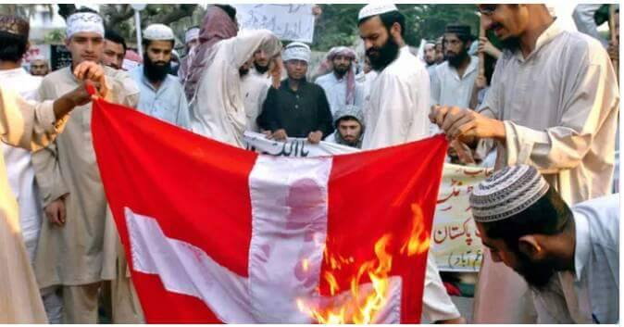
Muslims, who came as refugees burning the Swiss flag because it has the cross; they feel offended!

Slide 100
A 103 years old woman from Afghanistan…asking for refuge in Vienna… ask yourself HOW did she manage?

Slide 101
L

Slide 102
Facing the TRUTH! The Quran commands Muslims 1. NOT to befriend with non-Muslims : “Let not the believers (Muslims) take for friends or helpers Unbelievers (Literally: Kafirs) rather than believers: if any do that, in nothing will there be help from Allah…”(Quran 3:28 Surat Al-liumran) 2. NOT to befriend Jews/Christians: “0 ye who believe(Muslims)! Take not the Jews and Christians for your friends and protectors ... take not for friends and protectors those who take your religion for a mockery or sport.”(Quran 5:51 Surat Al Maida). 3. NOT to befriend others “O ye who believe (Muslims)! take not for friends and protectors those who take your religion for a mockery or sport,- whether among those who received the Scripture before you…” (Quran 5:57 Surat Al Maida).

Slide 103
4. To kill the Jews and Christian “Fight the People of the Book (Christians and Jews), who do not accept the religion of the truth (Islam), until they pay Jizya/tribute (penalty tax) by hand, being inferior.” (Quran 9:29 Surat Al-Tawbeh) 5. To convert non-Muslims to Islam by force “Kill the Mushrikun (polytheists, Christians and non-Muslims), wherever you find them, and capture them and besiege them, and lie in wait for them in each and every ambush. But, if they repent and perform As-salat (public prayer with Muslims) and give Zakat (Islamic alms), then leave their way free. Allah is oft forgiving, most merciful” (Quran 9:5 Sura At-Taubah)

Slide 104
6. To behead others "I will instill terror into the hearts of the unbelievers/kafir, smite ye above their necks and smite all their finger-tips off them. It is not ye who slew them; it was Allah." (Quran 8:12-17 Sura Al-Anfal) 7. “O Prophet! Rouse the Believers to the fight. If there are twenty amongst you, patient and persevering, they will vanquish two hundred: if a hundred, they will vanquish a thousand of the Kafir/Unbelievers: for these are a people without understanding”‎ Quran 8:65 Surat Al-Anfal 8. To fight non-Muslims until they exterminate all other religions and make Islam the only religion in the world: “And fight until there is no more Fitnah (disbelief and worshipping of others along with Allah) and (all and every kind of) worship is for Allah (alone)” (Quran 2:193 Sura Al-Bakarah)

Slide 105
About the Jews Verses 1. “And well ye knew those amongst you who transgressed in the matter of the Sabbath: We said to them: "Be ye apes, despised and rejected."‎ Quran2:65 Surat Al-Bakara 2. Say: "Shall I point out to you something much worse than this, (as judged) by the treatment it received from Allah? those who incurred the curse of Allah and His wrath, those of whom some He transformed into apes and swine, those who worshipped evil;- these are (many times) worse in rank, and far more astray from the even path!"‎ Quran 5:60 Surat Al-Nissa 3. “Strongest among men in enmity to the believers wilt thou find the Jews and Pagans; and nearest among them in love to the believers wilt thou find those who say, "We are Christians": because amongst these are men devoted to learning and men who have renounced the world, and they are not arrogant.‎ Quran 5:82 Surat Al-Nissa

Slide 106
In the Hadith In is teaching Mohammed also urges Muslims to practice Jihad. 1. Mohammed once was asked: what is the best deed for the Muslim next to believing in Allah and His Apostle? His answer was: "To participate in Jihad in Allah's cause."(Al-Bukhari vol 1:25) 2. Mohammed was also quoted as saying: "I have been ordered to fight with the people till they say, none has the right to be worshipped but Allah” (Al-Bukhari vol 4:196) Islam and Apostasy Mohammed said, "Whoever changes his Islamic religion, kill him." (Bukhari 9:57)

Slide 108
V

Slide 109
Islamic 1st Century of the Golden Age of Baghdad the 8th Century: 1.Islam moves to the East—Hindustan: Tax on the Hindus and 26 thousand Hindus died in one battle. 2. Then in Armenia Bishops and Nobles invited the Muslims to have a debate after it was over the Muslims pushed everyone inside the Church and burned them alive. 3. Ephesus 7 thousand Greek were enslaved. Islamic 2nd Century of the Golden Age of Baghdad the 9th Century: 1.The Caliph orders the destruction of ALL new Churches. 2. Amorium(In today’s Turkey): Massive enslavement 3. Egyptian Christian— The Copts-- revolt against Jizyah--- THIS is the beginning of their sufferance.

Slide 110
Islamic 3rd Century of the Golden Age of Baghdad the 10th Century: 1. Thessalonica, Greece--- 22 Greeks thousands enslaved. 2. Seville, Spain--- Christians massacred. 3. 30 Thousand Churches destroyed by the order of the Caliph in Egypt and Syria. Islamic 4th Century of the Golden Age of Baghdad the 11th Century: 1.Morocco 6 thousand Jews killed. 2. Hundreds of Jews in Cordoba, Spain killed. 3. Four thousand Jews were killed in Granada, Spain. 4. Georgia and Armenia invaded. 5.Hindustan: 15 thousand were killed in one battle, 500 thousands enslaved.

Slide 111
Islamic 5th Century of the Golden Age of Baghdad the 12th Century: 1. Yemen—Jews must convert…or die. 2. Christians of Granada were deported to Morocco. 3. India: many cities destroyed under the order ‘Covert-or-die’. 4. In ONE town 20 thousand enslaved. Islamic 6th Century of the Golden Age of Baghdad the 13th Century: 1.India: 50 thousand slaves were freed by conversion. 2. A 20-years Campaign created 400 thousand new Muslims out of Hindus. 3. Buddhist monks butchered and nuns raped. The Library or Erlanda was burned…it took days to burn! 4. Damascus and Safed: Christians mass murdered 5. Jews of Marrakesh massacred. 6. In Tabriz, Iran forced conversions of Jews.

Slide 112
Islamic 7th Century of the Golden Age of Baghdad the 14th Century: 1. In Cairo, Egypt the Christian rioted because their Churches were burnt. 2. The REST of the Jews of Tabriz, Iran were forced to convert. 3. Tamerlane in India kills as many Hindus as 90 thousand in a day. 4. In India 30 thousand were massacred in cold blood. 5. Tughlaq took 180 thousand slaves. Islamic 8th Century NOR MORE Golden Age of Bahgdad the 15th Century: 1. Tamerlane in India devastated 700 villages. 2. Tamerlane annihilated Nestorian and Jacobite Christians.(Arab Christianity). Persia was half Christian. The Nestorian has missionaries in China. 3. After 700 years of attacks Islam captured and destroyed Constantinople. Islam is patient…

Slide 113
You could contact us through our E-mail: ICOM@internationalchristianoutreachministry.org K.ICOM@seznam.cz Or visit our Website on Google: www.internationalchristianoutreachministry.org And please remember us and our Ministry in your daily prayer.

Slide 114
To support our Ministry please send your donation to: Selman H. Hassan IBAN: AT442011182795816400 Swift code/BIC: GIBAATWWXXX First Bank of Austria Sparkassen AG, Austria

