Slide 1
Italy
Lukáš Franta

Slide 2
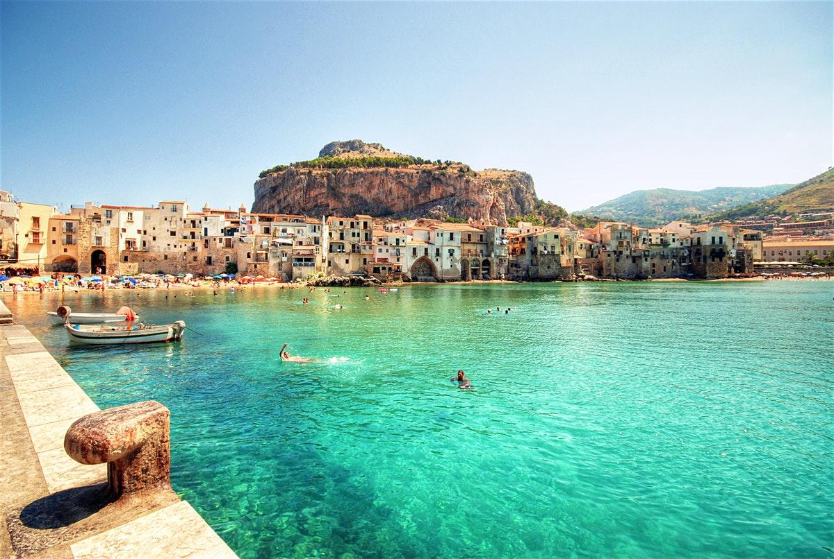
About Italy
Italy Is Located on The Apennine Peninsula in the south part of Europe. An arch of the Alps separates it from the other parts of Europe. Italy includes many islands, the largest of which is Sicily and Sardinia
Italy ranks among the most economically advanced countries in the world

Slide 3
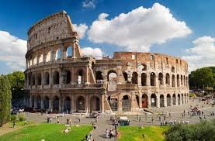
Rome is the capital city and is the place of the famous historical monuments.
The territory of the country is crossed by the limits of lithospheric plates, so there are many active volcanoes.

Slide 4
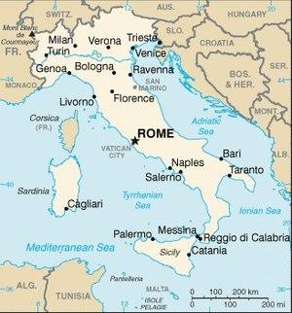
Major Cities

Slide 5
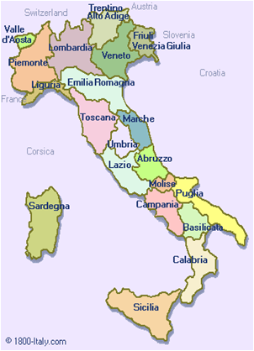
Italy has 20 states/regions. Each region had its own government, language, cuisine and culture
In 1861 the regions unified

Slide 6
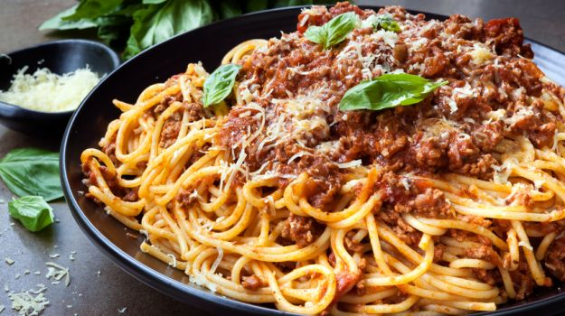
Cuisine
Each Region has it’s own pasta, oil/fat, sauce
Main meal time is at 1 PM
•Primo – soup, risotto, or pasta
•Secondo – fish, meat or veg based main course + vegetables + bread

Slide 7
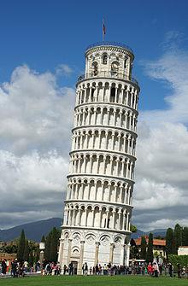
Leaning Tower of Pisa
The tower's tilt began during construction in the 12th century, caused by an inadequate foundation on ground too soft on one side to properly support the structure's weight. The tilt increased in the decades before the structure was completed in the 14th century. It gradually increased until the structure was stabilized (and the tilt partially corrected) by efforts in the late 20th and early 21st centuries.

Slide 8
Colosseum
The Colosseum's original Latin name was Amphitheatrum Flavium, often anglicized as Flavian Amphitheatre. The building was constructed by emperors of the Flavian dynasty, following the reign of Nero. This name is still used in modern English, but generally the structure is better known as the Colosseum. In antiquity, Romans may have referred to the Colosseum by the unofficial name Amphitheatrum Caesareum (with Caesareum an adjective pertaining to the title Caesar), but this name may have been strictly poetic as it was not exclusive to the Colosseum; Vespasian and Titus, builders of the Colosseum, also constructed an amphitheater of the same name in Puteoli (modern Pozzuoli).

Slide 9
St. Peter’s Basilica
Designed principally by Donato Bramante, Michelangelo, Carlo Maderno and Gian Lorenzo Bernini, St. Peter's is the most renowned work of Renaissance architecture and the largest church in the world. While it is neither the mother church of the Catholic Church nor the cathedral of the Diocese of Rome, St. Peter's is regarded as one of the holiest Catholic shrines. It has been described as "holding a unique position in the Christian world" and as "the greatest of all churches of Christendom".

Slide 10
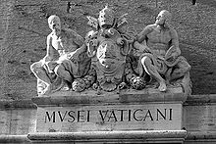
Vatican Museums
The Vatican Museums are Christian and art museums located within the city boundaries of the Vatican City. They display works from the immense collection amassed by Popes throughout the centuries including some of the most renowned classical sculptures and most important masterpieces of Renaissance art in the world. The museums contain roughly 70,000 works, of which 20,000 are on display, and currently employ 640 people who work in 40 different administrative, scholarly, and restoration departments.

Slide 11
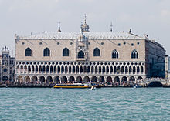
Doge’s Palace
In 810, Doge Agnello Participazio moved the seat of government from the island of Malamocco to the area of the present-day Rialto, when it was decided a palatium duci (Latin for "ducal palace") should be built. However, no trace remains of that 9th-century building as the palace was partially destroyed in the 10th century by a fire. The following reconstruction works were undertaken at the behest of Doge Sebastiano Ziani (1172–1178). A great reformer, he would drastically change the entire layout of the St. Mark's Square. The new palace was built out of fortresses, one façade to the Piazzetta, the other overlooking the St. Mark's Basin.

Slide 12
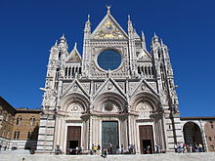
Siena Cathedral
The cathedral itself was originally designed and completed between 1215 and 1263 on the site of an earlier structure. It has the form of a Latin cross with a slightly projecting transept, a dome and a bell tower. The dome rises from a hexagonal base with supporting columns. The lantern atop the dome was added by Gian Lorenzo Bernini. The nave is separated from the two aisles by semicircular arches.

Slide 13
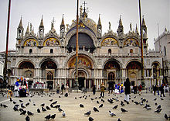
St. Mark’s Basilica
The Patriarchal Cathedral Basilica of Saint Mark (Italian: Basilica Cattedrale Patriarcale di San Marco), commonly known as Saint Mark's Basilica (Italian: Basilica di San Marco; Venetian: Baxéłega de San Marco), is the cathedral church of the Roman Catholic Archdiocese of Venice, northern Italy. It is the most famous of the city's churches and one of the best known examples of Italo-Byzantine architecture. It lies at the eastern end of the Piazza San Marco, adjacent and connected to the Doge's Palace.

Slide 14
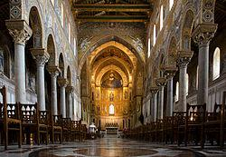
Monreale
Monreale (Sicilian: Murriali) is a town and comune in the province of Palermo, in Sicily, Italy. It is located on the slope of Monte Caputo, overlooking the very fertile valley called "La Conca d'oro" (the Golden Shell), famed for its orange, olive and almond trees, the produce of which is exported in large quantities. The town, which has a population of approximately 30,000, is about 15 kilometres (9 miles) inland (south) of Palermo, the capital of the island.

Slide 15
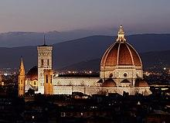
Florence Cathedral
The Cattedrale di Santa Maria del Fiore, in English "Cathedral of Saint Mary of the Flower") is the main church of Florence, Italy. Il Duomo di Firenze, as it is ordinarily called, was begun in 1296 in the Gothic style with the design of Arnolfo di Cambio and completed structurally in 1436 with the dome engineered by Filippo Brunelleschi.

Slide 16
Ponte Vecchio
The bridge spans the Arno at its narrowest point where it is believed that a bridge was first built in Roman times, when the via Cassia crossed the river at this point. The Roman piers were of stone, the superstructure of wood. The bridge first appears in a document of 996. After being destroyed by a flood in 1117 it was reconstructed in stone but swept away again in 1333 save two of its central piers, as noted by Giovanni Villani in his Nuova Cronica.

Slide 17
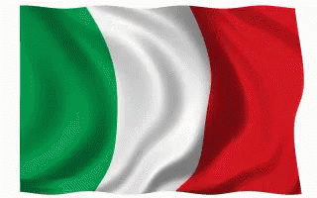
The End
I hope you enjoyed this Presentation!

